Slide 1
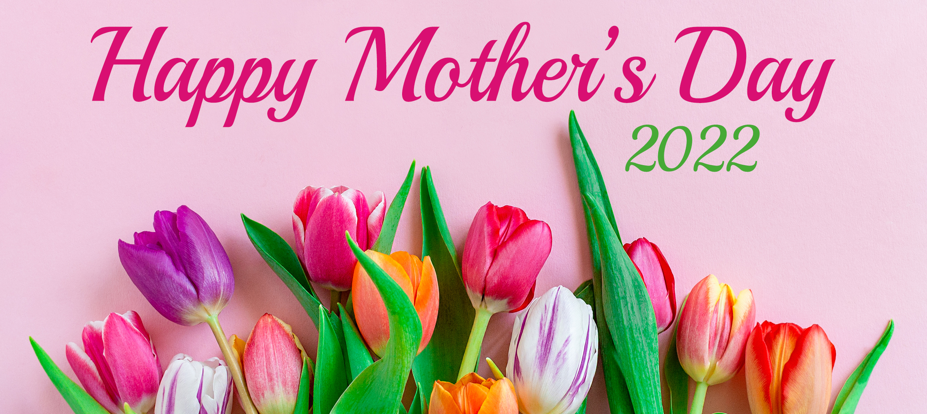


Slide 2
Contents
Mother’s Day Spending (Slides 3-12)
TV Advertising Is Imperative To Influence Mother’s Day Shoppers (Slides 13-23)
Local TV Allows Advertisers to Target their Message in a Trusted Environment (Slides 24-29)
However Consumers Shop, TV Advertising is Key (Slides 30-39)
Broadcast TV Assets Can Reach Those Who Stream Programming on Ad-Free Platforms (Slides 40-42)

Slide 3
Mother’s Day Spending

Slide 4
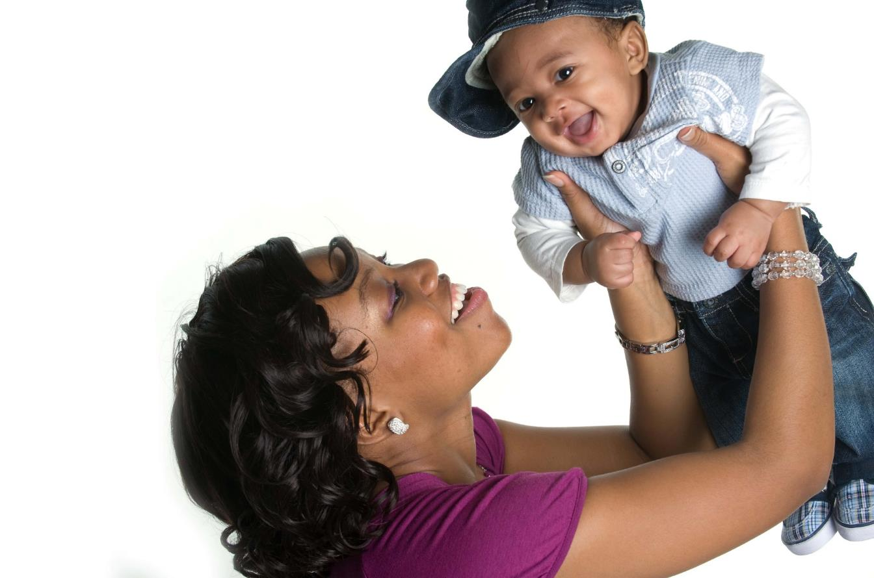
Mother’s Day 2022 Spending is An All-Time High
Source: NRF's Annual 2022 Mother's Day Spending Survey.

Slide 5
Per Person Spending Also An All-Time High In 2022
Source: NRF's Annual 2022 Mother's Day Spending Survey.

Slide 6
Mother’s Day is the Largest Spending Event
In the First Half of the Year
Source: NRF and Prosper Insights & Analytics 2021/2022 Seasonal Insights. Valentine’s Day and Easter updated for 2022.

Slide 7
90% of Consumers Will Shop For Mother’s Day
Percent That Will Shop For Mother’s Day
Source: Clarus Commerce 2022 Mother’s Day Shopping Statistics.

Slide 8
Recipients for Mother’s Day Gifts
Source: Clarus Commerce - Mother’s Day Quick Poll March 2022. Surveyed 1,768 U.S. consumers 18+.

Slide 9
74% of Consumers Plan to Shop for
Mother’s Day in Either April or May
“This year, Mother’s Day is May 8th. How early do you plan to shop?”
Source: Clarus Commerce - Mother’s Day Quick Poll March 2022. Surveyed 1,768 U.S. consumers 18+.

Slide 10
79% of Consumers Plan to Spend
Less than $100 for Mother’s Day
Source: Clarus Commerce - Mother’s Day Quick Poll March 2022. Surveyed 1,768 U.S. consumers 18+.

Slide 11
Over Half of Americans Plan to Shop at a Local Store or Restaurant for Mother’s Day
Source: Microsoft Advertising Insights: Mother’s Day Insights February 2022.
Civic Science survey – 689 responses. Responses collected on 2/9/2022.

Slide 12
Flowers Are Expected to Be
The Most Popular Gift for Mother’s Day
Source: Microsoft Advertising Insights: Mother’s Day Insights February 2022.
Civic Science survey – 850* and 796** responses. Responses collected on 2/9/2022.

Slide 13
TV Advertising Is Imperative To Influence Mother’s Day Shoppers

Slide 14
What Influenced Consumers Most: Television
% Influenced by media
Source: GfK TVB Purchase Funnel 2022 A18+
QA4/QA5/QA6/QA7/QA8 Most important for media with at least 1 funnel stage at 2%+ shown; 2%, 1%, & 0% not shown/labeled

Slide 15
Of Those that Cited TV as the Most Important in Awareness Phase, Two Thirds Picked Broadcast TV
Source: GfK TVB Purchase Funnel 2022 A18+
QA4 “Thinking about the ads you saw/heard for the categories, which advertising media made you most aware of the category?”
How to read: Of the 49% who chose television, 66% chose broadcast TV

Slide 16
“Have TV ads influenced your search selections?”
Source: GfK TVB Purchase Funnel 2022; A18+, A18-34, A18-49, A25-54
QA10 “When doing an online search, how often, if at all, have TV ads you have seen influenced you in some ways in your search?”
(Yes = combination of Every time, Most of the time & Sometimes) Among those who do online searches

Slide 17
TV Has Highest Reach of Platforms
Broadcast Leads the Way
Source: GfK TVB Media Comparisons Study 2022. M-S 4A-4A. Persons 18+. Online/internet platforms such as email, social media, internet radio and websites, are totaled
for any online device-PC, Smartphone and Tablets. Broadcast TV News Websites/Apps includes local TV station & network websites/apps for news/weather/sports.

Slide 18
People Spend the Most Time with Television
Source: GfK TVB Media Comparisons Study 2022. M-S 4A-4A. Persons 18+. Online/internet platforms such as email, social media, internet radio and websites, are totaled for any online device-PC, Smartphone and Tablets. Broadcast TV News Websites/Apps includes local TV station & network websites/apps for news/weather/sports.

Slide 19
Broadcast Delivers Top Rated Programs
Adults 25-54 Live+1 Ratings
Source: Nielsen 03/29/2021-5/9/2021 Adults 25-54 Live+1 Ratings; Broadcast Includes all Networks and Syndication.
10 Cable Networks based on A25-54 Ratings

Slide 20
Broadcast TV Dominated the Top Rated Programs
Source: Nielsen NPower, 3/29/21-5/9/21, A18+ Live+1 Ratings. Broadcast Includes all Networks and Syndication.

Slide 21
Broadcast TV’s Reach: Significantly Higher Than Cable
Source: Nielsen NPower. May 4, 2021. Prime A18+ Live+1 Ratings.

Slide 22


Out of 5 choices, the top 4 were Broadcast Networks
If you could choose only five networks, which five would you choose?
Network “A”
Network “B”
Network “C”
Network “D”
Network “E”
BROADCAST NETWORK
CABLE NETWORK
Source: GfK TVB Media Comparisons Study 2022. Respondents were given 50 choices of Broadcast and Cable Networks with an option to write in a network.

Slide 23

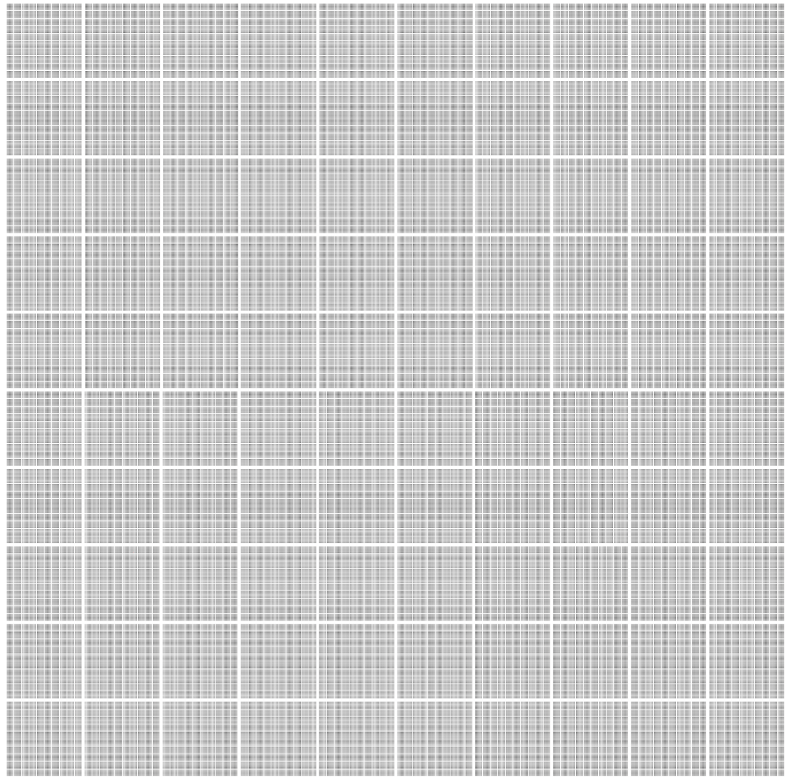
Similar Reach, But Broadcast Delivered it thru 18,234 telecasts.
YouTube needed 107.5 Billion Video Views.
Broadcast
Television
107.5
Billion
Video Views
18,234
Telecasts
There are
1 million dots
Shown here
.
To get to 107.5 Billion
We would have to show
107,499 more slides of dots
Source: Feb 2022 Nielsen; Most Current, Live+1. ComScore, People 18+, Data Source: VMX Multi-Platform, (YouTube number excludes all Broadcast TV content). Unduplicated A18+ Viewers: Broadcast TV- 183,765,000, Youtube 181,733,000 Broadcast TV = All broadcast reported by Nielsen + Syndication.

Slide 24
Local TV Allows Advertisers to Target their Message in a Trusted Environment

Slide 25
Local Broadcast Television News: #1 For Trust
I trust the News that I see/hear on this media source:
Percent Agree
Source: GfK TVB Media Comparisons Study 2022. Persons 18+. Agree Strongly or Agree Somewhat.
Q9 - For each source, please indicate the extent to which you agree or disagree with the following statement: I trust the News that I see/hear on this media source.

Slide 26
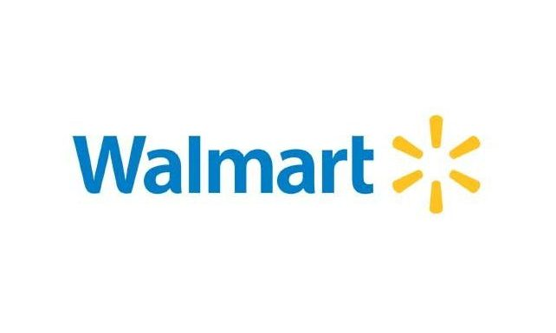

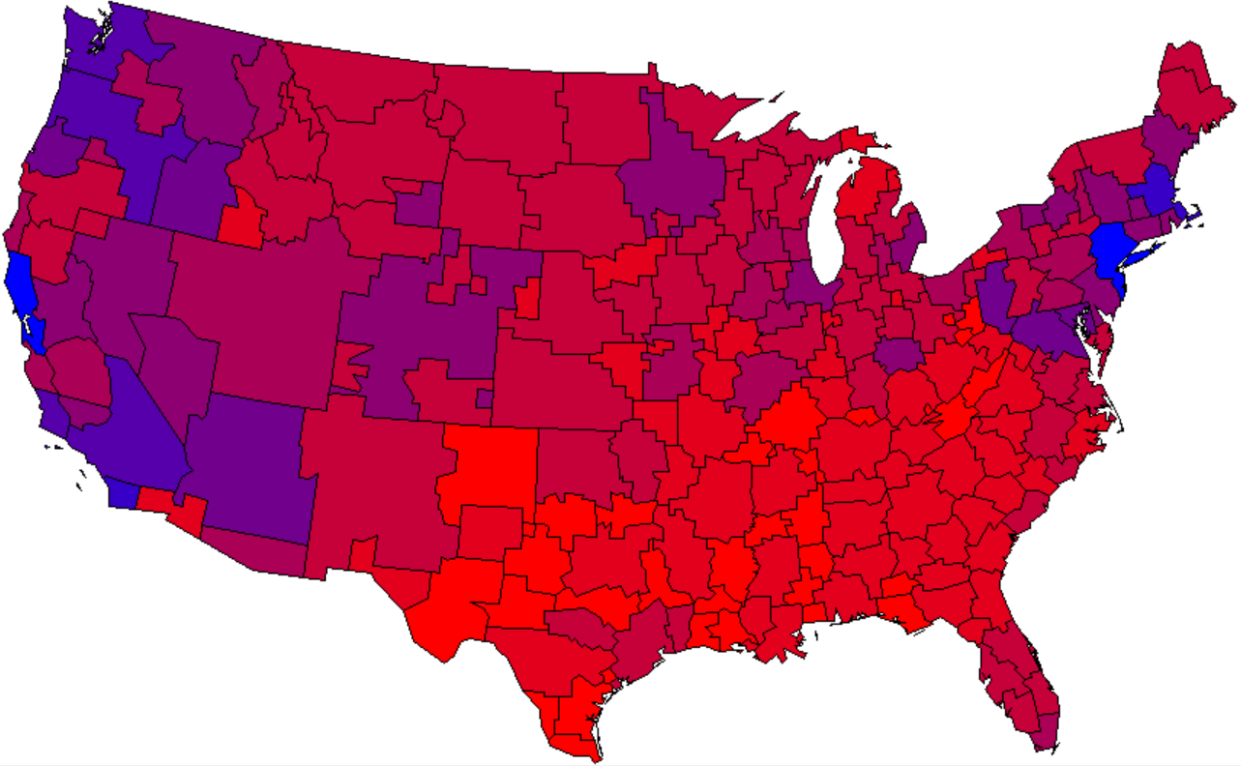
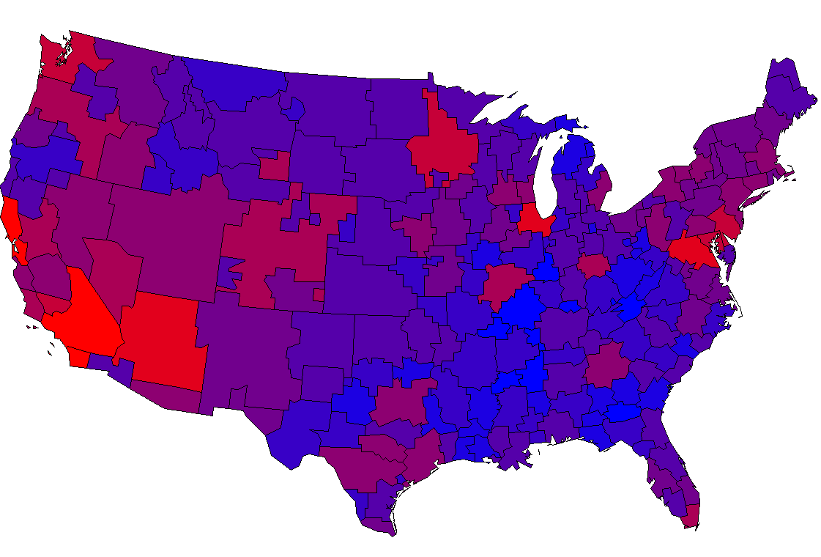
One Size Does NOT Fit All. Local TV Recognizes Each Market’s Uniqueness
The Redder the better- Higher the Sales Index
Source: GfK MRI 2021 Market-by-Market weighted by Adult 18+ population. Shopped in past 3 months

Slide 27


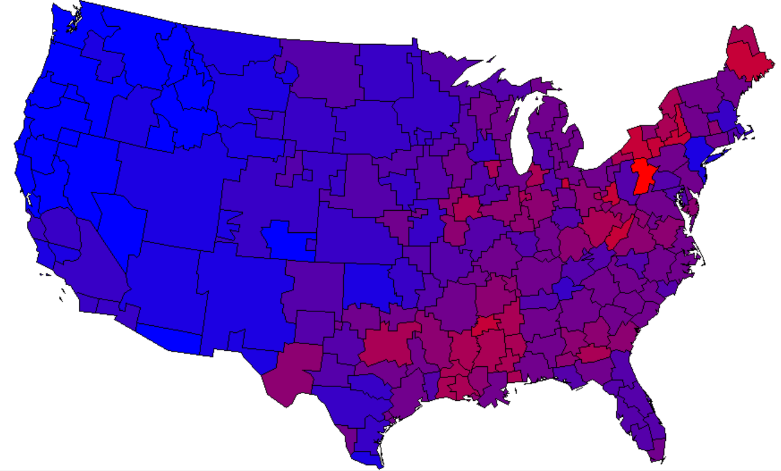
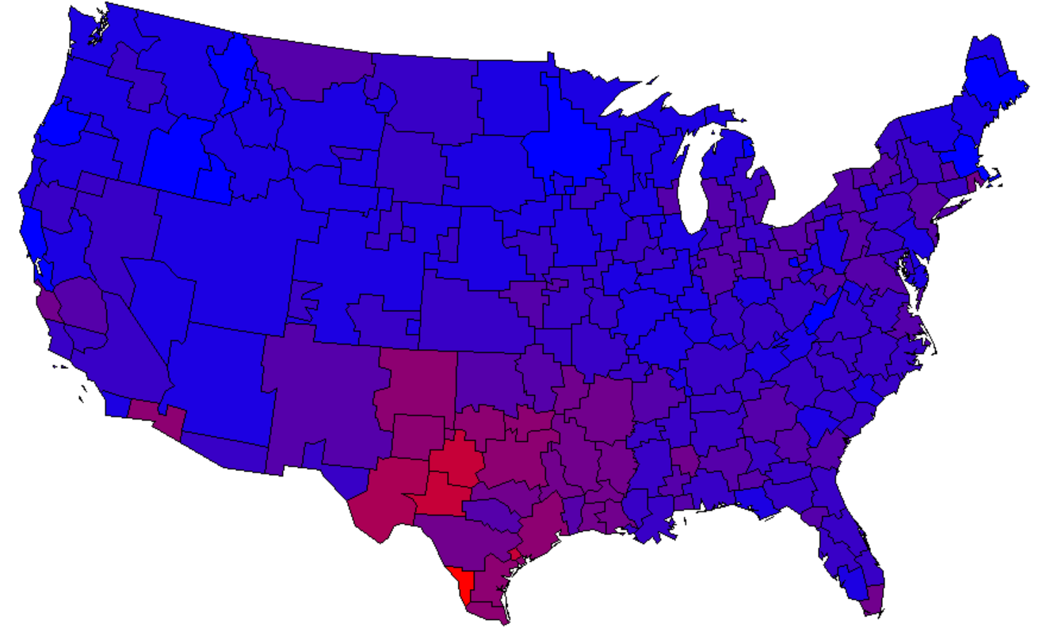

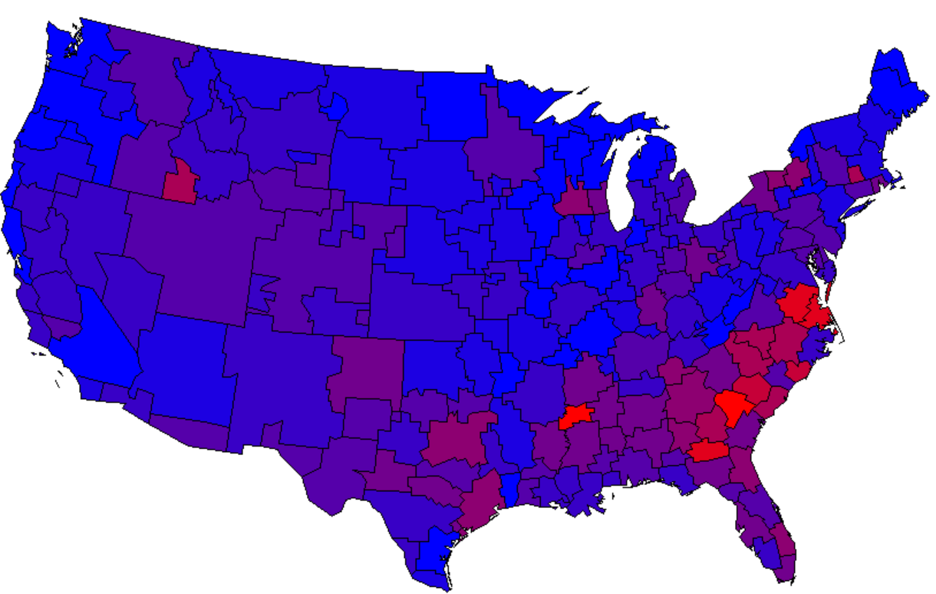
Jewelry Shopping is a Local Decision
The Redder the better
- High Index
Source: GfK MRI 2021 Market-by-Market weighted by Adult 18+ population. Purchased Fine Jewelry at Jared, Kay or Zales.

Slide 28

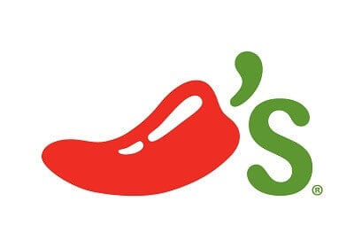
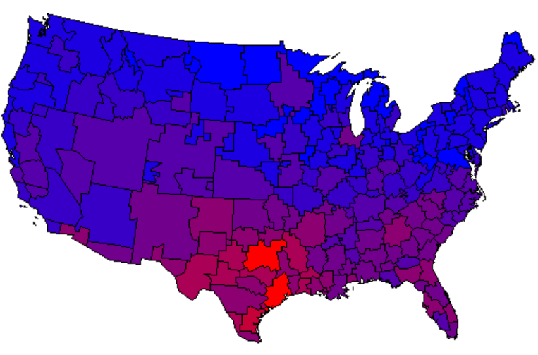
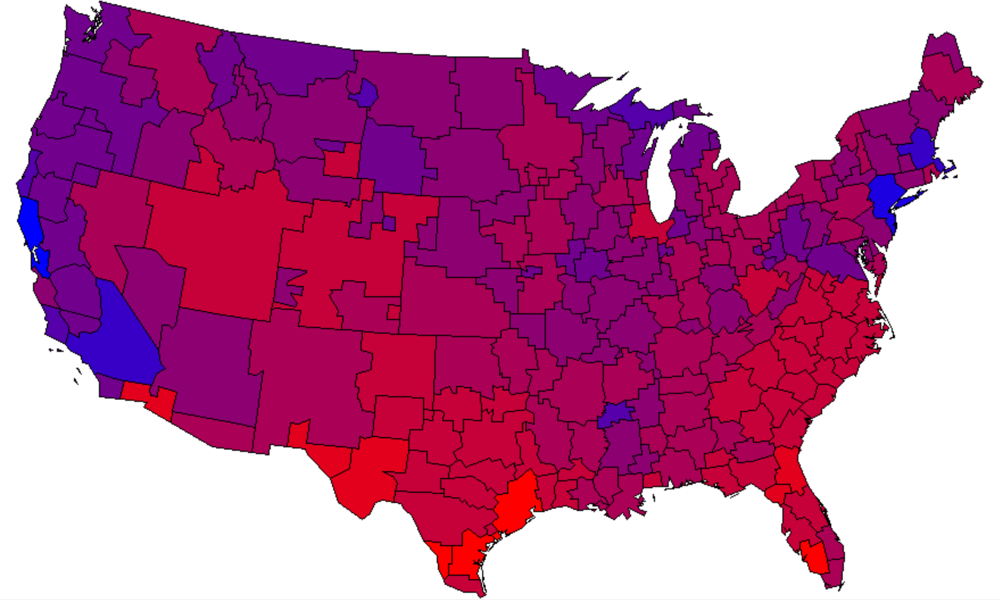
Target Adults Who Enjoy Dining Out
With Local Broadcast
The Redder the better - High Index
Source: GfK MRI 2021 Market-by-Market weighted by Adult 18+ population. Bought at in the last 6 months: Chili's Grill & Bar, Olive Garden.

Slide 29
Local Broadcast TV is The Primary Source of News For Shopping/Retail Opinion Leaders
% of Shopping/Retail Opinion Leaders Consuming Any Type of News
Base: Shopping/Retail Opinion Leaders, n=623
Q11) Primarily, which source do you use to get your news and information?
Source: Engagement Labs TVB American Conversation Study 2022

Slide 30
However Consumers Shop,
TV Advertising is Key

Slide 31
Retail Online = Online Only + Online & In-store
Retail In-Store = In-Store Only + Online & In-store
Nearly 8 In 10 Retail Consumers Shopped
Both In-Store & Online
Online
Only
In-store
Only
Online & In-store
12%
77%
11%
Online
In-store
89%
88%
Source: GfK TVB Purchase Funnel 2022 A18+: Retail
CI-2: “Now, please think about the holiday season. Have you purchased, or do you plan to purchase from the following?”

Slide 32
82% of Consumers Shop In a Retail Store,
72% Shop Online At Least Once A Month
Source: GfK TVB Media Comparisons Study 2022. QC5B - How often, if at all, do you shop in a retail store/online?

Slide 33
Have You Purchased, or Do you Plan To
Purchase From the Following?
% A18+
YES
Source: GfK TVB Purchase Funnel 2022 A18+
C-3: “Now, please think about the holiday season. Have you purchased, or do you plan to purchase from the following?”

Slide 34
Are You Currently, Or Planning to Do More, Less, or The Same?
Same or more
76%
79%
Source: GfK TVB Purchase Funnel 2022 In-store retail category, A18+
CI-1: “For each of the following, are you currently or planning to do more, less or the same compared to what you did six months ago?”

Slide 35
Given COVID-19, Which of the Following Best Describes Your Current Perspective on How You Eat Food from a
QSR/Casual Dining Restaurant?
Source: GfK TVB Purchase Funnel 2022 QSR/Casual Dining A18+
CI-7: Given COVID-19, which of the following best describes your current perspective on how you eat food from a fast food, quick serve, or casual restaurant

Slide 36
What Influenced Consumers Most For In-Store & Online Retail:
Awareness
In-store/Online Retail % A18+
Source: GfK TVB Purchase Funnel 2022 A18+ Browse & Purchase In-Store: In-store retail category, Browse & Purchase Online: Online retail category; QA4 “Thinking about the ads you saw/heard for the categories, which advertising media made you most aware of the category?” Most important for media with at least 1 funnel stage at 2%+ shown; 2%, 1%, & 0% not shown/labeled.

Slide 37
“Have TV ads influenced your search selections?”
Source: GfK TVB Purchase Funnel 2022 In-store & Online retail category, A18+
QA10 “When doing an online search, how often, if at all, have TV ads you have seen in this category influenced you in some ways in your search?” (Yes = combination of Every time, Most of the time & Sometimes) Among those who do online searches.

Slide 38
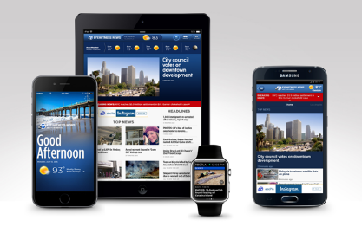
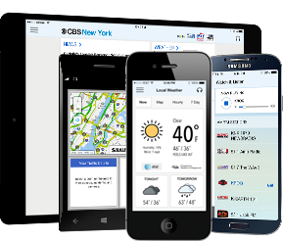
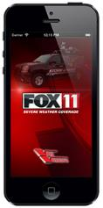
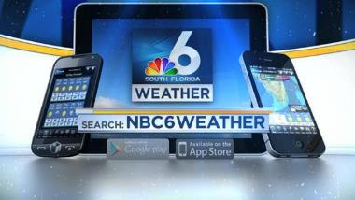
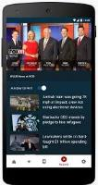

Local Broadcast TV Websites Provide
Multi-platform Opportunities

Slide 39
Combining Broadcast TV with Broadcast Websites Results in 4% Increased Reach For Online Shoppers
_{0.5%}
_{Reach}
_{Added}
_{4.2%}
_{Reach}
_{Added}
Source: GfK TVB Media Comparisons Study 2022. M-S 4A-4A. Persons 18+ Have you recently, or do you plan in the next month, to do any shopping online: Yes.

Slide 40
Broadcast TV Assets Can Reach Those Who Stream Programming on Ad-Free Platforms

Slide 41
Streaming with NO Advertising
Advertisers Cannot Reach these Viewers
But Broadcast Assets Can Reach Most of Them
Source: GfK TVB Media Comparisons Study 2022. M-S 4A-4A. Persons 18+ Have you recently, or do you plan in the next month, to do any shopping in a retail store: Yes.

Slide 42
Streaming with NO Advertising
Advertisers Cannot Reach these Viewers
But Broadcast Assets Can Reach Most of Them
Source: GfK TVB Media Comparisons Study 2022. M-S 4A-4A. Persons 18+ Have you recently, or do you plan in the next month, to do any shopping online: Yes.

Slide 43
Key Mother’s Day Takeaways
Mother’s Day is the top spending event in the first half of the year.
90% of consumers will shop for Mother’s Day & over half of Americans plan to shop at a local store or restaurant for Mother’s Day.
TV advertising is imperative to influence Mother’s Day shoppers.
9 out of 10 respondents said television influenced their search selections.
Broadcast TV delivers top Mother’s Day ratings and reach.
Local TV allows advertisers to target their message in a trusted environment.
Broadcast TV delivers both in-store and online shoppers.
Online shoppers and in-store shoppers selected television as the most important influence.
Broadcast TV assets can reach those who stream programming on ad-free platforms.

Slide 44

Thank You

