Slide 2
Contents
2022 Winter Holidays Marketing Data/Projections (Slides 3-17)
TV Advertising Is Imperative To Influence Holiday Shoppers (Slides 18-31)
Local TV Allows Advertisers to Target their Message in a Trusted Environment (Slides 32-38)
However Consumers Shop, TV Advertising is Key (Slides 39-52)

Slide 3
2022 Winter Holidays Marketing Data/Projections

Slide 4
According to the NRF, 2022 Holiday Sales Are Expected to Exceed 2021’s Record Highs by 6-8%
Source: NRF 2022 Holiday Data. U.S. Census. Non-seasonally adjusted retail sales. NRF holiday spending is defined as the months of November and December. NRF's forecast excludes automobile dealers, gasoline stations and restaurants.

Slide 5
2022 Holiday Retail Sales Expected To Increase Between 4-6%, E-commerce 13-14% From 2021
Anticipated U.S. Holiday Retail Sales
Up 4-6% From 2021
Up 13-14% From 2021
Source: Deloitte 2022 Holiday Retail Sales.

Slide 6
Per Person Spending Is Set To Increase On Average By 6% This Holiday Season
Source: Roku + Harris 2022 Holiday Report.

Slide 7
72% of Shoppers Expect Their Holiday Spending to Increase or Stay the Same As 2021
How Much Do You Expect To Spend This Holiday Season Compared To Last?
Source: Civic Science: Navigating the Holidays.

Slide 8
Younger, Parents and Hispanic Shoppers Plan on Spending More Than The Average Adult
Millennials are planning to spend $1,139 on holiday shopping, $98 more than the average adult.
Gen-Z is planning to spend $1,418 on holiday shopping, $377 more than the average adult.
Hispanics are planning to spend $1,392 on holiday shopping, $351 more than the average adult.
Parents are planning to spend $1,181 on holiday shopping, $140 more than the average adult.
Source: Samba TV and HarrisX 2022 Holiday Report.
Notes:
SambaTV_2022 Report

Slide 9
Consumers Will Start Making Holiday Purchases in:
Source: Inmar 2022 Holiday Trends Guide.
Notes:
SambaTV_2022 Report

Slide 10
Amazon Tops The List of Preferred Retailers This Holiday Season
Top Retailers That They Plan to Visit for Holiday Shopping
Source: JLL Research, Holiday Survey 2022. Can pick up to 3 retailers.

Slide 11
Gifts that Consumers Will Purchase This Season
Source: Samba TV and HarrisX 2022 Holiday Report.
Notes:
SambaTV_2022 Report

Slide 12
For Gift-Giving, Consumers Plan to Spend the Most on Children
Source: Samba TV and HarrisX 2022 Holiday Report.
Notes:
SambaTV_2022 Report

Slide 13
Black Friday and Cyber Monday Will Be $22 Billion in Ecommerce Sales, Up 2-4% From 2021
US Cyber Five Retail Ecommerce Holiday Season Sales, by Shopping Day, 2022
Billions and % change vs. previous year
+3.8%
+3.3%
+2.3%
Source: eMarketer, September 2022.

Slide 14
Half of Holiday Shoppers Will Wait Until Black Friday or Cyber Monday To Buy Phones, Tablets and Laptops
Source: Inmar 2022 Holiday Trends Guide.

Slide 15
The Economy Is Top of Mind For Consumers Heading Into The Holiday
Percent of consumers who say that the state of the U.S. economy is impacting their spending plans for the holidays
Source: NRF and Prosper Insights & Analytics October 2022 Holiday Survey.

Slide 16
How Do Shoppers Plan to Save This Holiday Season?
64%
of consumers will adjust how they shop in response to inflation and
price increases.
Source: Inmar 2022 Holiday Trends Guide.

Slide 17
Which of the Following Was Most Important When Deciding Where to Shop?
Source: Civic Science: Navigating the Holidays.

Slide 18
TV Advertising Is Imperative To Influence Holiday Shoppers

Slide 19
Adults

Slide 20
What Influenced Consumers Most: Television
% Influenced by media
Source: GfK TVB Purchase Funnel 2022 A18+
QA4/QA5/QA6/QA7/QA8 Most important for media with at least 1 funnel stage at 2%+ shown; 2%, 1%, & 0% not shown/labeled

Slide 21
Of Those that Cited TV as the Most Important in Awareness Phase, Two Thirds Picked Broadcast TV
Source: GfK TVB Purchase Funnel 2022 A18+
QA4 “Thinking about the ads you saw/heard for the categories, which advertising media made you most aware of the category?”
How to read: Of the 49% who chose television, 66% chose broadcast TV

Slide 22
TV Has Highest Reach and Time Spent for Adults 18+ Broadcast Leads the Way
Adults 18+
Source: GfK TVB Media Comparisons Study 2022. M-S 4A-4A. Persons 18+. Online/internet platforms such as email, social media, internet radio and websites, are totaled for any online device-PC, Smartphone and Tablets. Broadcast TV News Websites/Apps includes local TV station & network websites/apps for news/weather/sports.

Slide 23
Broadcast: Superior Holiday Season Ratings
Adults 25-54 Live+1 Ratings
Source: Nielsen 09/27/2021-12/25/2021 Adults 25-54 Live+1 Ratings; Broadcast Includes all Networks and Syndication.
10 Cable Networks based on A25-54 Ratings

Slide 24
Broadcast TV Dominated the Top Rated Programs During The Holiday Season
Source: Nielsen NPower, 9/27/21-12/25/21, A25-54 Live+1 Ratings. Broadcast Includes all Networks and Syndication.

Slide 25
Great Reach for Thanksgiving Ad Kickoff: One Program Has Up to 7X the Reach of A Full Day on Cable
1 unit
1 unit
1 unit
1 unit
1 unit
24 units
17 units
12 units
24 units
38 units
26 units
10 units
Source: Nielsen NPower. November 25th 2021, Adults 18+; Live + 1

Slide 26
Out of 5 choices, the top 4 were Broadcast Networks
If you could choose only five networks, which five would you choose?
Network “A”
Network “B”
Network “C”
Network “D”
Network “E”
BROADCAST NETWORK
CABLE NETWORK
Source: GfK TVB Media Comparisons Study 2022. Respondents were given 50 choices of Broadcast and Cable Networks with an option to write in a network.

Slide 27
Parents

Slide 28
TV Has Highest Reach of Ad Supported Platforms Broadcast Leads the Way For Parents
Parents 18+
% Reached Yesterday
Source: GfK TVB Media Comparisons Study 2022. M-S 4A-4A. Persons 18+ parent/legal guardian of children 0 -17 in HH. Online/internet platforms such as email, social media, are totaled for any online device-PC, Smartphone and Tablets.

Slide 29
For Adults 18+ and Even More So For Parents, Television Ads Are Motivation To Do Further Research Online
Has an advertisement on television motivated you to go the Internet to find out more information about that product or service?
Source: GfK TVB Media Comparisons Study 2022. Adults 18+ parent/legal guardian of children 0 -17 in HH. Includes only those who answered. Q3 - Has an advertisement on television motivated you to go the Internet to find out more information about that product or service?

Slide 30
“Have TV ads influenced your search selections?”
% A18+
% Parents
Source: GfK TVB Purchase Funnel 2022 A18+, Parents.
QA10 “When doing an online search, how often, if at all, have TV ads you have seen influenced you in some ways in your search?” (Yes = combination of Every time, Most of the time & Sometimes) Among those who do online searches

Slide 31
66% of Parents Stream Programs with No ads Advertisers Cannot Reach them on those Platforms
But Broadcast Assets Can Reach Most of Them
Source: GfK TVB Media Comparisons Study 2022. M-S 4A-4A. Persons 18+ parent/legal guardian of children 0 -17 in HH.

Slide 32
Local TV Allows Advertisers to Target their Message in a Trusted Environment

Slide 33
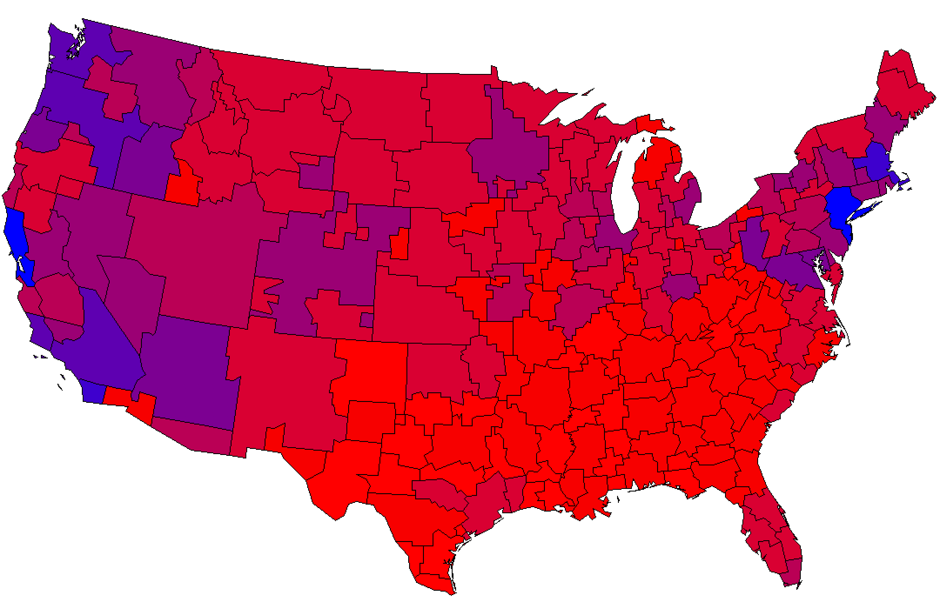
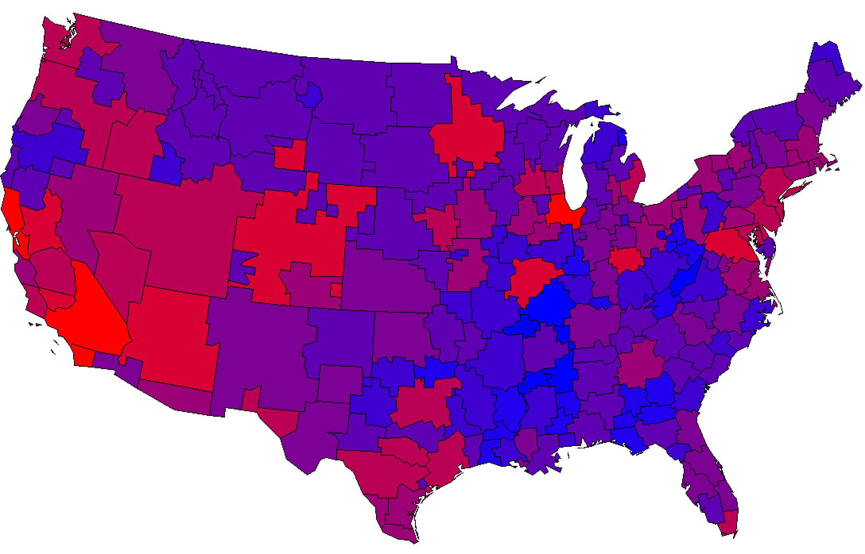
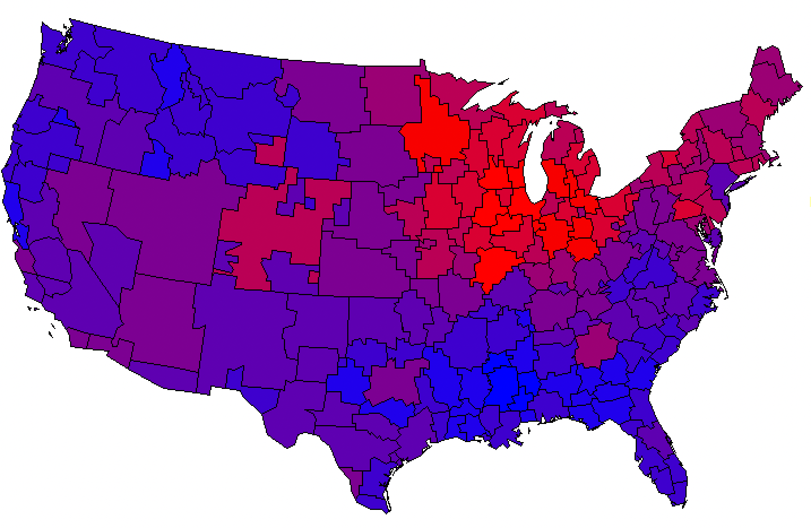
Cover Each Company’s Strong Markets with Local Broadcast
The Redder the better- High Index
Source: GfK MRI 2021 Market-by-Market weighted by Adults 18+. Shopped at Target, Walmart or Kohls in the last 3 Months.

Slide 34
The Primary Source For Local Traffic, Weather & Sports: Local Broadcast Television News
What source do you turn to first for information about local weather, traffic, or sports?
Source: GfK TVB Media Comparisons Study 2022. Persons 18+. Includes only those who chose a media. Q6 - What source do you turn to first for information about local weather, traffic, or sports? Streaming Radio & Podcasts were under 1% each.

Slide 35
Local Broadcast TV is The Primary Source of News For Shopping/Retail Opinion Leaders
% of Shopping/Retail Opinion Leaders Consuming Any Type of News
Base: Shopping/Retail Opinion Leaders, n=623
Q11) Primarily, which source do you use to get your news and information?
Source: Engagement Labs TVB American Conversation Study 2022

Slide 36
Local Broadcast Television News: #1 For Trust
I trust the News that I see/hear on this media source:
Percent Agree
Source: GfK TVB Media Comparisons Study 2022. Persons 18+. Agree Strongly or Agree Somewhat. Q9 - For each source, please indicate the extent to which you agree or disagree with the following statement: I trust the News that I see/hear on this media source.

Slide 37
Local Television Websites/Apps Most Preferred
Which of the following websites or apps are you most likely to turn to
when you need information about local news or events?
% A18+
Source: GfK TVB Purchase Funnel 2022 A18+
C3 “Which of the following websites or apps are you most likely to turn to when you need information about local news or events?”

Slide 38
Local Broadcast Television News: Most Involved In Your Community
Which source of news do you feel is the most involved in your community?
Source: GfK TVB Media Comparisons Study 2022. Persons 18+. Includes only those who chose a media. Q8 - And, which source of news do you feel is the most involved in your community?

Slide 39
However Consumers Shop, TV Advertising is Key

Slide 40
Shopping Online Does Not Preclude Shopping In-Store Often Shoppers Do A Combination of Both
Online
Only
In-store
Only
Online & In-store
12%
77%
11%
Online
In-store
89%
88%
Source: GfK TVB Purchase Funnel 2022 A18+: Retail CI-2: “Now, please think about the holiday season. Have you purchased, or do you plan to purchase from the following?”

Slide 41
82% of Consumers Shop In a Retail Store, 72% Shop Online At Least Once A Month
Source: GfK TVB Media Comparisons Study 2022. QC5B - How often, if at all, do you shop in a retail store/online?

Slide 42
Television is The Top Advertising Medium That Influences Purchase Decisions For In-Store Shoppers
(%) In-Store Shoppers
Advertising medium which you feel most influences you to make a purchase decision
Source: GfK TVB Media Comparisons Study 2022. Persons 18+ Have you recently, or do you plan in the next month, to do any shopping in a retail store: Yes. Includes only those who chose a media. Q1 - Please select the one type of advertising medium which, you feel, most influences you to make a purchase decision? Broadcast TV News Websites/Apps includes local TV station & network websites/apps for news/weather/sports.

Slide 43
Television is The Top Advertising Medium That Influences Purchase Decisions For Online Shoppers
(%) Online Shoppers
Advertising medium which you feel most influences you to make a purchase decision
Source: GfK TVB Media Comparisons Study 2022. Persons 18+ Have you recently, or do you plan in the next month, to do any shopping online: Yes. Includes only those who chose a media. Q1 - Please select the one type of advertising medium which, you feel, most influences you to make a purchase decision? Broadcast TV News Websites/Apps includes local TV station & network websites/apps for news/weather/sports.

Slide 44
What Influenced Consumers Most For In-Store & Online Retail: Awareness
In-store/Online Retail % A18+
Source: GfK TVB Purchase Funnel 2022 A18+ Browse & Purchase In-Store: In-store retail category, Browse & Purchase Online: Online retail category; QA4 “Thinking about the ads you saw/heard for the categories, which advertising media made you most aware of the category?” Most important for media with at least 1 funnel stage at 2%+ shown; 2%, 1%, & 0% not shown/labeled.

Slide 45
Of Those that Cited TV as the Most Important in Awareness Phase, 6 out of 10 Picked Broadcast TV
Source: GfK TVB Purchase Funnel 2022 A18+: Retail QA4 “Thinking about the ads you saw/heard for the categories, which advertising media made you most aware of the category?” How to read: Of those who chose television, 68% chose broadcast TV

Slide 46
“Have TV ads influenced your search selections?”
Source: GfK TVB Purchase Funnel 2022 A18+: Retail QA10 “When doing an online search, how often, if at all, have TV ads you have seen influenced you in some ways in your search?” (Yes = combination of Every time, Most of the time & Sometimes)

Slide 47
Regardless of Online Retail Methods, Shoppers Highly Trust Local TV Assets
Source: GfK TVB Purchase Funnel 2022 A18+: Retail B2 “I trust the news I see/hear on this media source” (Agree Strongly + Agree Somewhat)

Slide 48
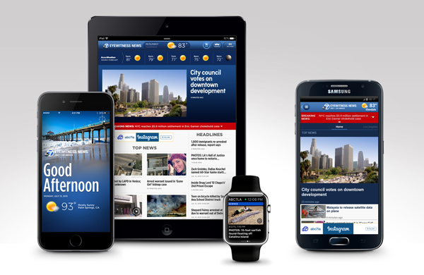
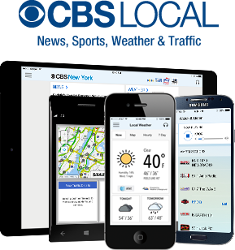
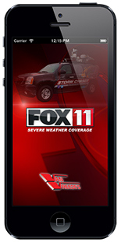
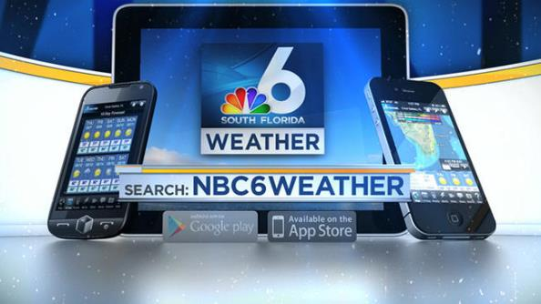
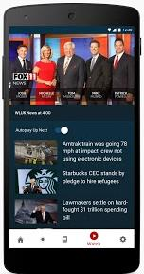
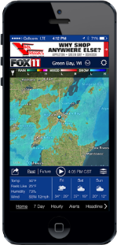
Broadcast TV Websites/Apps Provide Multi-platform Opportunities

Slide 49
Combining Broadcast TV with Broadcast Websites Results in 4% Increased Reach For In-Store Shoppers
_{0.5%}
_{Reach}
_{Added}
_{3.9%}
_{Reach}
_{Added}
Source: GfK TVB Media Comparisons Study 2022. M-S 4A-4A. Persons 18+ Have you recently, or do you plan in the next month, to do any shopping in a retail store: Yes.

Slide 50
Combining Broadcast TV with Broadcast Websites Results in 4% Increased Reach For Online Shoppers
_{0.5%}
_{Reach}
_{Added}
_{4.2%}
_{Reach}
_{Added}
Source: GfK TVB Media Comparisons Study 2022. M-S 4A-4A. Persons 18+ Have you recently, or do you plan in the next month, to do any shopping online: Yes.

Slide 51
Streaming with NO Advertising Advertisers Cannot Reach these Viewers
But Broadcast Assets Can Reach Most of Them
Source: GfK TVB Media Comparisons Study 2022. M-S 4A-4A. Persons 18+ Have you recently, or do you plan in the next month, to do any shopping in a retail store: Yes.

Slide 52
Streaming with NO Advertising Advertisers Cannot Reach these Viewers
But Broadcast Assets Can Reach Most of Them
Source: GfK TVB Media Comparisons Study 2022. M-S 4A-4A. Persons 18+ Have you recently, or do you plan in the next month, to do any shopping online: Yes.

Slide 53
Key Holiday Takeaways
According to Deloitte, 2022 holiday retail sales are expected to increase anywhere from 4-6% from 2021, while e-commerce sales are expected to increase 13-14%.
72% of shoppers expect their holiday spending to increase or stay the same as 2021.
The majority of consumers plan to start holiday shopping in October or November.
Broadcast TV delivers top holiday ratings and reach.
77% of consumers shop both online and in-store.
For both online and in-store shoppers, TV ads are important.
TV ads are the top advertising medium for purchase influence and most important in the awareness stage for both types of shoppers.
Broadcast TV assets can reach online and in-store shoppers who stream programming on ad-free platforms.

Slide 54
Happy
Holidays!

