Slide 1
Awareness
Interest
2023
Purchase
Funnel
Study
General Overview
Visit Store/ Website for Info
Consider Purchasing
Purchase

Slide 2
Study Objective and Methodology

Slide 3
Objective: To identify the importance of media platforms in influencing consumers during their purchase decision process for these categories
TVB commissioned to do the research study.

Slide 4
Research Overview: Methodology
WHO:
4,000 interviews were collected via opt-in sample.
To qualify, respondents needed to be age 18+ and:
be in the market for each product/service category,*
Product/service categories: Auto, Banking/Financial, Furniture/Bedding/Carpet, Legal, Medical services: Urgent care/Hospitals, Medical services: Dentist/Orthodontist, Eye Doctor/Lasik, Retail online and in-store
Have seen/heard or read an advertisement for that category in ANY of about 20 media platforms both traditional and digital, in the past 2 months
Each respondent answered a series of questions for up to three product/service categories.
WHEN: Interviews took place December 1, 2022– December 15,2022
WHAT: Via 12-minute online quantitative survey about the influence of advertising platforms at each stage of the consumer purchase decision, actions taken post-advertising, and attitudinal questions.
Respondents were given the choice of taking the survey in either English or Spanish.
The General Overview presentation that follows includes all eight categories.
* Definition for being “in the market” for each category was based on shopping frequency and/or current product ownership/planned purchase (actual criteria differed by category)
Source: GfK TVB Purchase Funnel 2023

Slide 5
These are the media platforms measured Respondents did not have to be exposed to a TV ad to be included in the study
TV
Radio
Mail
OOH
Print
Digital
(Broadcast, Cable and On-Demand)
(Billboard and Movie Theater)
(Newspaper and Magazine, Yellow Pages)
Digital media include:
Cable site/app
Consumer review site/app
Display/banner ad
Email ad
Internet radio
Local radio station site/app
Local TV station site/app
Network TV station site/app
Magazine
Newspaper
Search engine
Social media
Streaming TV services
Video ad
Yellow Pages site/app

Slide 6
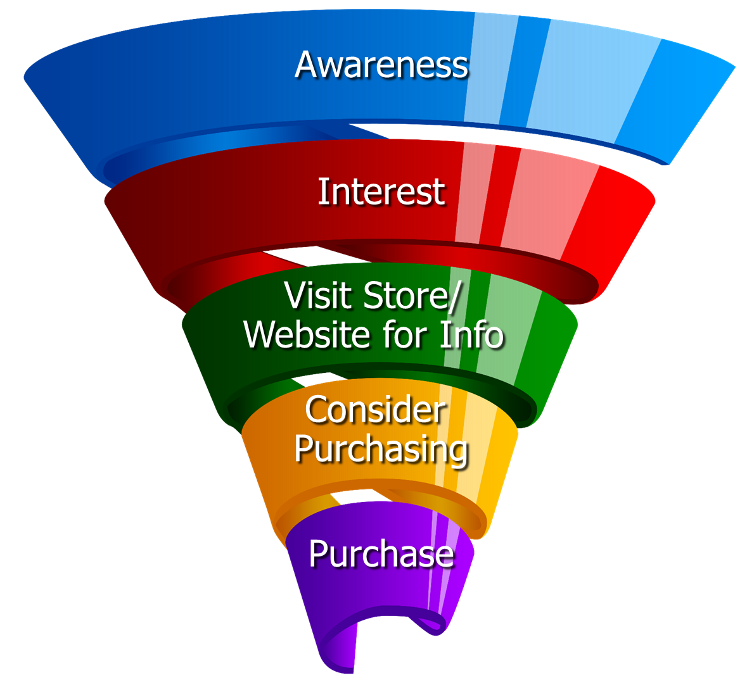
Respondents were asked to rate which medium was important in each stage of the Purchase Funnel
Reaching
Consumers
Early
Preparing for
Purchase Decision
Making a purchase

Slide 7
Media Influence

Slide 8
Media Makes a Difference in Motivating In-Market Consumers…But it Declines Moving Down the Funnel
% Influenced by Media
% NOT Influenced by Media
Source: GfK TVB Purchase Funnel 2023 A18+
QA4/QA5/QA6/QA7/QA8 (cume of all media cited as most important)

Slide 9
A Majority of Respondents (57%) Were Exposed to Three or More Media Sources
Source: GfK TVB Purchase Funnel 2023 A18+
S10/S11 In The past two months, did you see, hear, or read an advertisement in any of these media/digital Internet media?

Slide 10
Ad Exposure Does NOT Guarantee Importance, Except for TV
Source: GfK TVB Purchase Funnel 2023 A18+
S10/S11/QA4 “In the past two months, did you see, hear or read any advertisement in any of these media/digital internet media?”/ “Thinking about the ads you saw/heard for the categories, which advertising media made you most aware of the category?”

Slide 11
Ad Exposure Does NOT Guarantee Importance, Except for TV
Source: GfK TVB Purchase Funnel 2023 A18+
S10/S11/QA4 “In the past two months, did you see, hear or read any advertisement in any of these media/digital internet media?”/ “Thinking about the ads you saw/heard for the categories, which advertising media made you most aware of the category?”

Slide 12
What Influenced Consumers Most: Television
% Influenced by media
Source: GfK TVB Purchase Funnel 2023 A18+
QA4/QA5/QA6/QA7/QA8 Most important for media with at least 1 funnel stage at 2%+ shown; 2%, 1%, & 0% not shown/labeled

Slide 13
Of Those that Cited TV as the Most Important in Awareness Phase, Two-Thirds Picked Broadcast TV
Source: GfK TVB Purchase Funnel 2023 A18+
QA4 “Thinking about the ads you saw/heard for the categories, which advertising media made you most aware of the category?”
How to read: Of the 49% who chose television, 66% chose broadcast TV

Slide 14
What Influenced Consumers Most: Awareness Stage
Source: GfK TVB Purchase Funnel 2023 A18+ those who saw/heard ads in at least 1 media source; Most important media type among those who saw/heard ads in at least 1 media source at 2%+ shown; 2%, 1%, & 0% not shown/labeled

Slide 15
Exposure To Television Ads By Category
About six in 10 adults were exposed to television ads regardless of category
%A18+ exposed to television ads
Television (Broadcast & Cable)
Source: GfK TVB Purchase Funnel 2023 A18+
S10/S11 “In the past two months, did you see, hear or read any advertisement in any of these media/digital internet media?”

Slide 16
Medical: Dentist/Eye Doctor: 9 Out of 10 Respondents Said Social Media Wasn’t Important In Building Awareness for a Product/Service
TV (Broadcast & Cable)
% Deeming Important
Social media
% Deeming Important
Source: GfK TVB Purchase Funnel 2023 A18+ Medical Services: Dentist/Orthodontist/Eye Doctor/Lasik
QA4 “Thinking about the ads you saw/heard for the categories, which advertising media made you most aware of the category?”

Slide 17
Meta
Digital Companies Know the Value of TV
At Least Half their Q3 2022 Ad Dollars Were in TV
Google
Total Ad Spending $84.8 Million
Total Ad Spending $165.7 Million
Source: Kantar Media, Time Period: 7/1/2022-9/30/2022, TV= Spot TV, Network TV, Cable TV, SLN TV, Syndication. Internet Display, Internet Search, Online Video, Mobile Web, Mobile Video, Outdoor, Print= Magazine, National Newspaper, Local Newspapers. (No Newspaper data available)

Slide 18
The Primary Source for News: Broadcast Television
Which of the following sources, if any, would you say is your primary source for news?
Source: GfK TVB Purchase Funnel 2023 A18+
B1 “Which one of the following sources, if any, would you say is your primary source for news?” (Among those who have a primary news source)

Slide 19
“I trust the news I see/hear on this media source”
Traditional Media
Digital Media
Source: GfK TVB Purchase Funnel 2023 A18+
B2 “I trust the news that I see/hear on this media source.” Top 2 box (Agree Strongly + Agree Somewhat)

Slide 20
Media Confluence

Slide 21
“Have TV ads influenced your online search selections?”
% A18+
Source: GfK TVB Purchase Funnel 2023 A18+
QA10 “When doing an online search, how often, if at all, have TV ads you have seen influenced you in some ways in your search?” (Yes = combination of Every time, Most of the time & Sometimes) Among those who do online searches

Slide 22
“Have TV ads influenced your search selections?”
Source: GfK TVB Purchase Funnel 2023 A18+
QA10 “When doing an online search, how often, if at all, have TV advertisements you have seen in this category influenced you in some way in your search selections?” (Every time, most of the time, sometimes)

Slide 23
Local Television Websites/Apps Most Preferred
Which of the following websites or apps are you most likely to turn to
when you need information about local news or events?
% A18+
Source: GfK TVB Purchase Funnel 2023 A18+
C3 “Which of the following websites or apps are you most likely to turn to when you need information about local news or events?”

Slide 24
Local Television Websites/Apps Are The Most Visited Among Local Websites/Apps
When, if at all, did you last visit these types of websites or apps?
% A18+ among those that visit these websites/apps
Source: GfK TVB Purchase Funnel 2023 A18+
C1 “When, if at all, did you last visit these types of websites/apps?” Among those who visit these site types.

Slide 25
“When visiting a television station’s website or app, do you view the ads?”
% A18+
Source: GfK TVB Purchase Funnel 2023 A18+ C2 “How often do you look at the video ads on that local television station’s website or app?” (Yes = combination of Every time, Most of the time & Sometimes)

Slide 26
“Have you ever commented, posted, liked or shared info or articles from a local TV station’s website or app?”
% A18+
Yes
51%
Source: GfK TVB Purchase Funnel 2023 A18+
C4 “Have you ever commented, posted, liked or shared info or articles from a local TV station’s website or app?”

Slide 27
“Have you ever commented, posted, liked or shared info or articles from a local TV station’s website or app?”
Source: GfK TVB Purchase Funnel 2023 A18+
C4 “Have you ever commented, posted, liked or shared information or articles from a local TV station’s website or app?”

Slide 28
Most Respondents Were Exposed to TV Commercials 2-5 Times
Source: GfK TVB Purchase Funnel 2023 A18+
QA1 “How many times to you estimate you saw a TV commercial for the category in the past month? (auto, retail, furniture/bedding/carpet, banking services, legal, hospital/urgent care, dentist/orthodontist/eye doctor/lasik)

Slide 29
More TV Exposure Increases Importance, Trust, Preference
% A18+
Source: GfK TVB Purchase Funnel 2023 A18+
QA4/B1/B2/C3; TV=Broadcast & Cable

Slide 30
More Exposures Means More Action
Which of the following did you do after seeing/hearing the ads for the category on television?
Source: GfK TVB Purchase Funnel 2023 A18+
QA9 “Which of the following did you do after seeing/hearing the ads for the category on television?”

Slide 31
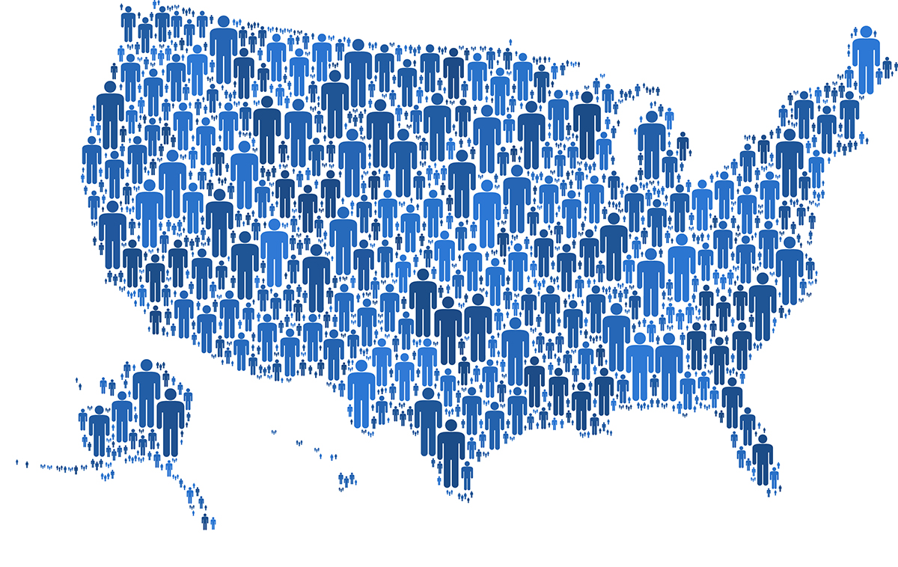
Demographics

Slide 32
Key Targets Use More Media Especially Adults 25-54
Source: GfK TVB Purchase Funnel 2023, A18+, A18-34, A18-49, A25-54
S10/S11 “In the past two months, did you see, hear, or read an advertisement for the category in any of these media/digital Internet media?”

Slide 33
What Influenced Consumer Awareness Most: Awareness
Source: GfK TVB Purchase Funnel 2023; % Most important media type among those who saw/heard ads in at least 1 media source at 2%+ shown; 2%, 1%, & 0% not shown/labeled QA4 “Thinking about the ads you saw/heard for the category, which advertising media made you aware of the category?”

Slide 34
What Influenced A18-34 Consumers Most
Source: GfK TVB Purchase Funnel 2023 A18-34, QA4/QA5/QA6/QA7/QA8 Most important media type among those who saw/heard ads in at least 1 media source at 2%+ shown; 2%, 1%, & 0% not shown/labeled

Slide 35
What Influenced A18-49 Consumers Most
Source: GfK TVB Purchase Funnel 2023 A18-49, QA4/QA5/QA6/QA7/QA8 Most important media type among those who saw/heard ads in at least 1 media source at 2%+ shown; 2%, 1%, & 0% not shown/labeled

Slide 36
What Influenced A25-54 Consumers Most
Source: GfK TVB Purchase Funnel 2023 A25-54, QA4/QA5/QA6/QA7/QA8 Most important media type among those who saw/heard ads in at least 1 media source at 2%+ shown; 2%, 1%, & 0% not shown/labeled

Slide 37
TV Motivates Key Demos
Which of the following did you do after seeing/hearing the ads for the category on television?
Source: GfK TVB Purchase Funnel 2023, A18+, A18-34, A18-49, A25-54
QA9 “ Which of the following did you do after seeing/hearing the ads for the category on television?”

Slide 38
“Have TV ads influenced your search selections?”
Source: GfK TVB Purchase Funnel 2023; A18+, A18-34, A18-49, A25-54
QA10 “When doing an online search, how often, if at all, have TV ads you have seen influenced you in some ways in your search?” (Yes = combination of Every time, Most of the time & Sometimes) Among those who do online searches

Slide 39
“When visiting a television station’s website or app, do you view the ads?”
Source: GfK TVB Purchase Funnel 2023; A18+, A18-34, A18-49, A25-54
C2 “How often do you look at the video ads on that local television station’s website or app?” (Yes = combination of Every time, Most of the time & Sometimes)

Slide 40
“Have you ever commented, posted, liked or shared info or articles from a local TV station’s website or app?”
Source: GfK TVB Purchase Funnel 2023; A18+, A18-34, A18-49, A25-54
C4 “Have you ever commented, posted, liked or shared info or articles from a local TV station’s website or app?”

Slide 41
Household Income

Slide 42
What Influenced Consumer Awareness Most: Household Income Awareness
Source: GfK TVB Purchase Funnel 2023 A18+ HH income; % Most important media type among those who saw/heard ads in at least 1 media source at 2%+ shown; 2%, 1%, & 0% not shown/labeled QA4 “Thinking about the ads you saw/heard for the category, which advertising media made you aware of the category?”

Slide 43
TV Motivates Key HH Income Segments
Which of the following did you do after seeing/hearing the ads for the category on television?
Source: GfK TVB Purchase Funnel 2023, A18+ HH income
QA9 “ Which of the following did you do after seeing/hearing the ads for the category on television?”

Slide 44
“Have TV ads influenced your search selections?”
Source: GfK TVB Purchase Funnel 2023; A18+ HH Income
QA10 “When doing an online search, how often, if at all, have TV ads you have seen influenced you in some ways in your search?” (Yes = combination of Every time, Most of the time & Sometimes) Among those who do online searches

Slide 45
“When visiting a television station’s website or app, do you view the ads?” HH Income
Source: GfK TVB Purchase Funnel 2023; A18+ HH Income
C2 “How often do you look at the video ads on that local television station’s website or app?” (Yes = combination of Every time, Most of the time & Sometimes)

Slide 46
Opinion Leaders My Friends/Family Ask and Trust my Advice On This Topic

Slide 47
TV Ads Motivate Opinion Leaders
Which of the following did you do after seeing/hearing the ads for the category on television?
Went online to learn more about what was advertised
Remembered you had seen the brand advertised before (i.e., the newspaper, radio or the internet)
Went to the website or app advertised to learn more about what was advertised
Friended, liked, or followed what was advertised on social media
Talked with others about the advertisement
Source: GfK TVB Purchase Funnel 2023 Total A18+; Opinion leaders (Those respondents who agreed with the statement, ”My family/friends often ask for and trust my advice on this topic”)
QA9 “Which of the following did you do after seeing/hearing the ads for the category on television?”

Slide 48
Local TV Assets Resonate with Opinion Leaders
“Have TV ads influenced your search selections?”
“When Visiting a Television Station’s Website or App, do you View the Ads?”
“Have you ever commented, posted, liked or shared info or articles from a local TV station’s website or app?”
A18+
Opinion Leaders
Source: GfK TVB Purchase Funnel 2023 Total A18+ & Opinion Leaders (Those respondents who agreed with the statement, ”My family/friends often ask for and trust my advice on this topic”); QA10/C2/C4

Slide 49
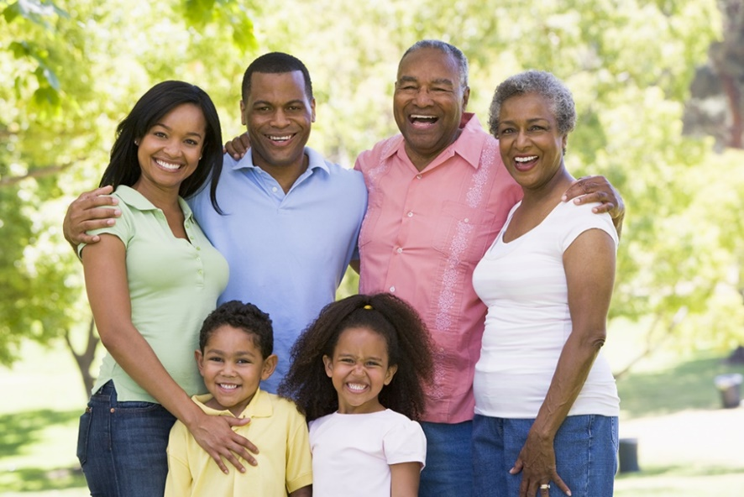
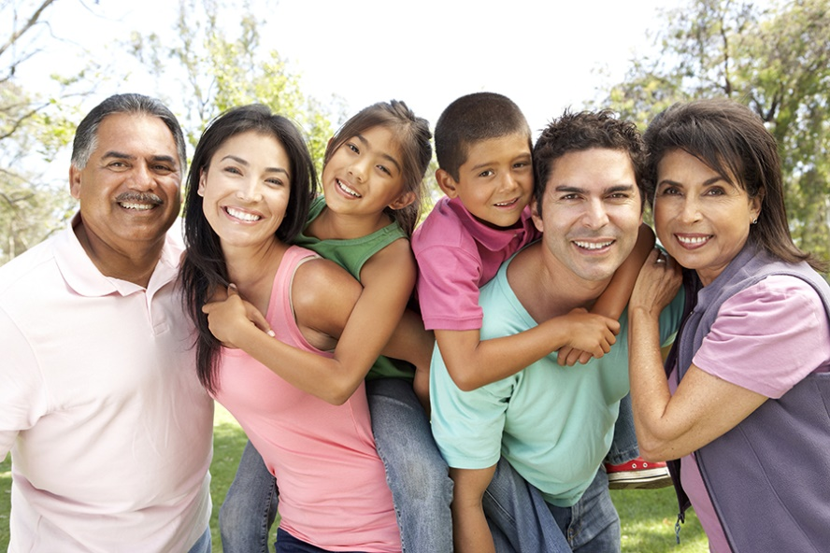
Black/African Americans & Hispanics

Slide 50
What Influenced Black/African-American Consumers Most
Source: GfK TVB Purchase Funnel 2023; African American A18+ QA4/QA5/QA6/QA7/QA8 Most important media type among those who saw/heard ads in at least 1 media source at 2%+ shown; 2%, 1%, & 0% not shown/labeled

Slide 51
What Influenced Hispanic Consumers Most
Source: GfK TVB Purchase Funnel 2023; Hispanic A18+, QA4/QA5/QA6/QA7/QA8 Most important media type among those who saw/heard ads in at least 1 media source at 2%+ shown; 2%, 1%, & 0% not shown/labeled

Slide 52
TV Motivates
Which of the following did you do after seeing/hearing the ads for the category on television?
Total A18+
Black/African American
Hispanic
Source: GfK TVB Purchase Funnel 2023 Total, African American, Hispanic A18+
QA9 “ Which of the following did you do after seeing/hearing the ads for the category on television?”

Slide 53
TV and Digital Interplay is High Among Black/African-Americans & Hispanics
“Have TV ads influenced your search selections?”
“When visiting a TV station’s website or app, do you view the ads?”
“Have you ever commented, posted, liked or shared info or articles from a local TV station’s website or app?”
A18+
Black/African-American
Hispanic
Source: GfK TVB Purchase Funnel 2023; Total, African American, Hispanic A18+
QA10/C2/C4

Slide 54
Categories: Topline Insights

Slide 55
Top Actions After Exposure to TV Ad
Auto
Banking
Traditional Action
Digital Action
Source: GfK TVB Purchase Funnel 2023 A18+ QA9: “Which of the following did you do after seeing/hearing the ads for the category on television?”

Slide 56
Top Actions After Exposure to TV Ad
Furniture/Bedding/Carpet
Legal
Traditional Action
Digital Action
Source: GfK TVB Purchase Funnel 2023 A18+
QA9: “Which of the following did you do after seeing/hearing the ads for the category on television?”

Slide 57
Top Actions After Exposure to TV Ad
Medical: Dentist/Orthodontist, Eye doctor/Lasik
Medical: Hospital/Urgent care
Traditional Action
Digital Action
Source: GfK TVB Purchase Funnel 2023 A18+ QA9: “Which of the following did you do after seeing/hearing the ads for the category on television?”

Slide 58
Top Actions After Exposure to TV Ad
Retail: In-store
Retail: Online
Traditional Action
Digital Action
Source: GfK TVB Purchase Funnel 2023 A18+ QA9: “Which of the following did you do after seeing/hearing the ads for the category on television?”

Slide 59
Purchase Attitudes

Slide 60
Retail Online = Online Only + Online & In-store Retail In-Store = In-Store Only + Online & In-store
76% of Retail Consumers Shopped Both In-Store & Online During The Holiday Season
Online
Only
In-store
Only
Online & In-store
14%
76%
10%
Online
90%
In-store
86%
Source: GfK TVB Purchase Funnel 2023 A18+: Retail
CI-2: “Now, please think about the holiday season. Have you purchased, or do you plan to purchase from the following?”

Slide 61
What Influenced Consumers Most For Online Retail: Awareness
% A18+ Online Retail
Source: GfK TVB Purchase Funnel 2023 Online retail Category; QA4 Most important for media with at least 1 funnel stage at 2%+ shown; 2%, 1%, & 0% not shown/labeled

Slide 62
Holiday Season: Have You Purchased, or Do you Plan To Purchase From the Following?
% A18+
YES
Source: GfK TVB Purchase Funnel 2023 A18+
C-3: “Now, please think about the holiday season. Have you purchased, or do you plan to purchase from the following?”

Slide 63
Which of The Following Best Describes Recent Purchase?
Auto
% A18+ “Yes”
Source: GfK TVB Purchase Funnel 2023 A18+: Auto CI-5: “Which of the following best describes your recent purchase?”

Slide 64
Which of The Following Best Describes Your Recent Purchase?
Furniture
% A18+ “Yes”
Source: GfK TVB Purchase Funnel 2023 A18+: Furniture CI-5: “Which of the following best describes recent purchase?”

Slide 65
Which of The Following Best Describes Your Recent Purchase?
Banking
% A18+ “Yes”
Source: GfK TVB Purchase Funnel 2023 A18+: Banking CI-5: “Which of the following best describes your recent purchase?”

Slide 66
“Over the past two years, which of the following locations, if any, did you go to in order to receive medical treatment or a procedure?”
Source: GfK TVB Purchase Funnel 2023 Dentist/Orthodontist or Eye doctor/Lasik Category A18+ S6: “Over the past two years, which of the following, if any, did you go to in order to receive medical treatment or a procedure?”

Slide 67
Change From Last Year

Slide 68
For Each of The Following, Are You Currently, Or Planning to Do More, Less, or The Same?
76%
73%
78%
65%
74%
74%
66%
76%
70%
Source: GfK TVB Purchase Funnel 2023 A18+ CI-1: “For each of the following, are you currently or planning to do more, less or the same compared to what you did last year?” Among those who for whom the choices were applicable.

Slide 69
Key Points
Most respondents were exposed to 3 or more media sources.
At 63%, television was the top platform for exposure to ads.
Exposure to a media platform is not a guarantee of consumer importance, except for TV.
More exposure to TV ads increases importance, trust, and preference.
Television is the most important influencer at all stages of the purchase funnel. This is true for all key age groups, ethnic groups, opinion leaders.
TV was also most important for awareness among all key household income levels and consumer categories.
The primary source of news for respondents is broadcast TV.
Local TV news is the most trusted among media platforms. Local TV news websites/apps are among the most trusted among digital platforms. Social media is the least trusted.

Slide 70
Exposure to TV Ads Motivates Consumers to Action
Drives people online to learn more
Initiates word of mouth
Helps ad recall of ads in other media
Creates social media interaction
Drives visit to a store/branch/online store, etc.
Motivates people to make purchases
86% of adults who do online searches said TV ads influenced their online search selections.
This number goes up to 89% for A18-34, 93% for Black/African Americans, 90% for Hispanics, 91% for opinion leaders, and 92% for HH income $100K+.
Categories: auto, furniture, and legal also over-index among adults who say TV ads influenced their online search selections.

Slide 71
Digital
Local TV websites/apps were the most preferred websites for local news and events and were the most visited among local websites/apps.
88% of those visiting a local TV station’s website or apps said they viewed the ads.
Local TV websites/apps were among the most trusted digital platforms.
77% of those in the legal category said they commented, posted, liked or shared info or articles from a local TV station’s website or app.

Slide 72
Individual category presentations

Slide 73
Thank You

