Slide 2
Contents
Mother’s Day 2023 Spending (Slides 3-11)
TV Advertising Is Imperative To Influence Mother’s Day Shoppers (Slides 12-21)
Local TV Allows Advertisers to Target their Message in a Trusted Environment (Slides 22-28)
However Consumers Shop, TV Advertising is Key (Slides 29-42)
Broadcast TV Assets Can Reach Those Who Stream Programming on Ad-Free Platforms (Slides 43-45)

Slide 3
Mother’s Day 2023 Spending

Slide 4
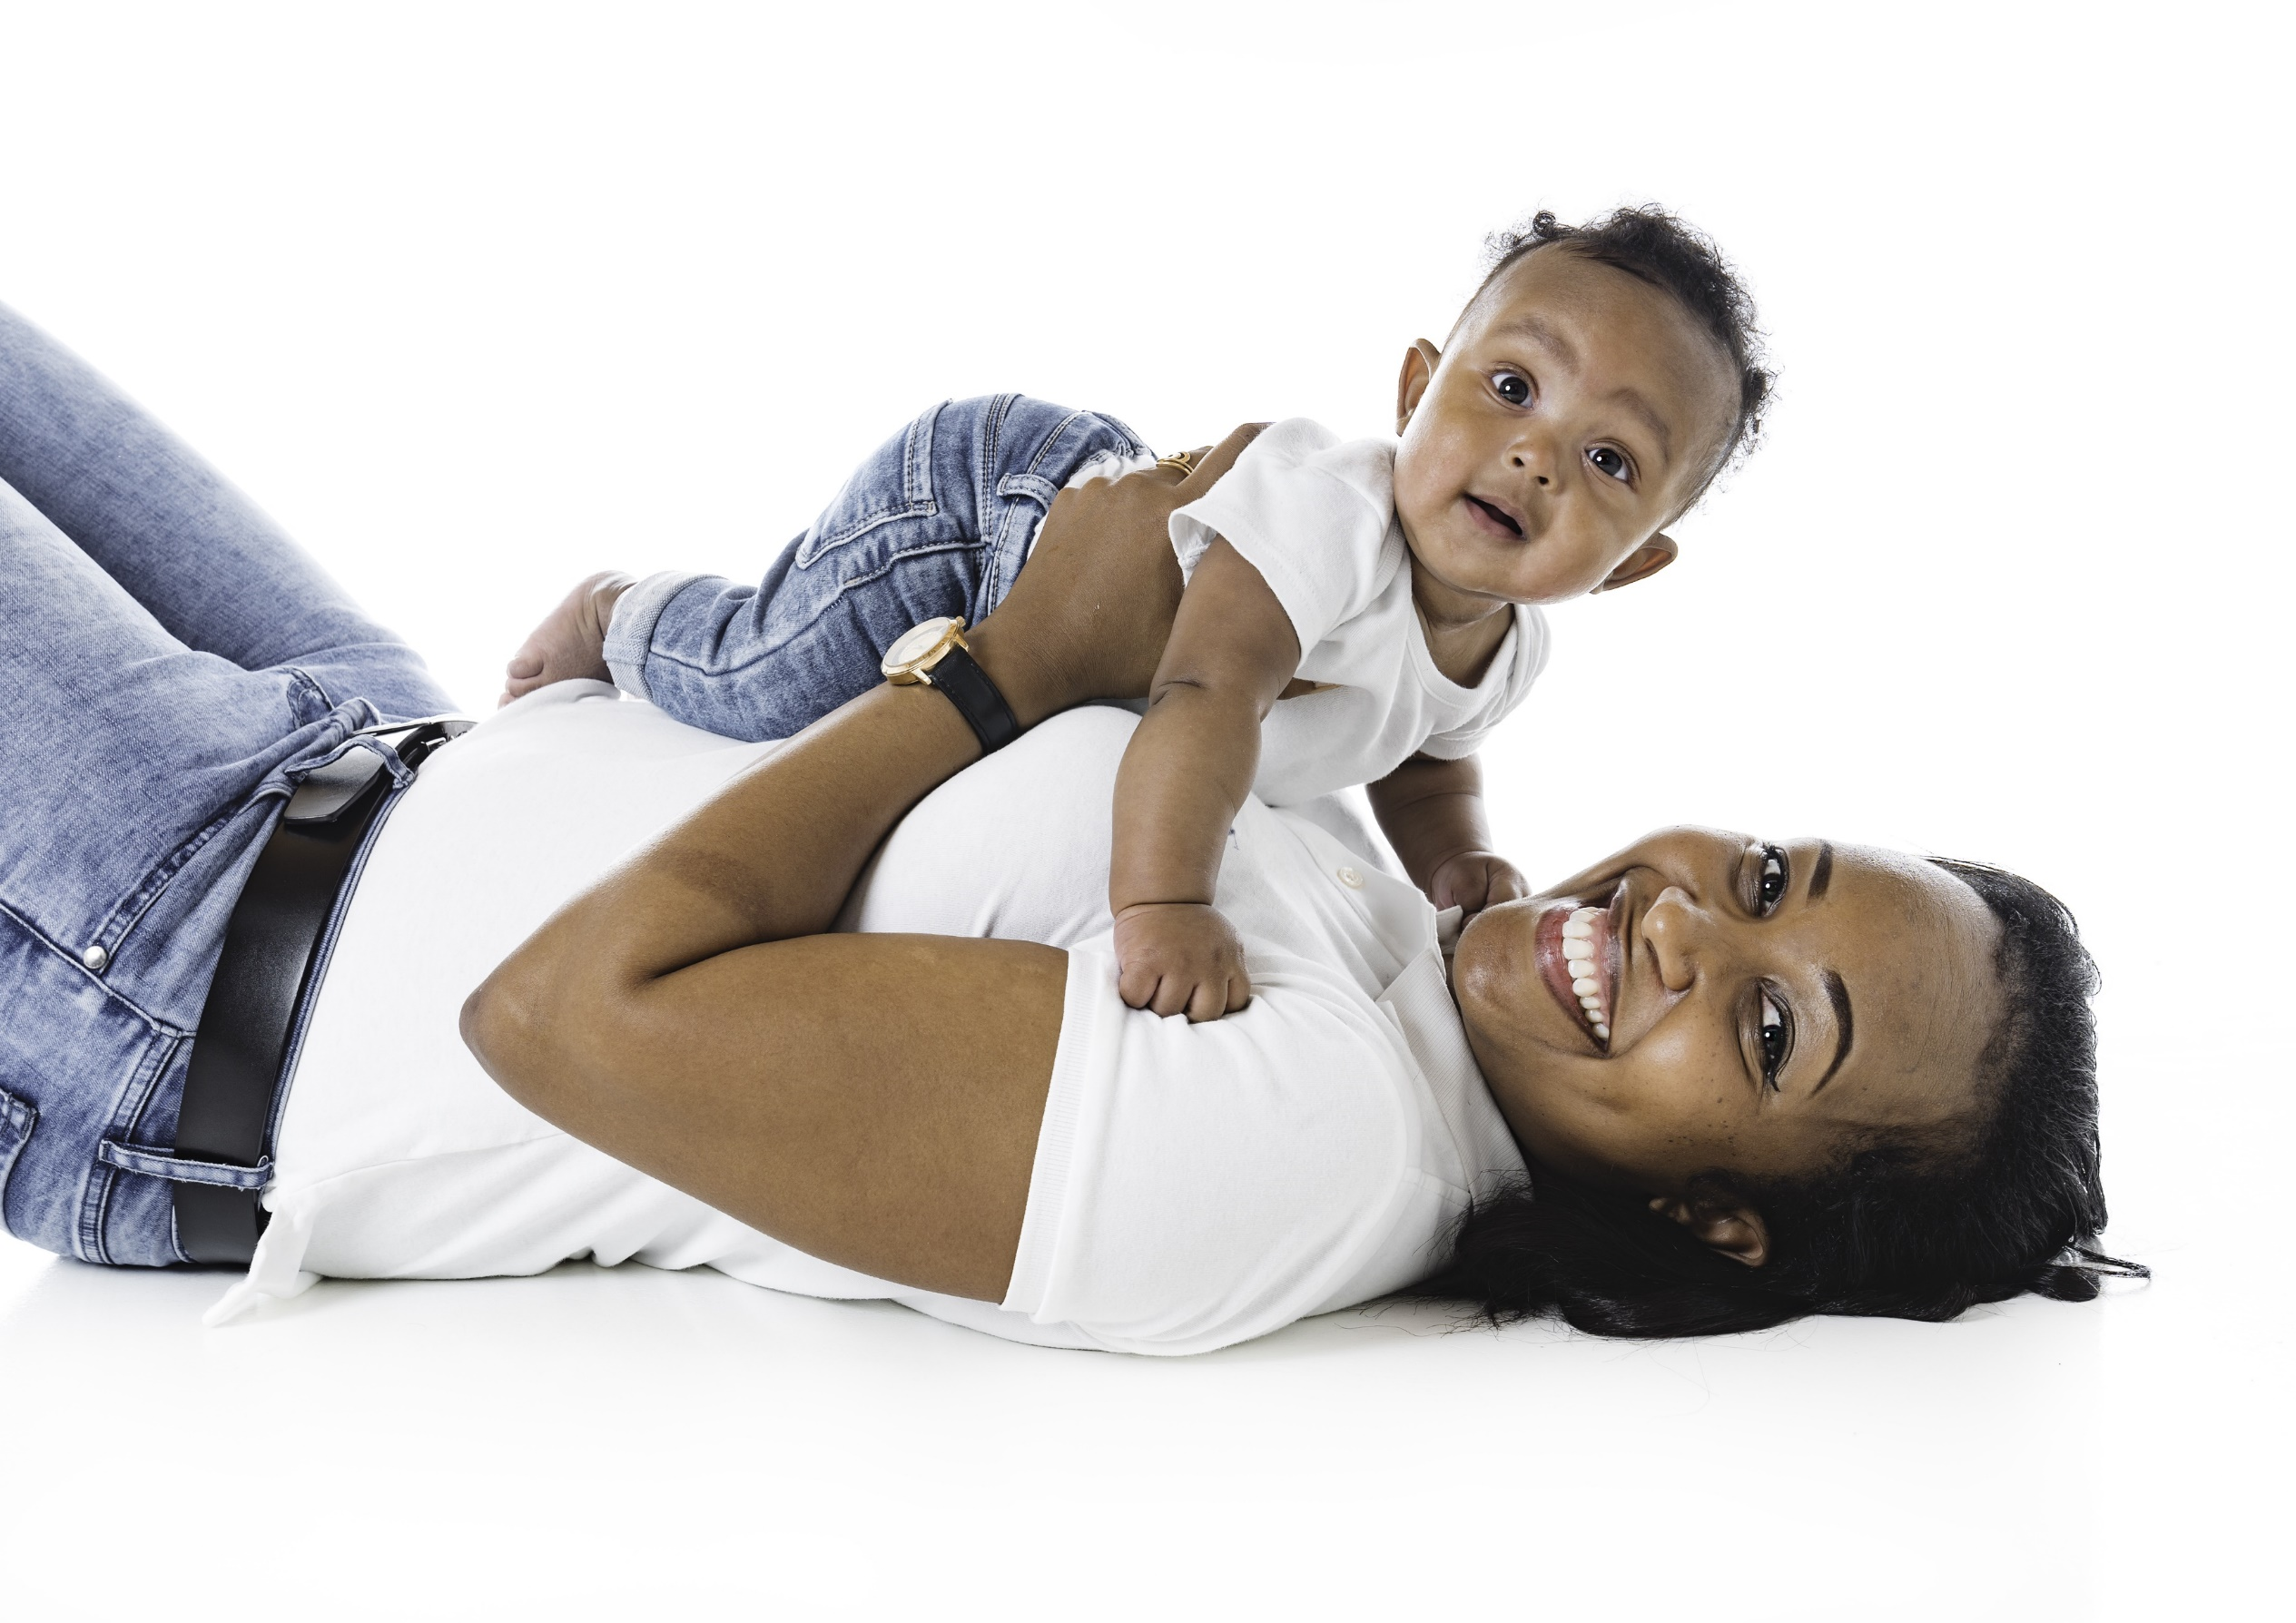
Mother’s Day 2023 Spending Projected To Be An All-Time High
Source: NRF's Annual 2023 Mother's Day Spending Survey.

Slide 5
Mother’s Day is the Largest Spending Event In the First Half of the Year
Source: NRF and Prosper Insights & Analytics 2022/2023 Seasonal Insights. Mother’s Day, Valentine’s Day and Easter updated for 2023.

Slide 6
84% of Americans Will Celebrate Mother’s Day
Percent That Plan To Celebrate Mother’s Day
Source: NRF's Annual 2023 Mother's Day Spending Survey.

Slide 7
Mothers Are The Top Recipients for Mother’s Day Gifts
Source: Retailmenot.com 2023 Mother’s Day Survey.

Slide 8
71% of Consumers Plan to Shop Within The 2 Weeks Prior To Mother’s Day
When do you usually purchase Mother's Day gifts for a mother?
Source: The Optimove 2023 Mother’s Day Consumer Summer Shopping Survey.

Slide 9
Online and Department Stores Are The Top Places To Shop for Mother’s Day
Source: NRF's Annual 2023 Mother's Day Spending Survey.

Slide 10
Walmart, Amazon and Target Are Top Shopping Destinations for Mother’s Day Gifts
Source: Retailmenot.com 2023 Mother’s Day Survey.

Slide 11
Mother's Day Top Gift Categories
Top 3 Gift Categories
(%)
Top 3 Gift Categories
By Spend (in billions)
Source: NRF and Prosper Insights & Analytics 2022/2023 Seasonal Insights.

Slide 12
TV Advertising Is Imperative To Influence Mother’s Day Shoppers

Slide 13
What Influenced Consumers Most: Television
% Influenced by media
Source: GfK TVB Purchase Funnel 2023 A18+
QA4/QA5/QA6/QA7/QA8 Most important for media with at least 1 funnel stage at 2%+ shown; 2%, 1%, & 0% not shown/labeled

Slide 14
Of Those that Cited TV as the Most Important in Awareness Phase, Two-Thirds Picked Broadcast TV
Source: GfK TVB Purchase Funnel 2023 A18+
QA4 “Thinking about the ads you saw/heard for the categories, which advertising media made you most aware of the category?”
How to read: Of the 49% who chose television, 66% chose broadcast TV

Slide 15
“Have TV ads influenced your search selections?”
Source: GfK TVB Purchase Funnel 2023; A18+, A18-34, A18-49, A25-54
QA10 “When doing an online search, how often, if at all, have TV ads you have seen influenced you in some ways in your search?” (Yes = combination of Every time, Most of the time & Sometimes) Among those who do online searches

Slide 16
TV Has Highest Reach of Platforms Broadcast Leads the Way
Source: GfK TVB Media Comparisons Study 2023. M-S 4A-2A. Persons 18+. Online/internet platforms such as email, social media, internet radio and websites, are totaled for any online device-PC, Smartphone and Tablets. Broadcast TV News Websites/Apps includes local TV station & network websites/apps for news/weather/sports.

Slide 17
People Spend the Most Time with Television
Source: GfK TVB Media Comparisons Study 2023. M-S 4A-2A. Persons 18+. Online/internet platforms such as email, social media, internet radio and websites, are totaled for any online device-PC, Smartphone and Tablets. Broadcast TV News Websites/Apps includes local TV station & network websites/apps for news/weather/sports.

Slide 18
Broadcast Delivers Top Rated Programs
Adults 18+ Live+1 Ratings
Source: Nielsen 3/28/2022-5/08/2022 Adults 18+ Live+1 Ratings; Broadcast Includes all Networks and Syndication.
10 Cable Networks based on A18+ Ratings.

Slide 19
Broadcast TV Dominated the Top-Rated Programs
Source: Nielsen NPower, 3/28/2022-5/08/2022, A18+ Live+1 Ratings. Broadcast Includes all Networks and Syndication.

Slide 20
Broadcast TV’s Reach: Significantly Higher Than Cable
Source: Nielsen NPower. April 25, 2022. Prime A18+ Live+1 Ratings.

Slide 21
Out of 5 choices, the top 4 were Broadcast Networks
If you could choose only five networks, which five would you choose?
Network “A”
Network “B”
Network “C”
Network “D”
Network “E”
BROADCAST NETWORK
CABLE NETWORK
Source: GfK TVB Media Comparisons Study 2023. QTV4 – “Now think about all the television networks you watch, either regularly or occasionally. If you could choose only five networks, which five would you choose?” Respondents were given 50 choices of Broadcast and Cable Networks with an option to write in a network.

Slide 22
Local TV Allows Advertisers to Target their Message in a Trusted Environment

Slide 23
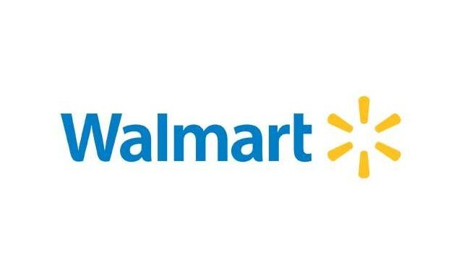
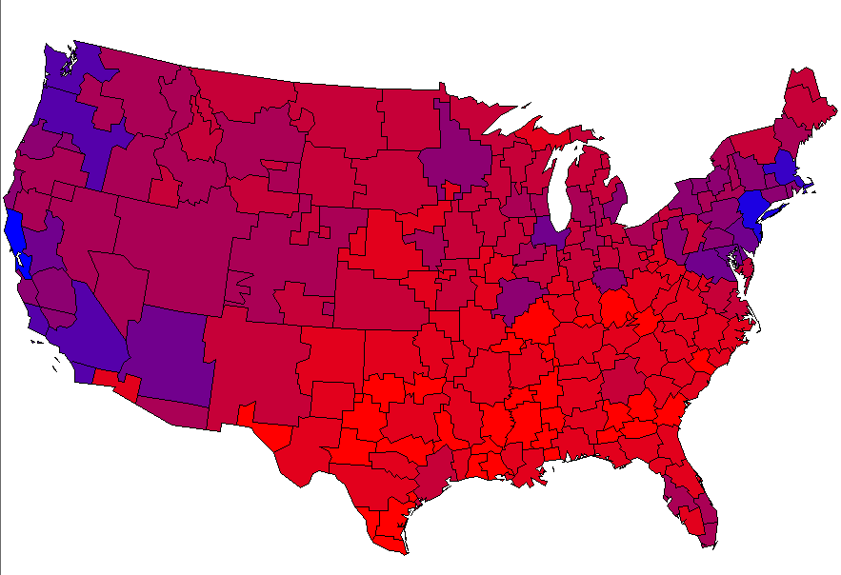
One Size Does NOT Fit All. Local TV Recognizes Each Market’s Uniqueness
The Redder the better- Higher the Sales Index
Source: MRI-Simmons 2022 Market-by-Market weighted by Adult 18+ population. Shopped in past 3 months.

Slide 24
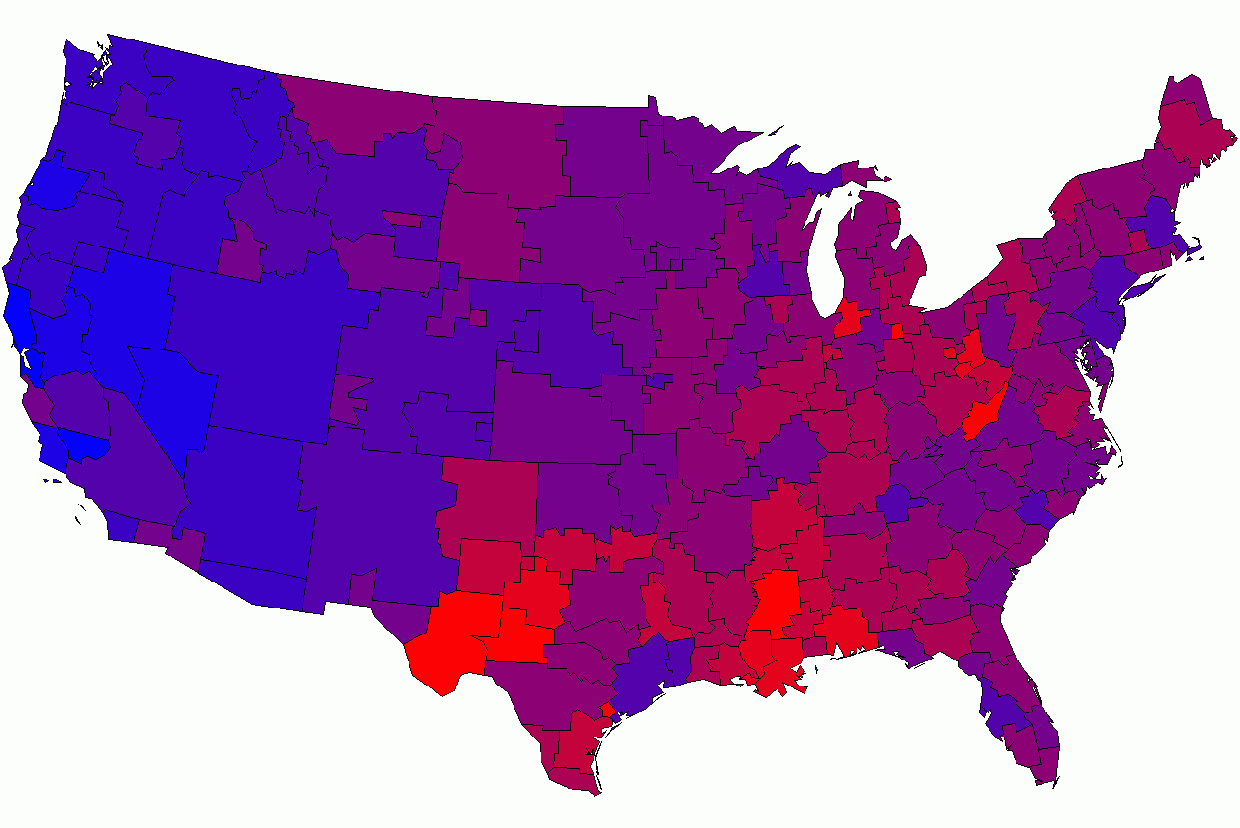
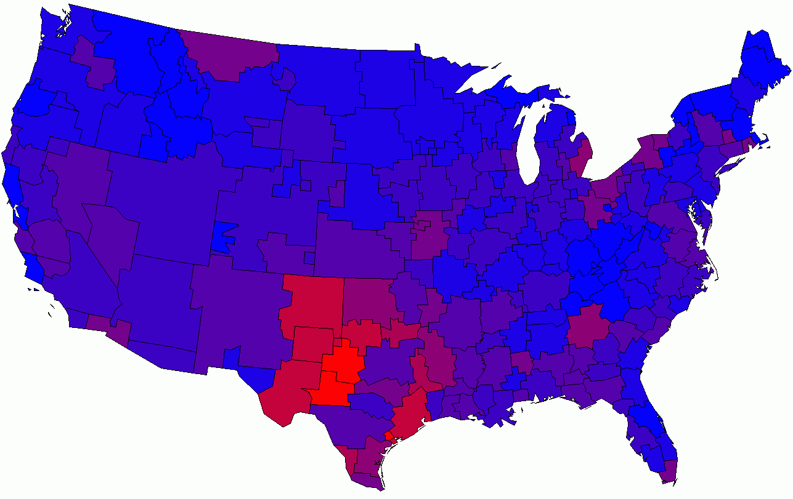
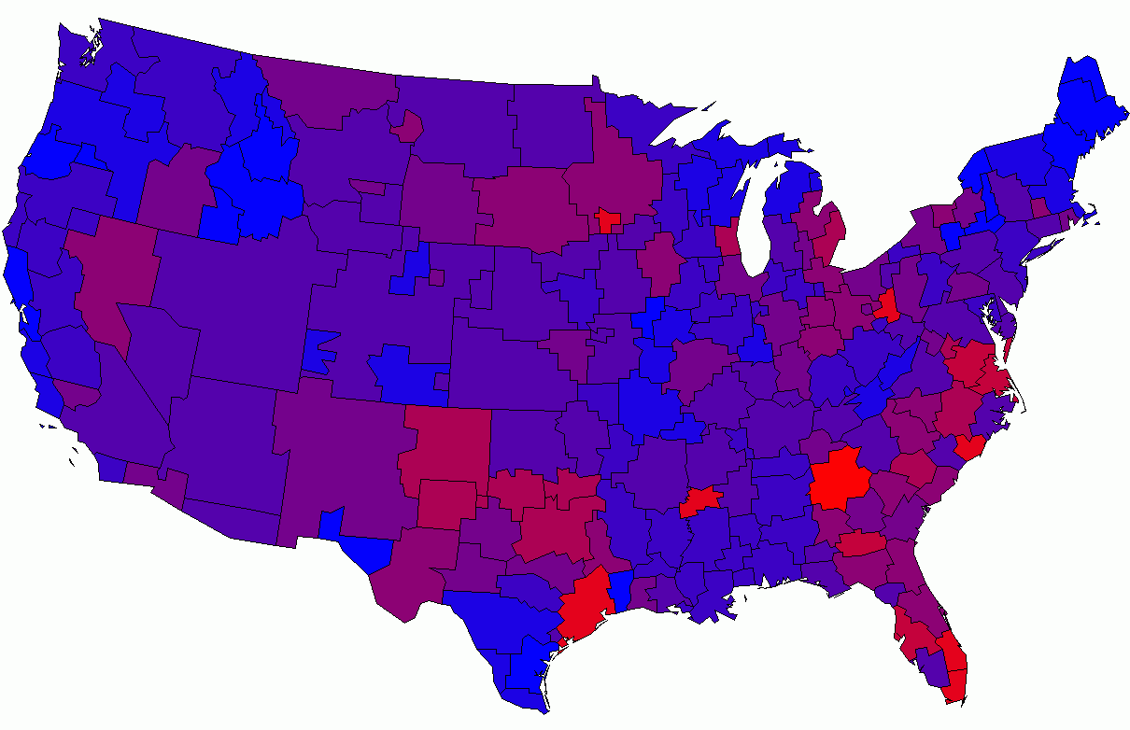
Jewelry Shopping is a Local Decision
The Redder the better
- High Index
Source: MRI-Simmons 2022 Market-by-Market weighted by Adult 18+ population. Purchased Fine Jewelry at Jared, Kay or Zales.

Slide 25
The Primary Source for News: Broadcast Television
Which of the following sources, if any, would you say is your primary source for news?
In-store retail
Source: GfK TVB Purchase Funnel 2023 In-store retail category A18+ B1 “Which of the following sources, if any, would you say is your primary source of news?” Percentages are rounded.

Slide 26
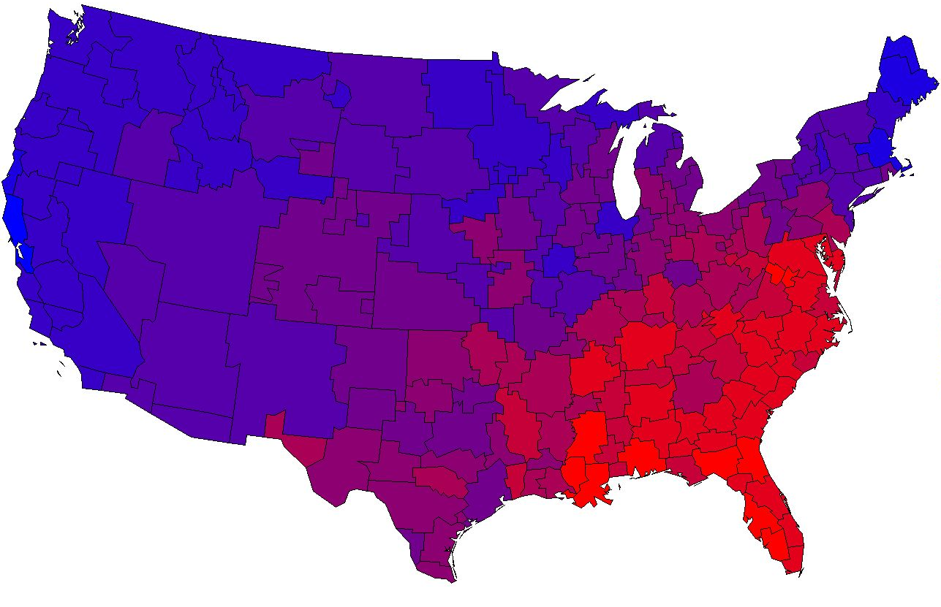
Target Adults Who Enjoy Dining Out With Local Broadcast
The Redder the better - High Index
Source: MRI-Simmons 2022 Market-by-Market weighted by Adult 18+ population. Bought at in the last 6 months: Chili's Grill & Bar, Olive Garden.

Slide 27
The Primary Source For News Among QSR/Casual Dining Patrons: Broadcast Television
Which one of the following sources, if any, would you say is your primary source for news?
A18+ QSR/Casual Dining Patrons
Source: GfK TVB Media Comparisons Study 2023. Persons 18+ Visited or ordered from a fast food/quick service or a casual dining restaurant in the past month. Includes only those who chose a media. QO5 - Which one of the following sources, if any, would you say is your primary source for news? Broadcast TV News & Broadcast TV News Websites/Apps include local TV station & broadcast network telecasts and websites/apps for news/weather/sports.

Slide 28
Local Broadcast Television News: #1 For Trust
I trust the News that I see/hear on this media source:
Percent Agree
Source: GfK TVB Media Comparisons Study 2023. Persons 18+. Agree Strongly or Agree Somewhat. QO9 - For each source, please indicate the extent to which you agree or disagree with the following statement: I trust the News that I see/hear on this media source.

Slide 29
However Consumers Shop, TV Advertising is Key

Slide 30
Retail Online = Online Only + Online & In-store Retail In-Store = In-Store Only + Online & In-store
Nearly 8 In 10 Retail Consumers Shopped Both In-Store & Online
In-store
Only
Online
Only
Online & In-store
14%
76%
10%
Online
90%
In-store
86%
Source: GfK TVB Purchase Funnel 2023 A18+: Retail CI-2: “Now, please think about the holiday season. Have you purchased, or do you plan to purchase from the following?”

Slide 31
82% of Consumers Shop In a Retail Store, 73% Shop Online At Least Once A Month
Source: GfK TVB Media Comparisons Study 2023. QC5B/ QC6B - How often, if at all, do you shop in a retail store/online?

Slide 32
Television is The Top Advertising Medium That Influences Purchase Decisions For In-Store Shoppers
% A18+ In-Store Shoppers
Advertising medium which you feel most influences you to make a purchase decision
Source: GfK TVB Media Comparisons Study 2023. Persons 18+ Have you recently or do you plan in the next month, to do any shopping in a retail store: Yes. Includes only those who chose a media. QO1 - Please select the one type of advertising medium which, you feel, most influences you to make a purchase decision? Broadcast TV News Websites/Apps includes local TV station & network websites/apps for news/weather/sports.

Slide 33
Television is The Top Advertising Medium That Influences Purchase Decisions For Online Shoppers
% A18+ Online Shoppers
Advertising medium which you feel most influences you to make a purchase decision
Source: GfK TVB Media Comparisons Study 2023. Persons 18+ Have you recently, or do you plan in the next month, to do any shopping online: Yes. Includes only those who chose a media. QO1 - Please select the one type of advertising medium which, you feel, most influences you to make a purchase decision? Broadcast TV News Websites/Apps includes local TV station & network websites/apps for news/weather/sports.

Slide 34
Have You Purchased, or Do you Plan To Purchase From the Following?
% A18+
YES
Source: GfK TVB Purchase Funnel 2023 A18+
C-3: “Now, please think about the holiday season. Have you purchased, or do you plan to purchase from the following?”

Slide 35
Are You Currently, Or Planning to Do More, Less, or The Same?
Same or more
74%
79%
Source: GfK TVB Purchase Funnel 2023 In-store retail category, A18+ CI-1: “For each of the following, are you currently or planning to do more, less or the same compared to what you did a year ago?” Among those for whom the questions were applicable.

Slide 36
What Influenced Consumers Most For Online Retail: Awareness
% A18+ Online Retail
Source: GfK TVB Purchase Funnel 2023 Online retail Category; QA4 Most important for media with at least 1 funnel stage at 2%+ shown; 2%, 1%, & 0% not shown/labeled

Slide 37
Of Those that Cited TV as the Most Important in Awareness Phase, 7 out of 10 Picked Broadcast TV
Source: GfK TVB Purchase Funnel 2023 In-store & Online retail category A18+
QA4 “Thinking about the ads you saw/heard for the categories, which advertising media made you most aware of the category?”
How to read: Of those who chose television as most important for awareness, 68% chose broadcast TV.

Slide 38
“Have TV ads influenced your search selections?”
Source: GfK TVB Purchase Funnel 2023 In-store/online retail category A18+ QA10 “When doing an online search, how often, if at all, have TV ads you have seen influenced you in some ways in your search?” (Yes = combination of Every time, Most of the time & Sometimes)

Slide 39
Regardless of Physical Retail Methods, Shoppers Highly Trust Local TV Assets
Source: GfK TVB Purchase Funnel 2023 In-store retail category, A18+ B2 “I trust the news I see/hear on this media source” (Agree Strongly + Agree Somewhat)

Slide 40
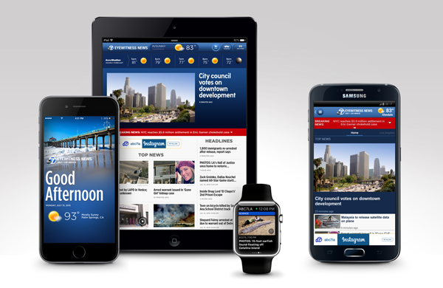
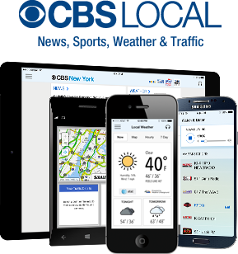
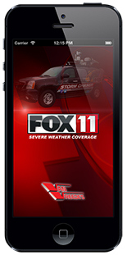
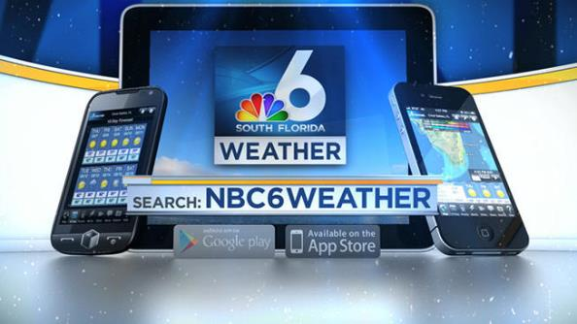
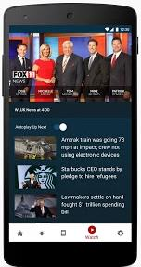
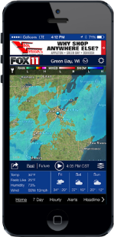
Broadcast TV Websites/Apps Provide Multi-platform Opportunities

Slide 41
Broadcast Websites Added More Reach to Broadcast TV than Cable or Streaming For In-Store Shoppers
A18+ In-Store Shoppers
_{0.7%}
_{Reach}
_{Added}
_{5.7%}
_{Reach}
_{Added}
_{2.5%}
_{Reach}
_{Added}
_{3.3%}
_{Reach}
_{Added}
Source: GfK TVB Media Comparisons Study 2023. M-S 4A-2A. Persons 18+ Have you recently or do you plan in the next month, to do any shopping in a retail store: Yes.

Slide 42
Broadcast Websites Added More Reach to Broadcast TV than Cable or Streaming For Online Shoppers
A18+ Online Shoppers
_{0.7%}
_{Reach}
_{Added}
_{6.0%}
_{Reach}
_{Added}
_{2.9%}
_{Reach}
_{Added}
_{3.8%}
_{Reach}
_{Added}
Source: GfK TVB Media Comparisons Study 2023. M-S 4A-2A. Persons 18+ Have you recently, or do you plan in the next month, to do any shopping online: Yes.

Slide 43
Broadcast TV Assets Can Reach Those Who Stream Programming on Ad-Free Platforms

Slide 44
Streaming with NO Advertising: Advertisers Cannot Reach these Viewers
But Broadcast Assets Can Reach Most of Them
Source: GfK TVB Media Comparisons Study 2023. M-S 4A-2A. Persons 18+ In-Store Shoppers.

Slide 45
Streaming with NO Advertising: Advertisers Cannot Reach these Viewers
But Broadcast Assets Can Reach Most of Them
Source: GfK TVB Media Comparisons Study 2023. M-S 4A-2A. Persons 18+ Online Shoppers.

Slide 46
Key Mother’s Day Takeaways
Mother’s Day spending is projected to be at an all-time high in 2023.
Mother’s Day is the top spending event in the first half of the year.
TV advertising is imperative to influence Mother’s Day shoppers.
9 out of 10 respondents said television influenced their search selections.
Broadcast TV delivers top Mother’s Day ratings and reach.
Local TV allows advertisers to target their message in a trusted environment.
Broadcast TV delivers both in-store and online shoppers.
Online shoppers and in-store shoppers selected television as the most important influence.
Broadcast TV assets can reach those who stream programming on ad-free platforms.

Slide 47
Thank You

