Slide 2
Contents
Back-to-Class 2023 Marketing Data/Projections (Slides 3-19)
TV Advertising Is Imperative To Influence Back-To-Class Shoppers (Slides 20-29)
Local TV Allows Advertisers to Target their Message in a Trusted Environment (Slides 30-37)
However Consumers Shop, TV Advertising is Key (Slides 38-57)

Slide 3
Back-to-Class 2023 Marketing Data/Projections

Slide 4
There Is A Mix of Education Levels in Households with Students
Source: KPMG Consumer Pulse Survey, fielded June 6, 2023–June 13, 2023. “How many children under the age of 18 live in your household?”, “For the upcoming school year (2023-2024), how many of the children (under 18) in your household will be in each of the following academic age groups?”, “How many people in your household are currently enrolled in or starting college this upcoming school year (2023-2024)?”

Slide 5
Back-To-School

Slide 6
Back-to-School Spending Is Expected to Be A Record High In 2023
Source: NRF's Annual 2023 Back-to-School Spending Survey, conducted by Prosper Insights & Analytics.

Slide 7
Per Household Spending Is Expected to Reach An All-Time High In 2023
Source: NRF's Annual 2023 Back-to-School Spending Survey, conducted by Prosper Insights & Analytics.

Slide 8
52% of Back-to-School Shoppers Plan To Spend More Per Child
17% expect to spend less
52% expect to spend more
Source: KPMG Consumer Pulse Survey, fielded June 6, 2023–June 13, 2023. “On average, how much did you spend on back-to-school supplies per child in each of the following academic age groups last year (2022)?, On average, how much do you plan on spending on back-to-school supplies per child in each of the following academic age groups this year (2023)? Please include apparel/uniforms spend.”, “Why do you plan to spend less per child?”, “Why do you plan to spend more per child?”

Slide 9
Most Back-to-School Shopping Happens Late July and Early August
Source: LTK 2023 Back-to-School Shopper Study.

Slide 10
83% of Shoppers Expect to See Higher Prices when Back-to-School and Back-to-College Shopping this Year
Source: NRF's Annual 2023 Back-to-School Spending Survey, conducted by Prosper Insights & Analytics.

Slide 11
Back-to-School Shoppers are Implementing Saving-Focused Shopping Behaviors
Source: NRF's Annual 2023 Back-to-School Spending Survey, conducted by Prosper Insights & Analytics.

Slide 12
BTS Shoppers Are Concerned With Inflation, 70% of Whom Will Look Out For Early Discounts To Mitigate Rising Prices.
Levels of Concern with Rising Prices and Actions to Tackle Inflation
Source: KPMG Consumer Pulse Survey, fielded June 6, 2023–June 13, 2023. On a scale of 1 to 5, how concerned are you with inflationary pricing for back-to-school supplies?”; ”You mentioned you are concerned with inflationary pricing, what actions will you take because of these concerns?”

Slide 13
Back-to-School Households Spend The Most Money On Electronics
Source: NRF's Annual 2023 Back-to-College Spending Survey, conducted by Prosper Insights & Analytics.

Slide 14
Smartphones, Headphones, and Laptops are The Top Electronics Being Purchased For Children
Source: CivicScience Back-to-School Shoppers Get Head Start Amid Inflation Concerns and Learning Loss. Adults 18+.

Slide 15
Back-To-College

Slide 16
Back-to-College Spending Is Expected to Reach An All Time-High In 2023
Source: NRF's Annual 2023 Back-to-School Spending Survey, conducted by Prosper Insights & Analytics.

Slide 17
Per Household Spending For Back-To-College Is Expected to Be Record High In 2023
Source: NRF's Annual 2023 Back-to-School Spending Survey, conducted by Prosper Insights & Analytics.

Slide 18
50% of Back-to-College Shoppers Plan To Spend More Per Student
22% expect to spend less
50% expect to spend more
Source: KPMG Consumer Pulse Survey, fielded June 6, 2023–June 13, 2023. “You indicated that you have at least one college student in your household. On average, how much did you spend on back-to-school supplies per college student last year (2022)?, On average, how much do you plan on spending on back-to-school supplies per college student this year (2023)? Please include apparel/uniforms, footwear and dorm furnishings.”, “Why do you plan to spend less per college student?”, “Why do you plan to spend more per college student?”

Slide 19
The Top Categories for Back-to-College Shopping are…
Source: NRF's Annual 2023 Back-to-College Spending Survey, conducted by Prosper Insights & Analytics.

Slide 20
TV Advertising Is Imperative To Influence Back-To-Class Shoppers

Slide 21
What Influenced Consumers Most: Television
% Influenced by media
Source: GfK TVB Purchase Funnel 2023 A18+
QA4/QA5/QA6/QA7/QA8 Most important for media with at least 1 funnel stage at 2%+ shown; 2%, 1%, & 0% not shown/labeled

Slide 22
Of Those that Cited TV as the Most Important in Awareness Phase, Two-Thirds Picked Broadcast TV
Source: GfK TVB Purchase Funnel 2023 A18+
QA4 “Thinking about the ads you saw/heard for the categories, which advertising media made you most aware of the category?”
How to read: Of the 49% who chose television, 66% chose broadcast TV

Slide 23
TV Has Highest Reach of Platforms Broadcast Leads the Way
Source: GfK TVB Media Comparisons Study 2023. M-S 4A-2A. Persons 18+. Online/internet platforms such as email, social media, internet radio and websites, are totaled for any online device-PC, Smartphone and Tablets. Broadcast TV News Websites/Apps includes local TV station & network websites/apps for news/weather/sports.

Slide 24
People Spend the Most Time with Television
Source: GfK TVB Media Comparisons Study 2023. M-S 4A-2A. Persons 18+. Online/internet platforms such as email, social media, internet radio and websites, are totaled for any online device-PC, Smartphone and Tablets. Broadcast TV News Websites/Apps includes local TV station & network websites/apps for news/weather/sports.

Slide 25
Out of 5 choices, the top 4 were Broadcast Networks
If you could choose only five networks, which five would you choose?
Network “A”
Network “B”
Network “C”
Network “D”
Network “E”
BROADCAST NETWORK
CABLE NETWORK
Source: GfK TVB Media Comparisons Study 2023. QTV4 – “Now think about all the television networks you watch, either regularly or occasionally. If you could choose only five networks, which five would you choose?” Respondents were given 50 choices of Broadcast and Cable Networks with an option to write in a network.

Slide 26
Broadcast Programs During the Summer Far Outstrip Even Cable Originals
To be read: Fox News Channel’s “Jesse Watters Primetime" had a 0.84 average A18+ rating in June 2023.
During the same time period, there were 162 Broadcast & Syndication programs that had higher average ratings.
Source: Nielsen NPower 05/29/2023-06/25/2023. Adults 18+. Live+1 Ratings.

Slide 27
Broadcast TV: Tops in Summer Ratings
# Of Top-Rated Programs
Moms
Adults 18-24
Broadcast delivered 47 of the top 50 programs for Moms
and 42 of the top 50 for A18-24
Source: Nielsen NPower 5/29/23-6/25/23. Broadcast (Includes Syndication) & Cable Live+1 Ratings. Moms= Women 18+ w/ children <18.

Slide 28
For Moms and A18-24, Television Ads Are Motivation To Do Further Research Online
Has an advertisement on television motivated you to go the Internet to find out more information about that product or service?
Source: GfK TVB Media Comparisons Study 2023. Women 18+ parent/legal guardian of children 0 -17 in HH. A18-24. Q3 - Has an advertisement on television motivated you to go the Internet to find out more information about that product or service?

Slide 29
“Have TV ads influenced your search selections?”
% Moms
% A18-24
Source: GfK TVB Purchase Funnel 2023 Moms (Women 18+ parent/legal guardian). A18-24 (n=860)
QA10 “When doing an online search, how often, if at all, have TV ads you have seen influenced you in some ways in your search?” (Yes = combination of Every time, Most of the time & Sometimes) Among those who do online searches

Slide 30
Local TV Allows Advertisers to Target their Message in a Trusted Environment

Slide 31
School Start Dates Vary from City to City
Top 50 DMAs: 20 Different Start Dates
Seattle
9/6
Portland
8/29
Minneapolis
9/5
Detroit
8/28
Boston 9/7
Milwaukee
9/5
Philly
9/5
Harrisburg
8/28
Grand Rapids
8/22
Cleveland
8/21
Hartford
8/29
Chicago
8/21
Pittsburgh
8/28
NYC 9/7
Sacramento 8/31
Columbus
8/23
San Fran
8/16
Salt Lake City
8/30
Indianapolis
7/31
Baltimore
8/28
Denver
8/21
Cincinnati
8/17
DC
8/28
Kansas City
8/21
St. Louis
8/21
Louisville
8/16
Raleigh
8/28
Norfolk
8/28
Las Vegas 8/7
LA 8/14
Nashville
8/8
Charlotte
8/28
Greensboro
9/5
Phoenix
8/2
OK City
8/10
San Diego
8/21
Albuquerque
8/3
Atlanta
8/1
Greenville
8/21
Birmingham
8/7
Dallas
8/14
New Orleans
8/7
Jacksonville
8/14
Late July/August
Austin
8/14
Orlando
8/18
Houston
8/28
Tampa
8/10
San Antonio 8/15
West Palm Beach
8/10
September
Miami
8/17
All dates & methods of reopening are subject to change. Updated 7/6/2023.

Slide 32
Start Advertising When it’s Right for Your Market with Spot TV
Lead By a month
Earliest Start Date
Latest Start Date
7/1
7/31
9/7
National Media
No Geographic Flexibility
Local Broadcast
Boston
Portland
Dallas
Indianapolis

Slide 33
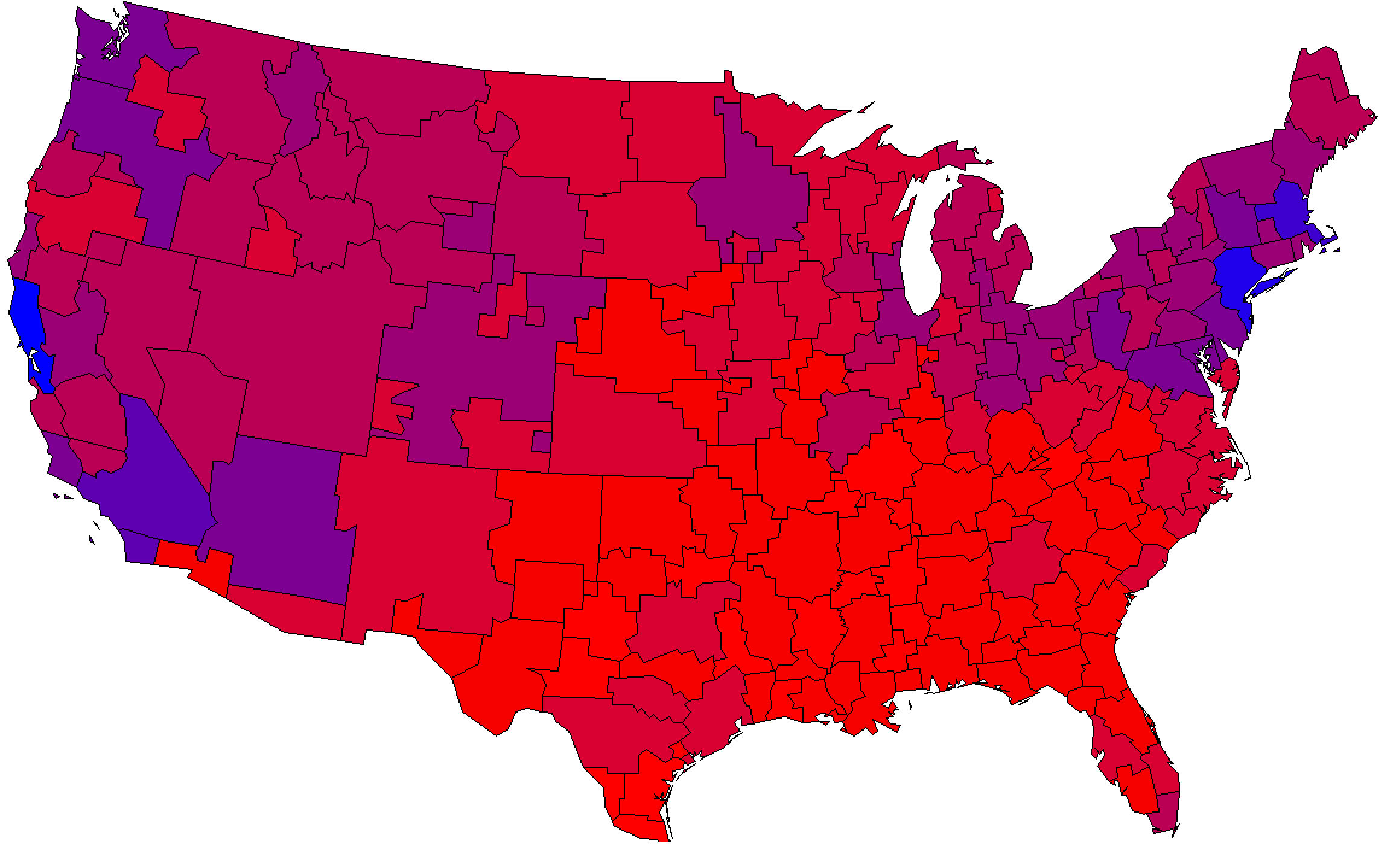
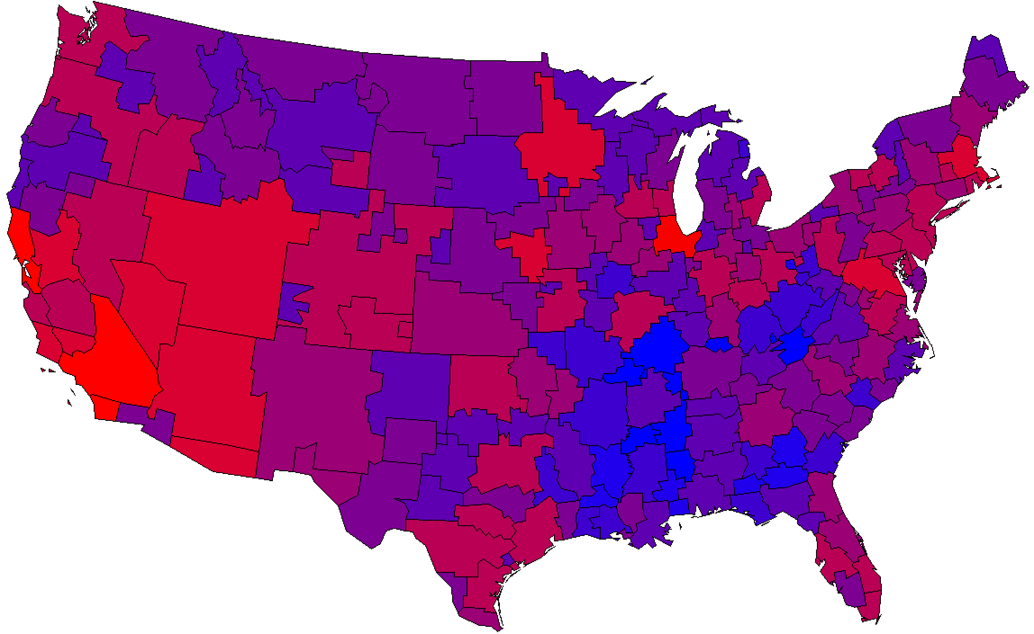
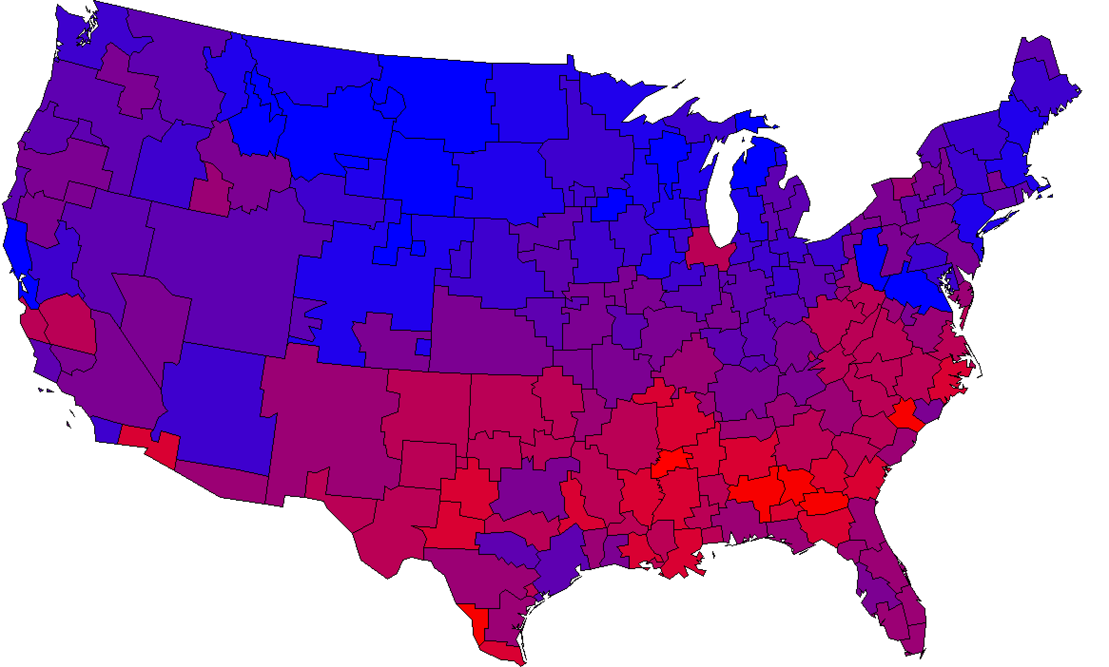
Cover Each Company’s Strong Markets with Local Broadcast
The Redder the better- High Index
Source: GfK MRI Fall 2022 Market-by-Market weighted by Adults 18+ w/children 0-17 years. Shopped at Target, Walmart or Dollar Tree in the last 3 Months.

Slide 34
The Primary Source For Local Traffic, Weather & Sports: Local Broadcast Television News
What source do you turn to first for information about local weather, traffic, or sports?
Source: GfK TVB Media Comparisons Study 2023. Persons 18+. Includes only those who chose a media. QO6 - What source do you turn to first for information about local weather, traffic, or sports? Streaming Radio & Podcasts were under 1% each.

Slide 35
Local Broadcast Television News: #1 For Trust
I trust the News that I see/hear on this media source:
Percent Agree
Source: GfK TVB Media Comparisons Study 2023. Persons 18+. Agree Strongly or Agree Somewhat. QO9 - For each source, please indicate the extent to which you agree or disagree with the following statement: I trust the News that I see/hear on this media source.

Slide 36
Local Television Websites/Apps Most Preferred
Which of the following websites or apps are you most likely to turn to
when you need information about local news or events?
% A18+
Source: GfK TVB Purchase Funnel 2023 A18+
C3 “Which of the following websites or apps are you most likely to turn to when you need information about local news or events?”

Slide 37
Local Broadcast Television News: Most Involved In Your Community
Which source of news do you feel is the most involved in your community?
Source: GfK TVB Media Comparisons Study 2023. Persons 18+. Includes only those who chose a media. QO8 - And, which source of news do you feel is the most involved in your community?

Slide 38
However Consumers Shop, TV Advertising is Key

Slide 39
When Shopping for Back-to-School, 55% Will Shop Online This Season
Source: NRF's Annual 2023 Back-to-School Spending Survey, conducted by Prosper Insights & Analytics

Slide 40
When Shopping for Back-to-College, 49% Will Shop Online This Season
Source: NRF's Annual 2023 Back-to-School Spending Survey, conducted by Prosper Insights & Analytics

Slide 41
Retail Online = Online Only + Online & In-store Retail In-Store = In-Store Only + Online & In-store
Nearly 8 In 10 Retail Consumers Shopped Both In-Store & Online
In-store
Only
Online
Only
Online & In-store
14%
76%
10%
Online
90%
In-store
86%
Source: GfK TVB Purchase Funnel 2023 A18+: Retail CI-2: “Now, please think about the holiday season. Have you purchased, or do you plan to purchase from the following?”

Slide 42
82% of Consumers Shop In a Retail Store, 73% Shop Online At Least Once A Month
Source: GfK TVB Media Comparisons Study 2023. QC5B/ QC6B - How often, if at all, do you shop in a retail store/online?

Slide 43
Television is The Top Advertising Medium That Influences Purchase Decisions For In-Store Shoppers
% A18+ In-Store Shoppers
Advertising medium which you feel most influences you to make a purchase decision
Source: GfK TVB Media Comparisons Study 2023. Persons 18+ Have you recently or do you plan in the next month, to do any shopping in a retail store: Yes. Includes only those who chose a media. QO1 - Please select the one type of advertising medium which, you feel, most influences you to make a purchase decision? Broadcast TV News Websites/Apps includes local TV station & network websites/apps for news/weather/sports.

Slide 44
Television is The Top Advertising Medium That Influences Purchase Decisions For Online Shoppers
% A18+ Online Shoppers
Advertising medium which you feel most influences you to make a purchase decision
Source: GfK TVB Media Comparisons Study 2023. Persons 18+ Have you recently, or do you plan in the next month, to do any shopping online: Yes. Includes only those who chose a media. QO1 - Please select the one type of advertising medium which, you feel, most influences you to make a purchase decision? Broadcast TV News Websites/Apps includes local TV station & network websites/apps for news/weather/sports.

Slide 45
Have You Purchased, or Do you Plan To Purchase From the Following?
% A18+
YES
Source: GfK TVB Purchase Funnel 2023 A18+
C-3: “Now, please think about the holiday season. Have you purchased, or do you plan to purchase from the following?”

Slide 46
Are You Currently, Or Planning to Do More, Less, or The Same?
Same or more
74%
79%
Source: GfK TVB Purchase Funnel 2023 In-store retail category, A18+ CI-1: “For each of the following, are you currently or planning to do more, less or the same compared to what you did a year ago?” Among those for whom the questions were applicable.

Slide 47
What Influenced Consumers Most For Online Retail: Awareness
% A18+ Online Retail
Source: GfK TVB Purchase Funnel 2023 Online retail Category; QA4 Most important for media with at least 1 funnel stage at 2%+ shown; 2%, 1%, & 0% not shown/labeled

Slide 48
What Influenced Consumers Most For In-Store Retail: Awareness
In-store Retail % A18+
Source: GfK TVB Purchase Funnel 2023 A18+ In-store retail category; QA4 “Thinking about the ads you saw/heard for the categories, which advertising media made you most aware of the category?” Most important for media with at least 1 funnel stage at 2%+ shown; 2%, 1%, & 0% not shown/labeled

Slide 49
Of Those that Cited TV as the Most Important in Awareness Phase, 7 out of 10 Picked Broadcast TV
Source: GfK TVB Purchase Funnel 2023 In-store & Online retail category A18+
QA4 “Thinking about the ads you saw/heard for the categories, which advertising media made you most aware of the category?”
How to read: Of those who chose television as most important for awareness, 68% chose broadcast TV.

Slide 50
“Have TV ads influenced your search selections?”
Source: GfK TVB Purchase Funnel 2023 In-store/online retail category A18+ QA10 “When doing an online search, how often, if at all, have TV ads you have seen influenced you in some ways in your search?” (Yes = combination of Every time, Most of the time & Sometimes)

Slide 51
Regardless of Physical Retail Methods, Shoppers Highly Trust Local TV Assets
Source: GfK TVB Purchase Funnel 2023 In-store retail category, A18+ B2 “I trust the news I see/hear on this media source” (Agree Strongly + Agree Somewhat)

Slide 52
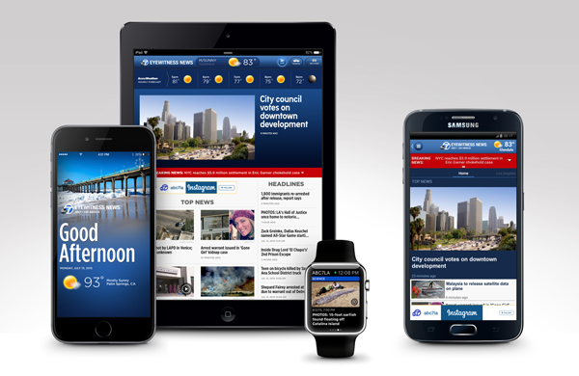
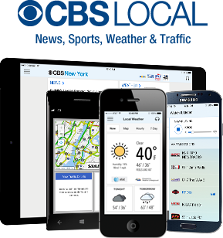
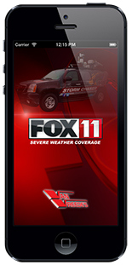
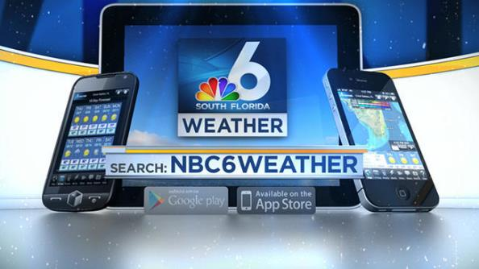
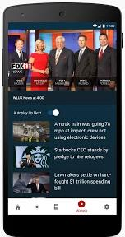
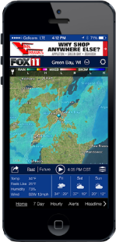
Broadcast TV Websites/Apps Provide Multi-platform Opportunities

Slide 53
Broadcast Websites Added More Reach to Broadcast TV than Cable or Streaming For In-Store Shoppers
A18+ In-Store Shoppers
_{0.7%}
_{Reach}
_{Added}
_{5.7%}
_{Reach}
_{Added}
_{2.5%}
_{Reach}
_{Added}
_{3.3%}
_{Reach}
_{Added}
Source: GfK TVB Media Comparisons Study 2023. M-S 4A-2A. Persons 18+ Have you recently or do you plan in the next month, to do any shopping in a retail store: Yes.

Slide 54
Broadcast Websites Added More Reach to Broadcast TV than Cable or Streaming For Online Shoppers
A18+ Online Shoppers
_{0.7%}
_{Reach}
_{Added}
_{6.0%}
_{Reach}
_{Added}
_{2.9%}
_{Reach}
_{Added}
_{3.8%}
_{Reach}
_{Added}
Source: GfK TVB Media Comparisons Study 2023. M-S 4A-2A. Persons 18+ Have you recently, or do you plan in the next month, to do any shopping online: Yes.

Slide 55
Broadcast TV Assets Can Reach Those Who Stream Programming on Ad-Free Platforms

Slide 56
Streaming with NO Advertising: Advertisers Cannot Reach these Viewers
But Broadcast Assets Can Reach Most of Them
Source: GfK TVB Media Comparisons Study 2023. M-S 4A-2A. Persons 18+ In-Store Shoppers.

Slide 57
Streaming with NO Advertising: Advertisers Cannot Reach these Viewers
But Broadcast Assets Can Reach Most of Them
Source: GfK TVB Media Comparisons Study 2023. M-S 4A-2A. Persons 18+ Online Shoppers.

Slide 58
Key Back-to-School Takeaways
Back-to-class spending is projected to be at an all-time high in 2023.
Parents are expected to spend more for back-to-school per child this year than last year.
Most back-to-school shopping happens in late July and early August.
TV advertising is imperative to influence back-to-class shoppers.
9 out of 10 respondents said television influenced their search selections.
Broadcast TV delivers top back-to-class ratings.
Local TV allows advertisers to target their message in a trusted environment.
Broadcast TV delivers both in-store and online shoppers.
Online shoppers and in-store shoppers selected television as the most important influence.
Broadcast TV assets can reach those who stream programming on ad-free platforms.

