Slide 1
SkillUp: Personal Finance

Slide 2
Thank you to our Underwriter
And our Supporting Partners
ABC Owned Television Stations, AdCellerant, BIA Advisory Services, Comscore, Cox Media Group, The E.W. Scripps Company, Graham Media Group, Gray Television, Hearst Television, Katz Television Group, Locality, Marathon Ventures, Morgan Murphy Media, NBCUniversal Local, Nielsen, Standard Media Group, Telemundo, Univision Television Group, Vivvix

Slide 3
SkillUp: Personal Finance
Barbara Leclerc Co-Chief Investment Officer, Senior Advisor
Bridgewater Advisors
Josefine Teneback Cays Partner, Senior Advisor
Bridgewater Advisors

Slide 4
7 ways to kickstart your financial journey
Josefine Teneback Cays, CFA, CFP® – Partner, senior advisor
Barbara Leclerc, CFA, CFP® – Co-chief investment officer, senior advisor

Slide 5
1. Learn about your employment benefits
Salary / bonus
Health coverage offered
Health Savings Plans (HSA)
Must be enrolled in a high-deductible healthcare plan (HDHP)
Receive a tax deduction today AND earnings could be tax-free if used for qualified medical expenses
Contribution limits (2023):
Single coverage: $3,850
Family coverage: $7,750
At age 55, individuals can contribute an additional $1,000
Dependent care benefits / dependent care flex spending accounts
Transportation benefits
Notes:
Change highlighted text to “if you have a high-deductible plan, fund a Health Savings Account to pay for medical expenses and get a tax deduction

Slide 6
1. Learn about your employment benefits
Life insurance
Lost income to a household can be detrimental
Disability insurance
If employer pays the premiums, benefits would be taxable
If employee pays the premiums, benefits would be non-taxable
Retirement plans (e.g. - 401(k), 403(b), etc…)
Check your beneficiaries
Notes:
Change highlighted text to “if you have a high-deductible plan, fund a Health Savings Account to pay for medical expenses and get a tax deduction

Slide 7
2. Take advantage of an employer match
What if someone could guarantee you a 50% return on your investment? Would you take it?
In an effort to encourage participation in the company retirement plans, such as a 401(k) or 403(b), many employers offer a match to your retirement contributions.
Notes:
Should we add a line about limitations on the match such as front loading the 401(k)

Slide 8
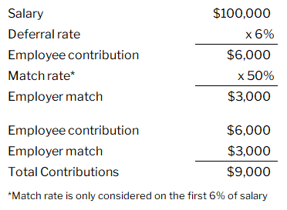
2. Take advantage of an employer match
What if someone could guarantee you a 50% return on your investment? Would you take it?
In an effort to encourage participation in the company retirement plans, such as a 401(k) or 403(b), many employers offer a match to your retirement contributions.
An Example:
Employer matches 50% of employee contributions, up to 6% of salary.
Employee wants to take full advantage of the match.
Notes:
Should we add a line about limitations on the match such as front loading the 401(k)

Slide 9
3. Understand the benefits of Roth contributions
Traditional:
Deposit pre-tax dollars today
Distributions are taxable
Roth:
Deposit after-tax dollars today
Distributions are tax-free
Must be age 59 ½
Must have been opened at least 5 years
Notes:
Look for a good graphic on this!! (Needs work on illustration) - might be a 5 minute slide

Slide 10
4. Establish an emergency fund for “rainy days”
What is an emergency?
Loss of employment?
Vacation to Hawaii?
Car repairs?
Celebratory dinner?
Intended to avoid borrowing and avoid selling investments
How much should it be?
3-6 months of living expenses
Where should I keep it?
Ideally a high-yield savings account
Rates as of 10/31/23:
Synchrony 4.75%
Vio Bank: 5.25%
Discover Bank: 4.30%
Bankrate.com provides updated information

Slide 11
5. Educate yourself on the markets
Three main asset classes:
Cash
Bonds
Stocks
Difference between a stock and a bond
Ownership vs lending
Risk vs return
How to compare markets
Benchmarks
10-year treasury
S&P 500
Return
Stocks
Bonds
Cash
Risk

Slide 12
Growth of $1 since 1926
$13,000
$98
$17

Slide 13
Einstein said it best
Notes:
Compounding requires “time”

Slide 14
The 5th grade challenge
Start with 1 penny and double your money daily for 30 days
OR
Take $100,000 today and walk away
Notes:
Compounding requires “time”

Slide 15
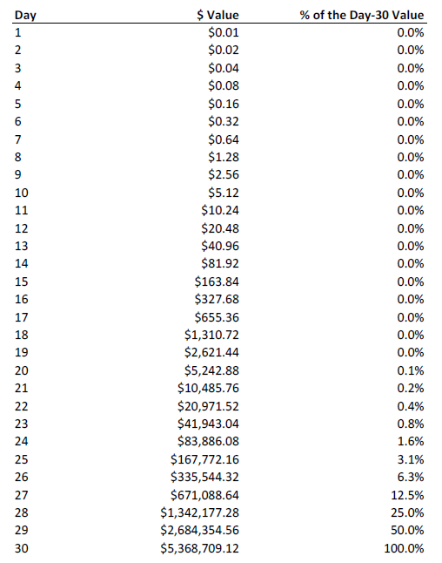
The 5th grade challenge
Start with 1 penny and double your money daily for 30 days
OR
Take $100,000 today and walk away
Notes:
Compounding requires “time”

Slide 16
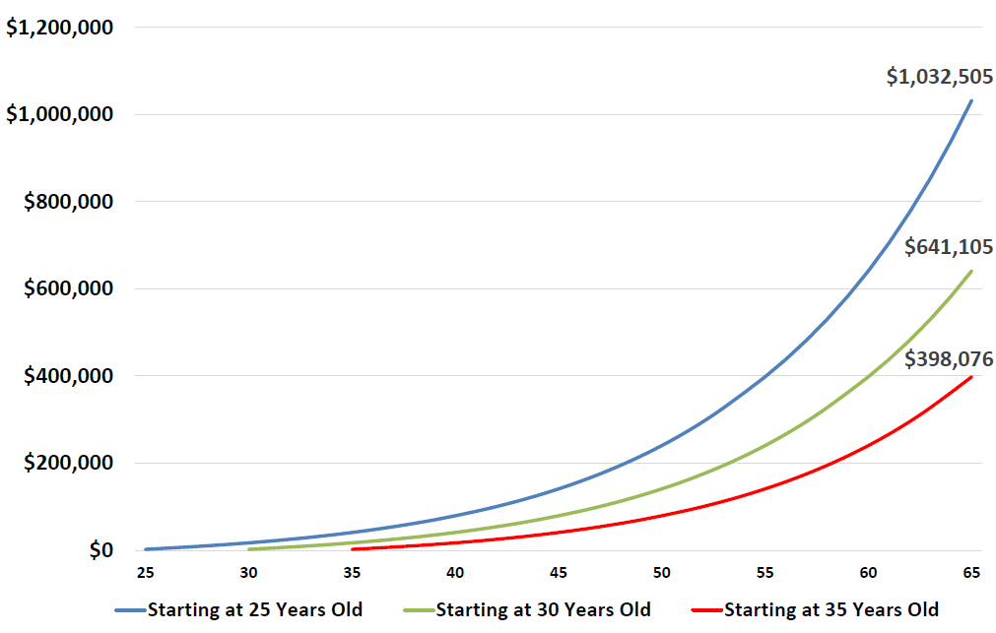
6. Start early - time is your most valuable asset!
Each person saves $2,000 each year for 30 years*
Each person saves a total of $60,000
The only difference is the age they begin saving

Slide 17
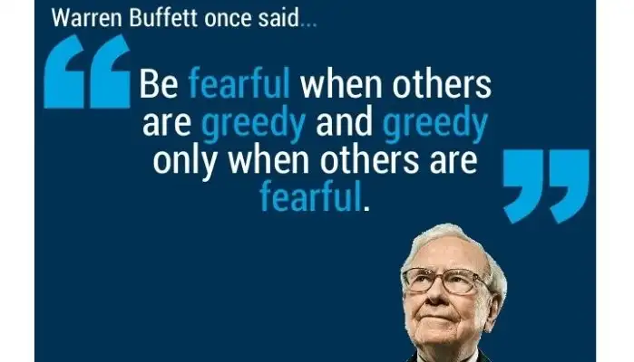
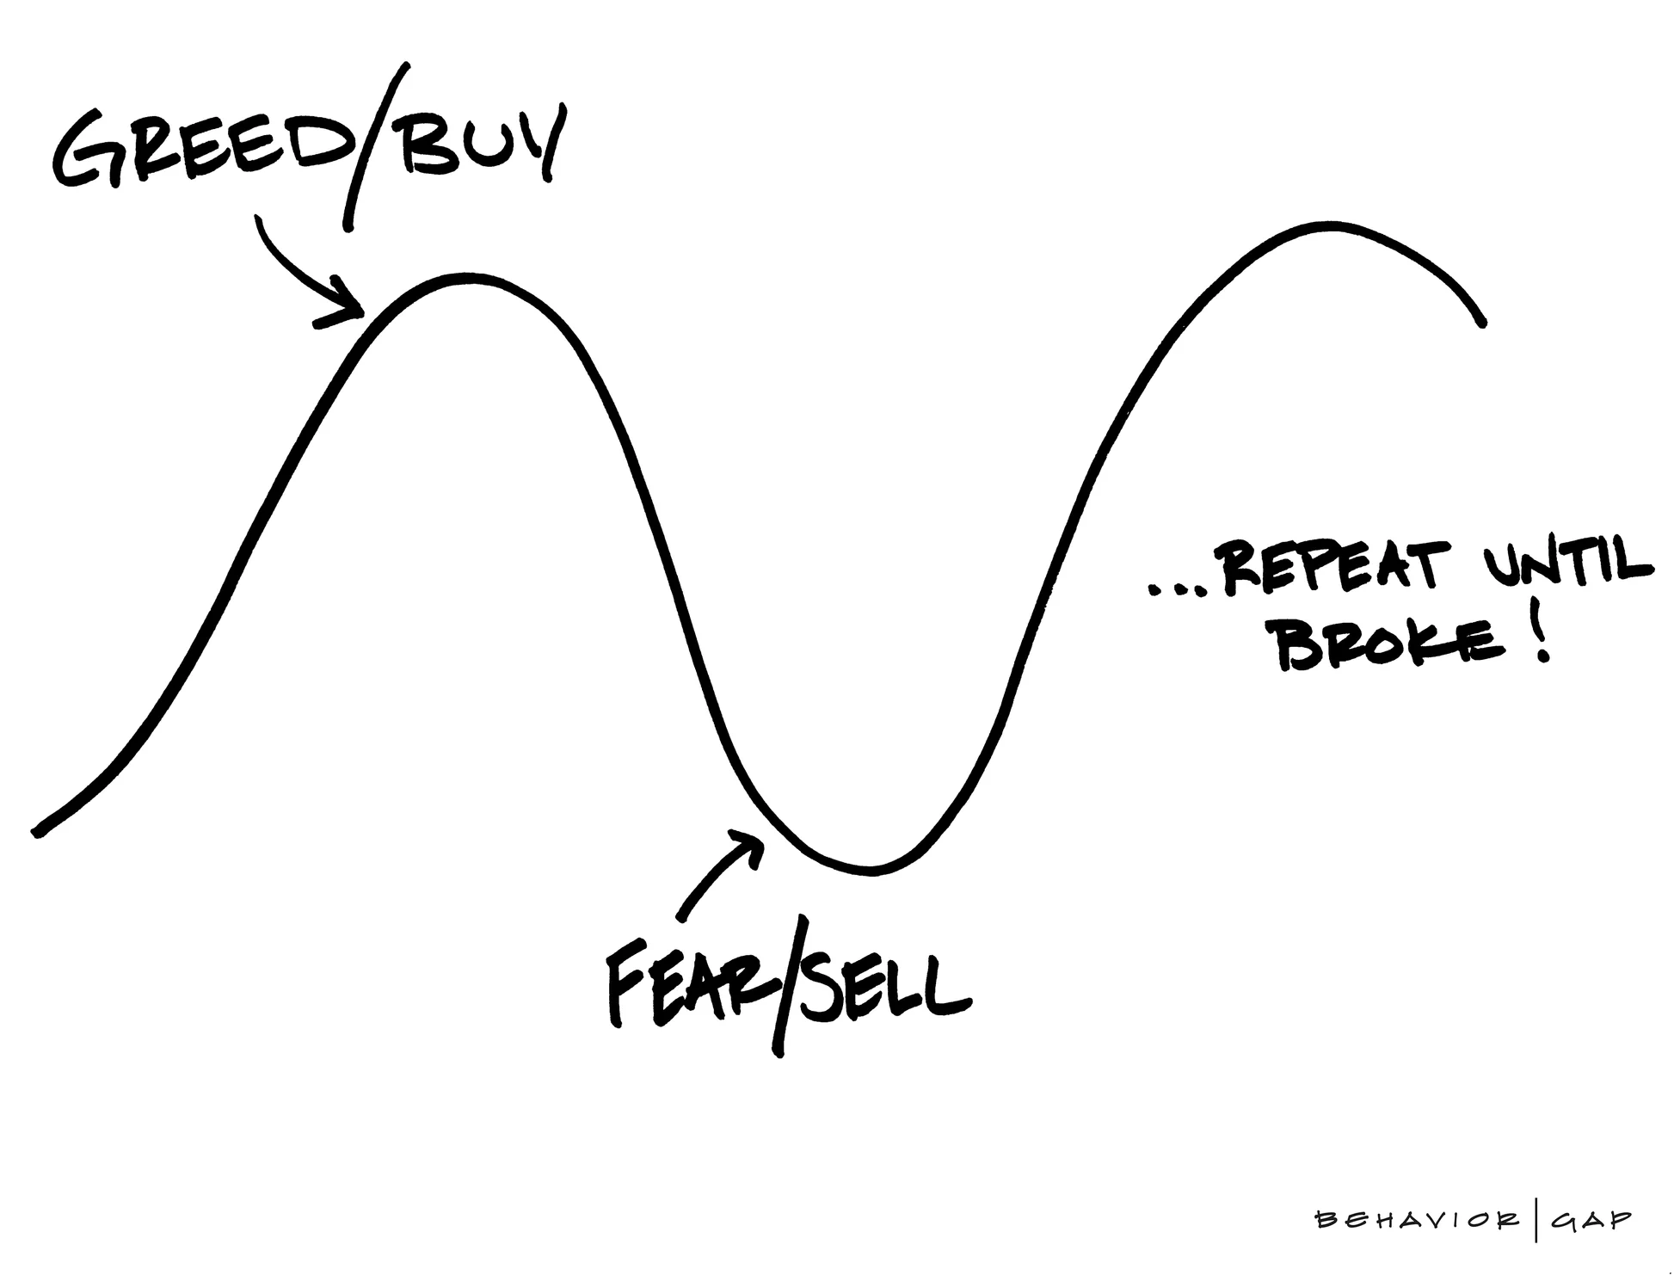
7. Recognize your emotions & behavior
Emotions can play a large role in your financial decisions and investment choices
Taking the emotions out of investing is important
Sticking with it - a disciplined approach
one way to take the emotion out of investing is by dollar cost averaging (e.g. - 401(k) contributions)
Notes:
“emotions aren’t your friend when you’re investing”

Slide 18
Where to start?
Get organized & track your progress
pick one topic a month to investigate
create a physical or electronic filing system
use spreadsheets to track information
utilize aggregators such as YNAB or Empower
understand your money coming in and going out
Ask for help
Utilize resources offered through work
Hourly financial planners
Project-based financial planners
Financial advisory firms
Look for credentials, education, and experience: CFP®
Utilize web searches focused on your local area
Notes:
Under “Get organized” - “pick one topic a month to investigate” “create a physical or electronic filing system for financial documents” “use spreadsheets to track information”
Under “Continue to educate” - “see list of useful websites at the end of the presentation”
Flesh out different types of investment managers? i.e. robo, mutual fund company reps, brokers? Separate advice-based from product-based?

Slide 19
Resources available
Financial advice searches:
National Association of Personal Financial Advisors (NAPFA) - napfa.org/
CERTIFIED FINANCIAL PLANNER™ website - cfp.net
Education sites for beginners
Investopedia - https://www.investopedia.com/
Napkin Finance - https://napkinfinance.com/
Life insurance calculator - https://www.bankrate.com/insurance/life-insurance/life-insurance-calculator/
Aggregation & budget sites
YNAB.com (You need a budget)
Empower.com
Monarchmoney.com
Bank rates & HSA resources
Bankrate.com
HSA bank
Fidelity HSA
Optum Bank

Slide 20
Thank you to our Underwriter
And our Supporting Partners
ABC Owned Television Stations, AdCellerant, BIA Advisory Services, Comscore, Cox Media Group, The E.W. Scripps Company, Graham Media Group, Gray Television, Hearst Television, Katz Television Group, Locality, Marathon Ventures, Morgan Murphy Media, NBCUniversal Local, Nielsen, Standard Media Group, Telemundo, Univision Television Group, Vivvix
Thank you for joining us!

