Slide 1
Automotive Update
Trisha Ripperger, SVP Strategic Communications & Category Development

Slide 2
April Sales Review
Updated 5/2
 | 2025 | 2024
Total Sales | 1,591,072 | 1,432,132
Retail Sales | 1,353,117 | 1,178,422
SAAR | 17.3 mil | 16.0 mil
Retail SAAR | 14.7 mil | 12.9 mil
% Change
+ 11.1%
+ 14.8%
+ 7.8%
+ 13.7 %

Slide 3
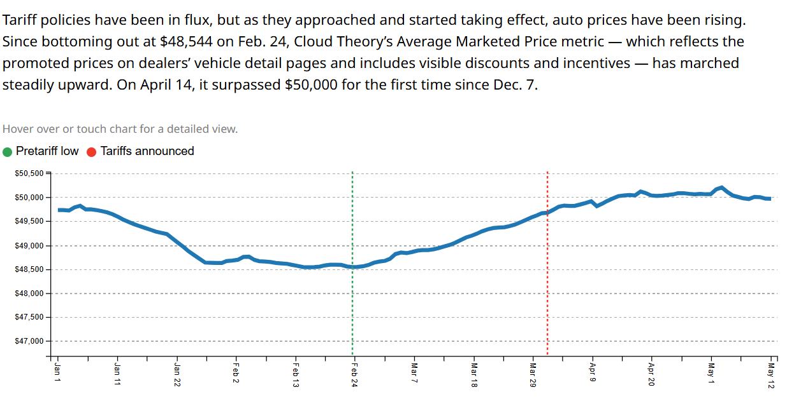
Average Marketed Price

Slide 4

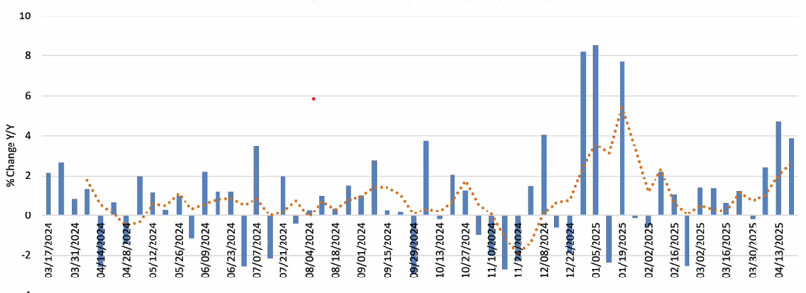
Consumer Spending Growth Accelerating in April

Slide 5
Key Takeaways
The new-vehicle sales pace declined slightly in April but remailed up substantially year over year as buyers were motivated to buy ahead of tariff-related increases to prices.
The used market also saw month-over-month declines but gains year over year. Used prices increased.
The Fed left interest rate policy unchanged as it waits to see evidence of inflation and labor market deterioration from tariffs.
Average transaction prices for new remain high at $48k+. All-Loans Index for April was 95.7% compared to 96.3% in March (Down slightly).

Slide 6
New Vehicle Market
The April SAAR decreased by 3.1% to 17.3 million, which was up 7.8% from last year’s 16.0 million but down from March’s 17.8 million.
April’s strength was driven by retail sales, with fleet sales showing weak gains.
The average transaction price of a new vehicle in April increased by 2.5% from March to $48,699, which was up 1.1% year over year.
The average price relative to the average manufacturer’s suggested retail price (MSRP) was steady at 96.1%, so discounting did not change.
The average MSRP also increased 2.5% month over month but was up 1.9% year over year.
Manufacturer incentives declined by 2.1% month over month to $3,278, which was up 6.7% year over year.

Slide 7
Used Vehicle Market
The used market also saw month-over-month declines but gains year over year. Used prices increased.
Retail sales volumes decreased by 1.7% in April compared to March, but they were up 13% year over year.
Certified pre-owned (CPO) sales declined by 7% month over month but were up 11.8% year over year.
Wholesale vehicle values increased by 2.7% in April on a seasonally adjusted basis, with the Manheim Used Vehicle Value Index rising to 208.2, which was up 4.9% from a year ago.
As of April 25, $265.7 billion in tax refunds had been issued, which was up 2% year over year, with the average refund being $2,945, up 3% year over year.

Slide 8
Federal Reserve & Interest Rates
The Fed left interest rate policy unchanged as it waits to see evidence of inflation and labor market deterioration from tariffs.
The Federal Reserve is focused on price stability and full employment, with its hands tied due to expected tariff-driven inflation.
While they wait to see evidence of inflation moving up, the labor market remains strong, even though labor market conditions are expected to deteriorate because of tariffs.
The path for rates is uncertain, and uncertainty doesn’t help consumers make plans for finance-sensitive purchases like vehicles.
The biggest change in auto loan rates over the last two months has been a direct response to tariffs, leading to tighter supply and higher prices in the new vehicle market.
Manufacturers have been spending less on attractive rate offers as a result. Since February, incentives are down; vehicle prices are up.
New auto loan rates increased by 10 basis points since February, just 26 basis points below a 25-year high reached last June.
Used auto loan rates declined by 64 basis points since February, averaging just over 14.1% last week.

Slide 9

Seven automakers report that monthly sales jumped 14% year over year, with Ford, Hyundai, Kia, Toyota, Honda and Mazda all posting solid gains.
Ford led the charge with 16% increase, boosted by continuing “Employee pricing” program.
  Truck sales were up 19 %, SUVs rose 13% and the compact Maverick pickup soarded 67% Lincoln sales spiked 40%]
Toyota posted a 10% gain, by tripling of Prius sales and strong results from the Sienna, Tacoma.
Lexus sales rose 23% & Honda was up 18% driven by a 33% jump at its Acura luxury brand.
Hyundai, which pledged not to raise prices through early June, reported at 19% sales increase. Kia followed with a 14% gain. General Motors, which reports quarterly, confirmed a 20% rise in April compared to last year.

Slide 10
Industry Analyst Perspectives
“Buyers pulled forward their purchases, fearing further cost increases tied to expanding tariffs on vehicles and parts. April results are dominated by the prospect of future vehicle price increases,” said J.D. Power’s Thomas King.
“The first phase of frenzy….seems to have already passed,” said Cox Automotive’s Jonathan Smoke,” warning that future months could see weaker sales.

