Slide 1


August Automotive Update
Trisha Ripperger, SVP Strategic Communications & Category Development

Slide 2

August Sales Review
 | 2025 | 2024
Total Sales | 1,454,685 | 1,412,345
Retail Sales | 1,253,793 | 1,223,560
SAAR | 16.1 mil | 15.1 mil
Retail SAAR | 13.7 mil | 13.1 mil
% Change
+3.0%
+2.5%
+6.2%
+4.8 %

Slide 3

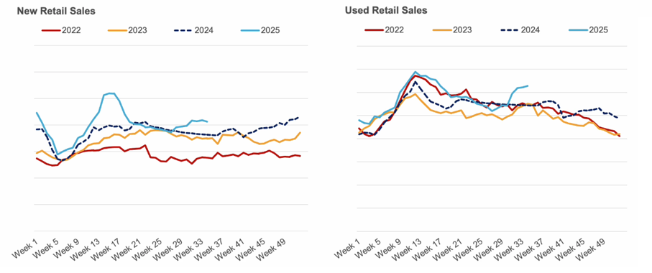
New Retail Sales Reached a Summer Peak in August
New sales dropped in the latest week, while used sales grew for the fourth week in a row

Slide 4
New Vehicle Sales
The average new-vehicle listing price at the end of August inched higher by 0.2% month over month to $48,697
As of early September, the total U.S. supply of unsold new vehicles stands at 2.76 million units, marking a 4.8% increase month over month, but still 3.9% below last year’s levels
This is likely the beginning of the steady climb towards higher prices, given the enormous cost pressure on automakers due to tariffs
We expect tailwinds in the industry from the rollback of EV penalties and sizeable benefits from the One Big Beautiful Bill Act for large businesses, it may be early 2026 before we see substantial increases
Days’ supply rose to 77, up 4.1% from August, but down 10% year over year, indicating that while inventory is growing, vehicles are moving off lots faster than they were a year ago

Slide 5
Used Vehicle Sales
The average used-vehicle listing price dropped to $25,393
Retail Used Vehicle sales were up in August
Used-vehicle inventory increased to 2.21 million units at the start of September
Used days’ supply dropped slightly to 43
Ford, Chevrolet, Toyota, Honda and Nissan were the top-selling brands, accounting for 50% of all used vehicles sold
The used market especially benefits from consumers seeking more affordable alternatives than those offered in the new car segment.
Sales continue to outperform recent years, with an 8% increase in August compared to the previous year.

Slide 6
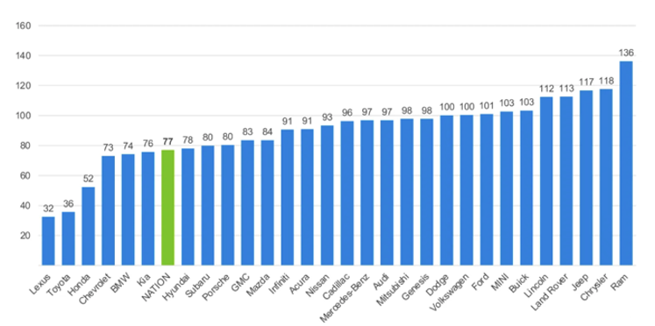

August Days’ Supply of Inventory by Brand

Slide 7
Inventory Levels
Although inventory levels remain below last year’s benchmarks, the upward momentum in sales and pricing reveals a resilient and adaptive market
The first half of 2025 saw significant inventory drawdowns as consumers rushed to purchase vehicles ahead of anticipated tariff-driven price hikes
The latter half is beginning to show disciplined manufacturer replenishment strategies and selective focus on profitable, in-demand models
Current POV: As we approach the final quarter of the year, attention will center on how automakers recalibrate production, respond to cost pressures, and leverage promotional activities, all while consumers weigh new incentives amid rising retail prices

Slide 8
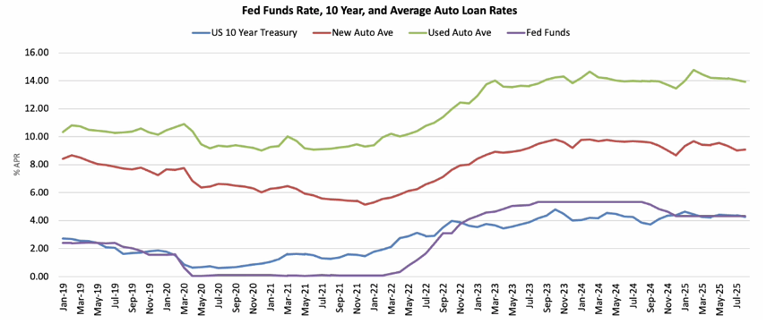
Loan Rates Little Changed in August
Down from 25-Year Highs
New Average rate up slightly to 9.09%
Used Average rate down to 13.93%

Slide 9
Tariffs
DOMESTIC VS. IMPORTS LANDSCAPE
The balance between domestic and imported vehicles is being reshaped by new trade policies.
Tariff effects: The 25% tax on imported vehicles and parts, have significantly increased costs for many automakers
  Imported vehicles: Prices for imported vehicles, including many popular EV models, are expected to rise substantially, potentially making them unaffordable for many buyers.
  Domestic vehicles: While U.S.-built vehicles are not immune to price increases due to reliance on imported parts, domestic manufacturers with strong North American supply chains (e.g., Tesla, Ford) are better positioned to weather the changes
Production shifts: Automakers are beginning to adjust their strategies. Some are relocating or expanding production to North America to avoid tariffs, while others are focusing on tariff-resilient supply chains. This could increase the availability of domestic models, particularly in the long term.

Slide 10
NADA’S POV: EV’S & Tariffs
Buying surge (pre-expiration)
Projected EV sales slowdown Q4
Increased vehicle prices
Shift to hybrids and used vehicles
  Hybrids: The hybrid segment continues to show strong growth, offering an appealing middle-ground for eco-conscious buyers who are wary of EV costs and charging infrastructure.
  Used EVs: The used EV market is gaining significant traction. Steep depreciation on newer EVs means affordable used models are now available, with many still qualifying for a $4,000 used-vehicle tax credit until its own September 30 expiration

Slide 11
Attract Hybrid & Used EV Owners
Stations can use specific marketing strategies to attract hybrid and used EV owners, including targeted outreach, enhanced service offerings, digital visibility, and strategic partnerships
These customers are motivated by cost savings, sustainability, and convenience, making a specialized approach more effective than general promotions.
Attracting hybrid vehicle owners
  Hybrid drivers are a growing market segment interested in balancing fuel efficiency with traditional fueling convenience.
Targeted Outreach and Promotions
  Emphasize fuel efficiency
  Offer bundled services
  Community workshops: builds trust with potential customers

Slide 12
Streaming with NO Advertising:
Advertisers Cannot Reach these Viewers
But Broadcast Assets Can Reach Almost All of Them
Source: GfK/NIQ TVB Media Comparisons Study 2025. M-S 4A-2A. Persons 18+ Car Buyers.

Slide 13
Forecasts
Updated June 25, 2025
15.6 – 16.3M 15.7M Baseline NEW SALES (Original Forecast: 16.3M) | 12.8 – 13.3M 13.0M NEW RETAIL SALES (Original Forecast: 13.3M) | 2.7 – 2.9M 2.8M FLEET SALES (Original Forecast: 3.0M)
3.1 – 3.3M 3.2M NEW LEASE VOLUME (Original Forecast: 3.3M) | 25% LEASE PENETRATION (Unchanged) | 2.4 – 2.6M 2.5M CPO SALES (Original 2.5M)
37.5 – 38.3M 38.0M USED SALES (Original 37.8M) | 19.9 – 20.3M 20.1M USED RETAIL SALES (Original 20.1M) | 2.1% – 2.8% DEC 2025 Y/Y MANHEIM USED VEHICLE VALUE INDEX (Original +1.4%)

