Slide 1


December Automotive Update
Trisha Ripperger, EVP, Chief Client & Communications Officer

Slide 2

December Sales Review
 | 2025 | 2024 | % Change
Total Sales | 1,460,177 | 1,494,220 | - 2.3%
Retail Sales | 1,208,305 | 1,270,587 | - 4.9%
SAAR | 16.0 mil | 16.8 mil | - 8.2%
Retail SAAR | 13.1 mil | 14.0 mil | - 8.2%
Source: Cox Automotive

Slide 3
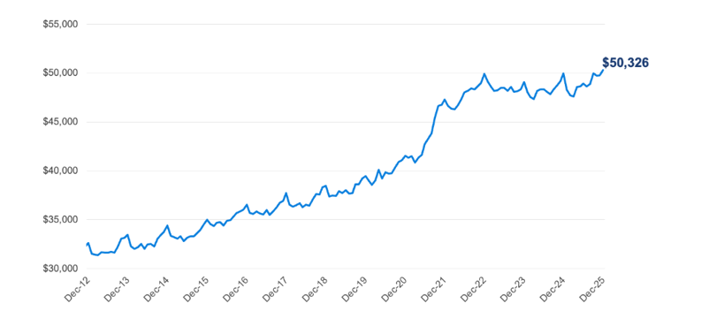
ATP Higher in December
New-Vehicle Average Transaction Price
Source: Cox Automotive/Kelley Blue Book

Slide 4
New-Vehicle Prices Hit New High in December 2026
A strong mix of midsize SUVs and full-size pickup trucks pushed the average higher, as both segments outperformed in the final month of 2025. (Note: New-vehicle prices typically peak in December).
The average price paid for a new vehicle in December was $50,326, an all-time high according to initial Kelley Blue Book estimates. The ATP last month was up 0.8% year over year and up 1.1% from November.
The average new-vehicle manufacturer’s suggested retail price (MSRP) – commonly called “the asking price” – also set a record in December, at $52,627. The average MSRP was 1.2% higher year over year, below the long-term average increase. The average MSRP has been above $50,000 for eight straight months.
Incentives increased in December to 7.5% of ATP, the highest point in 2025. The incentive level in December increased 10.7% compared to November (6.7% of ATP) but was lower year over year. In December 2024, the average incentive was equal to 7.9% of ATP.
Source: Cox Automotive/Kelley Blue Book

Slide 5
Full-Size Pickups Surpassed $15 Billion in Sales For The First Time in December
Strong sales of full-size pickup trucks also pushed the ATP higher last month. With more than 233,000 full-size pickups sold, December was the best month for the segment in five years and the sixth best in the past decade.
The average price paid for a full-size pickup in December was $66,386, slightly below the record set in October 2025. In December, combined revenue from retail and fleet sales of full-size pickups surpassed $15 billion for the first time.
“Last month, nearly 20% of shoppers bought luxury, a peak for 2025 – and that doesn’t include the volume of high-end pickups that were snapped up by affluent shoppers.” – Erin Keating, Cox Automotive Executive Analyst
Source: Cox Automotive/Kelley Blue Book

Slide 6
2025 EV Sales Decline Only 2% Vs. 2024
Policy Shifts, New Product Set Stage for Next Chapter
As widely forecast, sales of new electric vehicles (EVs) in the U.S. fell sharply in the fourth quarter, following record-breaking results in Q3.
With government-backed sales incentives revoked at the start of October, total EV sales in Q4 plunged to 234,000 units, down 46% compared to Q3 and 36% lower year over year.
Sales in the final quarter of 2025 were at the lowest point since Q4 2022.
While the Q4 collapse will command headlines, total EV sales in calendar year 2025 tell a different story:
Thanks in part to record volume in Q3, total EV sales last year came in just shy of 2024’s 1.30 million. In fact, 2025 was the second-best year on record for EV sales in the U.S., and the EV share of total market sales was a strong 7.8%, down from 8.1% a year earlier, according to Kelley Blue Book estimates.
Source: Cox Automotive/Kelley Blue Book

Slide 7
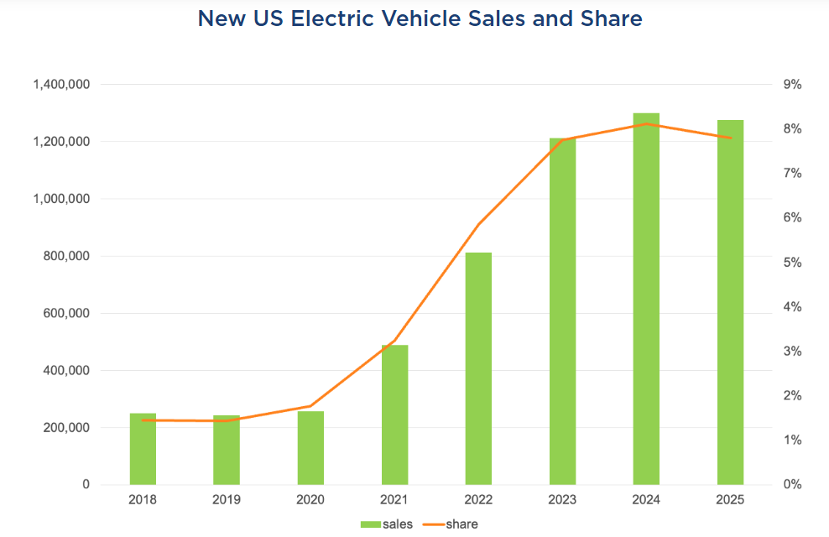
2025 Was The Second-Best Year on
Record For EV Sales in The U.S.
The EV Share of Total Market Sales was a Strong 7.8%, Down From 8.1% a Year Earlier
Source: Cox Automotive/Kelley Blue Book

Slide 8
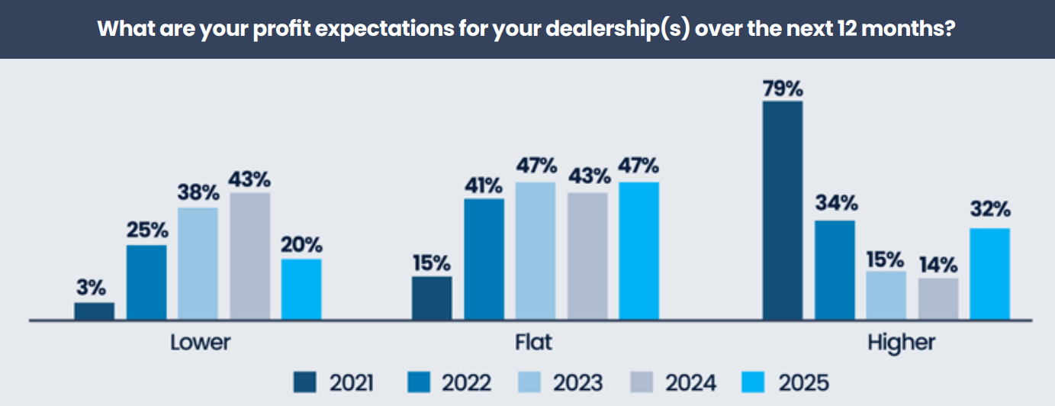

Auto Dealer Sentiment Turns Positive in 2025
Source: Kerrigan Automotive
2025 Kerrigan Dealer Study

Slide 9
Survey Reveals Profit & Valuation Expectations Improve for the First Time Since 2021
More positive than negative
Earnings expectations improve
Dealers believe that dealership values will increase or remain stable
  2026 – 83%
  2025 – 67%
    A 16% increase; domestics are most optimistic
Source: Kerrigan Automotive
2025 Kerrigan Dealer Study

Slide 10
2026 Forecast
In the 2026 Auto Market, franchise auto dealers consider:
Consolidation
Hybrid/EV acceleration
Strong fixed-operations/services performance, creating an environment ripe for opportunity for buyers and sellers.
Rising vehicle prices and interest rates are keeping customers in their cars longer, boosting service visits and making fixed operations a reliable profit driver!
Advertise service business
Stock Vehicles that people want
Target your messaging ro reach affluent buyers AND value shoppers

Slide 11
Take Action!
Driving Sales – Dealers must focus on building their brand to reach new customers and earn more sales.
Incentives are strong – Craft messaging accordingly. I.E., “You could get a new vehicle with a lower payment.”
Service Revenue and Ticket Volume are up –
  Dealers need to use the most trusted media to instill consumer confidence
  Tell potential consumers why they should service their vehicle from your dealership
  Also, a great way for used car acquisition and new car sales

