Slide 1
JANUARY AUTOMOTIVE UPDATE
Trisha Ripperger, EVP, Chief Client & Communications Officer

Slide 2



JANUARY SALES REVIEW
 | 2026 | 2025 | % Change
Total Sales | 1,112,235 | 1,106,120 | -0.6%
Retail Sales | 883,577 | 899,577 | - 1.8%
SAAR | 14.9 mil | 15.5 mil | - 3.5%
Retail SAAR | 12.3 mil | 12.7 mil | - 3.0%

Slide 3
INVENTORY COUNTS ARE RELATIVELY
STABLE, SLOWER SALES ARE DRIVING
HIGHER DAYS’ SUPPLY
Toyota continues to operate with a comparatively lean footprint. Its sales pace in January fell by roughly 25% compared to December, pushing days’ supply from the low-30s into the low-40s. Even with this softening, Toyota remains one of the most balanced operators in the market.
Nissan sales pace in January slowed by 12% from the prior month, lifting days’ supply from the mid-90s to above 110.
Honda’s cadence cooled similarly, with sales falling 17% and with days’ supply rising from the upper-40s into the mid-60s.
Hyundai and Kia posted sales declines of 23% to 11%, respectively, pushing their days’ supply well into triple digits for Hyundai and into the low 100s for Kia.
AMONG THE LARGEST DOMESTIC FULL-LINE MANUFACTURERS, PRESSURE IS MORE PRONOUNCED
Chevrolet’s sales slowed by about 25% month over month, pushing days’ supply from the upper-60s into the mid-80s.
Ford’s sales pace declined even more sharply, dropping 30%, with days’ supply jumping from the mid-90s to well above 130.

Slide 4
JANUARY NEW-VEHICLE MARKET DEFINED BY SOFTER DEMAND AND STABLE SUPPLY
Compared with the December report, when the 30-day sales pace was just above 1 million units and the national days’ supply sat at 76, conditions have shifted. Severe winter storms across the country likely played a role in slowing showroom traffic. Dealers are carrying roughly the same number of vehicles, but shoppers are moving more slowly, stretching turn rates and prompting modest price adjustments. February opened with average listing prices slightly lower at $49,248, down 2.6% from a month earlier but up 1.4% from the same time last year, which is evidence of selective, measured responses from dealers rather than broad discounting.
Looking ahead to a year-over-year view, the picture does improve. The sales pace is down only 4.0% year over year, while inventory volume and days’ supply are both lower than at this point one year ago. This combination suggests the industry is structurally healthier than during last winter’s elevated stock environment, even as the current month shows clear signs of short-term slowing.

Slide 5
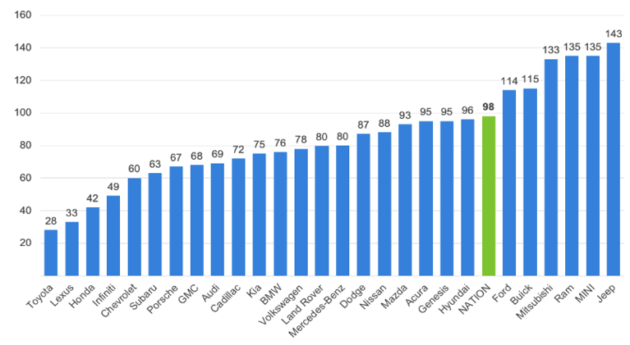


JANUARY DAYS’ SUPPLY OF INVENTORY BY BRAND
Automaker with days’ supply at least twice the industry average:
Chrysler
* CHRYSLER NEEDS BROADCAST TO DRIVE SALES!

Slide 6

KEY TAKEAWAYS
ON INVENTORY
The market’s higher days’ supply reflects a slower sales pace, not rising inventory.
Across brands, inventory counts are either flat or moving only modestly.
January was just a slow month, and dealers echoed this reality at NADA 2026, noting quiet showrooms even for those with well-balanced stock positions.

Slide 7
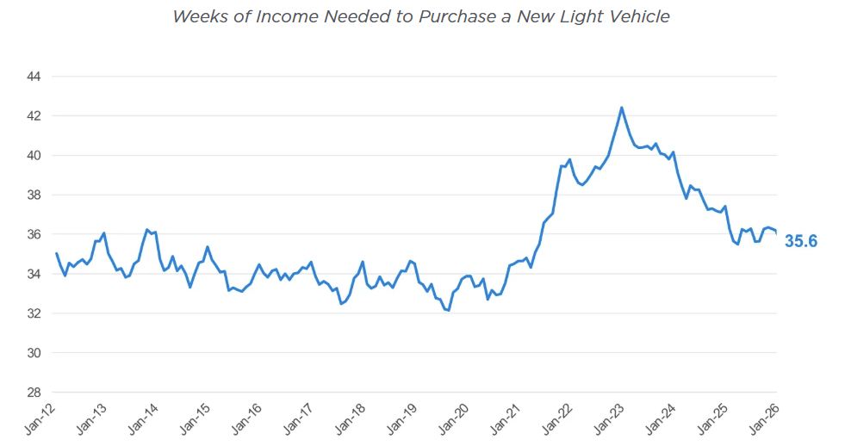
NEW-VEHICLE AFFORDABILITY IMPROVES IN JANUARY ON HIGHER INCOME, LOWER LOAN RATES
[A SIGN THAT MACRO TAILWINDS FROM LOWER RATES AND HIGHER INCOMES CONTINUE TO OUTWEIGH REDUCED MANUFACTURER SUPPORT]
THE NEW-VEHICLE AFFORDABILITY INDEX FELL BY 1.8% YEAR OVER YEAR, INDICATING AFFORDABILITY IMPROVED LAST MONTH
A YEAR EARLIER, IT REQUIRED 36.2 WEEKS OF MEDIAN INCOME TO PURCHASE THE AVERAGE NEW VEHICLE.

Slide 8
MODEST PRICE DECLINE POINTS TO
DISCIPLINED DEALER RESPONSE
The average listing price of $49,248 is slightly lower than at the beginning of the year. The decline is modest, less than 3%, and reflects a combination of subtle mix shifts and selective price positioning by retailers. The move is not large enough to indicate meaningful discount pressure, but it does highlight that dealers are reacting appropriately to the pace of demand.

Slide 9
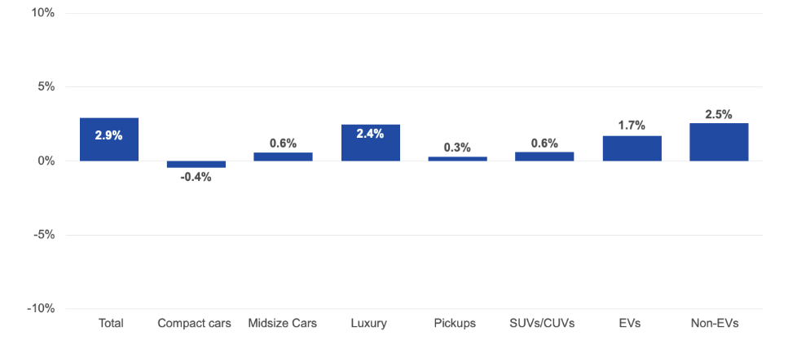
SEGMENT PERFORMANCE/OPPORTUNITIES
Price Changes for Selective Market Classes
year-over-year % change, Mid-February 2026
Prices in the overall market rose 2.9% year-over-year, supported primarily by continued price growth in the luxury vehicle segment.

Slide 10
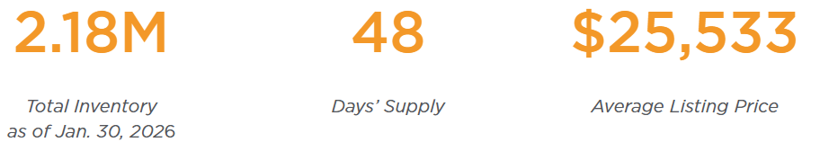
USED VEHICLE UPDATE
FEBRUARY BEGAN WITH USED-VEHICLE INVENTORY LEVELS DOWN MONTH OVER MONTH BUT HIGHER THAN IN JANUARY 2025
Nationwide, dealers – both franchised and independent – had a total supply of 2.18 million used vehicles on their lots at the beginning of February. That figure is 3% higher than the same time last year but down 1% compared to the 2.20 million a month earlier.

Slide 11
KEY OPPORTUNITY
FOR MARKETING
DEALERS CONTROL PROFITABILITY ON PRE-OWNED SALES AND ARE ALWAYS IN ACQUISITION MODE
DEALERS SHOULD BE MARKETING THEIR PRE-OWNED INVENTORY AVAILABILITY & AFFORDABILITY!
DEALERS ACQUIRE PRE-OWNED INVENTORY MOST EFFICIENTLY IN THE SERVICE DRIVE

Slide 12
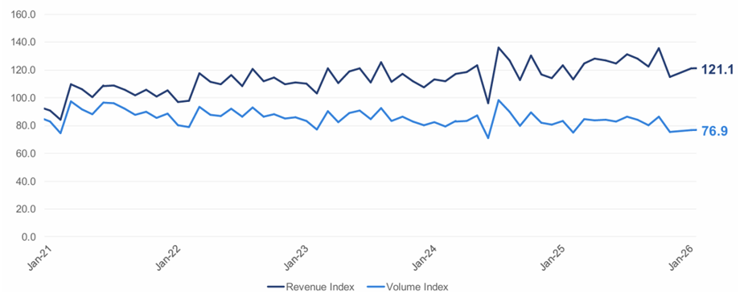
JANUARY SERVICE REVENUE &
TICKET VOLUME INDICES UPDATES
Service Revenue Index decreases 1.6% year-over-year
Ticket Volume Index decreases 7.7% year-over-year

Slide 13
2026 FORECAST TAKEAWAYS
The automotive industry is expected to face challenges and opportunities in 2026, particularly in EV adoption, supply chain dynamics and consumer affordability.
Supply Chain Shifts: The automotive sector is undergoing a transformation in its supply chains, with manufacturers focusing on reshoring and diversifying suppliers to mitigate risks.
EV Affordability: With the expiration of the federal EV tax credits, the affordability of EV’s will be a critical issue. However, with the introduction of new lower-cost models it may ignite greater consumer demand.
There is also a tremendous opportunity to market pre-owned EV Inventory
Consumer Demand and Market Dynamics: As car prices hover around 50K, affordability will be a key factor influencing purchasing decisions.
INCENTIVES, FINANCING AND A ROBUST USED CAR MARKET WILL BE CRITICAL FOR MANUFACTURERS TO ATTRACT BUYERS.

Slide 14
FORECASTS
Updated 12/17/25
15.8M (-2.4% versus 2025) NEW SALES | 13.1M (-1.5% versus 2025) NEW RETAIL SALES | 2.7M (-6.1% versus 2025) FLEET SALES
2.8M (-12.6% versus 2025) NEW LEASE VOLUME | 21% (-3% versus 2025) LEASE PENETRATION | 2.6M (-2.2% versus 2025) CPO SALES
38.3M (-0.9% versus 2025) USED SALES | 20.3M (-0.7% versus 2025) USED RETAIL SALES | 2.0% (+1.7% versus 2025) DEC 2026 Y/Y MANHEIM USED VEHICLE VALUE INDEX

