Slide 1
July Automotive Update
Trisha Ripperger, SVP Strategic Communications & Category Development

Slide 2



July Sales Review
 | 2025 | 2024 | % Change
Total Sales | 1,370,061 | 1,285,711 | + 6.6%
Retail Sales | 1,178,487 | 1,091,728 | + 7.9%
SAAR | 16.4 mil | 15.8 mil | + 3.7%
Retail SAAR | 13.8 mil | 13.4 mil | + 2.8%

Slide 3
Retail Sales
Retail Sales Hold Strong
Both new and used vehicle sales trended higher toward the end of July, outperforming year-ago levels.
Retail momentum is supported by improved consumer sentiment and promotional financing.
Dealers are seeing consistent demand across segments, with used vehicles showing particular strength.
New light-vehicle sales increased 6.6% year over year in July, with one more selling day than July 2024.
The sales pace last month was the best July since 2019 and came in better than expected.
By volume, new-vehicle sales increased 9.3% month over month, with two more selling days than June.
Financing Conditions Improve
Low APR financing offers reached their highest levels in years, and average loan rates declined in July.
The average used vehicle loan rate fell to 14.02%, while new vehicle rates dropped to 9.02%.
These declines enhance affordability and support continued retail growth.

Slide 4
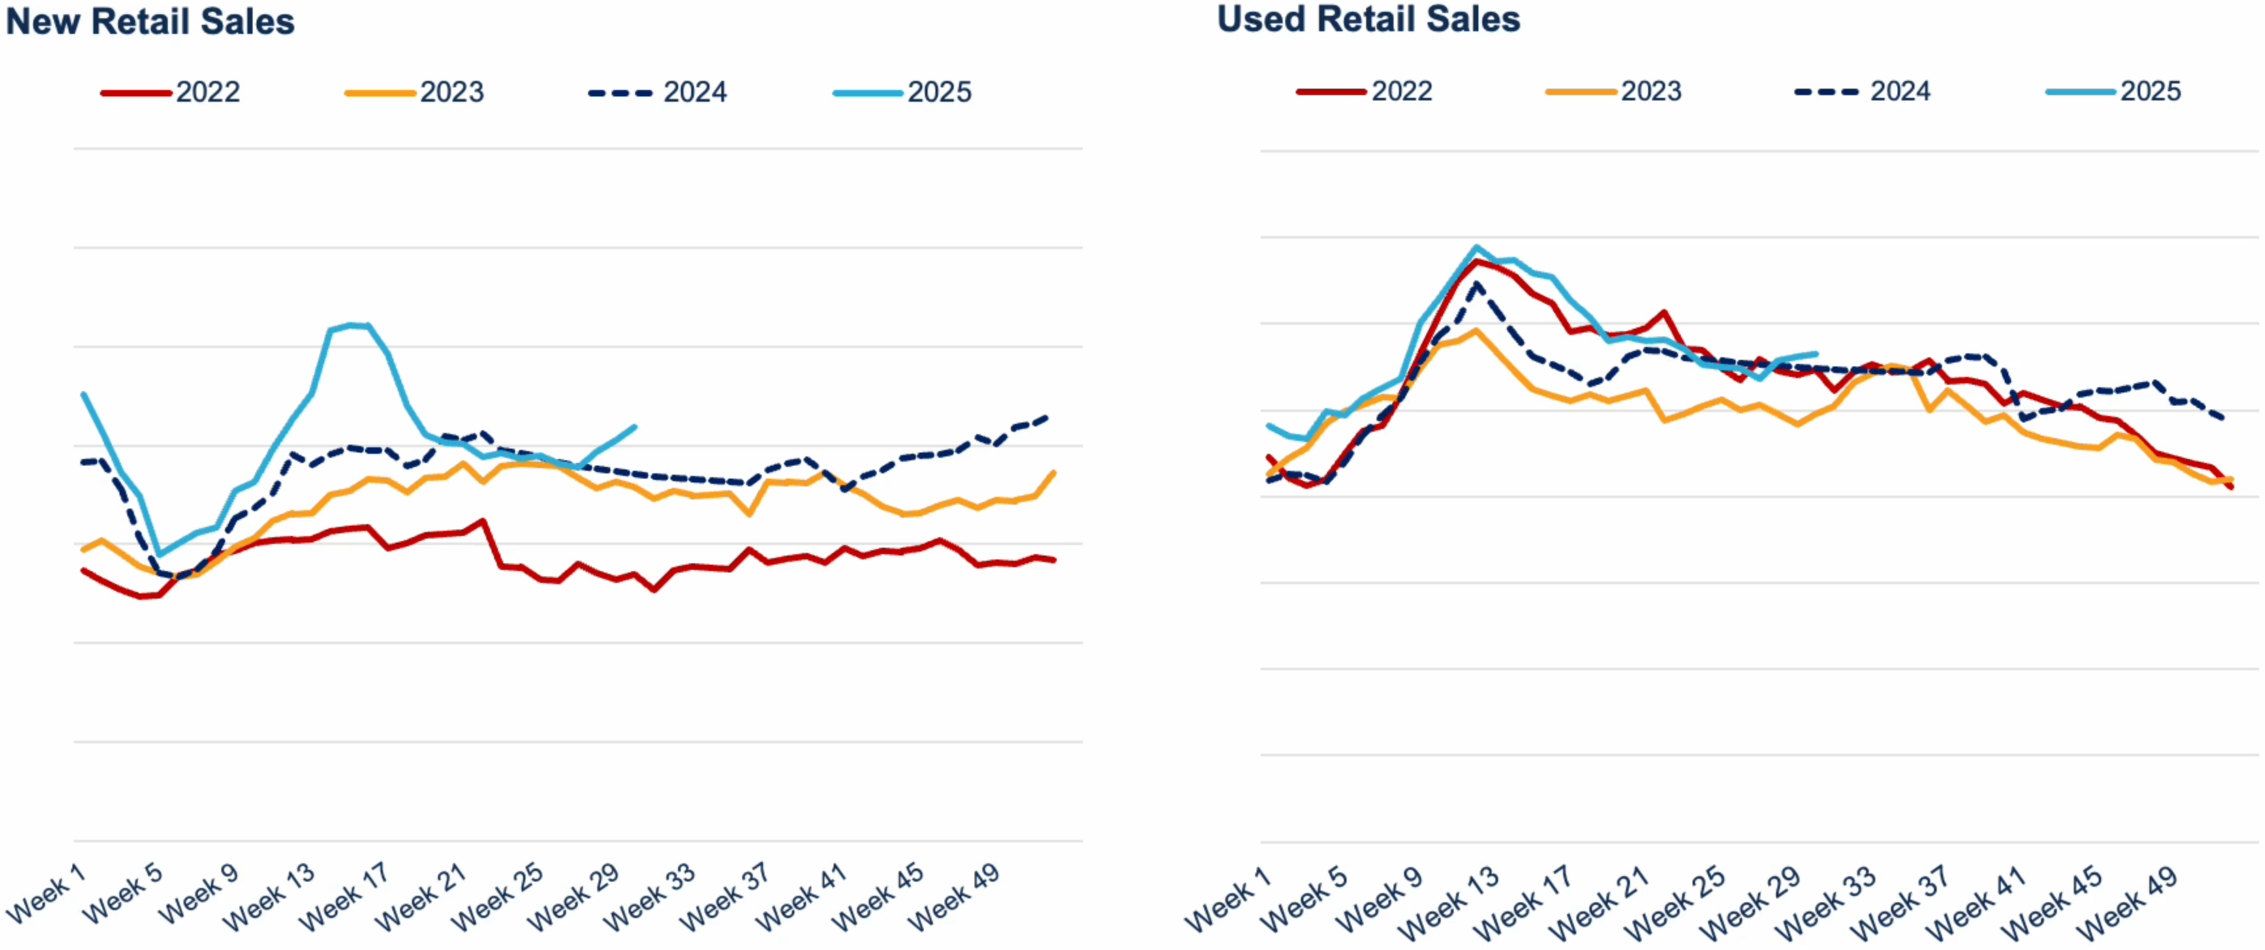
New & Used Retail SALES are Holding Higher
Sales trends for New & Used are rising towards the end of July and are up against last year
Source: Cox Automotive

Slide 5
Inventory Update
1
2
3
4
5
6
7
8
Inventory Tightens Further
New & used vehicle supply declined throughout July, reinforcing pricing discipline & dealer margins
New vehicle days’ supply fell weekly, while used inventory also trended lower
Tight supply conditions are expected to persist, especially as demand remains elevated
Used-Vehicle Prices Remain Stable
Retail wholesale prices for used vehicles tracked closely together, with minimal weekly declines
Price stability reflects balanced supply-demand dynamics & disciplined inventory management
Once again, Ford, Chevrolet, Toyota, Honda & Nissan were the top-selling brands, accounting for 49% of all used vehicles sold

Slide 6
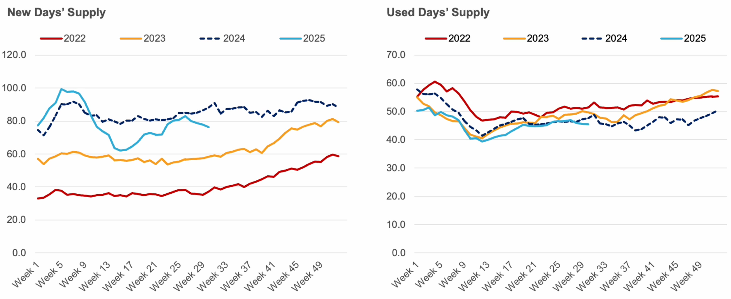
New & Used SUPPLY continued declines in July
New supply has fallen quickly every week for the last month while used also continues to slowly decline

Slide 7
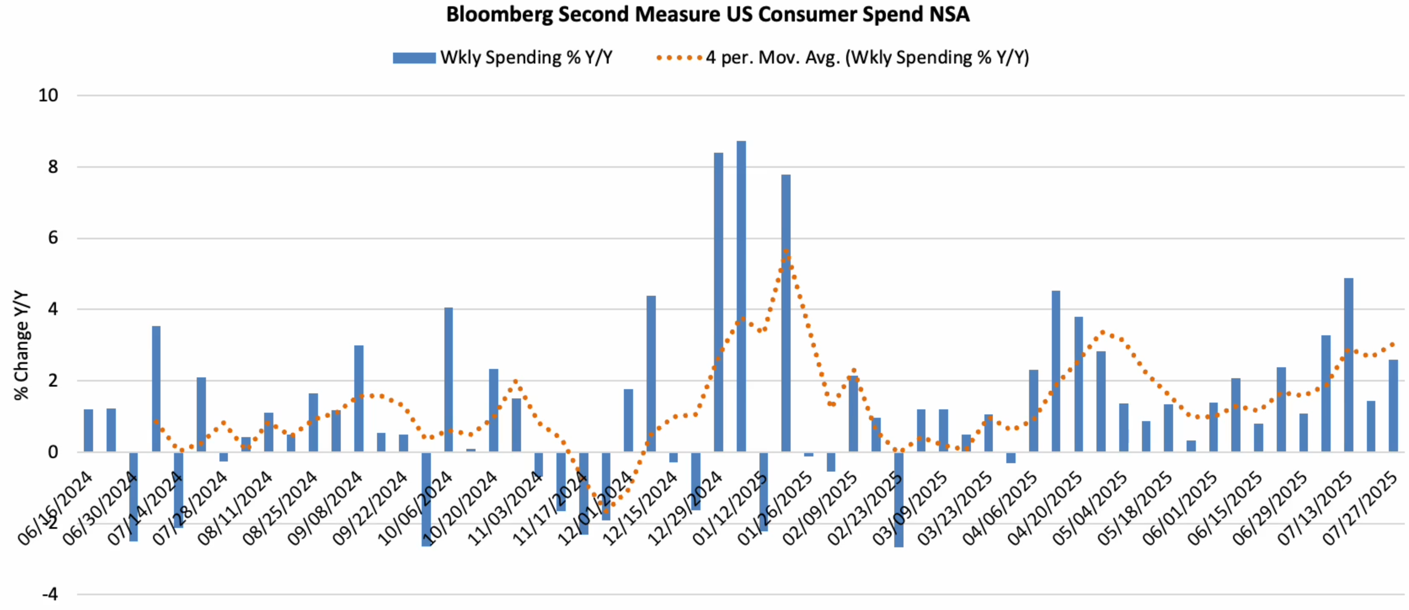
Consumer Spending Growth Accelerated in July
Total Consumer spending saw year over year growth cool in May, stabilize in June, and accelerate in July

Slide 8
Inventory Update
As inventory levels rise and new model year vehicles begin to populate dealer lots, the automotive market finds itself in a delicate balance.
Supply growth has not been matched by demand, pushing days’ supply higher, and average listing prices have largely plateaued.
With incentives holding relatively firm as well, shoppers can expect a market marked by incremental change rather than dramatic shifts. Tariff negotiations have been kicked down, which means it could be the fourth quarter before we see any significant movement in overall consumer prices.
Everyone is hunting for clear evidence of higher prices on new vehicles driven by tariffs, and yet, the story just hasn’t materialized.
Automakers continue to hold their fire on raising the manufacturer’s suggested retail prices (MSRPs) significantly as demand remains tepid and policy has yet to be solidified.
New-vehicle inventory has started to grow as next-model-year vehicles (MY2026) begin to show up on dealer lots, although the volume of these vehicles is still down more than 20% from last year at this time, according to the Cox Automotive analysis of vAuto Live Market View data
2.83 Total Inventory
as of 6/30/25
82 Days’ Supply
$48,749 Average
Listing Price

Slide 9
15.6 – 16.3M NEW SALES (Original Forecast: 16.3M) | 12.8 – 13.3M NEW RETAIL SALES (Original Forecast: 13.3M) | 2.8 – 2.9M FLEET SALES (Original Forecast: 3.0M)
3.2 – 3.3M NEW LEASE VOLUME (Original Forecast: 3.3M) | 25% LEASE PENETRATION (unchanged) | 2.4 – 2.5M CPO SALES (Original 2.5M)
37.6 – 38.0M USED SALES (Original 37.8M) | 19.9 – 20.2M USED RETAIL SALES (Original 20.1M) | +2.1% - +2.8% DEC 2025 Y/Y MANHEIM USED VEHICLE VALUE INDEX (Original +1.4%)
Updated
Forecasts

