Slide 1
Mid-Year Automotive Update
Trisha Ripperger, SVP Strategic Communications & Category Development

Slide 2
June Sales Review
 | 2025 | 2024
Total Sales | 1,254,418 | 1,308,997
Retail Sales | 1,033,238 | 1,064,986
SAAR | 15.3 mil | 15.0 mil
Retail SAAR | 12.9 mil | 12.2 mil
% Change
- 4.2%
- 3.0%
+ 2.3%
+ 6.0 %

Slide 3
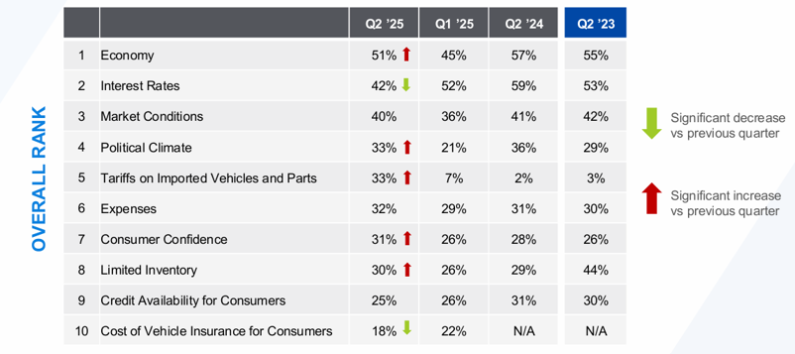

Q2 Dealer Sentiment Index:
Factors Holding Back Business

Slide 4
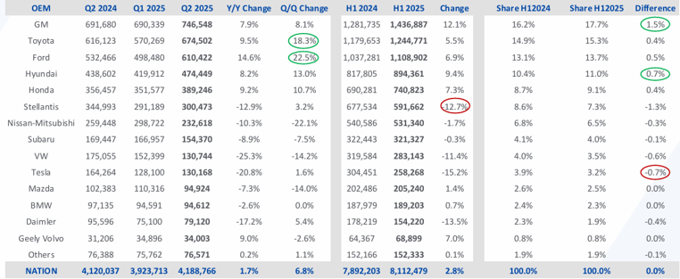
OEM Performance
Biggest Automakers Are Gaining Most Share in 2025

Slide 5

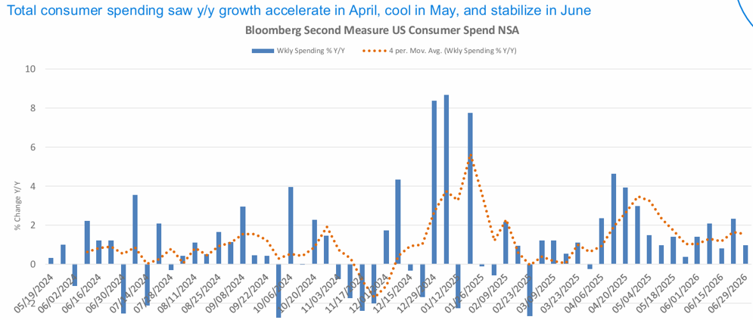
Consumer Spending Growth Remaining Positive

Slide 6
New Vehicle Market
The new-vehicle (SAAR) declined in June, but the retail SAAR increased and was higher than a year ago. Consumers are price-sensitive, so incentives are increasing again, and discounting is on the rise to keep retail sales moving. Prices were up modestly in June.
Retail new-vehicle sales rose 6% year over year in June, even as total sales volume declined due to fewer selling days.
The average transaction price (ATP) for new vehicles rose 0.4% month over month to $48,907, up 1.2% year over year.
Incentives increased 2.6% month over month to $3,396, up 8.5% year over year, reaching 6.9% of ATP and was higher than the 6.5% level one year ago. It was 9.7% in March 2019. New vehicle rates declined to 9.26%.
Discounting also increased, with the average price relative to MSRP falling to 95.7%. Dealer.com data shows new leads are up month over month
Ford announced in July for new cars $0 down, 0% financing deals for Q3
Still, the impact of the spring sales run on inventories varied both by automaker and vehicle line. Toyota, Honda, BMW, Subaru, Chevrolet and Kia had the leanest inventories last month, Cox Automotive said, while Hyundai, Ram, VW, Jeep and Mercedes-Benz had the highest stockpiles. Among major brands, only Volkswagen saw its monthly stockpiles rise since March, Cox said late last month.

Slide 7
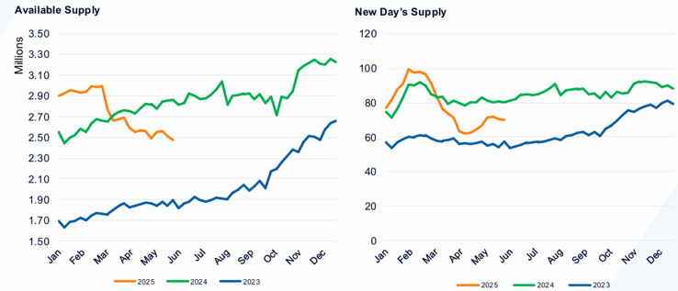
New Vehicle Inventory
Tight, as Tariffed Inventory and Cost Pressures Grow
Toyota, Honda, BMW, Subaru, Chevrolet and Kia had the leanest inventories last month. Hyundai, Ram, VW, Jeep and Mercedes-Benz had the highest stockpiles. Among major brands, only Volkswagen saw its monthly stockpiles rise since March.

Slide 8
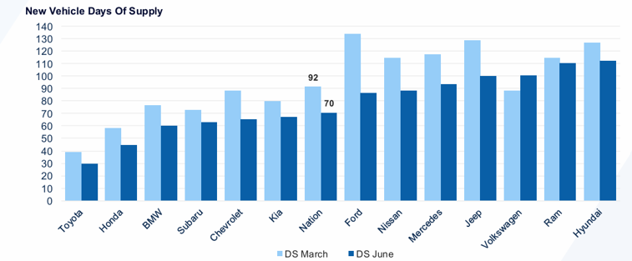
Brand Inventory
Status Varies, but Most Major Brands Are Down After Strong Spring Sales

Slide 9
Used Vehicle Market
Used vehicle sales and service activity are gaining momentum.
The average used vehicle loan rate dropped to 14.08%. Low-interest rate loan offerings surged in early July as new vehicle sales cooled.
Unique credit applications per dealer rose 7% year over year last week, with gains in new loans offsetting declines in used.
Leads are up year over year on Autotrader but down on Kelley Blue Book, showing platform-specific engagement shifts for dealers.
Service trends on Xtime relative to last year improved in the week ending June 28, as completed appointments were up 34% year over year.
Used vehicle sales declined modestly in June but remained up year over year. Wholesale used prices increased on a seasonally adjusted basis in June but declined on an unadjusted basis. Prices are up year over year.

Slide 10
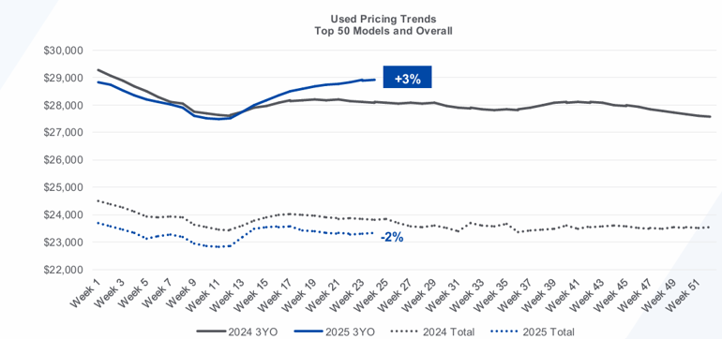
Used Vehicle Prices

Slide 11
Auto executives warned tariffs would shut down the industry. Why haven’t they?
Parts exemptions prevented the biggest challenges
“Early indications were yes, we would have had some supply disruptions, but the fact that it didn’t trickle down to the supply base as badly as we expected with the way that the tariffs have been set has been a reprieve.”
Automakers, meantime, have managed to absorb some of the hit from tariffs by passing along costs, decontenting vehicles and adjusting consumer incentives, Robinet said.
Sam Fiorani, vice-president of global vehicle forecasting at U.S.-based AutoForecast Solutions, said the dramatic fallout parts tariffs would have had on the industry likely prompted the White House to reconsider.
“The tariffs were initially expected to shake up the whole industry, but the sheer size of it and the importance to the economies of Canada, the U.S. and Mexico, have to have tempered the Trump administration’s moves in that direction.”
Volpe maintains that if Trump reverses course and enacts the parts tariffs fully, the North American industry, which runs on tight margins and just-in-time deliveries, will be unable to function.

Slide 12
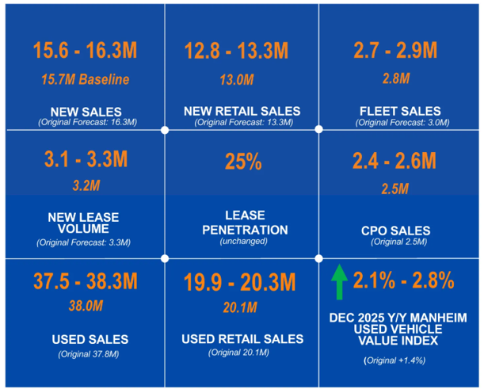
Updated Forecasts

Slide 13
Industry Perspectives
Smoke Predicts “Long and Sticky Summer”
In the latest Auto Market Report, Chief Economist Jonathan Smoke reported, “It looks as though we are in for a long and sticky summer. That seems apropos for the auto market, as demand and retail prices look fairly sticky, and at present, there isn’t much happening either in the economy or in the auto market to change the demand patterns.”
“We’re now in a holding pattern as we wait to see what happens with trade negotiations. Auto loan rates are drifting lower, but we are not expecting substantial improvement in rates this summer. The one wildcard is what manufacturers do with rate subvention to spur more retail demand for new vehicles. Indeed, rate deals are on the rise, just as we should start to see new model-year supply building up.”

