Slide 1
May Automotive Update
Trisha Ripperger, SVP Strategic Communications & Category Development

Slide 2
May Sales Review
Updated 6/4/25
 | 2025 | 2024
Total Sales | 1,466,595 | 1,431,081
Retail Sales | 1,219,355 | 1,155,805
SAAR | 15.6 mil | 15.8 mil
Retail SAAR | 13.4 mil | 12.8 mil
% Change
+ 2.5%
+ 5.5%
-1.1%
+ 4.5 %

Slide 3
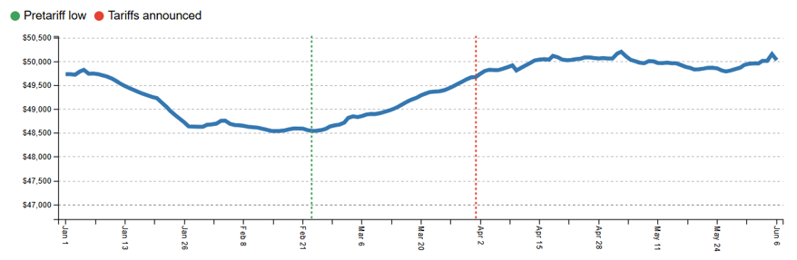
Average Marketed Price
Tariff policies have been in flux, but as they approached and started taking effect, auto prices have been rising. Since bottoming out at $48,544 on Feb. 24, Cloud Theory’s Average Marketed Price metric – which reflects the prompted prices on dealers’ vehicle detail pages and includes visible discounts and incentives – has marched steadily upward. On April 14, it surpassed $50,000 for the first time since Dec. 7.

Slide 4
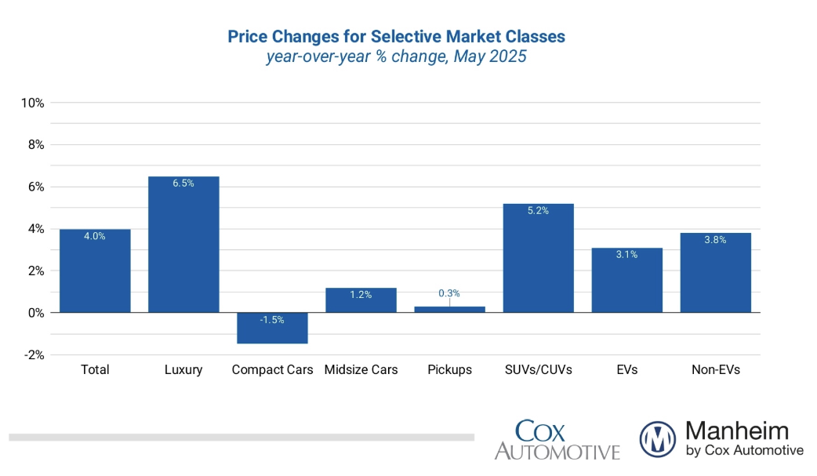
Price Changes for Selective
Market Classes

Slide 5
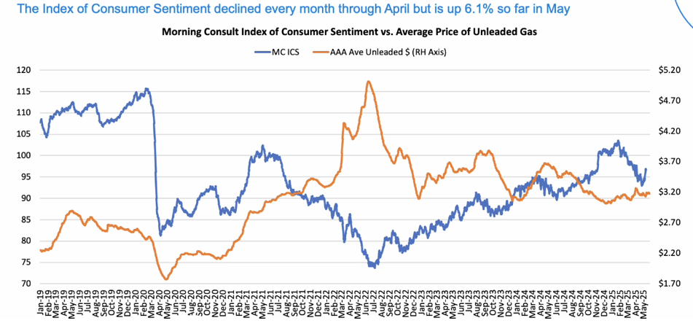

Consumer Sentiment Trending Higher in May

Slide 6
Key Takeaways
Customer Traffic Surges: The customer traffic index rose to 37, up from 33 in Q1 and higher than year-ago levels. Franchised dealers reported a 10-point jump in in-person visits – the largest increase since the metric was introduced in Q3 2022 – reflecting strong consumer engagement amid new tariff policies.
Profitability Improves: The profit index climbed to 39, the highest in over a year. Franchised dealers led the gains, rising from 41 to 52, with more dealers now viewing their profits as strong rather than weak. Independent dealers also saw modest improvement, up three points to 35.
Inventory Tightens: Strong vehicle sales in March and April led to tighter inventory levels. The new-vehicle inventory index dropped to 50, the lowest since late 2022, while used-vehicle inventory fell to 41. Dealers also reported reduced pressure to lower prices as inventory declined, with the price pressure index falling from 63 to 57.

Slide 7
New Vehicle Market
The new-vehicle sales pace declined slightly in May but remailed up y/y
Average transaction prices for new remain high at $48k+.
Vehicle Segment Details Light trucks +4.9 y/y, cars -12.8% y/y.
The Conference Board Consumer Confidence Index ® jumped 14.4% in May (Strongest monthly gain since March 2021).
Optimism about both current conditions and future expectations improved, with future sentiment up 31%.
Plans to purchase a vehicle within the next six months rose to the highest level since December, although they are still slightly down year over year.
Real personal income growth and a rising savings rate point to stronger household balance sheets, which could support future auto demand despite recent spending pullbacks.

Slide 8
Used Vehicle Market
The used market also saw month-over-month declines but gains year over year. Used prices increased.
The Fed left interest rate policy unchanged as it waits to see evidence of inflation and labor market deterioration from tariffs.
Affordability remains challenging for consumers, and used-vehicle supply is more constrained at lower price points. Used cars below $15,000 continue to show low availability, with only 32 days’ supply, six days lower than the same time last year and 10 days below the overall industry average.
The top five sellers of the month were listed at an average price of $23,926, more than 6% below the average listing price for all vehicles sold. Once again, Ford, Chevrolet, Toyota, Honda and Nissan were the top-selling brands, accounting for 51% of all used vehicles sold.

Slide 9
May OEM Performance
U.S Automakers
Increases: GM +5.8% & Ford +16.9% increase y/y (Employee Pricing Program extended until July 6)
Decreases: Stellantis continued same incentives as Ford but saw -13.4% y/y & Tesla - 22.4%, marking the seventh consecutive month of decline.
Japanese Automakers (Mixed Results)
Increases: Toyota +7.6% y/y (Strong sales of EV’s including HV’s) & Honda +6.5% y/y (Record high of EV’s /HV’s)
Decreases: Nissan -3.9%, Subaru -10.4%, Mazda -18.6%, Mitsubishi -16.1%
Korean Automakers
Increases: Hyundai +8.1%, Kia +5.1% (Slow increases y/y for eight straight consecutive months)
* Genesis marked eight consecutive months of double-digit growth
European Automakers
Increases: BMW +4.1% & Volvo +15%
Decreases: Volkswagen +40%, Mercedes-Benz +4.1%

Slide 10
Industry Perspectives
“Dealers have a front-line view of the U.S. auto market, which appears to be at an inflection point,” said Jonathan Smoke, Chief Economist at Cox Automotive. “The recent sales pace has been a positive, lifting current market sentiment higher for franchised dealers. But as we’ve said before, 2025 is going to be a roller coaster for this industry, and the market could be a lot more hair-raising in the months ahead.”
According to U.S. media reports on June 4, automakers such as Ford, Subaru, Mitsubishi and Hyundai are planning to raise sticker prices in the coming weeks in response to the tariff hikes, with other OEMs likely to follow suit. There are concerns that the front-loaded demand may lead to a market slowdown from June onward. - MarkLines
“

