Slide 1
November Automotive Update
Trisha Ripperger, EVP, Chief Client & Communications Officer

Slide 2



November Sales Review
 | 2025 | 2024 | % Change
Total Sales | 1,273,390 | 1,373,493 | - 7.3%
Retail Sales | 1,059,711 | 1,163,042 | - 8.9%
SAAR | 15.6 mil | 16.5 mil | - 5.6%
Retail SAAR | 12.8 mil | 14.0 mil | - 8.4%

Slide 3
Key Highlights
Consumer sentiment data in November showed a 3.5 year high
Financing conditions remained steady MoM
Vehicle supply (New 88 days & Used 48 days) and retail prices held steady
New vehicle sales are below last year’s levels, while used sales remain steady
More consumers are securing favorable financing terms
Average USED auto loan rate decreased to 14.26%
Average NEW auto loan rate dropped to 9.52%
ATP (NEW) increased in November to $49,814
Top of mind for dealers: Preventing finance fraud, privacy compliance, abundance of EV inventory
Electric vehicle sales are expected to continue a decline
Gen Z’s share of auto delinquency grows
(Source Experian/Automotive News)
Used-vehicle inventory levels rose again at the start of November, surpassing the previous 2025 high set in October
The average used-vehicle listing price increased to $25,945 up from $25,889

Slide 4
Automakers are walking a fine line, rising inventories could quickly shift from strategic flexibility to a liability if stock outpaces sales momentum.
Mainstream Brands: Recent inventory trends reveal that some manufacturers may be edging toward overstocked territory as consumer demand shifts.
Cadillac’s days’ supply surged by 15% from a month earlier, signaling a potentially risky buildup if sales don’t keep up.
Jeep’s situation is even more pronounced, with a 24% jump in days’ supply and a 13% increase in inventory, driven by models like the Cherokee, Compass and Wrangler, putting the brand at a high-water mark for 2025 and close to having more vehicles than the market might absorb.
Low-Volume Brands:
Porsche’s inventory level rose 12%, a substantial increase that could lead to excess supply if demand softens.
Mazda and Mercedes-Benz, with slower sales, are accumulating more vehicles on their lots, which may force them to rethink their strategies if these trends continue.

Slide 5
MSRP’s
(MSRP) – commonly called “the asking price” – was higher by 1.7% year over year in November. The MSRP also increased month over month, gaining 0.3%. The average new-vehicle MSRP – at $51,986 – has been above $50,000 since April, as a rich mix of expensive vehicles sold each month continues to drive elevated pricing.
In November, the average MSRP for a full-size pickup was above $70,000 for the third straight month. At $70,178, the average MSRP was 1.8% higher than in November 2024 and mostly unchanged from October. Incentives held steady as well, measured at 8.4% of ATP. Nearly 183,000 full-sized pickup trucks were sold last month, accounting for 14.2% of total sales.
New vehicles sold in November with an MSRP below $30,000 accounted for 7.5% of total sales last month, down from 10.3% in November 2024, as lower-priced vehicles continue to struggle in the U.S. market. The most popular under-$30,000 vehicles last month were the Toyota Corolla, Chevrolet Trax and Hyundai Elantra. (Note: 10.8% of vehicles sold last month had MSRPs over $75,000.)

Slide 6
New-Vehicle Sales
“The new-vehicle sales pace had been expected to slow in the fourth quarter, and that’s what we are seeing. The headwinds from higher prices and fewer government subsidies for electric vehicles are finally slowing the market after a surprisingly strong previous six months. Sales began surging in the spring as buyers rushed to market to beat expected higher prices in the wake of announced tariffs. Now, with more tariffed products replacing existing non-tariffed inventory, prices are drifting higher, leading to slower sales which may last through the remainder of the year and into next year.”

Slide 7
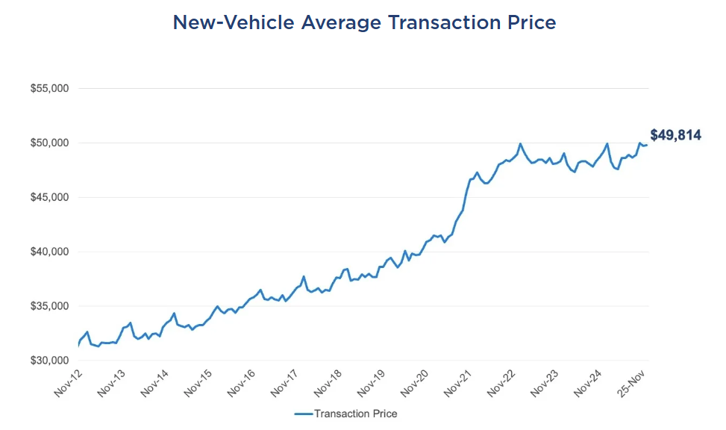
ATP (New-Vehicles) Higher in November
New-vehicle prices have been increasing steadily since 2024- prices have remained mostly stable at just under $50,000

Slide 8
EV Prices Declines &
Incentives Up in November
The average price for a new electric vehicle (EV) in November was $58,638. The EV ATP climbed 3.7% year over year but was down 0.8% from October. Incentives as a percentage of ATP were 13.3%, which is 4.1% lower than in November 2024 but 20.1% higher than in October.
EV Sales were weak for the second straight month, according to initial estimates from Kelley Blue Book. At just over 70,000, sales were lower by more than 40% year over year and down roughly 5% from October. A full report on November EV sales will be released next week.
Tesla’s ATP was $54,310 in November, down 1.7% from one year ago but up 1.5% from October. Sales declined for the second straight month and were down 22.7% year over year in November, beating the segment, mostly due to significant declines in the popular Model 3, which fell 42.1% year over year and 11.9% month over month. The Model Y, the most popular EV sold in the U.S., saw prices increase modestly in November, up 0.9% both year over year and month over month. Sales volume was 0.5% lower than in November 2024 but 2.5% higher than in October.
Tesla Cybertruck, at one point the best-selling vehicle priced over $100,000, saw sales fall to 1,194 units in November, the lowest volume of 2025. Cybertruck prices in November, at $94,254, were higher year over year and compared to October.

Slide 9
Take Action!
Sales are down – Dealers must focus on building their brand to reach new customers and earn more sales.
Incentives are strong – Craft messaging accordingly. IE: “You could get a new vehicle with a lower payment.”
Service revenue and ticket volume are up – Dealers need to use the most trusted media to instill consumer confidence. Tell potential consumers why they should service their vehicle from their dealership- also a great way for used car acquisition and new car sales.

Slide 10
2026 Forecast
The automotive industry is expected to face challenges and opportunities in 2026, particularly in EV adoption, supply chain dynamics and consumer affordability.
Supply Chain Shifts: The automotive sector is undergoing a transformation in its supply chains, with manufacturers focusing on reshoring and diversifying suppliers to mitigate risks. Tariffs and geopolitical tensions are expected to continue impacting pricing and margins, leading to a slow recovery in the industry.
EV Affordability: With the expiration of the federal EV tax credits, the affordability of EV’s will be a critical issue. However, with the introduction of new lower-cost models it may ignite greater consumer demand.
Consumer Demand and Market Dynamics: As car prices hover around 50K, affordability will be a key factor influencing purchasing decisions. Incentives, financing and a robust used car market will be critical for manufacturers to attract buyers.

Slide 11
15.8 – 16.4M 16.1 Baseline NEW SALES (Original Forecast: 16.3M) | 12.9 – 13.3M 13.1M NEW RETAIL SALES (Original Forecast: 13.3M) | 2.8 – 3.0M 2.9M FLEET SALES (Original Forecast: 3.0M)
3.1 – 3.3M 3.2M NEW LEASE VOLUME (Original Forecast: 3.3M) | 24% LEASE PENETRATION (Original Forecast: 25%) | 2.5 – 2.7M 2.6M CPO SALES (Original Forecast: 2.5M)
37.9 – 38.5M 38.3M USED SALES (Original Forecast: 37.8M) | 20.0 – 20.5M 20.3M USED RETAIL SALES (Original Forecast: 20.1M) | 1.5% - 2.1% 1.8% DEC 2025 Y/Y MANHEIM USED VEHICLE VALUE INDEX (Original Forecast: +1.4%)
Forecasts

