Slide 1
October Automotive Update
Trisha Ripperger, SVP Strategic Communications & Category Development

Slide 2



October Sales Review
 | 2025 | 2024 | % Change
Total Sales | 1,284,173 | 1,331,769 | - 3.6%
Retail Sales | 1,098,585 | 1,124,320 | - 2.3%
SAAR | 15.3 mil | 16.1 mil | - 4.9%
Retail SAAR | 13.0 mil | 13.3 mil | + 2.7%

Slide 3
KEY HIGHLIGHTS
Consumer spending and sentiment softened in October, but retail auto sales remained stable
Financing conditions improved as loan rates eased and low APR options increased, supporting affordability
Vehicle supply and retail prices held steady, while the labor market continued to show resilience
New vehicle sales are now below last year’s levels, while used sales remain steady
More consumers are securing favorable financing terms
Average USED auto loan rate decreased to 13.72%
Average NEW auto loan rate dropped to 9.33%
ATP decreased in October to $49,766 after a record high in September
Consumers’ views of buying conditions declined to the lowest level since June 2022
Electric vehicle sales are expected to drop sharply following the tax credit’s expiration
New & Used-vehicle inventory levels showed declines in October
October represents the first month in 2025 to see days’ supply outperform the prior year
The average used-vehicle listing price increased to $25,825, slightly up from $25,371

Slide 4
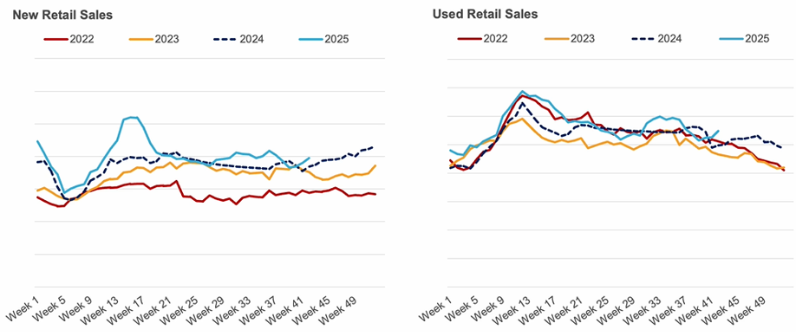
New & Used SALES recovered modestly in October
Source: Cox Automotive

Slide 5
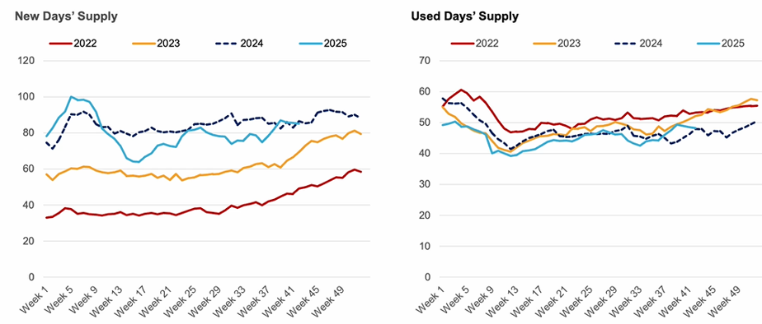
New & Used SUPPLY declines in October

Slide 6
15.8 – 16.4M 16.1 Baseline NEW SALES (Original Forecast: 16.3M) | 12.9 – 13.3M 13.1M NEW RETAIL SALES (Original Forecast: 13.3M) | 2.8 – 3.0M 2.9M FLEET SALES (Original Forecast: 3.0M)
3.1 – 3.3M 3.2M NEW LEASE VOLUME (Original Forecast: 3.3M) | 24% LEASE PENETRATION (Original Forecast: 25%) | 2.5 – 2.7M 2.6M CPO SALES (Original Forecast: 2.5M)
37.9 – 38.5M 38.3M USED SALES (Original Forecast: 37.8M) | 20.0 – 20.5M 20.3M USED RETAIL SALES (Original Forecast: 20.1M) | 1.5% - 2.1% 1.8% DEC 2025 Y/Y MANHEIM USED VEHICLE VALUE INDEX (Original Forecast: +1.4%)
Updated
Forecasts

Slide 7
Take Action!
Sales Opportunities- Dealers must get their message out now using traditional and digital video to reach the most consumers possible and gain sales….It’s a why buy message from “X” dealer…if I’m in market today and building (Their) brand equity for future sales.
Financing deals are available – Example messaging to craft for sales acquisition: “You could get a newer vehicle with a lower payment” (Recommend taking sample creative to your dealers).
Consumer views of buying conditions have declined – Dealers need to use the most trusted media to instill confidence. Make it easy for them to do so. Use the next 2 slides from TVB Research in your presentation.

Slide 8
Which Source of News Do You Feel is
The Most Involved in Your Community?

Slide 9

Local Broadcast TV News Assets Are #1 For Trust, Far More Than Cable, National Streaming News, and Social Media
% A18+ Agreeing
“I trust the news that I see/hear on…”

