Slide 1


FEBRUARY AUTOMOTIVE UPDATE
Trisha Ripperger, EVP, Chief Client & Communications Officer

Slide 2


FEBRUARY NEW CAR SALES REVIEW
 | 2026 | 2025 | % Change
Total Sales | 1,197,312 | 1,215,074 | -1.46%
Retail Sales | 950,677 | 963,467 | - 1.32%
SAAR | 16.0 mil | 16.0 mil | - 0.0%
Retail SAAR | 13.0 mil | 12.7 mil | +2.36%
Source: Cox Automotive

Slide 3
FEBRUARY ‘26 OVERVIEW
Near term demand is holding: Credit availability is at a 3-year high and tax refunds (+10.6% YoY) are supporting availability – especially for used vehicles. Credit availability reached its highest level since June 2022, giving dealers another tool to help bridge affordability challenges. Tax refunds are still running 10.6% above last year, with the average refund nearing $3,700, which often helps boost used-vehicle demand. The improvement reflects lenders’ continued willingness to extend credit more broadly, particularly to borrowers with weaker credit profiles.
Confidence is weakening: Consumer sentiment has fallen as geopolitical risk and rising gas prices pressure big-ticket purchase intent. The University of Michigan’s index posted its lowest reading of the year, while Morning Consult’s daily tracker is down more than 6% from a year ago as consumers react to the uncertainty of war in the Middle East and rapidly rising gas prices.
Source: Cox Automotive

Slide 4
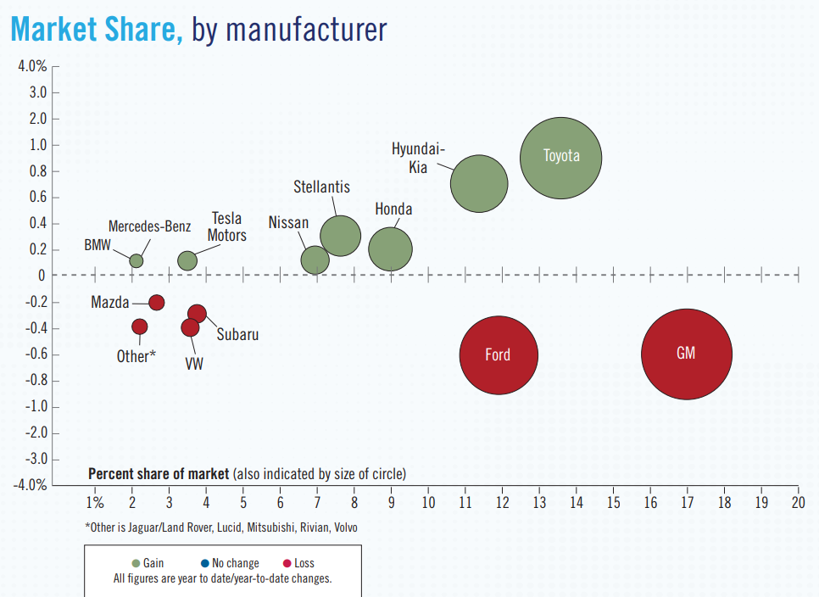
MARKET SHARE, by manufacturer
Source: NADA

Slide 5
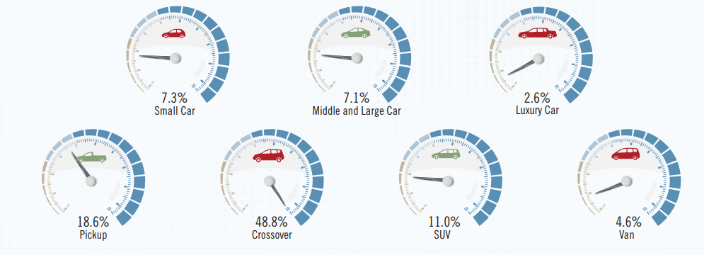
MARKET SHARE, by segment
7.3%
7.1%
2.6%
Small Car
Middle and Large Car
Luxury Car
18.6%
48.8%
11.0%
4.6%
Pickup
Crossover
SUV
Van
Source: NADA

Slide 6
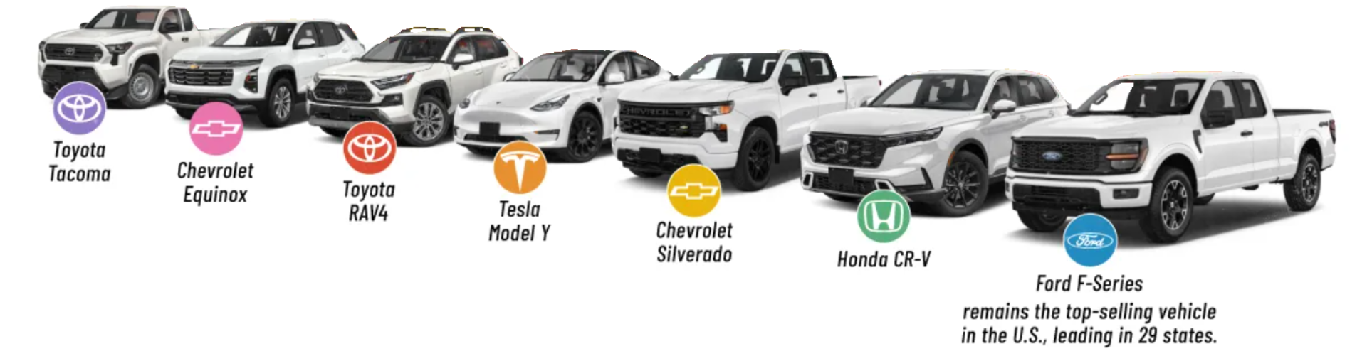
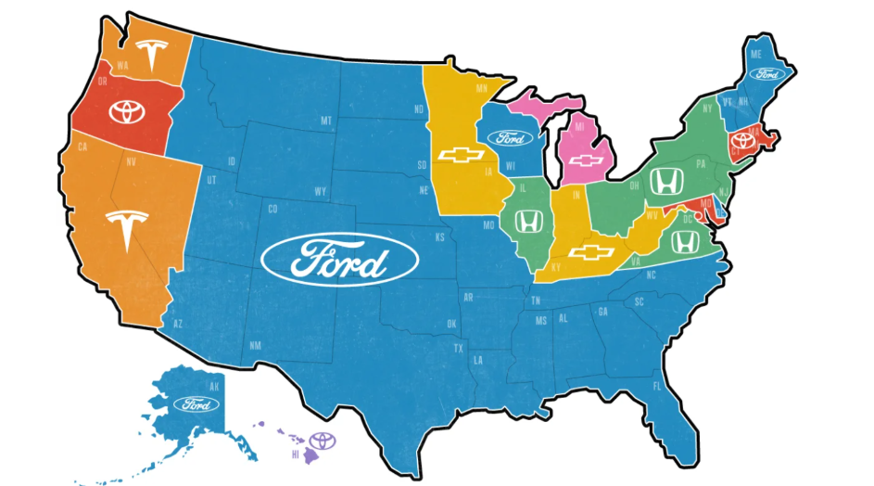

Toyota
Tacoma
Chevrolet
Equinox
Toyota
RAV4
Tesla
Model Y
Chevrolet
Silverado
Honda CR-V
Ford F-Series
remains the top-selling vehicle
in the U.S., leading in 29 states.
Source: Edmunds. Data for 2025 new vehicle registrations. Logos on the map represent the best-selling model in the legend. Ford F-Series includes multiple models like the F-150, F-250, F-350, F-450, etc.

Slide 7
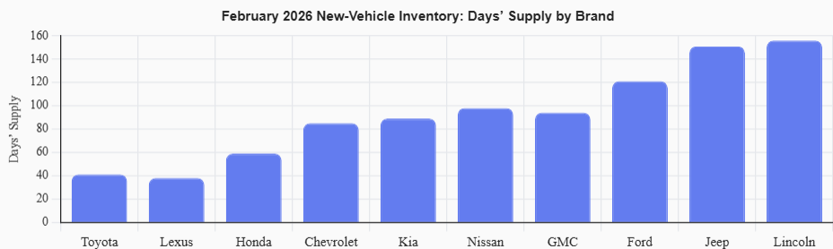
DAYS SUPPLY
February 2026 new-vehicle inventory shows sharp brand divergence
Toyota (41 days) and Lexus (38 days) remain exceptionally tight.
INDUSTRY AVERAGE: 92 days
Ford (121), Jeep (151), and Lincoln (156) carry significant excess supply.
February 2026 New-Vehicle Inventory: Days’ Supply by Brand
160
140
120
100
Days’ Supply
80
60
40
20
0
Toyota
Lexus
Honda
Chevrolet
Kia
Nissan
GMC
Ford
Jeep
Lincoln
Source: Cox Automotive

Slide 8
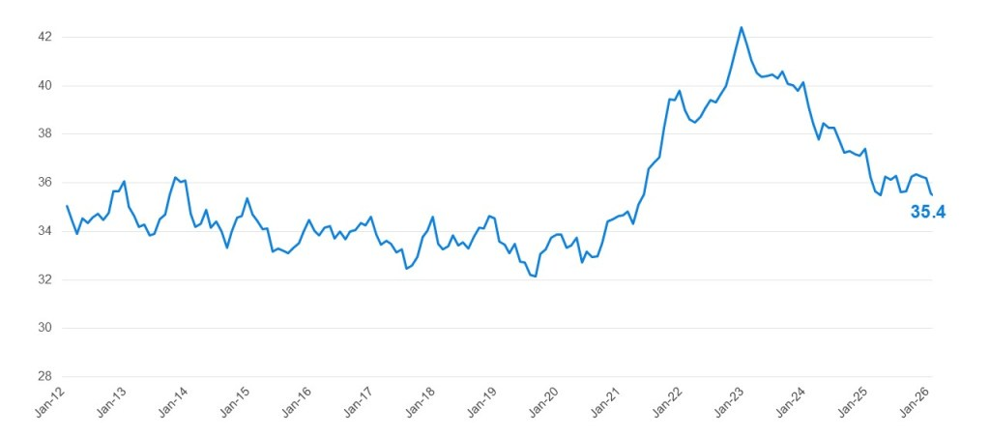
VEHICLE AFFORDABILITY INDEX
Weeks of Income Needed to Purchase a New Light Vehicle
February 2026
42
40
38
36
34
32
30
28
Jan-12
Jan-13
Jan-14
Jan-15
Jan-16
Jan-17
Jan-18
Jan-19
Jan-20
Jan-21
Jan-22
Jan-23
Jan-24
Jan-25
Jan-26
Source: Cox Automotive

Slide 9
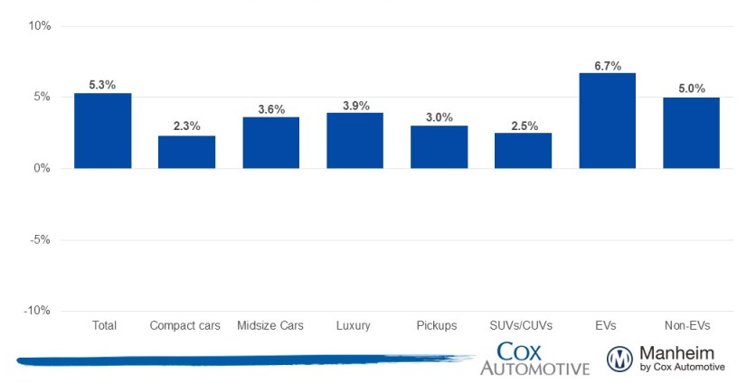
Prices in the overall market rose 5.3% year over year,
supported by price growth across all major segments and the continued
strength of the luxury segment.
Price Changes for Selective Market Classes
year-over-year % change, Mid March 2026
10%
6.7%
5.3%
5.0%
5%
3.6%
3.9%
2.3%
3.0%
2.5%
0%
-5%
-10%
Total
Compact Cars
Midsize Cars
Luxury
Pickups
SUVs/CUVs
EVs
Non-EVs

Slide 10
USED VEHICLE UPDATE
February used-vehicle inventory levels were down month over month, but higher than in February 2025.
The used-vehicle sales paces improved in February, as prices softened modestly from January.
2.18M
$25,287
Total inventory
as of Feb. 2026
48
Average Listing Price
Days Supply
Source: Cox Automotive/vAuto

Slide 11
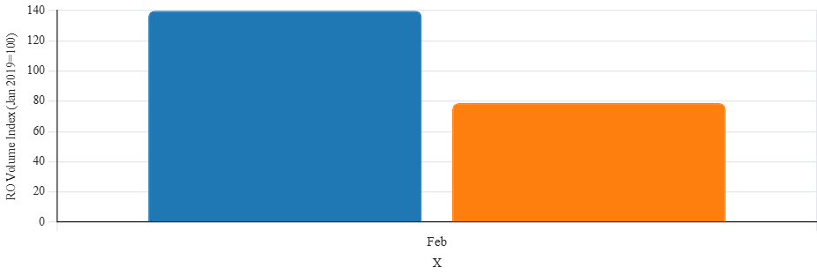
FIXED OPS
Revenue remains elevated ($ per RO)
Traffic/RO volume is
below baseline
140
120
100
80
RO Volume Index (Jan 2019=100)
60
40
20
0
Feb
X
RO Index 139.9
RO Index 78.8
Source: Cox Automotive

Slide 12
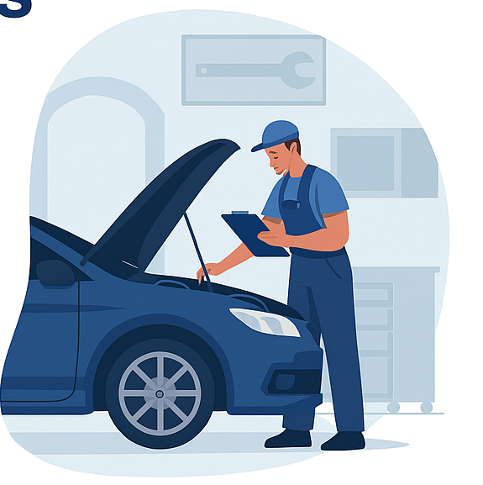

February Service revenue grew despite lower traffic, highlighting the structural strength of Fixed Ops. Rising revenue per RO continues to offset seasonal softness in volume – keeping Fixed Ops a critical profit driver.
What this means:
Fixed Ops remains a stabilizer
Consumers are repairing, not replacing
Execution matters
Source: Cox Automotive

Slide 13
2026 FORECAST TAKEAWAYS
The automotive industry is expected to face challenges and opportunities in 2026, particularly in EV adoption, supply chain dynamics and consumer affordability.
Supply Chain Shifts: The automotive sector is undergoing a transformation in its supply chains, with manufacturers focusing on reshoring and diversifying suppliers to mitigate risks.
EV Affordability: With the expiration of the federal EV tax credits, the affordability of EV’s will be a critical issue. However, with the introduction of new lower-cost models it may ignite greater consumer demand.
There is also a tremendous opportunity to market pre-owned EV Inventory
Consumer Demand and Market Dynamics: As car prices hover around 50K, affordability will be a key factor influencing purchasing decisions.
INCENTIVES, FINANCING AND A ROBUST USED CAR MARKET WILL BE CRITICAL FOR MANUFACTURERS TO ATTRACT BUYERS.

Slide 14
FORECASTS
Updated 12/17/25
15.8M (-2.4% versus 2025) NEW SALES | 13.1M (-1.5% versus 2025) NEW RETAIL SALES | 2.7M (-6.1% versus 2025) FLEET SALES
2.8M (-12.6% versus 2025) NEW LEASE VOLUME | 21% (-3% versus 2025) LEASE PENETRATION | 2.6M (-2.2% versus 2025) CPO SALES
38.3M (-0.9% versus 2025) USED SALES | 20.3M (-0.7% versus 2025) USED RETAIL SALES | 2.0% (+1.7% versus 2025) DEC 2026 Y/Y MANHEIM USED VEHICLE VALUE INDEX
Source: Cox Automotive

