Slide 1
MARCH AUTOMOTIVE UPDATE
Trisha Ripperger, EVP, Chief Client & Communications Officer

Slide 2



March New Car Sales Review
 | 2026 | 2025 | % Change
Total Sales | 1.403m | 1.593m | -11.9%
Retail Sales | 1.129m | 1.285m | - 12.1%
SAAR | 16.3m | 17.9m | - 8.7%
Retail SAAR | 13.5m | 14.4m | - 6.5%

Slide 3
Inventory & Days Supply
Total inventory: 2.89M vehicles (+1.3% MoM)
Industry days’ supply: 79 days (down from 96 in February)
March improvement driven by higher sales pace—not inventory cuts
Inventory pressure remains brand-specific (not market-wide)
Luxury and import brands like Toyota, Lexus, and Audi continue to maintain the leanest inventories while Stellantis brands remain at the high end

Slide 4
March Days’ Supply of Inventory By Brand
Automotive New-Vehicle Day’s Supply by Make (March 2026)
Days of Supply

Slide 5
Key Takeaways on Inventory
Days’ supply improvements reflect faster selling, not a collapse in inventory.
Excess supply is concentrated among a handful of brands.
Where inventory is high, marketing is the lever to protect margin.
BROADCAST HELPS CONVERT DEMAND QUICKLY
WHEN SUPPLY IS UNEVEN

Slide 6
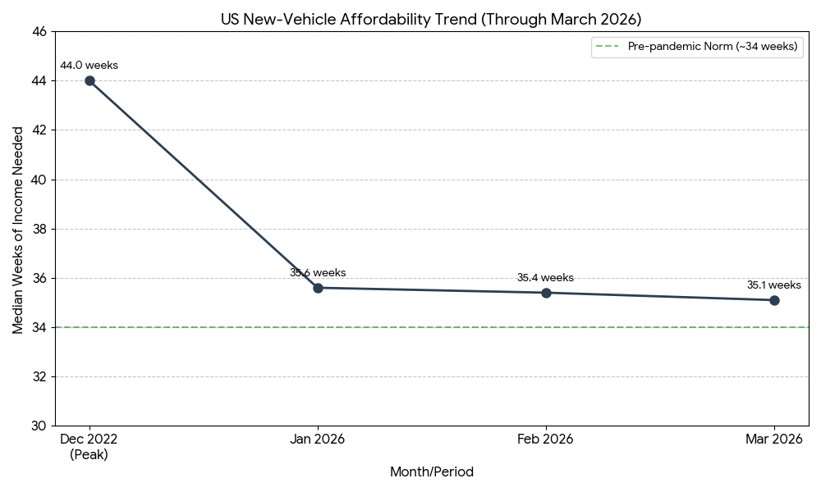
New Vehicle Affordability

Slide 7
March 2026 $48,667 Average Listing Price
SEVERAL KEY FACTORS INFLUENCING THESE PRICES:
Inventory Mix Skew
Pricing Power vs. Margin Protection
While listing prices appear stable, the market is “bifurcated.” Inventory growth is heavily concentrated in vehicles priced above $40,000 (largely full-size SUV’s and pickups). Conversely, the supply of affordable vehicles (under $40,000) remains extremely tight, which keeps average asking prices high even as demand for expensive models softens.
Dealers are finding it difficult to significantly raise asking prices without rising a sharp drop in sales volume. Instead, they are increasing incentives – now averaging 7.2% of the transaction price – to move higher-priced inventory.
Income Growth Outpacing Inflation
Cost Pressures
A significant highlight for March is that despite high prices, affordability actually improved. Household income rose by 3.9% year-over-year, outpacing the 3.5% rise in vehicle transaction prices. This has led to the “Median Weeks of Income” index falling to its lowest point in years (35.1 weeks).
Analysts also noted that automakers are beginning to pass along tariff-related costs into the MSRP, which explains why sticker prices are rising faster (+3.9%) than actual transaction prices (+3.5%) where dealers are forced to negotiate or discount.

Slide 8
Used Vehicle Update
As the spring selling season ramped up, the used-vehicle market in March 2026 saw a seasonal tightening of inventory and a slight uptick in prices compared to the start of the year.
2.14M
44
$25,815
Total Inventory
Days Supply
Average Listing Price
Inventory Contraction: Total used inventory dipped to 2.14 million units in March. This is a typical seasonal pattern as tax refund season drives higher consumer demand, drawing down the stock that dealers built up during the winter months.
Faster Turn Rates: The days' supply dropped to 44 days, indicating that used vehicles are moving off lots faster than they were in January. This increased velocity is largely due to improved consumer traffic in showrooms as weather conditions improved and interest rates showed signs of stabilization.
Price Appreciation: The average listing price rose to $25,815. While modest, this increase reflects a shift in the "mix" of available inventory—specifically, a higher volume of newer, lower-mileage off-lease vehicles entering the market compared to the older high-mileage units that dominated the winter supply.

Slide 9
:
2
4
5
Key Opportunity for Marketing
Target “Lean Inventory” Buyers
With brands like Toyota, Lexus, and Audi maintaining very low days’ supply (36 days), marketing for these makes should pivot from broad “sales events” to “reservation” or “in-transit” messaging.
  Strategy: Focus on “Claim yours before it arrives” to capture high-intent buyers who are competing for limited stock.
Aggressive Incentives for Over-Supplied Brands
Stellantis brands, specifically Chrysler (158 days), Dodge (131 days), and Jeep (125 days), are carrying more than double the national average of inventory.
  Strategy: These brands have a critical need for broadcast-heavy retail campaigns focusing on significant manufacturer incentives, low-APR financing, and lease deals.

Slide 10
:
2
4
5
Key Opportunity for Marketing
Highlight Improved Affordability
With vehicle affordability reaching a three-year best in March (35.1 weeks of income), there is a psychological window to re-engage sidelined buyers.
  Strategy: Shift marketing copy from “Prices are high” to “Your dollar goes further.” Use data-driven creative that highlights how income growth and lower loan rates have lowered the monthly payment burden compared to last year.
Pre-Owned EV Education
As new EV inventory begins to stabilize and some federal credits shift, a secondary market for used EVs is growing.
  Strategy: Position used EVs as the “ultimate value play” for commuters, emphasizing the low total cost of ownership (TCO) and available pre-owned EV tax credits. Marketing should focus on debunking battery-life myths and highlighting the immediate savings over internal combustion engine (ICE) counterparts.

Slide 11
March 2026 Fixed Ops
TREND PERFORMANCE
Service Revenue Index | Slight Recovery | Rising from the -1.6% low in Jan as deferred maintenance from winter is addressed.
Ticket Volume Index | Increasing | Rebounding from the -7.7% Jan slump; driven by spring inspections and tire changeovers.
Average Revenue per Repair Order | Growing | Higher parts costs and complex EV maintenance are driving the average ticket price up, even when volume is flat.
Customer Pay vs. Warranty | Mixed | Customer pay revenue is seeing seasonal growth, while warranty work remains a steady baseline for most franchised dealers.

Slide 12
2026 March Fixed Ops
The “Service Drive” as an Inventory Source:
Fixed Ops is currently the most efficient “acquisition engine” for pre-owned inventory. Dealers are using the March uptick in service visits to identify high-quality trade-ins before they hit the expensive auction market.
Declining Ticket Volume:
The significant drop in ticket volume earlier in the year has forced dealers to be more aggressive with service-based marketing. In March, successful dealers are shifting budgets toward “Spring Maintenance” specials to fill bays that were quiet during the winter months.
EV Impact:
Fixed Ops departments are reporting a continued shift in revenue mix. While EVs require fewer oil changed, the “per-visit” revenue for March has been bolstered by high-margin items like tires, cabin filters, and software updates, which are more frequent or costly in the EV segment.

Slide 13
2026 Forecasts
Updated End of Q1 2026
15.8M (-2.6% versus 2025) NEW SALES | 13.1M (-2.3% versus 2025) NEW RETAIL SALES | 2.8M (-4.2% versus 2025) FLEET SALES
2.8M (-12.7% versus 2025) NEW LEASE VOLUME | 22% (-2% versus 2025) LEASE PENETRATION | 2.6M (-0.8% versus 2025) CPO SALES
38.3M (-1.0% versus 2025) USED SALES | 20.4M (-0.8% versus 2025) USED RETAIL SALES | 2.0% (+1.7% versus 2025) DEC 2026 Y/Y MANHEIM USED VEHICLE VALUE INDEX

