Slide 1
MAY AUTOMOTIVE UPDATE
Trisha Ripperger, EVP, Chief Client & Communications Officer

Slide 2


MAY 2026
The May jobs report delivered a genuine upside surprise, with nonfarm payrolls rising 172,000 against expectations of 88,000. For auto dealers, the headline is a positive note: A healthier labor market supports consumer confidence and big-ticket purchase intent.
Sales volume was 1.47 million units, slightly higher than year-ago levels but up 7% from April.
For dealers, the picture heading into summer is one of genuine crosscurrents. New-vehicle demand at the higher end of the market remains. Used-vehicle demand and trade-in values continue to benefit from substitution effects. Credit availability remains near multi-year highs. But gas prices near $4.25 nationally, rising Treasury yields, and consumers increasingly cautious on discretionary spending are creating real headwinds for volume in the mid-market.

Slide 3

MAY NEW CAR SALES REVIEW
 | 2026 | 2025 | % Change
Total Sales | 1.466m | 1.461m | +0.4%
Retail Sales | 1.203m | 1.186m | +1.4%
SAAR | 16.1m | 15.6m | +3.2%
Retail SAAR | 13.4m | 12.7m | +5.5%
Notes:
Commplete

Slide 4
INVENTORY & DAYS SUPPLY
Dealers ended May with more cars in stock than they started.
Car brands started May with an average of 67 days. They ended it with 70.
The traditional target is 75 — 60 days’ worth on the lot and 15 more in transit — so they’re slightly below where they’d like to be.
Inventory remains 12.2% lower than a year ago, but each brand is in a unique situation.

Slide 5
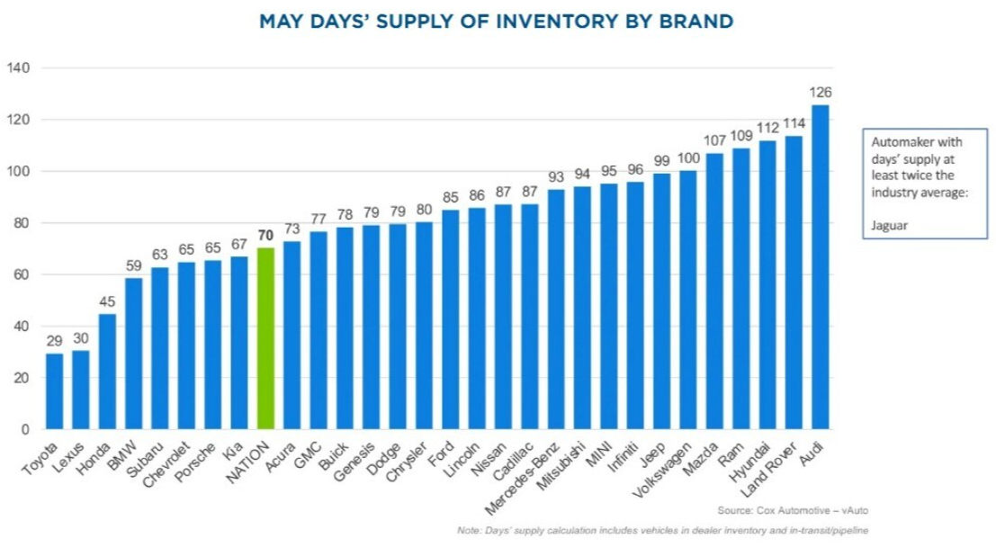
INVENTORY & DAYS SUPPLY
Source: KBB/Cox Automotive

Slide 6
INVENTORY & DAYS SUPPLY
Things Could Change Fast
Dealers may be in no hurry to restock, as lower inventories give them some negotiating leverage, and constant changes to tariff policy have some hoping to wait out the White House.
Several brands are holding thousands of cars at port warehouses because they don’t pay the tariff until they remove them from port. If the White House lowers tariffs as part of ongoing negotiations with several countries, we expect a flood of new cars delivered to dealerships quickly.
The industry is also waiting on more information about a purported deal on rare earth metals. China had interrupted supplies of the metals, which automakers use in every car. That move paused at least one factory and threatened wide-scale disruptions.

Slide 7
AVERAGE TRANSACTION PRICE
Industry ATP: The ATP for a new vehicle, according to Kelley Blue Book, was $49,220, down from Aprils’ $49,461.
March 2026 $49,275
April 2026 $49,461
Manufacturers eased off the pricing discipline recorded in April, leaning on incentives to support stronger May volume.
Source: KBB

Slide 8
ATP BY SEGMENT
 | ATP ($) | YoY Change
Midsize SUV | $50,185 | +2.9%
Compact SUV | $37,757 | +3.4%
Full-Size Pickup | $66,288 | +2.4%
Subcompact SUV | $31,122 | +4.2%
Compact Car | $27,443 | +0.7%
Source: Cox Automotive

Slide 9
ATP BY BRAND | Mainstream
Mainstream Brands | ATP ($) | YoY Change
Toyota | $46,686 | +3.7%
Ford | $56,316 | +3.8%
Chevrolet | $48,884 | -1.2%
Honda | $37,772 | +1.0%
Hyundai | $37,219 | +2.4%
Kia | $39,160 | +9.1%
Nissan | $36,018 | +1.8
Source: Cox Automotive

Slide 10
ATP BY BRAND | Luxury
Luxury Brands | ATP ($) | YoY Change
Cadillac | $84,650 | +5.8%
BMW | $73,011 | +0.3%
Mercedes | $72,763 | -2.5%
Lexus | $62,961 | +2.6%
Lincoln | $74,301 | +7.1%
Infiniti | $72,614 | +8.6%
Cadillac | $84,650 | +5.8%
Source: Cox Automotive

Slide 11
MSRP | $51,595
May pricing data shows a market that remains disciplined at the sticker-price level, while incentives increased modestly to support sales volume.
Average MSRP was $51,595 essentially unchanged from April, while ATP eased to $49,220, leaving an average gap of $2,375 between asking price and actual transaction price. That gap reflects incentive spending equal to 7.1% of ATP - up from 6.9% in April.
Source: Federal Reserve Bank of St. Louis

Slide 12
Key opportunity for marketing
:
2
4
5
  Dealers are operating in a market where headline sticker prices remain firm, but purchase support is doing more of the work.
  That creates a strong opportunity to market:
  Value
  Payment flexibility
  Available incentives
Notes:
Incomplete
Value
Payment flexibility
Available incentives

Slide 13
FIXED OPS PERFORMANCE TRENDS
Service remains a major profit driver
  Service Departments entered May operating near peak revenue levels continuing strong performance from Q1/Q2 trends
Demand is strong – but share is slipping
  Shops were busy, but dealers continued losing some traffic to independents
  Strong revenue full market capture
Aging vehicles are driving service volume
  Consumers keep cars 5+ years - driving vehicles to 10 years old on average which means more repair frequency and higher ticket values
Higher repair order value = key growth driver
  Customers receiving digital inspections (photos/video) spend $640 per RO vs $410 without
Missed opportunities remains significant
  Each lost service encounter = 12K+ lifetime value lost
Source: Cox Automotive

Slide 14
Talk tracks when speaking with Dealers
Pricing Environment Has Shifted → Lead with Value
  MSRP holding steady (~$51.6k) while incentives rise
  ATP softened slightly → buyers are more deal-sensitive
✅ Talk Track:
“Today’s buyers aren’t just looking for price – they’re looking for value. Strong messaging helps you capture that demand without giving away margin.”

Slide 15
Talk tracks when
speaking with Dealers
Demand is Still There – But More Selective
  Sales holding near 15.8M annually (normalized, not declining sharply)
  Market is more fragmented by income and affordability
✅ Talk Track:
“Shoppers are still active – but you have to reach the right audience faster. Mass reach plus targeting wins in today’s market.”
15

Slide 16
Talk tracks when
speaking with Dealers
Inventory + Incentives = Marketing Opportunity
  Incentives increasing to help move specific vehicles
  Mix imbalance (high supply in some segments)
✅ Talk Track:
“When you have inventory to move, media is the fastest way to generate demand without relying solely on price cuts.”
16

Slide 17
Talk tracks when
speaking with Dealers
Leasing Down → Payments Matter More
  Lease penetration down to ~21%
  Fewer leases = higher perceived monthly payments
✅ Talk Track:
“Messaging that emphasizes affordability, payments,
and financing is more important than ever.”
17

Slide 18
Talk tracks when
speaking with Dealers
Used + Fixed Ops Are Stability Drivers
  Used market holding steady (~38M units)
  Fixed ops delivering record revenue levels (Cox Study)
✅ Talk Track:
“Dealers aren’t just selling new cars – service and used vehicles are
critical growth engines that need consistent visibility.”
18

Slide 19
Talk tracks when
speaking with Dealers
Visibility = Market Share in a Flat Market
  Lower overall growth means shares battles intensify
✅ Talk Track:
“When demand flattens, the dealers who stay visible are the ones
who gain share – while others fall behind.”
19

Slide 20
2026 FORECASTS
Updated End of Q1 2026
15.8M (-1.3% versus 2025) UPDATED 5/2026 NEW SALES | 13.1M (-2.3% versus 2025) NEW RETAIL SALES | 2.8M (-4.2% versus 2025) FLEET SALES
2.8M (-12.7% versus 2025) NEW LEASE VOLUME | 22% (-2% versus 2025) LEASE PENETRATION | 2.6M (-0.8% versus 2025) CPO SALES
38.3M (-1.0% versus 2025) USED SALES | 20.4M (-0.8% versus 2025) USED RETAIL SALES | 2.0% (+1.7% versus 2025) DEC 2026 Y/Y MANHEIM USED VEHICLE VALUE INDEX
Source: Cox Automotive

