Slide 1
American Conversation Study
Financial/banking category Opinion Leaders
2022

Slide 2
The American Conversation
Word of Mouth has always been a critical influencer
“The most powerful form of marketing” – McKinsey
Modeling consistently shows conversation drives up to 50% of consumer sales
Source: Engagement Labs

Slide 3
Purpose of this study
This study was commissioned to assess and quantify the role media platforms have in driving Americans’ conversations.

Slide 4
Methodology
This study was conducted online among a sample of 2,000 Americans, age 18+.
The data has been weighted to demographically reflect the US Census
People were asked to recall the topics of their conversations from the past 24 hours, and then were asked a series of questions describing up to 5 category conversations.
Each of these conversations were the person’s most significant or meaningful conversation in the category. Categories followed up upon were selected randomly.
Respondents were also asked attitudinal questions.
Questions were asked to identify opinion leaders in key categories. This deck highlights Financial/Banking opinion leaders.
When items in the survey reflected local stations, the respondent’s local affiliate call letters were shown.
The survey was fielded online from February, 22nd to March 8th, 2022.
The median interview length was 20 minutes.

Slide 5
Financial/Banking opinion leaders Categories On Which they frequently give advice, suggestions and ideas to other people, such as family and friends Analysis subject to sample size

Slide 6
The Primary Effect on News of the Day Conversations Is TV
% of Financial/Banking Opinion Leader Conversations Affected By External Factors,
either as conversation spark or through being referenced in conversation
Base: Financial/Banking Opinion Leaders (News of the Day conversations, n=431)
Q8/Q9) Which of the following comes closest to describing what prompted or sparked the conversation?
Source: Engagement Labs TVB American Conversation Study 2022

Slide 7
Broadcast TV Is A More Powerful Conversation Driver Than Cable TV
% of Financial/Banking Opinion Leader Conversations Affected By TV Type,
either as conversation spark or through being referenced in conversation
Base: Financial/Banking Opinion Leaders (All Conversations, n=1704; News of the Day, n=431)
Q9a) Conversations including either media spark or reference.
Source: Engagement Labs TVB American Conversation Study 2022

Slide 8
Local Broadcast TV is The Primary Source of News For Financial/Banking Opinion Leaders
% of Financial/Banking Opinion Leaders Consuming Local/Regional News
Base: Financial/Banking opinion leaders, n=369
Q11) Primarily, which source do you use to get your news and information?
Source: Engagement Labs TVB American Conversation Study 2022

Slide 9
Out of 5 choices, the top 4 were Broadcast Networks For Financial/Banking Opinion Leaders
If you could get only 5 channels of your choice on your television set, which 5 channels would you pick?
BROADCAST NETWORK
CABLE NETWORK
Base: Financial/Banking Opinion Leaders, n=369 Q21A) If you could get only 5 channels of your choice on your television set, which 5 channels would you pick? Source: Engagement Labs TVB American Conversation Study 2022

Slide 10
How Likely Are You To Believe What Somebody Tells You If They Say They Heard About it From This Source?
% of Financial/Banking Opinion Leaders More Likely To Believe What They See/hear from this source…
Base: Financial/Banking Opinion Leaders, n=369
Q14: How likely are you to believe what somebody tells you if they say they heard about it from this source? Top 2 box shown
Source: Engagement Labs TVB American Conversation Study 2022

Slide 11
Local Broadcast TV News Sources Are #1 For Trust Among Americans…Far More Than Cable News Or Social Media
% of Financial/Banking Opinion Leaders Who Trust News from…
Top 2 Box
79%
78%
78%
77%
75%
74%
70%
70%
67%
66%
65%
57%
36%
Base: Financial/Banking Opinion Leaders, n=369
Q17: For each source, please indicate the extent to which you agree or disagree with the following statement: I trust the news that I see/hear on…
Source: Engagement Labs TVB American Conversation Study 2022

Slide 12
‘Fake News’ is Perceived as Greatest on Social Media
% of Financial/Banking Opinion Leaders Who Find Fake News Most Prevalent on…
Base: Financial/Banking Opinion Leaders, n=369
Q16: I Find the problem with “fake news” to be most prevalent on…
Source: Engagement Labs TVB American Conversation Study 2022

Slide 13
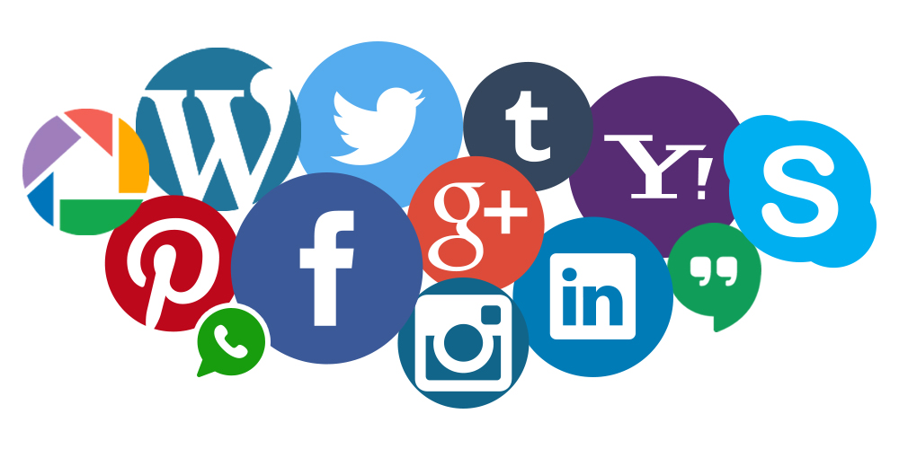
Financial/Banking Opinion Leaders Associate with a Trusted, Platform
“How likely are you to believe what you see/hear on…”
80%
69%
42%
“I trust the news I see/hear on…”
79%
67%
36%
“Fake news most prevalent on…”
7%
23%
65%
Base: Financial/Banking Opinion Leaders Q14,Q16, Q17 top 2 boxes shown
Source: Engagement Labs TVB American Conversation Study 2022

Slide 14
For Financial/Banking Opinion Leaders, TV and Local News Are Very Important
% of Category Opinion Leaders Who Agree (top 2 boxes) by Financial/Banking
Base: Total Public n=2000; Financial/Banking opinion leaders n=369
Q13) Please tell us if you agree or disagree with the following statements? (Top 2 Box shown Strongly agree + Somewhat agree).
Source: Engagement Labs TVB American Conversation Study 2022

Slide 15
Out of a Choice of 30 Issues, These Topics Resonated the Most Among Financial/Banking Opinion Leaders
Issues | % Financial/Banking Opinion Leaders
Attack on Ukraine | 53%
Energy or gasoline costs | 38%
What’s happening in other countries | 38%
Vaccine and mask mandates | 37%
The President and how he is doing his job | 37%
The overall state of the economy | 35%
Concern about your own financial situation | 29%
Healthcare or health insurance | 29%
Inflation | 28%
Something seen on TV (show, sporting event, etc.) | 28%
Base: Financial/Banking Opinion Leaders, n=369
QISSUES: Can you please tell us which of these topics you’ve had a conversation about during the last 24 hours, whether in person, over the phone, or online? Top ten issues shown
Source: Engagement Labs TVB American Conversation Study 2022

Slide 16
Key Findings: Financial/Banking Opinion Leaders
The primary effect on news of the day conversations is TV.
Broadcast is a bigger driver of conversations than cable for News of the Day conversations.
Local broadcast TV news is:
The primary source of news for local/regional news consumption
#1 for trust
Most believable
When given a choice, they choose broadcast over cable.
Fake news is perceived to be the greatest on social media.
TV and local TV news are very important to Financial/Banking opinion leaders
Out of 30 topical issues, the attack on Ukraine, energy or gasoline costs, and what’s happening in other countries resonated the most with Financial/Banking opinion leaders.

