Slide 1
American Conversation Study
Legal Category Opinion Leaders
2022

Slide 2
The American Conversation
Word of Mouth has always been a critical influencer
“The most powerful form of marketing” – McKinsey
Modeling consistently shows conversation drives up to 50% of consumer sales
Source: Engagement Labs

Slide 3
Purpose of this study
This study was commissioned to assess and quantify the role media platforms have in driving Americans’ conversations.

Slide 4
Methodology
This study was conducted online among a sample of 2,000 Americans, age 18+.
The data has been weighted to demographically reflect the US Census
People were asked to recall the topics of their conversations from the past 24 hours, and then were asked a series of questions describing up to 5 category conversations.
Each of these conversations were the person’s most significant or meaningful conversation in the category.
Categories followed up upon were selected randomly.
Respondents were also asked attitudinal questions.
Questions were asked to identify opinion leaders in key categories. This deck highlights Legal opinion leaders.
When items in the survey reflected local TV stations, the respondent’s local affiliate call letters were shown.
The survey was fielded online from February, 22nd to March 8th , 2022
The median interview length was 20 minutes.

Slide 5
Legal opinion leaders Categories On Which they frequently give advice, suggestions and ideas to other people, such as family and friends Analysis subject to sample size

Slide 6
For Legal Opinion Leaders, The Primary Effect on News of the Day Conversations Is TV
% of Legal Opinion Leader’s Conversations Affected By External Factors,
either as conversation spark or through being referenced in conversation
Base: Legal Opinion Leaders (News of the day conversations n=206)
Q8/Q9) Which of the following comes closest to describing what prompted or sparked the conversation?
Source: Engagement Labs TVB American Conversation Study 2022

Slide 7
Broadcast TV Is A More Powerful Conversation Driver Than Cable TV
% of Legal Opinion Leader’s Conversations Affected By TV Type,
either as conversation spark or through being referenced in conversation
Base: Legal Opinion Leaders (All Conversations, n=869; News of the Day, n=206) Q9a) Conversations including either media spark or reference.
Source: Engagement Labs TVB American Conversation Study 2022

Slide 8
For Legal Opinion Leaders, Local Broadcast TV is The Primary Source of News
% of Legal Opinion Leaders Consuming Any Type of News
Base: Legal Opinion Leaders, n=190
Q11) Primarily, which source do you use to get your news and information?
Source: Engagement Labs TVB American Conversation Study 2022

Slide 9
Out of 5 choices, the top 4 were Broadcast Networks For Legal Opinion Leaders
If you could get only 5 channels of your choice on your television set, which 5 channels would you pick?
BROADCAST NETWORK
CABLE NETWORK
Base: Legal Opinion Leaders, n=190 Q21) If you could get only 5 channels of your choice on your television set, which 5 channels would you pick? Source: Engagement Labs TVB American Conversation Study 2022

Slide 10
How Likely Are You To Believe What Somebody Tells You If They Say They Heard About it From This Source?
% of Legal Opinion Leaders More Likely To Believe What They See/hear from this source…
Base: Legal Opinion Leaders, n=190
Q14: How likely are you to believe what somebody tells you if they say they heard about it from this source? Top 2 box shown
Source: Engagement Labs TVB American Conversation Study 2022

Slide 11
Local Broadcast TV News Sources Are Among The Most Trusted …Far More Than Cable News Or Social Media
% of Legal Opinion Leader’s Who Trust News from…
Top 2 Box
79%
76%
73%
73%
71%
69%
69%
68%
68%
68%
64%
56%
40%
Base: Legal Opinion Leaders n=190
Q17: For each source, please indicate the extent to which you agree or disagree with the following statement: I trust the news that I see/hear on…
Source: Engagement Labs TVB American Conversation Study 2022

Slide 12
‘Fake News’ is Perceived as Greatest on Social Media
% of Legal Opinion Leader’s Who Find Fake News Most Prevalent on…
Only 5% report ‘fake news’ to be most prevalent on local broadcast TV
Base: Legal Opinion Leaders , n=190
Q16: I find the problem with “fake news” to be most prevalent on…
Source: Engagement Labs TVB American Conversation Study 2022

Slide 13
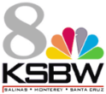
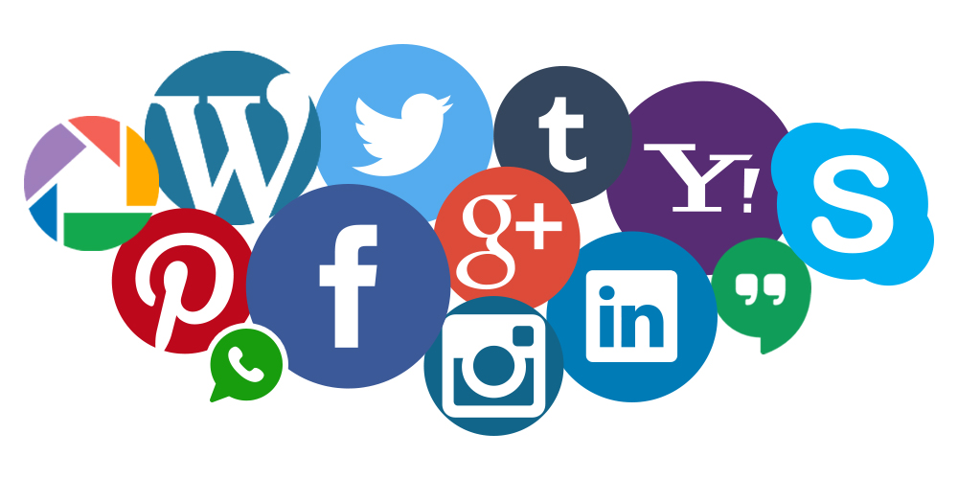
Legal Opinion Leaders Associate with a Trusted, Believable, Platform
“Likely to believe what somebody tells you if they heard it from…”
83%
72%
46%
“I trust the news I see/hear on…”
79%
68%
40%
“Fake news most prevalent on…”
5%
19%
59%
Base: Legal Opinion Leaders, n=190 Q14,Q16, Q17 top 2 boxes shown
Source: Engagement Labs TVB American Conversation Study 2022

Slide 14
For Legal Opinion Leaders, TV and Local News Are Very Important
% of People Who Agree (top 2 boxes) by Legal Category Opinion Leaders
Base: Total Public n=2000; Automotive opinion leaders n=190
Q13) Please tell us if you agree or disagree with the following statements? (Top 2 Box shown Strongly agree + Somewhat agree).
Source: Engagement Labs TVB American Conversation Study 2022

Slide 15
Out of a Choice of 30 Issues, These Topics Resonated the Most Among Legal Opinion Leaders
Issues | % Legal Opinion Leaders
Attack on Ukraine | 49%
What’s happening in other countries | 39%
The President and how he is doing his job | 35%
Energy or gasoline costs | 35%
The overall state of the economy | 35%
Vaccine and mask mandates | 34%
Mental health | 32%
Healthcare or health insurance | 31%
Something seen on TV (show, sporting event, etc.) | 31%
Concern about your own financial situation | 29%
Base: Legal Opinion Leaders, n=190
QISSUES: Can you please tell us which of these topics you’ve had a conversation about during the last 24 hours, whether in person, over the phone, or online? Top ten issues shown
Source: Engagement Labs TVB American Conversation Study 2022

Slide 16
Key Findings: Legal Opinion Leaders
The primary effect on news of the day conversations is TV.
Broadcast is a bigger driver of conversations than cable.
Local broadcast TV news is their primary news source, and is the most believable and trustworthy.
If people could get only 5 TV channels, 4 of them would be Broadcast.
Fake news is perceived to be the greatest on social media and the lowest on local broadcast TV.
TV and local broadcast TV news are very important to Legal Opinion leaders in many ways.
Out of a choice of 30 topical issues, the attack on Ukraine, what’s happening in other countries, and the president and how he is doing his job resonated the most with Legal Opinion Leaders.

