Slide 1
2023
Purchase Funnel Study

Slide 2
Study Objective and Methodology

Slide 3
Objective: To identify the importance of media platforms in influencing automotive consumers during their purchase decision process.
TVB commissioned to do the research study.

Slide 4
Automotive Research Overview: Methodology
WHO:
The general study which included 8 categories (Automotive, Banking, Furniture/Bedding/Carpet, Legal, Medical: Hospital/Urgent care, Medical: Dentist/Orthodontist, Eye doctor/Lasik, Online retail, and In-Store retail) had 4,000 interviews collected via opt-in sample. Each respondent answered a series of questions for up to three product/service categories
This analysis focuses on the automotive category. The number of respondents for the automotive category was 1,591
To qualify for the automotive category, respondents needed to be age 18+ and:
Recently purchased or plan to purchase in the near future a car, truck, or SUV (purchase or lease)
Have seen/heard or read an advertisement for that category in ANY of about 20 media platforms both traditional and digital, in the past 2 months
WHEN: Interviews took place December 1, 2022– December 15,2022
WHAT: Via 12-minute online quantitative survey about the influence of advertising platforms at each stage of the consumer purchase decision, actions taken post-advertising, and attitudinal questions
Respondents were given the choice of taking the survey in either English or Spanish
Source: GfK TVB Purchase Funnel 2023 Automotive category

Slide 5
These are the media platforms measured Respondents did not have to be exposed to a TV ad to be included in the study
TV
Radio
Mail
OOH
Print
Digital
(Broadcast, Cable and On-Demand)
(Billboard and Movie Theater)
(Newspaper and Magazine, Yellow Pages)
Digital media include:
Cable site/app
Consumer review site/app
Display/banner ad
Email ad
Internet radio
Local radio station site/app
Local TV station site/app
Network TV station site/app
Magazine
Newspaper
Search engine
Social media
Streaming TV services
Video ad
Yellow Pages site/app

Slide 6
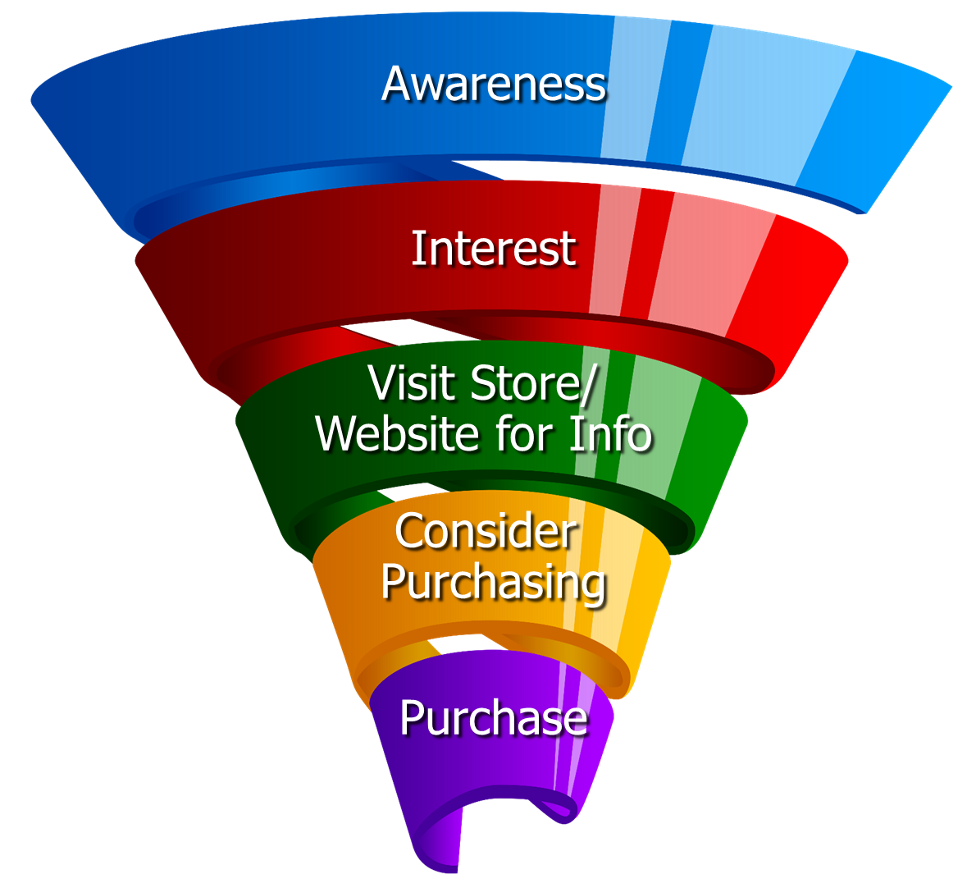
Respondents were asked to rate which medium was important in each stage of the Purchase Funnel
Reaching
Consumers
Early
Preparing for
Purchase Decision
Making a purchase

Slide 7
Media Influence

Slide 8
Media Makes a Difference in Motivating In-Market Auto Consumers…But it Declines Moving Down the Funnel
Automotive
% Influenced by Media
% NOT Influenced by Media
Source: GfK TVB Purchase Funnel 2023 Automotive Category A18+
QA4/QA5/QA6/QA7/QA8 (cume of all media cited as most important)

Slide 9
60% of Auto Respondents Were Exposed to Three or More Media Platforms, Over-indexing The Category Average
8 Category Average
Automotive
57%
60%
Source: GfK TVB Purchase Funnel 2023 Automotive Category A18+ S10/S11 “In the past two months, did you see, hear or read an advertisement for Automotive in any of these media/digital media?”

Slide 10
With Automotive Ads, TV Tops Exposure at 65%
Source: GfK TVB Purchase Funnel 2023 Automotive Category A18+ S10/S11 “In the past two months, did you see, hear or read any advertisement in any of these media/digital internet media?”

Slide 11
Ad Exposure Does NOT Guarantee Importance, Except for TV
Automotive
Source: GfK TVB Purchase Funnel 2023 Automotive Category A18+
S10/S11/QA4 “In the past two months, did you see, hear or read any advertisement in any of these media/digital internet media?”

Slide 12
What Influenced Automotive Consumers Most
Source: GfK TVB Purchase Funnel 2023 Automotive Category A18+
QA4/QA5/QA6/QA7/QA8 Most important for media with at least 1 funnel stage at 2%+ shown; 2%, 1%, & 0% not shown/labeled

Slide 13
Of Those that Cited TV as the Most Important, 60% Picked Broadcast TV
Source: GfK TVB Purchase Funnel 2023 Automotive Category A18+
QA4 How to read: Of the 44% that said TV was most important for awareness, 60% of them cited Broadcast TV as the most important.

Slide 14
The Primary Source for News: Broadcast Television
Which of the following sources, if any, would you say is your primary source for news?
Automotive A18+
Source: GfK TVB Purchase Funnel 2023 Automotive Category A18+
B1 “Which one of the following sources, if any, would you say is your primary source for news?” Among those who chose a primary source. Percentages are rounded

Slide 15
“I trust the news I see/hear on this media source”
Traditional Media
Digital Media
Source: GfK TVB Purchase Funnel 2023 Automotive Category A18+
B2 “I trust the news that I see/hear on this media source.” (Agree Strongly + Agree Somewhat)

Slide 16
Media Confluence

Slide 17
More TV Exposure Increases Importance, Trust, Preference
Automotive A18+
Source: GfK TVB Purchase Funnel 2023 Automotive Category A18+
QA4/B1/B2/C3; TV=Broadcast & Cable

Slide 18
More Exposures Means More Action For Automotive Consumers
Which of the following did you do after seeing/hearing the ads for the auto category on television?
Automotive A18+
Source: GfK TVB Purchase Funnel 2023 Automotive Category A18+
QA9 “Which of the following did you do after seeing/hearing the ads for the category on television?"

Slide 19
“Have TV ads influenced your search selections?”
8 Category Average
Source: GfK TVB Purchase Funnel 2023 Automotive Category A18+
QA10 “When doing an online search, how often, if at all, have TV ads you have seen influenced you in some ways in your search?” (Yes = combination of Every time, Most of the time & Sometimes) Among those who do online searches

Slide 20
Local Television Websites/Apps Most Preferred
Which of the following websites or apps are you most likely to turn to
when you need information about local news or events?
Automotive A18+
Source: GfK TVB Purchase Funnel 2023 Automotive Category A18+
C3 “Which of the following websites or apps are you most likely to turn to when you need information about local news or events?”

Slide 21
For Automotive Consumers, Local Television Websites/Apps Are The Most Visited Among Local Websites/Apps
When, if at all, did you last visit these types of websites or apps?
Automotive % A18+ among those that visit these websites/apps
Source: GfK TVB Purchase Funnel 2023 Automotive Category A18+
C1 “When if at all did you last visit these types of websites/apps?” Among those that visit these types of websites/apps

Slide 22
“When visiting a television station’s website or app, do you view the ads?”
8 Category Average
Automotive
Source: GfK TVB Purchase Funnel 2023 Automotive Category A18+ C2 “How often do you look at the video ads on that local television station’s website or app?”

Slide 23
“Have you ever commented, posted, liked or shared info or articles from a local TV station’s website or app?”
Source: GfK TVB Purchase Funnel 2023 Automotive Category A18+
C4 “Have you ever commented, posted, liked or shared info or articles from a local TV station’s website or app?”

Slide 24
Which of The Following Best Describes Recent Purchase?
Auto
% A18+
Source: GfK TVB Purchase Funnel 2023 A18+: Auto CI-5: “Which of the following best describes your recent purchase?”

Slide 25
Which of The Following Best Describes Recent Purchase?
Source: GfK TVB Purchase Funnel 2023 A18+: Auto; HH income CI-5: “Which of the following best describes your recent purchase?”

Slide 26
Opinion Leaders My Friends/Family Ask and Trust my Advice On This Topic

Slide 27
Automotive TV Ads Motivate Automotive Opinion Leaders
Which of the following did you do after seeing/hearing the ads for the category on television?
Friended, liked or followed what was advertised on social media (such as Facebook, Twitter)
Went online to learn more about what was advertised
Talked with others about the advertisement
Went to the website or app advertised to learn more about what was advertised
Remembered you had seen the brand advertised before (i.e., the newspaper, radio or the internet)
Source: GfK TVB Purchase Funnel 2023 Automotive Category, Opinion leaders A18+
QA9 “Which of the following did you do after seeing/hearing the ads for the category on television?”

Slide 28
Local TV Assets Resonate with Automotive Opinion Leaders
“Have TV ads influenced your search selections?”
“When visiting a television station’s website or app, do you view the ads?”
“Have you ever commented, posted, liked or shared info or articles from a local TV station’s website or app?”
Automotive Total
Automotive Opinion Leaders
Source: GfK TVB Purchase Funnel 2023 Automotive Category, Opinion leaders A18+
QA10/C2/C4

Slide 29
Automotive Category Key Points
Exposure to a media platform is not a guarantee of consumer importance, except for TV.
Television was top media for exposure to automotive ads at 65%
60% of Auto respondents were exposed to three or more media platforms, greater than the seven-category average of 57%.
Television is the most important influencer at all stages of the automotive purchase funnel.
Broadcast TV news is #1 for trust among all measured media platforms. Broadcast TV websites/apps are the most trusted among digital platforms. Podcasts and social media were the least trusted.
The primary source of news for automotive consumers was broadcast TV news.

Slide 30
Exposure to TV ads motivates automotive consumers to action
Drives users to go online to learn more
Initiates word of mouth
Helps recall of ads in other media
Creates social media engagement
88% said automotive TV ads influenced their search selections. This number goes up to 93% auto opinion leaders.

Slide 31
Automotive Digital Summary
Local TV websites/apps were the most preferred websites for local news and events and were the most visited among local websites/apps.
91% of those visiting a local TV station’s website or apps said they viewed the ads. This number increased to 93% for opinion leaders.
54% said they commented, posted, liked or shared info or articles from a local TV station’s website or app. This number went up to 61% for opinion leaders

Slide 32
Thank You

