Slide 1
2023
Purchase Funnel Study

Slide 2
Study Objective and Methodology

Slide 3
Objective: To identify the importance of media platforms in influencing Banking consumers during their purchase decision process.
TVB commissioned to do the research study.

Slide 4
Banking Services Research Overview: Methodology
WHO:
The general study which included 8 categories (Automotive, Banking, Furniture/Bedding/Carpet, Legal, Medical: Hospital/Urgent care, Medical: Dentist/Orthodontist, Eye doctor/Lasik, Online retail, and In-Store retail) had 4,000 interviews collected via opt-in sample. Each respondent answered a series of questions for up to three product/service categories
This analysis focuses on the banking services category. The number of respondents in this category was 1,630
To qualify for the banking services category, respondents needed to be age 18+ and:
Currently have any of the following banking services: a bank account such as checking, savings, or investment account, or loan such as a car loan or home loan/mortgage
Have seen/heard or read an advertisement for that category in ANY of about 20 media platforms both traditional and digital, in the past 2 months
WHEN: Interviews took place December 1, 2022– December 15,2022
WHAT: Via 12-minute online quantitative survey about the influence of advertising platforms at each stage of the consumer purchase decision, actions taken post-advertising, and attitudinal questions
Respondents were given the choice of taking the survey in either English or Spanish
Source: GfK TVB Purchase Funnel 2023 Banking services category

Slide 5
These are the media platforms measured Respondents did not have to be exposed to a TV ad to be included in the study
TV
Radio
Mail
OOH
Print
Digital
(Broadcast, Cable and On-Demand)
(Billboard and Movie Theater)
(Newspaper and Magazine, Yellow Pages)
Digital media include:
Cable site/app
Consumer review site/app
Display/banner ad
Email ad
Internet radio
Local radio station site/app
Local TV station site/app
Network TV station site/app
Magazine
Newspaper
Search engine
Social media
Streaming TV services
Video ad
Yellow Pages site/app

Slide 6
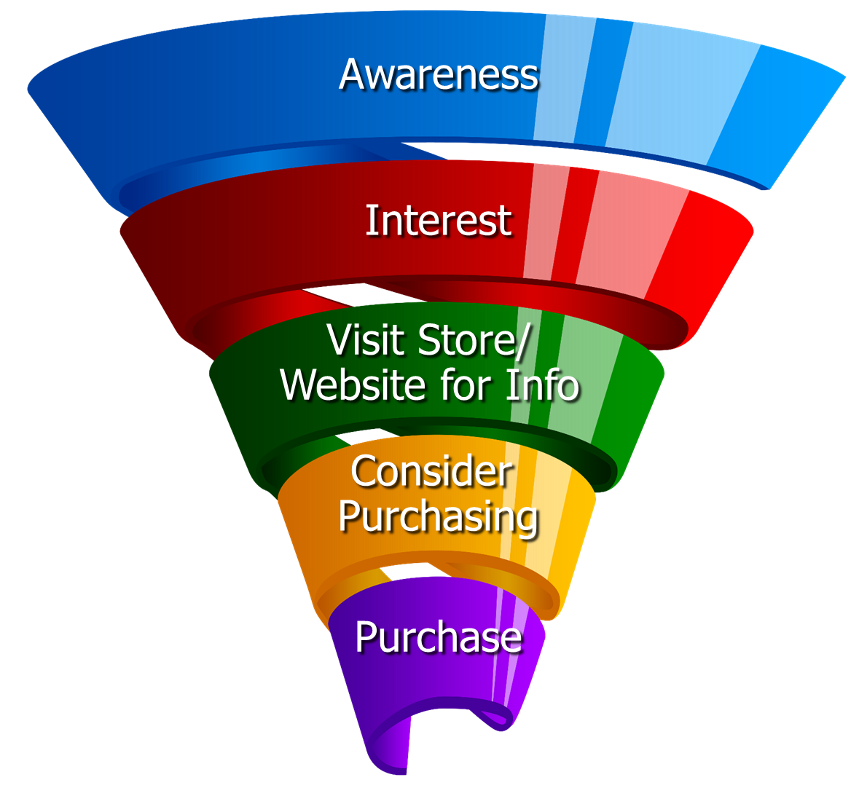
Respondents were asked to rate which medium was important in each stage of the Purchase Funnel
Reaching
Consumers
Early
Preparing for
Purchase Decision
Making a purchase

Slide 7
Media Influence

Slide 8
Over Half of Banking Consumers Were Exposed to Three or More Media Platforms
Banking Services % A18+
51%
Source: GfK TVB Purchase Funnel 2023 Banking Services Category A18+ S10/S11 “In the past two months, did you see, hear or read an advertisement for Banking in any of these media/digital media?”

Slide 9
With Banking Services Ads, TV Tops Exposure at 67%
Source: GfK TVB Purchase Funnel 2023 Banking Services Category A18+ S10/S11 “In the past two months, did you see, hear or read any advertisement in any of these media/digital internet media?”

Slide 10
Ad Exposure Does NOT Guarantee Importance, Except for TV
Banking Services
Source: GfK TVB Purchase Funnel 2023 Banking Services Category A18+ S10/S11/QA4 “In the past two months, did you see, hear or read any advertisement in any of these media/digital internet media?”

Slide 11
Media Makes a Difference in Motivating In-Market Banking Consumers…But it Declines Moving Down the Funnel
Banking Services
% Influenced by Media
% NOT Influenced by Media
Source: GfK TVB Purchase Funnel 2023 Banking Services Category A18+ QA4/QA5/QA6/QA7/QA8 (cume of all media cited as most important)

Slide 12
What Influenced Banking Services Consumers Most
Source: GfK TVB Purchase Funnel 2023 Banking Services Category A18+ QA4/QA5/QA6/QA7/QA8 Most important for media with at least 1 funnel stage at 2%+ shown; 2%, 1%, & 0% not shown/labeled

Slide 13
Of Those that Cited TV as the Most Important, 67% Picked Broadcast TV
Source: GfK TVB Purchase Funnel 2023 Banking Services Category A18+ QA4 “Thinking about the ads you saw/heard for the categories, which advertising media made you most aware of the category?” How to read: Of the 45% that said TV was most important for awareness, 67% of them cited Broadcast TV as the most important.

Slide 14
The Primary Source for News: Broadcast Television
Which of the following sources, if any, would you say is your primary source for news?
Banking Services
Source: GfK TVB Purchase Funnel 2023 Banking Services Category A18+ B1 “Which one of the following sources, if any, would you say is your primary source for news?” Among those who have a primary news source. Percentages are rounded

Slide 15
“I trust the news I see/hear on this media source”
Traditional Media
Digital Media
Source: GfK TVB Purchase Funnel 2023 Banking Services Category A18+ B2 “I trust the news that I see/hear on this media source.” (Agree Strongly + Agree Somewhat)

Slide 16
Media Confluence

Slide 17
“Have TV ads influenced your search selections?”
Source: GfK TVB Purchase Funnel 2023 Banking Services Category A18+ QA10 “When doing an online search, how often, if at all, have TV ads you have seen influenced you in some ways in your search?” (Yes = combination of Every time, Most of the time & Sometimes) Among those who do online searches

Slide 18
Local Television Websites/Apps Most Preferred
Which of the following websites or apps are you most likely to turn to
when you need information about local news or events?
Banking Services
Source: GfK TVB Purchase Funnel 2023 Banking Services Category A18+ C3 “Which of the following websites or apps are you most likely to turn to when you need information about local news or events?”

Slide 19
More TV Exposure Increases Importance, Trust, Preference
Banking Services % A18+
Source: GfK TVB Purchase Funnel 2023 A18+: Banking Services Category QA4/B1/B2/C3; TV=Broadcast & Cable

Slide 20
“When visiting a television station’s website or app, do you view the ads?”
Banking Services
Source: GfK TVB Purchase Funnel 2023 Banking Services Category A18+ C2 “How often do you look at the video ads on that local television station’s website or app?” (Yes = combination of Every time, Most of the time & Sometimes)

Slide 21
“Which, if any, of the following financial products do you currently have?”
Source: GfK TVB Purchase Funnel 2023 Banking Services Category A18+ S4 “Which, if any, of the following financial products do you currently have?”

Slide 22
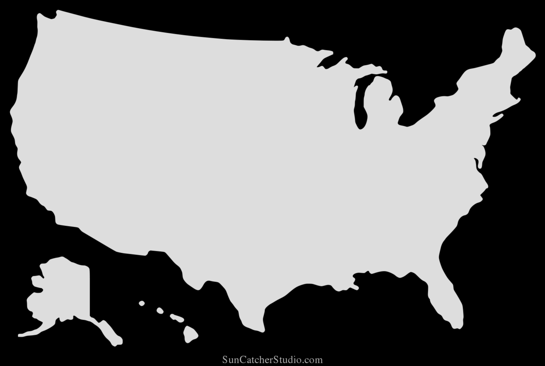
“Which, if any, of the following financial products do you currently have?”
Top Three Banking Services % A18+ Those answering, “Yes”
West
Midwest
South
Northeast
Service | %
Bank account: checking, savings, investment account | 78%
Home, auto, life insurance | 61%
Stock/mutual funds | 37%
Service | %
Bank account: checking, savings, investment account | 82%
Home, auto, life insurance | 66%
Stock/mutual funds | 35%
Service | %
Bank account: checking, savings, investment account | 75%
Home, auto, life insurance | 60%
Stock/mutual funds | 29%
Service | %
Bank account: checking, savings, investment account | 78%
Home, auto, life insurance | 65%
Stock/mutual funds | 38%
Source: GfK TVB Purchase Funnel 2023 Banking Services Category A18+ S4 “Which, if any, of the following financial products do you currently have?”

Slide 23
Which of The Following Best Describes Your Recent Purchase?
Banking Services
% A18+
Source: GfK TVB Purchase Funnel 2023 A18+: Banking Services Category CI-5: Which of the following best describes your recent purchase?

Slide 24
Opinion Leaders My Friends/Family Ask and Trust my Advice On This Topic

Slide 25
Banking TV Ads Motivate Banking Opinion Leaders
Which of the following did you do after seeing/hearing ads for the category on television?
Went online to learn more about what was advertised
Remembered you had seen the brand advertised before
Went to the website or app advertised to learn more about what was advertised
Friended, liked or followed what was advertised on social media
Contacted or visited the advertiser’s store/branch/facility
Source: GfK TVB Purchase Funnel 2023 Banking Services Category A18+ QA9 “Which of the following did you do after seeing/hearing the ads for the category on television?”

Slide 26
Local TV Assets Resonate with Banking Services Opinion Leaders
“Have TV ads influenced your search selections?”
“When visiting a television station’s website or app, do you view the ads?”
“Have you ever commented, posted, liked or shared info or articles from a local TV station’s website or app?”
Banking Services Total
Banking Services Opinion Leaders
Source: GfK TVB Purchase Funnel 2023 Banking Services Category, Opinion leaders A18+ QA10/C2/C4

Slide 27
Banking Services Category Key Points
Exposure to a media platform is not a guarantee of consumer importance, except for TV.
At 67%, television was the top platform for exposure to TV ads.
Over half of banking consumers were exposed to three or more media platforms.
Television is the most important influencer at all stages of the purchase funnel.
Local TV news is #1 for trust among all measured media platforms. Local TV websites/apps are highly trusted among digital platforms. Social media was the least trusted.

Slide 28
Exposure to TV ads motivates banking services consumers to action
Drives users to go online to learn more
Initiates word of mouth
Helps recall of ad in other media
Creates social media engagement
Moves consumers to contact or visit an advertiser
77% said banking TV ads influenced their search selections. This number goes up to 86% for opinion leaders.

Slide 29
Banking Services Digital Summary
Local TV websites/apps were the most preferred websites for local news and events.
83% of those visiting a local TV station’s website or apps said they viewed the ads. This number goes up to 88% for opinion leaders.
Over half of banking opinion leaders engaged with a local TV station’s social media channels.

Slide 30
Thank You

