Slide 1
2023
Purchase Funnel Study

Slide 2
Study Objective and Methodology

Slide 3
Objective: To identify the importance of media platforms in influencing legal consumers during their purchase decision process.
TVB commissioned to do the research study.

Slide 4
Legal Research Overview: Methodology
WHO:
The general study which included 8 categories (Automotive, Banking, Furniture/Bedding/Carpet, Legal, Medical: Hospital/Urgent care, Medical: Dentist/Orthodontist, Eye doctor/Lasik, Online retail, and In-Store retail) had 4,000 interviews collected via opt-in sample. Each respondent answered a series of questions for up to three product/service categories
This analysis focuses on the legal category. The number of respondents for the legal category was 1,158
To qualify for the legal category, respondents needed to be age 18+ and:
Received any legal services for a lawyer or law firm over the past two years
Have seen/heard or read an advertisement for that category in ANY of about 20 media platforms both traditional and digital, in the past 2 months
WHEN: Interviews took place December 1, 2022– December 15,2022
WHAT: Via 12-minute online quantitative survey about the influence of advertising platforms at each stage of the consumer purchase decision, actions taken post-advertising, and attitudinal questions
Respondents were given the choice of taking the survey in either English or Spanish
Source: GfK TVB Purchase Funnel 2023 Legal category

Slide 5
These are the media platforms measured Respondents did not have to be exposed to a TV ad to be included in the study
TV
Radio
Mail
OOH
Print
Digital
(Broadcast, Cable and On-Demand)
(Billboard and Movie Theater)
(Newspaper and Magazine, Yellow Pages)
Digital media include:
Cable site/app
Consumer review site/app
Display/banner ad
Email ad
Internet radio
Local radio station site/app
Local TV station site/app
Network TV station site/app
Magazine
Newspaper
Search engine
Social media
Streaming TV services
Video ad
Yellow Pages site/app

Slide 6
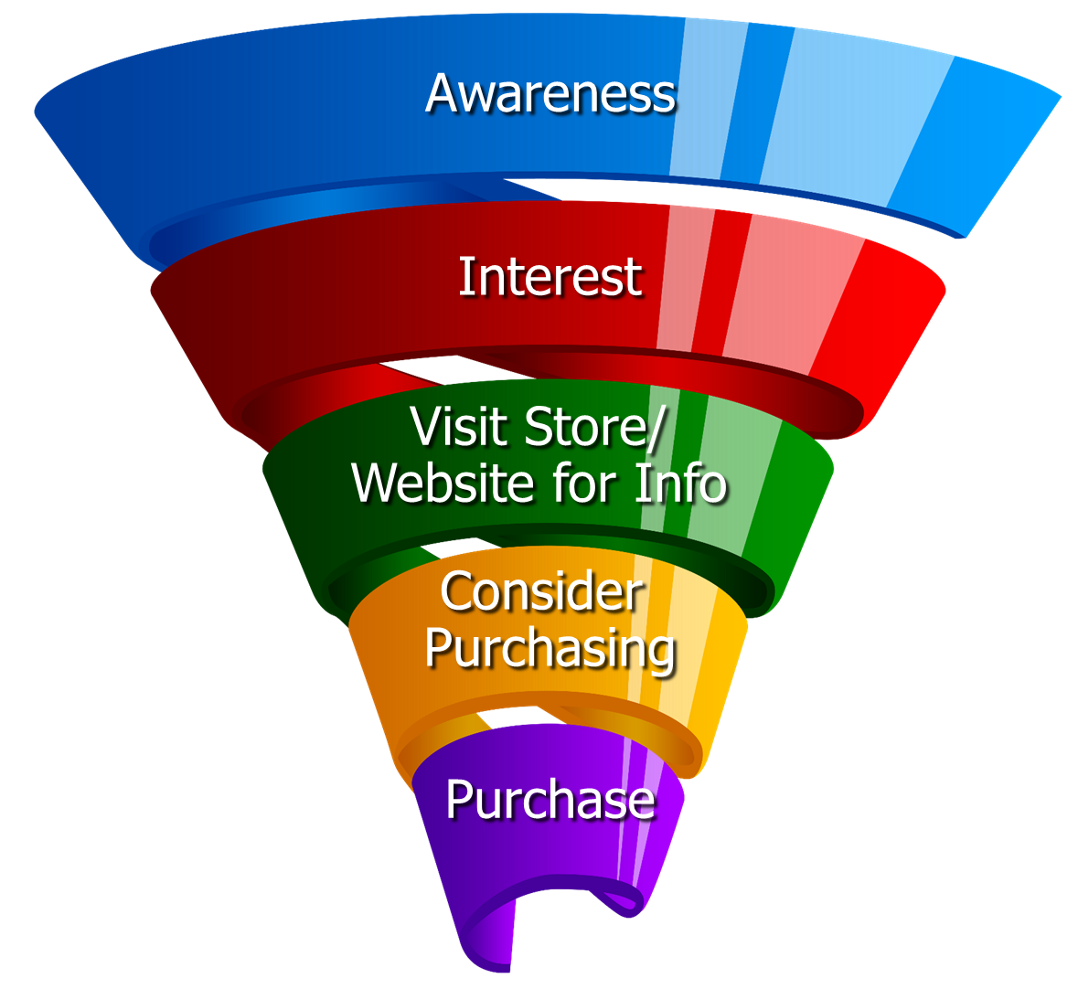
Respondents were asked to rate which medium was important in each stage of the Purchase Funnel
Reaching
Consumers
Early
Preparing for
Purchase Decision
Making a purchase

Slide 7
Media Influence

Slide 8
70% of Legal Respondents Were Exposed to Three or More Media Platforms, Over-indexing the Category Average
8 Category Average
Legal
57%
70%
Source: GfK TVB Purchase Funnel 2023 Legal Category A18+ S10/S11 “In the past two months, did you see, hear or read an advertisement for Legal in any of these media/digital media?”

Slide 9
With Legal Ads, TV Tops Exposure at 65%
Source: GfK TVB Purchase Funnel 2023 Legal Category A18+ S10/S11 “In the past two months, did you see, hear or read any advertisement in any of these media/digital internet media?”

Slide 10
Ad Exposure Does NOT Guarantee Importance, Except for TV
Legal
Source: GfK TVB Purchase Funnel 2023 Legal Category A18+ S10/S11/QA4 “In the past two months, did you see, hear or read any advertisement in any of these media/digital internet media?”

Slide 11
Media Makes a Difference in Motivating In-Market Legal Consumers…But it Declines Moving Down the Funnel
Legal
% Influenced by Media
% NOT Influenced by Media
Source: GfK TVB Purchase Funnel 2023 Legal Category A18+ QA4/QA5/QA6/QA7/QA8 (cume of all media cited as most important)

Slide 12
What Influenced Legal Consumers Most
Source: GfK TVB Purchase Funnel 2023 Legal Category A18+ QA4/QA5/QA6/QA7/QA8 Most important for media with at least 1 funnel stage at 2%+ shown; 2%, 1%, & 0% not shown/labeled

Slide 13
Of Those that Cited TV as the Most Important, 67% Picked Broadcast TV
Source: GfK TVB Purchase Funnel 2023 Legal Category A18+ QA4 How to read: Of the 44% that said TV was most important for awareness, 67% of them cited Broadcast TV as the most important.

Slide 14
The Primary Source for News: Broadcast Television
Which of the following sources, if any, would you say is your primary source for news?
Legal
Source: GfK TVB Purchase Funnel 2023 Legal Category A18+ B1 “Which one of the following sources, if any, would you say is your primary source for news?” Among those who chose a primary news source. Percentages are rounded

Slide 15
“I trust the news I see/hear on this media source”
Traditional Media
Digital Media
Source: GfK TVB Purchase Funnel 2023 Legal Category A18+ B2 “I trust the news that I see/hear on this media source.” (Agree Strongly + Agree Somewhat)0

Slide 16
Media Confluence

Slide 17
More TV Exposure Increases Importance, Trust, Preference
Legal Services % A18+
Source: GfK TVB Purchase Funnel 2023 Legal Category A18+
QA4/B1/B2/C3; TV=Broadcast & Cable

Slide 18
Television Motivates Legal Consumers Into Action
Which of the following did you do after seeing/hearing the ads for the legal category on television?
Source: GfK TVB Purchase Funnel 2023 Legal Category A18+ QA9 “Which of the following did you do after seeing/hearing the ads for the category on television?"

Slide 19
“Have TV ads influenced your search selections?”
8 Category Average
Legal
Source: GfK TVB Purchase Funnel 2023 Legal Category A18+ QA10 “When doing an online search, how often, if at all, have TV ads you have seen influenced you in some ways in your search?” (Yes = combination of Every time, Most of the time & Sometimes) Among those who do online searches

Slide 20
Local Television Websites/Apps Most Preferred By Legal Services Consumers
Which of the following websites or apps are you most likely to turn to
when you need information about local news or events?
Legal % A18+
Source: GfK TVB Purchase Funnel 2023 Legal Category A18+ C3 “Which of the following websites or apps are you most likely to turn to when you need information about local news or events?”

Slide 21
“When visiting a television station’s website or app, do you view the ads?”
8 Category Average
Legal
Source: GfK TVB Purchase Funnel 2023 Legal Category A18+ C2 “How often do you look at the video ads on that local television station’s website or app?”

Slide 22
“Have you ever commented, posted, liked or shared info or articles from a local TV station’s website or app?”
8 Category Average
Legal
Source: GfK TVB Purchase Funnel 2023 Legal Category A18+ C4 “Have you ever commented, posted, liked or shared info or articles from a local TV station’s website or app?”

Slide 23
Legal Services: Are you currently or planning to do more, less or the same compared to what you did last year?
Source: GfK TVB Purchase Funnel 2023 A18+ CI-1: “For Legal services, are you currently or planning to do more, less or the same compared to what you did last year?” Among those for whom the question is applicable.

Slide 24
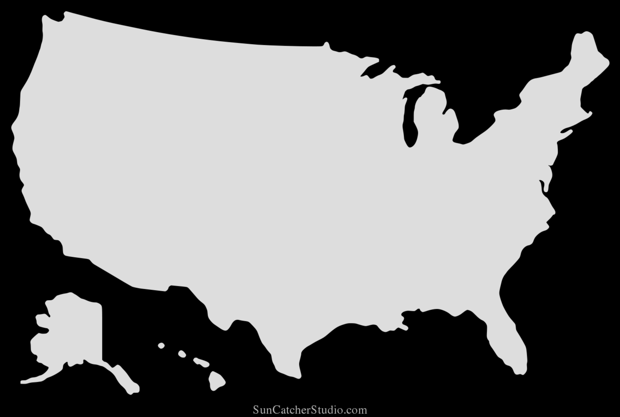
Legal Services: Are you planning to do more, less, or the same compared to last year?
Legal Services % A18+
Planning to do more
Northeast
46%
West
33%
Midwest
33%
South
33%
Source: GfK TVB Purchase Funnel 2023 A18+ CI-1: “For Legal services, are you currently or planning to do more, less or the same compared to what you did last year?” Among those for whom the question is applicable.

Slide 25
Legal Services: Which legal services did you receive?
Source: GfK TVB Purchase Funnel 2023 A18+ X3: “Which legal services did you receive?”

Slide 26
Opinion Leaders My Friends/Family Ask and Trust my Advice On This Topic

Slide 27
TV Ads Motivate Legal Opinion Leaders
Which of the following did you do after seeing/hearing the ads for the category on television?
Friended, liked or followed what was advertised on social media
Contacted or visited the advertiser’s store/office/branch/facility
Went online to learn more about what was advertised
Went to the website or app advertised to learn more about what was advertised
Remembered you had seen the brand advertised before
Looked in a newspaper or magazine to learn more about what was advertised
Source: GfK TVB Purchase Funnel 2023 Legal Category, Opinion leaders A18+ QA9 “Which of the following did you do after seeing/hearing the ads for the category on television?”

Slide 28
Local TV Assets Resonate with Legal Opinion Leaders
“Have TV ads influenced your search selections?”
“When visiting a television station’s website or app, do you view the ads?”
“Have you ever commented, posted, liked or shared info or articles from a local TV station’s website or app?”
Legal Total
Legal Opinion Leaders
Source: GfK TVB Purchase Funnel 2023 Legal Category, Opinion leaders A18+ QA10/C2/C4

Slide 29
Legal Category Key Points
70% of Legal respondents were exposed to three or more media platforms, greater than the seven-category average of 57%.
Exposure to a media platform is not a guarantee of consumer importance, except for TV.
Television is the most important influencer at all stages of the purchase funnel.
Broadcast TV news is the primary source of news for legal consumers.
Broadcast TV news and its digital assets are tops for trust among all measured media platforms.
Accident/Personal injury was the top legal service consumers received.
36% of respondents plan to obtain more legal services compared to last year. In the Northeast, this number grows to 46%.

Slide 30
Exposure to TV ads motivates legal consumers to action
Drives users to go online to learn more
Initiates word of mouth
Helps recall of ad in other media
Creates social media engagement
Moves users to contact or visit stores/offices/branches/facilities
90% said Legal TV ads influenced their search selections. This number goes up to 94% for opinion leaders.

Slide 31
Legal Category Digital Summary
Local TV websites/apps were the most preferred websites for local news and events.
95% of those visiting a local TV station’s website or apps said they viewed the ads. This number grows to 97% for opinion leaders.
77% said they commented, posted, liked or shared info or articles from a local TV station’s website or app. This number went up to 82% for Opinion Leaders.

Slide 32
Thank You

