Slide 1
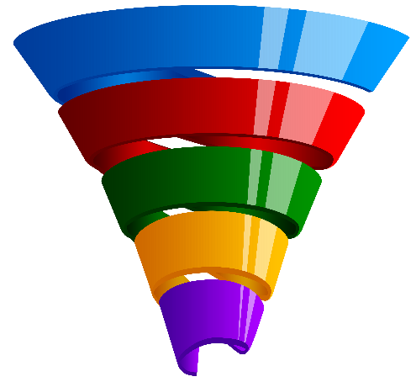
2023
Purchase Funnel Study

Slide 2
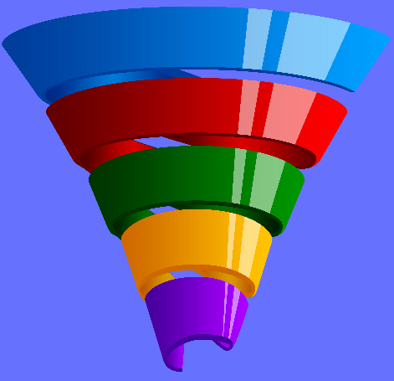
Study Objective and Methodology

Slide 3
Objective: To identify the importance of media platforms in influencing Dentist/Orthodontist or Eye doctor/Lasik consumers during their purchase decision process.
TVB commissioned to do the research study.

Slide 4
Dentist/Orthodontist or Eye doctor/Lasik Research Overview: Methodology
WHO:
The general study which included 8 categories (Automotive, Banking, Furniture/Bedding/Carpet, Legal, Medical: Hospital/Urgent care, Medical: Dentist/Orthodontist, Eye doctor/Lasik, Online retail, and In-Store retail) had 4,000 interviews collected via opt-in sample. Each respondent answered a series of questions for up to three product/service categories
This analysis focuses on the Dentist/Orthodontist or Eye doctor/Lasik category. The number of respondents for the the category was 1,561
To qualify for the Dentist/Orthodontist or Eye doctor/Lasik category, respondents needed to be age 18+ and:
Received Dentist/Orthodontist or Eye doctor/Lasik treatment over the past two years.
Have seen/heard or read an advertisement for that category in ANY of about 20 media platforms both traditional and digital, in the past 2 months
WHEN: Interviews took place December 1, 2022– December 15,2022
WHAT: Via 12-minute online quantitative survey about the influence of advertising platforms at each stage of the consumer purchase decision, actions taken post-advertising, and attitudinal questions
Respondents were given the choice of taking the survey in either English or Spanish
Source: GfK TVB Purchase Funnel 2023 Dentist/Orthodontist or Eye doctor/Lasik category

Slide 5
These are the media platforms measured Respondents did not have to be exposed to a TV ad to be included in the study
TV
Radio
Mail
OOH
Print
Digital
(Broadcast, Cable and On-Demand)
(Billboard and Movie Theater)
(Newspaper and Magazine, Yellow Pages)
Digital media include:
Cable site/app
Consumer review site/app
Display/banner ad
Email ad
Internet radio
Local radio station site/app
Local TV station site/app
Network TV station site/app
Magazine
Newspaper
Search engine
Social media
Streaming TV services
Video ad
Yellow Pages site/app

Slide 6
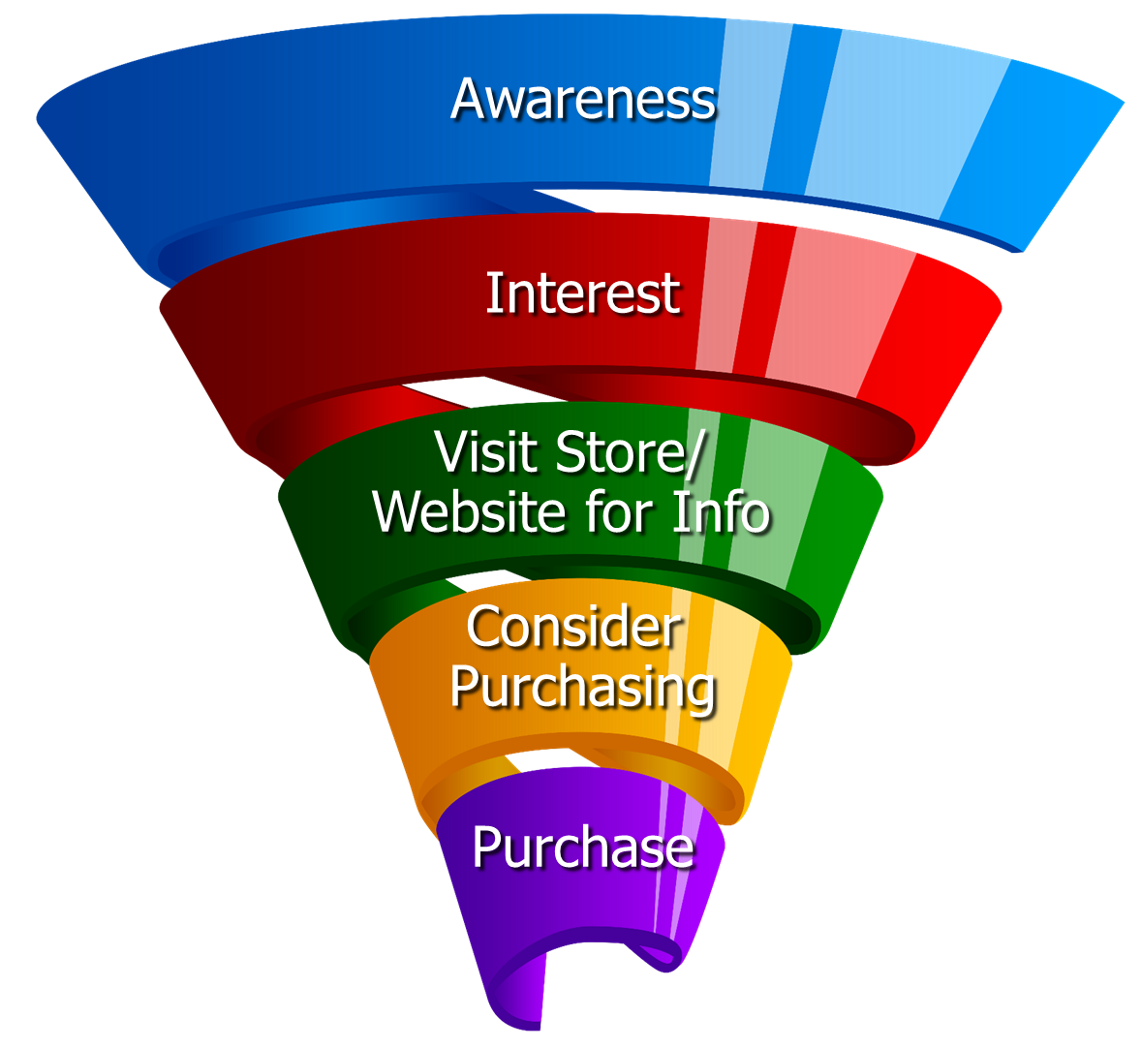
Respondents were asked to rate which medium was important in each stage of the Purchase Funnel
Reaching
Consumers
Early
Preparing for
Purchase Decision
Making a purchase

Slide 7
Media Influence

Slide 8
58% of Dentist/Orthodontist or Eye doctor/Lasik Consumers Were Exposed to Three or More Media Platforms
Dentist/Orthodontist or Eye doctor/Lasik % A18+
58%
Source: GfK TVB Purchase Funnel 2023 Dentist/Orthodontist or Eye doctor/Lasik Category A18+ S10/S11 “In the past two months, did you see, hear or read an advertisement for Dentist/Orthodontist or Eye doctor/Lasik in any of these media/digital media?”

Slide 9
With Dentist/Orthodontist or Eye doctor/Lasik Ads, TV Tops Exposure at 60%
Source: GfK TVB Purchase Funnel 2023 Dentist/Orthodontist or Eye doctor/Lasik Category A18+ S10/S11 “In the past two months, did you see, hear or read any advertisement in any of these media/digital internet media?”

Slide 10
Ad Exposure Does NOT Guarantee Importance, Except for TV
Dentist/Orthodontist or Eye doctor/Lasik
Source: GfK TVB Purchase Funnel 2023 Dentist/Orthodontist or Eye doctor/Lasik Category A18+ S10/S11/QA4 “In the past two months, did you see, hear or read any advertisement in any of these media/digital internet media?”

Slide 11
Media Makes a Difference in Motivating In-Market Dentist/Orthodontist or Eye doctor/Lasik Consumers…But it Declines Moving Down the Funnel
Dentist/Orthodontist or Eye doctor/Lasik A18+
% Influenced by Media
% NOT Influenced by Media
Source: GfK TVB Purchase Funnel 2023 Dentist/Orthodontist or Eye doctor/Lasik Category A18+ QA4/QA5/QA6/QA7/QA8 (cume of all media cited as most important)

Slide 12
What Influenced Dentist/Orthodontist or Eye doctor/Lasik Consumers Most
Source: GfK TVB Purchase Funnel 2023 Dentist/Orthodontist or Eye doctor/Lasik Category A18+ QA4/QA5/QA6/QA7/QA8 Most important for media with at least 1 funnel stage at 2%+ shown; 2%, 1%, & 0% not shown/labeled

Slide 13
Of Those that Cited TV as the Most Important, 7 in 10 Picked Broadcast TV
Source: GfK TVB Purchase Funnel 2023 Dentist/Orthodontist or Eye doctor/Lasik Category A18+ QA4 How to read: Of the 39% that said TV was most important for awareness, 68% of them cited Broadcast TV as the most important.

Slide 14
The Primary Source for News: Broadcast Television
Which of the following sources, if any, would you say is your primary source for news?
% A18+ Dentist/Orthodontist or Eye doctor/Lasik
Source: GfK TVB Purchase Funnel 2023 Dentist/Orthodontist or Eye doctor/Lasik Category A18+ B1 “Which one of the following sources, if any, would you say is your primary source for news?” Among those who chose a primary news source. Percentages are rounded

Slide 15
“I trust the news I see/hear on this media source”
Traditional Media
Digital Media
Source: GfK TVB Purchase Funnel 2023 Dentist/Orthodontist or Eye doctor/Lasik Category A18+ B2 “I trust the news that I see/hear on this media source.” (Agree Strongly + Agree Somewhat)

Slide 16
Media Confluence

Slide 17
More TV Exposure Increases Importance, Trust, Preference
Medical: Dentist/Orthodontist/Eye doctor/Lasik A18+
Source: GfK TVB Purchase Funnel 2023 Medical: Dentist/Orthodontist or Eye doctor/Lasik Category A18+ QA4/B1/B2/C3; TV=Broadcast & Cable

Slide 18
More Exposures Means More Action For Dentist/Orthodontist or Eye doctor/Lasik Consumers
Which of the following did you do after seeing/hearing the ads for the
Dentist/Orthodontist or Eye doctor/Lasik category on television?
Source: GfK TVB Purchase Funnel 2023 Dentist/Orthodontist or Eye doctor/Lasik Category A18+ QA9 “Which of the following did you do after seeing/hearing the ads for the category on television?"

Slide 19
“Have TV ads influenced your search selections?”
Source: GfK TVB Purchase Funnel 2023 Dentist/Orthodontist or Eye doctor/Lasik Category A18+ QA10 “When doing an online search, how often, if at all, have TV ads you have seen influenced you in some ways in your search?” (Yes = combination of Every time, Most of the time & Sometimes) Among those who do online searches

Slide 20
Local Television Websites/Apps Most Preferred
Which of the following websites or apps are you most likely to turn to
when you need information about local news or events?
% A18+ Dentist/Orthodontist or Eye doctor/Lasik
Source: GfK TVB Purchase Funnel 2023 Dentist/Orthodontist or Eye doctor/Lasik Category A18+ C3 “Which of the following websites or apps are you most likely to turn to when you need information about local news or events?”

Slide 21
For Dentist/Orthodontist or Eye doctor/Lasik Consumers, Local Television Websites/Apps Are The Most Visited Among Local Websites/Apps
When, if at all, did you last visit these types of websites or apps?
Dentist/Orthodontist or Eye doctor/Lasik % A18+ among those that visit these websites/apps
Source: GfK TVB Purchase Funnel 2023 Dentist/Orthodontist or Eye doctor/Lasik Category A18+ C1 “When if at all did you last visit these types of websites/apps?” Among those that visit these types of sites.

Slide 22
“When visiting a television station’s website or app, do you view the ads?”
8 Category Average
Dentist/Orthodontist or Eye doctor/Lasik
Source: GfK TVB Purchase Funnel 2023 Dentist/Orthodontist or Eye doctor/Lasik Category A18+
C2 “How often do you look at the video ads on that local television station’s website or app?”

Slide 23
“Have you ever commented, posted, liked or shared info or articles from a local TV station’s website or app?”
8 Category Average
Dentist/Orthodontist or Eye doctor/Lasik
Source: GfK TVB Purchase Funnel 2023 Dentist/Orthodontist or Eye doctor/Lasik Category A18+ C4 “Have you ever commented, posted, liked or shared info or articles from a local TV station’s website or app?”

Slide 24
“Over the past two years, which of the following locations, if any, did you go to in order to receive medical treatment or a procedure?”
Source: GfK TVB Purchase Funnel 2023 Dentist/Orthodontist or Eye doctor/Lasik Category A18+ S6: “Over the past two years, which of the following, if any, did you go to in order to receive medical treatment or a procedure?”

Slide 25
What was the purpose of your last dentist/orthodontist visit(s)?
Medical A18+
Source: GfK TVB Purchase Funnel 2023 Medical category A18+ X1” What was the purpose of your dentist/orthodontist visit(s)?”

Slide 26
What was the purpose of your eye doctor visit(s)?
Medical A18+
Source: GfK TVB Purchase Funnel 2023 Medical category A18+ X2 “What was the purpose of your last eye doctor visit(s)?”

Slide 27
Dentist/Orthodontist or Eye doctor/Lasik: In 2023, Do You Plan To Use These Methods More, The Same, or Less?
82%
81%
Source: GfK TVB Purchase Funnel 2023 Dentist/Orthodontist or Eye doctor/Lasik Category A18+ CI-9: “Starting next year (2023), do you plan to use these methods to get Dentist/Orthodontist or Eye doctor/Lasik care more, the same, or less?” Among those for whom the questions are applicable

Slide 28
Opinion Leaders My Friends/Family Ask and Trust my Advice On This Topic

Slide 29
Dentist/Orthodontist or Eye doctor/Lasik TV Ads Motivate Opinion Leaders
Which of the following did you do after seeing/hearing the ads for the category on television?
Went online to learn more about what was advertised
Friended, liked or followed what was advertised on social media
Contacted or visited the advertiser’s store/office/facility/branch
Remembered you had seen the brand advertised before
Talked with others about the advertisement
Source: GfK TVB Purchase Funnel 2023 Dentist/Orthodontist or Eye doctor/Lasik Category A18+ QA9 “Which of the following did you do after seeing/hearing the ads for the category on television?”

Slide 30
Local TV Assets Resonate with Dentist/Orthodontist or Eye doctor/Lasik Opinion Leaders
“Have TV ads influenced your search selections?”
“When visiting a television station’s website or app, do you view the ads?”
“Have you ever commented, posted, liked, or shared information, articles or videos from a local TV station’s website or app?”
Dentist/orthodontist or Eye doctor/Lasik total
Dentist/orthodontist or Eye doctor/Lasik Opinion Leaders
Source: GfK TVB Purchase Funnel 2023 Dentist/Orthodontist or Eye doctor/Lasik Category A18+ QA10/C2/C4

Slide 31
Dentist/Orthodontist or Eye doctor/Lasik Category Key Points
58% of Dentist/Orthodontist or Eye doctor/Lasik consumers were exposed to three or more media platforms.
Exposure to a media platform is not a guarantee of consumer importance, except for TV.
60% of respondents were exposed to ads on TV, more than any other measured platform.
Television is the most important influencer at all stages of the purchase funnel.
Broadcast TV is the primary news source.
Broadcast TV news is #1 for trust among all measured media platforms. Broadcast TV websites/apps are the most trusted among digital platforms. Social media was the least trusted.

Slide 32
Exposure to TV ads motivates Dentist/Orthodontist or Eye doctor/Lasik consumers to action
Drives users to go online to learn more.
Initiates word of mouth.
Helps recall of ad in other media.
Creates social media engagement with the product/advertiser.
More exposure to TV ads increases importance, trust, and preference.
87% said Dentist/Orthodontist or Eye doctor/Lasik TV ads influenced their search selections. This number goes up to 91% for opinion leaders.

Slide 33
Dentist/Orthodontist or Eye doctor/Lasik Digital Summary
Local TV websites/apps were the most preferred websites for local news and events and were the most visited among local websites/apps.
88% of those visiting a local TV station’s website or apps said they viewed the ads. This goes up to 91% for opinion leaders.
54% commented, posted, liked or shared information, articles, or videos from a local TV station’s website or app. This goes up to 60% for opinion leaders.

Slide 34
Thank You

