Slide 1
2023
Purchase Funnel Study

Slide 2
Study Objective and Methodology

Slide 3
Objective: To identify the importance of media platforms in influencing Hospital/Urgent care/Clinic consumers during their purchase decision process.
TVB commissioned to do the research study.

Slide 4
Hospital/Urgent care/Clinic Research Overview: Methodology
WHO:
The general study which included 8 categories (Automotive, Banking, Furniture/Bedding/Carpet, Legal, Medical: Hospital/Urgent care, Medical: Dentist/Orthodontist, Eye doctor/Lasik, Online retail, and In-Store retail) had 4,000 interviews collected via opt-in sample. Each respondent answered a series of questions for up to three product/service categories
This analysis focuses on the Hospital/Urgent care/Clinic category. The number of respondents for this category was 1,594
To qualify for the Hospital/Urgent care/Clinic category, respondents needed to be age 18+ and:
Received treatment in a hospital, urgent care or clinic (including those inside a pharmacy), over the past two years.
Have seen/heard or read an advertisement for the category in ANY of about 20 media platforms both traditional and digital, in the past 2 months
WHEN: Interviews took place December 1, 2022– December 15,2022
WHAT: Via 12-minute online quantitative survey about the influence of advertising platforms at each stage of the consumer purchase decision, actions taken post-advertising, and attitudinal questions
Respondents were given the choice of taking the survey in either English or Spanish
Source: GfK TVB Purchase Funnel 2023 Medical: Hospital/Urgent care/Clinic Category

Slide 5
These are the media platforms measured Respondents did not have to be exposed to a TV ad to be included in the study
TV
Radio
Mail
OOH
Print
Digital
(Broadcast, Cable and On-Demand)
(Billboard and Movie Theater)
(Newspaper and Magazine, Yellow Pages)
Digital media include:
Cable site/app
Consumer review site/app
Display/banner ad
Email ad
Internet radio
Local radio station site/app
Local TV station site/app
Network TV station site/app
Magazine
Newspaper
Search engine
Social media
Streaming TV services
Video ad
Yellow Pages site/app

Slide 6
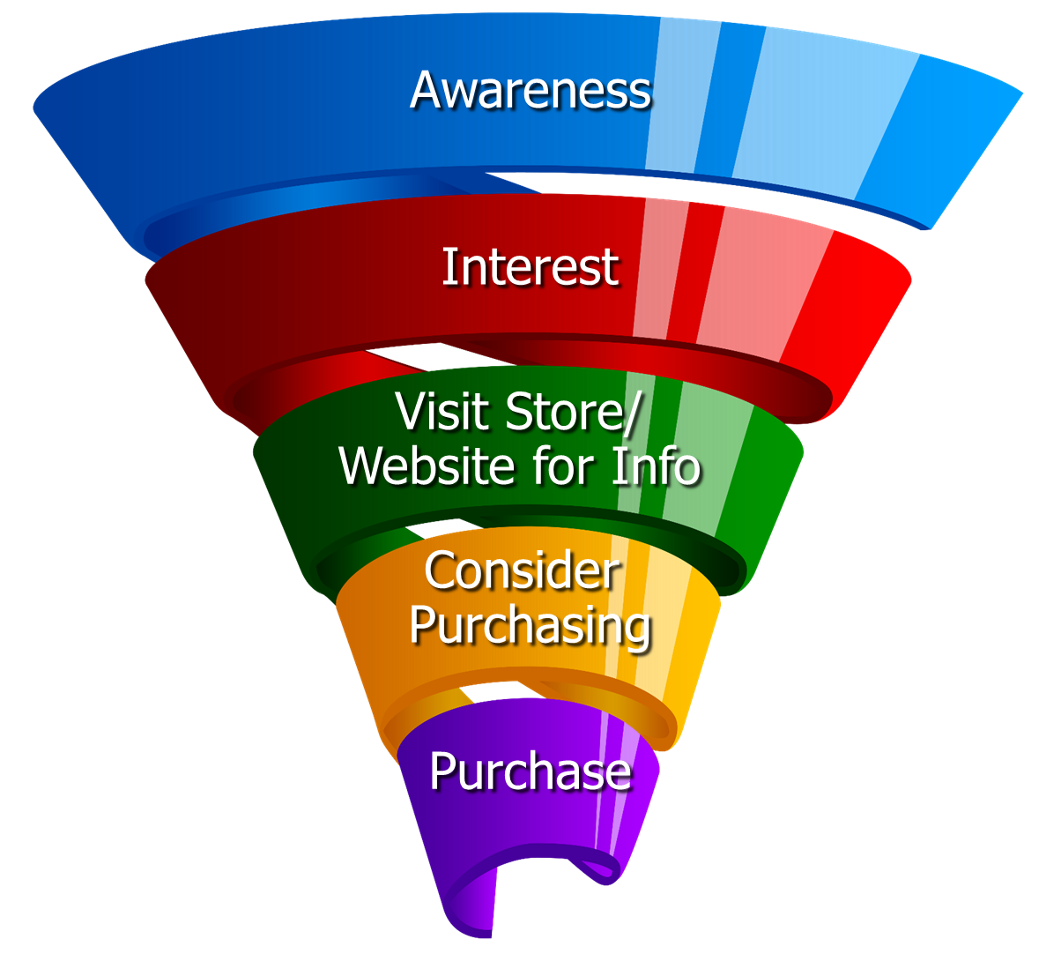
Respondents were asked to rate which medium was important in each stage of the Purchase Funnel
Reaching
Consumers
Early
Preparing for
Purchase Decision
Making a purchase

Slide 7
Media Influence

Slide 8
61% of Medical: Hospital/Urgent care/Clinic Consumers Were Exposed to Three or More Media Platforms, Over-indexing the category average
Medical: Hospital/Urgent care/Clinic
8 Category Average
57%
61%
Source: GfK TVB Purchase Funnel 2023 Medical: Hospital/Urgent care/Clinic Category A18+ S10/S11 “In the past two months, did you see, hear or read an advertisement for Medical: Hospital/Urgent care/Clinic in any of these media/digital media?”

Slide 9
With Hospital/Urgent care/Clinic Ads, TV Tops Exposure at 62%
Source: GfK TVB Purchase Funnel 2023 Medical: Hospital/Urgent care/Clinic Category A18+ S10/S11 “In the past two months, did you see, hear or read any advertisement in any of these media/digital internet media?”

Slide 10
Ad Exposure Does NOT Guarantee Importance, Except for TV
Medical: Hospital/Urgent care/Clinic
Source: GfK TVB Purchase Funnel 2023 Medical: Hospital/Urgent care/Clinic Category A18+ S10/S11/QA4 “In the past two months, did you see, hear or read any advertisement in any of these media/digital internet media?”

Slide 11
Media Makes a Difference in Motivating Hospital/Urgent Care/Clinic Consumers…But it Declines Moving Down the Funnel
Medical: Hospital/Urgent care/Clinic
% Influenced by Media
% NOT Influenced by Media
Source: GfK TVB Purchase Funnel 2023 Medical: Hospital/Urgent care/Clinic Category A18+ QA4/QA5/QA6/QA7/QA8 (cume of all media cited as most important)

Slide 12
What Influenced Medical: Hospital/Urgent care/Clinic Consumers Most
Source: GfK TVB Purchase Funnel 2023 Medical: Hospital/Urgent care/Clinic Category A18+ QA4/QA5/QA6/QA7/QA8 Most important for media with at least 1 funnel stage at 2%+ shown; 2%, 1%, & 0% not shown/labeled

Slide 13
Of Those that Cited TV as the Most Important, 7 Out of 10 Picked Broadcast TV
Source: GfK TVB Purchase Funnel 2023 Medical: Hospital/Urgent care/Clinic Category A18+ QA4 How to read: Of the 42% that said TV was most important for awareness, 70% of them cited Broadcast TV as the most important.

Slide 14
The Primary Source for News: Broadcast Television
Which of the following sources, if any, would you say is your primary source for news?
Medical: Hospital/Urgent care/Clinic
Source: GfK TVB Purchase Funnel 2023 Medical: Hospital/Urgent care/Clinic Category A18+ B1 “Which one of the following sources, if any, would you say is your primary source for news?” Among those that have a primary news source. Percentages are rounded

Slide 15
“I trust the news I see/hear on this media source”
Traditional Media
Digital Media
Source: GfK TVB Purchase Funnel 2023 Medical: Hospital/Urgent care/Clinic Category A18+ B2 “I trust the news that I see/hear on this media source.” (Agree Strongly + Agree Somewhat)

Slide 16
Media Confluence

Slide 17
More TV Exposure Increases Importance, Trust, Preference
Medical: Hospital/Urgent care/Clinic A18+
Source: GfK TVB Purchase Funnel 2023 Medical: Hospital/Urgent care/Clinic Category A18+ QA4/B1/B2/C3; TV=Broadcast & Cable

Slide 18
More Exposures Means More Action For Hospital/Urgent care/Clinic Consumers
Which of the following did you do after seeing/hearing the ads for the
Hospital/Urgent care/Clinic category on television?
Source: GfK TVB Purchase Funnel 2023 Medical: Hospital/Urgent care/Clinic Category A18+ QA9 “Which of the following did you do after seeing/hearing the ads for the category on television?"

Slide 19
“Have TV ads influenced your search selections?”
8 Category Average
Hospital/Urgent care/Clinic
Source: GfK TVB Purchase Funnel 2023 Medical: Hospital/Urgent care/Clinic Category A18+ QA10 “When doing an online search, how often, if at all, have TV ads you have seen influenced you in some ways in your search?” (Yes = combination of Every time, Most of the time & Sometimes) Among those who do online searches

Slide 20
Local Television Websites/Apps Most Preferred
Which of the following websites or apps are you most likely to turn to
when you need information about local news or events?
Medical: Hospital/Urgent care/Clinic % A18+
Source: GfK TVB Purchase Funnel 2023 Medical: Hospital/Urgent care/Clinic Category A18+ C3 “Which of the following websites or apps are you most likely to turn to when you need information about local news or events?”

Slide 21
For Hospital/Urgent care/Clinic Consumers, Local Television Websites/Apps Are The Most Visited Among Local Websites/Apps
When, if at all, did you last visit these types of websites or apps?
Medical: Hospital/Urgent care/Clinic % A18
Source: GfK TVB Purchase Funnel 2023 Medical: Hospital/Urgent care/Clinic Category A18+ C1 “When if at all did you last visit these types of websites/apps?” Among those that visit these types of websites/apps.

Slide 22
“When visiting a television station’s website or app, do you view the ads?”
8 Category Average
Medical: Hospital/Urgent care/Clinic
Source: GfK TVB Purchase Funnel 2023 Medical: Hospital/Urgent care/Clinic Category A18+
C2 “How often do you look at the video ads on that local television station’s website or app?”

Slide 23
“Have you ever commented, posted, liked or shared info or articles from a local TV station’s website or app?”
8 Category Average
Medical: Hospital/Urgent care/Clinic
Source: GfK TVB Purchase Funnel 2023 Medical: Hospital/Urgent care/Clinic Category A18+ C4 “Have you ever commented, posted, liked or shared info or articles from a local TV station’s website or app?”

Slide 24
“Over the past two years, which of the following locations, if any, did you go to in order to receive medical treatment or a procedure?”
Source: GfK TVB Purchase Funnel 2023 : Hospital/Urgent care/Clinic Category A18+ S6: “Over the past two years, which of the following, if any, did you go to in order to receive medical treatment or a procedure?”

Slide 25
Over the past two years, which of the following locations, if any, did you go to in order to receive medical treatment or a procedure?
Source: GfK TVB Purchase Funnel 2022 Medical: Hospital/Urgent care/Clinic Category A18+, HH income S6: “Over the past two years, which of the following locations, if any, did you got to in order to receive medical treatment or a procedure?”

Slide 26
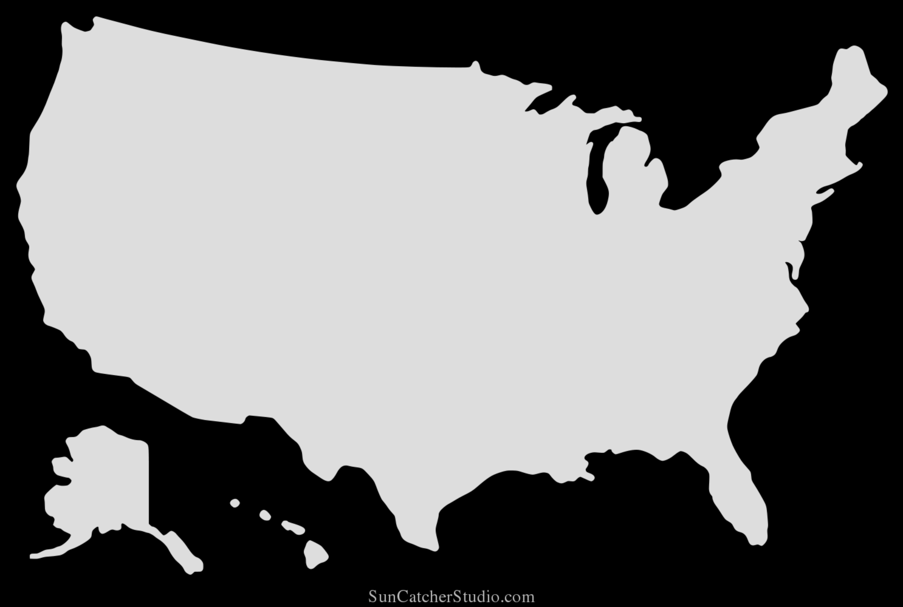
In 2023, Do You Plan To Use These Methods More, The Same, or Less?
% A18+
Plan to do more
West
Urgent care – 14%
Hospital/Clinic/Outpatient services – 28%
Northeast
Urgent care – 24%
Hospital/Clinic/Outpatient services – 30%
Midwest
Urgent care – 13%
Hospital/Clinic/Outpatient services – 22%
South
Urgent care – 18%
Hospital/Clinic/Outpatient services – 22%
Source: GfK TVB Purchase Funnel 2023 Medical: Hospital/Urgent care/Clinic Category A18+ CI-9: Starting next year (2023), do you plan to use these methods to get medical care more, the same, or less? Among those who for whom the choices were applicable.

Slide 27
In 2023, Do You Plan To Use These Methods More, The Same, or Less?
62%
70%
Source: GfK TVB Purchase Funnel 2023 Medical: Hospital/Urgent care/Clinic Category A18+ CI-9: Starting next year (2023), do you plan to use these methods to get medical care more, the same, or less? Among those who for whom the choices were applicable.

Slide 28
Opinion Leaders My Friends/Family Ask and Trust my Advice On This Topic

Slide 29
Hospital/Urgent care/Clinic TV Ads Motivate Opinion Leaders
Which of the following did you do after seeing/hearing ads for the category on television?
Went online to learn more about what was advertised
Talked with others about the advertisement
Friended, liked or followed what was advertised on social media
Remembered you had seen the brand advertised before
Went to the website or app advertised to learn more about what was advertised
Source: GfK TVB Purchase Funnel 2023 Medical: Hospital/Urgent care/Clinic Category A18+ QA9 “Which of the following did you do after seeing/hearing the ads for the category on television?”

Slide 30
Local TV Assets Resonate with Hospital/Urgent care/Clinic Opinion Leaders
“Have TV ads influenced your search selections?”
“When visiting a television station’s website or app, do you view the ads?”
“Have you ever commented, posted, liked, or shared information, articles or videos from a local TV station’s website or app?”
Hospital/Urgent care/Clinic Total
Hospital/Urgent care/Clinic Opinion Leaders
Source: GfK TVB Purchase Funnel 2022 Medical: Hospital/Urgent care/Clinic Category, Opinion leaders A18+ QA10/C2/C4

Slide 31
Hospital/Urgent care/Clinic Category Key Points
61% of Hospital/Urgent care/Clinic consumers were exposed to three or more media platforms, which over-indexed the 8-category average.
Exposure to a media platform is not a guarantee of consumer importance, except for TV.
Television is the most important influencer at all stages of the purchase funnel.
Broadcast TV is the primary news source.
Local TV news is #1 for trust among all measured media platforms. Local TV websites/apps are highly trusted among digital platforms. Social media is the least trusted.
62%-70% of respondents plan to use Hospital/Urgent care more in 2023. Adults living in the East and West also plan to use Hospital/Urgent care more in 2023.

Slide 32
Exposure to TV ads motivates Hospital/Urgent care/Clinic consumers to action
Drives users to go online to learn more
Initiates word of mouth
Helps recall of ad in other media
Creates social media engagement with the product/advertiser
87% said Hospital/Urgent care/Clinic TV ads influenced their search selections. This number goes up to 90% for opinion leaders.

Slide 33
Hospital/Urgent care/Clinic Digital Summary
Local TV websites/apps were the most preferred websites for local news and events and were the most visited among local websites/apps.
90% of those visiting a local TV station’s website or apps said they viewed the ads. This goes up to 93% for opinion leaders.
55% commented, posted, liked, or shared information, articles, or videos from a local TV station’s website or app. This increases to 61% for opinion leaders.

Slide 34
Thank You

