Slide 1
2023
Purchase Funnel Study

Slide 2
Study Objective and Methodology

Slide 3
Objective: To identify the importance of media platforms influencing in-store retail consumers during their purchase decision process.
TVB commissioned to do the research study.

Slide 4
In-Store Retail Research Overview: Methodology
WHO:
The general study which included 8 categories (Automotive, Banking, Furniture/Bedding/Carpet, Legal, Medical: Hospital/Urgent care, Medical: Dentist/Orthodontist, Eye doctor/Lasik, Online retail, and In-Store retail) had 4,000 interviews collected via opt-in sample. Each respondent answered a series of questions for up to three product/service categories
This analysis focuses on the in-store retail category. The number of respondents for this category was 1,205
To qualify for the in-store retail category, respondents needed to be age 18+ and:
Recently purchased or plan to purchase in the near future from a physical retail location such as Macy’s, Home Depot, Target, Dick’s Sporting Goods, Walmart, Best Buy, Kay Jewelers, local retailers, etc.
Have seen/heard or read an advertisement for that category in ANY of about 20 media platforms both traditional and digital, in the past 2 months
WHEN: Interviews took place December 1, 2022– December 15,2022
WHAT: Via 12-minute online quantitative survey about the influence of advertising platforms at each stage of the consumer purchase decision, actions taken post-advertising, and attitudinal questions
Respondents were given the choice of taking the survey in either English or Spanish
Source: GfK TVB Purchase Funnel 2023 In-store retail category

Slide 5
These are the media platforms measured Respondents did not have to be exposed to a TV ad to be included in the study
TV
Radio
Mail
OOH
Print
Digital
(Broadcast, Cable and On-Demand)
(Billboard and Movie Theater)
(Newspaper and Magazine, Yellow Pages)
Digital media include:
Cable site/app
Consumer review site/app
Display/banner ad
Email ad
Internet radio
Local radio station site/app
Local TV station site/app
Network TV station site/app
Magazine
Newspaper
Search engine
Social media
Streaming TV services
Video ad
Yellow Pages site/app

Slide 6
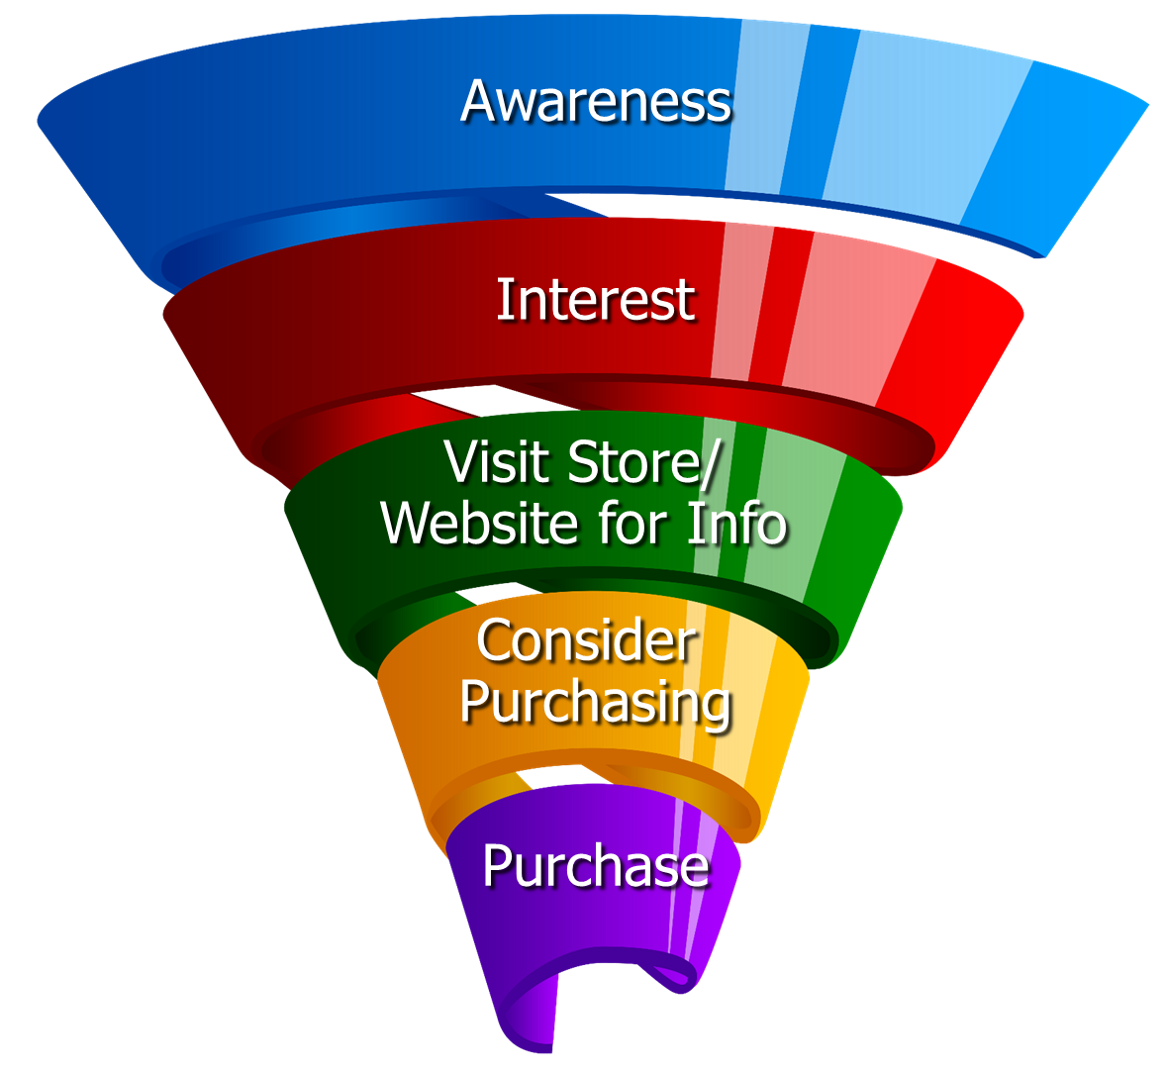
Respondents were asked to rate which medium was important in each stage of the Purchase Funnel
Reaching
Consumers
Early
Preparing for
Purchase Decision
Making a purchase

Slide 7
Media Influence

Slide 8
Over Half of In-Store Retail Consumers Were Exposed to Three or More Media Platforms
In-store retail
53%
Source: GfK TVB Purchase Funnel 2023 In-store retail Category A18+ S10/S11 “In the past two months, did you see, hear or read an advertisement for a retail store in any of these media/digital media?”

Slide 9
With In-Store Retail Ads, TV Tops Exposure at 66%
Source: GfK TVB Purchase Funnel 2023 In-store retail category A18+ S10/S11 “In the past two months, did you see, hear or read any advertisement in any of these media/digital internet media?”

Slide 10
Retail Ad Exposure Does NOT Guarantee Importance, Except for TV
In-store retail
Source: GfK TVB Purchase Funnel 2023 In-store retail category A18+ S10/S11/QA4 “In the past two months, did you see, hear or read any advertisement in any of these media/digital internet media?”/ “Thinking about the ads you saw/heard for the categories, which advertising media made you most aware of the category?”

Slide 11
Media Makes a Difference in Motivating In-Store Retail Consumers…But it Declines Moving Down the Funnel
In-store retail
% Influenced by Media
% NOT Influenced by Media
Source: GfK TVB Purchase Funnel 2023 In-store retail category A18+ QA4/QA5/QA6/QA7/QA8 (cume of all media cited as most important)

Slide 12
What Influenced In-Store Retail Consumers Most: Television
Source: GfK TVB Purchase Funnel 2023 In-store retail category A18+ QA4/QA5/QA6/QA7/QA8 Most important for media with at least 1 funnel stage at 2%+ shown; 2%, 1%, & 0% not shown/labeled

Slide 13
Of Those that Cited TV as the Most Important in the Awareness Phase, 68% Picked Broadcast TV
Source: GfK TVB Purchase Funnel 2023 In-store retail category A18+
QA4 “Thinking about the ads you saw/heard for the categories, which advertising media made you most aware of the category?”
How to read: Of the 45% who chose television as most important for awareness, 68% chose broadcast TV

Slide 14
The Primary Source for News: Broadcast Television
Which of the following sources, if any, would you say is your primary source for news?
In-store retail
Source: GfK TVB Purchase Funnel 2023 In-store retail category A18+ B1 “Which of the following sources, if any, would you say is your primary source of news?” Percentages are rounded.

Slide 15
“I trust the news I see/hear on this media source”
Traditional Media
Digital Media
Source: GfK TVB Purchase Funnel 2023 In-store retail category A18+ B2 “I trust the news that I see/hear on this media source.” (Agree Strongly + Agree Somewhat)

Slide 16
Media Confluence

Slide 17
More TV Exposure Increases Importance, Trust, Preference
In-store retail A18+
Source: GfK TVB Purchase Funnel In-store retail category A18+ QA4/B1/B2/C3; TV=Broadcast & Cable

Slide 18
More Exposures Means More Action For In-Store Retail Consumers
Which of the following did you do after seeing/hearing the ads for the in-store retail category on television?
Went online to learn more
about what was advertised
Went to the website or app advertised to learn more about what was advertised
Contacted or visited the advertiser’s store/office/facility/branch
Purchased the product or service advertised at a store/branch/online
Searched online for a coupon
or promotional offer
Remembered you had seen the brand
advertised before
Source: GfK TVB Purchase Funnel 2023 In-store retail category A18+ QA9 “Which of the following did you do after seeing/hearing the ads for the category on television?”

Slide 19
“Have TV ads influenced your search selections?”
8 Category Average
Source: GfK TVB Purchase Funnel 2023 In-store retail category A18+ QA10 “When doing an online search, how often, if at all, have TV ads you have seen influenced you in some ways in your search?” (Yes = combination of Every time, Most of the time & Sometimes)

Slide 20
Local Television Websites/Apps Most Preferred
Which of the following websites or apps are you most likely to turn to
when you need information about local news or events?
In-store retail % A18+
Source: GfK TVB Purchase Funnel 2023 In-store retail category A18+ C3 “Which of the following websites or apps are you most likely to turn to when you need information about local news and events?”

Slide 21
“When Visiting a Television Station’s Website or App, do you View the Ads?”
In-store retail % A18+
Source: GfK TVB Purchase Funnel In-store retail category A18+ C2 “How often do you look at the video ads on that local television station’s website or app?” (Yes = combination of Every time, Most of the time & Sometimes)

Slide 22
Opinion Leaders My Friends/Family Ask and Trust my Advice On This Topic

Slide 23
TV Ads Motivate In-Store Retail Opinion Leaders
Which of the following did you do after seeing/hearing the ads for the category on television?
Went online to learn more about what was advertised
Went to the website or app advertised to learn more about what was advertised
Purchased the product/service at a branch/store, or online
Remembered you had seen the brand advertised before
Friended, liked or followed what was advertised on social media
Source: GfK TVB Purchase Funnel 2023 In-store retail category A18+, Opinion leaders QA9 “Which of the following did you do after seeing/hearing the ads for the category on television?”

Slide 24
Local TV Assets Resonate with In-Store Retail Opinion Leaders
“Have TV ads influenced your search selections?”
“When visiting a television station’s website or app, do you view the ads?”
In-Store Retail Total
In-Store Retail Opinion Leaders
Source: GfK TVB Purchase Funnel 2023 In-store retail category, Opinion leaders A18+ QA10/C2

Slide 25
Purchase Attitudes

Slide 26
Retail Online = Online Only + Online & In-store Retail In-Store = In-Store Only + Online & In-store
76% of Retail Consumers Shopped Both In-Store & Online During The Holiday Season
In-store
Only
Online
Only
Online & In-store
14%
76%
10%
Online
90%
In-store
86%
Source: GfK TVB Purchase Funnel 2023 A18+: Retail CI-2: “Now, please think about the holiday season. Have you purchased, or do you plan to purchase from the following?”

Slide 27
Holiday Season: Shopping Activity At Retail Locations
Over half of respondents browsed AND purchased in-store.
In-store Retail % A18+
Source: GfK TVB Purchase Funnel 2023 In-store Retail category, A18+ CI-3: “Now, please think about the holiday season. Have you purchased, or do you plan to purchase from the following?”

Slide 28
What Influenced Consumers Most For In-Store Retail: Awareness
In-store Retail % A18+
Source: GfK TVB Purchase Funnel 2023 A18+ In-store retail category; QA4 “Thinking about the ads you saw/heard for the categories, which advertising media made you most aware of the category?” Most important for media with at least 1 funnel stage at 2%+ shown; 2%, 1%, & 0% not shown/labeled

Slide 29
“Have TV ads influenced your search selections?”
Source: GfK TVB Purchase Funnel 2023 In-store retail category, A18+ QA10 “When doing an online search, how often, if at all, have TV ads you have seen in this category influenced you in some ways in your search?” (Yes = combination of Every time, Most of the time & Sometimes) Among those who do online searches

Slide 30
“When Visiting a Television Station’s Website or App, do you View the Ads?”
Source: GfK TVB Purchase Funnel 2023 In-store retail category, A18+ C2 “When visiting a TV station’s website or app, do you view the ads?” (Yes = combination of Every time, Most of the time & Sometimes)

Slide 31
Regardless of Physical Retail Methods, Shoppers Highly Trust Local TV Assets
Source: GfK TVB Purchase Funnel 2023 In-store retail category, A18+ B2 “I trust the news I see/hear on this media source” (Agree Strongly + Agree Somewhat)

Slide 32
Are You Currently, Or Planning to Do More, Less, or The Same?
Same or more
74%
79%
Source: GfK TVB Purchase Funnel 2023 In-store retail category, A18+ CI-1: “For each of the following, are you currently or planning to do more, less or the same compared to what you did a year ago?” Among those for whom the questions were applicable.

Slide 33
In-Store retail Category Key Points
Over half of respondents were exposed to 3 or more media sources.
Exposure to a media platform is not a guarantee of consumer importance, except for TV.
Television was the top media platform for exposure to in-store retail ads at 66%.
Among in-store retail consumers, television is the most important influencer at all stages of the purchase funnel.
TV has highest level of importance driven by those physical retail consumers saying it’s “Most” important. Other platforms are predominantly 2nd and 3rd most important
The primary source for news is broadcast TV.
Local broadcast TV news is #1 for trust among all measured media platforms. Local TV websites/apps are the most trusted among digital platforms. Social media is the least trusted.

Slide 34
In-Store Retail TV + Digital Effects
Increased ad exposure motivates more online activity, ad recall, social media engagement, and purchasing among physical retail consumers.
TV drives users to go online to learn more – 88% of respondents say TV ads influence their online search selections. This increased to 93% among opinion leaders.
82% of physical retail consumers say they view the ads on local broadcast TV websites. This number grows to 88% for opinion leaders.
For local news and information, local broadcast TV websites are the most preferred.

Slide 35
In-Store Retail Shopping Habits
During the holiday season, browsing and purchasing in-store was the highest method, followed by those who browsed online and purchased in-store.
There is overlap in the way people shop. For example, 76% of consumers shopped both online and in-store.
Regardless of the way people shop
Television is the most important influencer at all stages of the purchase funnel
Local broadcast TV assets are the most trusted

Slide 36
Thank You

