Slide 1
Weather Emergency Survey
The “Bomb Cyclone” of 2018,
& its Impact on Boston, MA

Slide 2
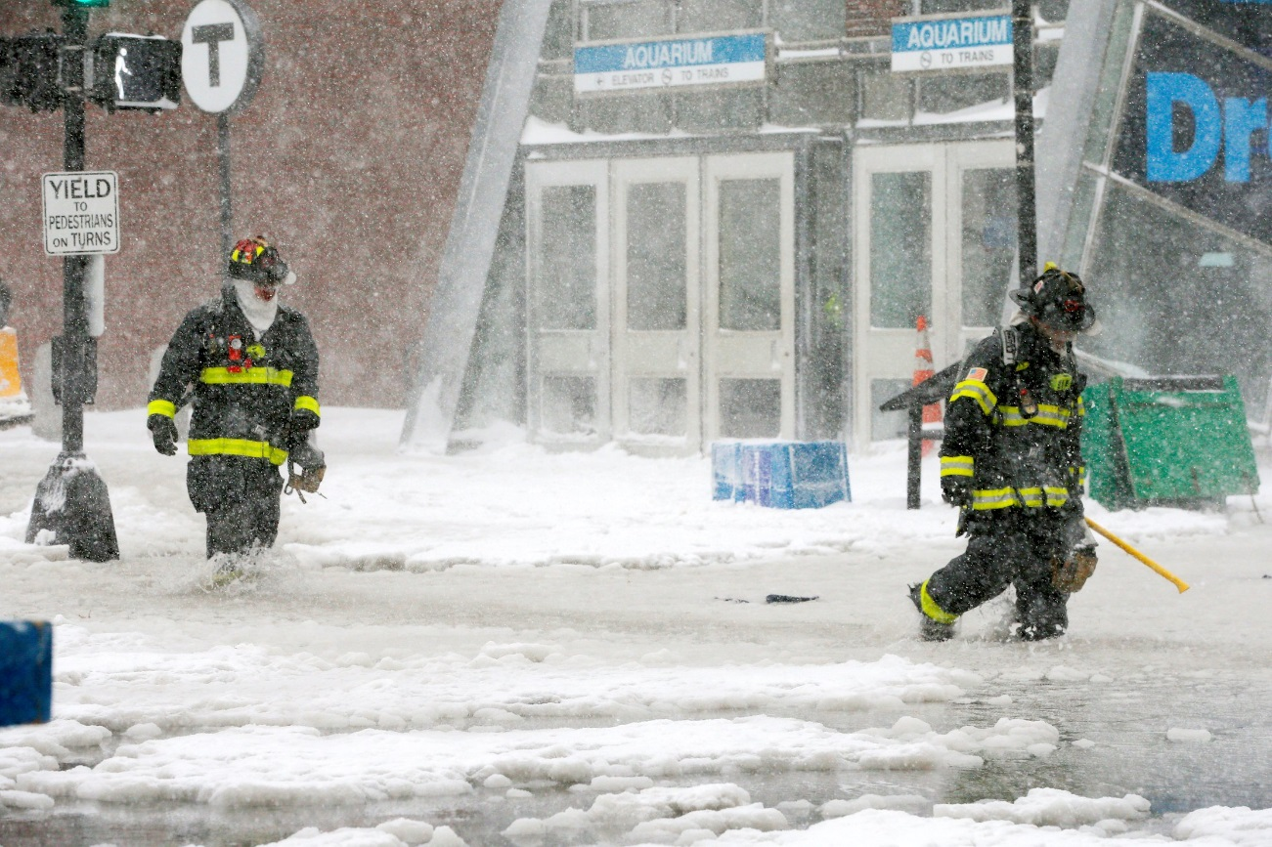
The “Bomb Cyclone” of 2018
Snow – The storm not only produced knee-deep snow from North Carolina to Maine, but also some historically significant amounts in Florida, Georgia and South Carolina.
Wind – Winds roared, reaching 50 to 80 mph along the coast in the Northeast.
Water – Like a hurricane storm surge, the storm’s enormous circulation and winds pushed a large amount of seawater inland. Boston set its highest water level on record, narrowly exceeding the level reached during the blizzard of 1978.
Temperature – As regions like Boston began cleanup, frigid temperatures rapidly descended upon the region.
Boston firefighters wade through a street flooded from tidal surge during Storm Grayson in Boston, Massachusetts, U.S., January 4, 2018. Reuters

Slide 3
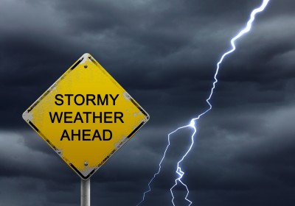
TVB and Research Now
The results of this Boston survey mirror the findings of previous severe weather-related surveys, including Hurricanes Harvey & Irma.
The main information source for residents in a time of crisis – and the most trusted – is their local broadcast television station.

Slide 4
Research Overview: Methodology
WHO:
796 interviews were collected via opt-in sample.
To qualify respondents needed to be age 18+ and:
Reside in the Boston (Manchester) DMA.
Had seen or heard any information or coverage of the approaching severe weather on any media platform.
Had to be in their own home and have electricity at the time of the survey (about 2% were not).
WHEN: Interviews began Friday morning, January 5th, and concluded Saturday morning, January 6th, 2018.
WHAT: A short online survey about respondents’ news media habits regarding the severe weather. Respondents were asked about their media usage the previous day, from 6 a.m. to 12 midnight.
Please note that to avoid any confusion between broadcast and cable, broadcast stations were delineated by call letters and channel numbers, with separate questions for cable networks/channels.
Source: Research Now Weather Survey. 1/5-1/6/18 Adults 18+.

Slide 5
Local TV News Tops for Severe Weather Information
Which of these sources did you watch, listen to or go to for information about the approaching severe weather conditions?
Source: Research Now Weather Survey. 1/5-1/6/18 Adults 18+.

Slide 6
Adults 18+ Spent Most Time with Local TV News Assets
Source: Research Now Weather Survey. 1/5-1/6/18 Adults 18+. Time Spent between 6 a.m. and 12 midnight

Slide 7
Local TV Station News Tops For Severe Weather Preparation Information
When facing severe weather approaching your city/town/region, which source do you feel gives you the best information on how to prepare (e.g. emergency procedures, traffic information, closures)?
Source: Research Now Weather Survey. 1/5-1/6/18 Adults 18+.

Slide 8
Local TV News Skewed Younger than Cable Network News
Source: Research Now Weather Survey. 1/5-1/6/18 Adults 18+.

Slide 9
Local TV News: #1 For Trust Websites/Apps for Local TV News Tops for Digital
For each source, please indicate the extent to which you agree or disagree with the following statement: I trust the news that I see/hear on this media source
Top 2 Boxes
Source: Research Now Weather Survey. 1/5-1/6/18 Adults 18+. Top 2 boxes = Agree Strongly and Agree Somewhat

Slide 10
Why Local TV?
What are your reasons for watching local TV news during this dangerous weather time?
I want information that
pertains to the area I live in
68%
I like that they are constantly
updating and giving latest information
58%
I want to know the
I want to know the status of public services
e.g. school closings, road conditions public transit, shelters
56%
I like that they visually
show areas affected
48%
I like that they are reporting from
different neighborhoods in my area
40%
I feel my local broadcast station is looking out for what I need to know and
will keep me safe
43%
I trust the news
from my local station
47%
Source: Research Now Weather Survey. 1/5-1/6/18 Adults 18+.

Slide 11
Why Local TV News Website/Apps?
What are your reasons for using local TV news websites/apps during this dangerous weather time?
I
I want to know the status of public services
e.g. school closings, road conditions public transit, shelters
48%
I like that they are constantly updating
and giving me the latest information
51%
I like that I can access it
wherever I am
44%
I like that I can get information
I need on my timetable
43%
I like getting the alerts
34%
I trust the news from
my local broadcast stations
website/app
34%
Source: Research Now Weather Survey. 1/5-1/6/18 Adults 18+.

Slide 12
Key Points
News Sources: 97% of respondents used local TV news for information about the storm.
Time Spent: At 3 hours and 37 minutes, respondents spent more time with local television than any other source, nearly four times more than time spent with the 2nd highest platform.
Local TV News Skewed Younger than Cable TV: 58% of the local TV news audience fell between the ages of 18 and 54, compared to just 46% for cable network news.
Information Source: 69% of respondents chose local TV for information when facing severe weather.
Trust: Local TV news was the most trusted source for coverage and information (84% of respondents agreed). Local TV digital assets were the most trusted digital source at 67%. Social media was the lowest at 36%.
The top reason cited for watching local TV news was that respondents wanted information that pertained to their area.
The top reason for using local TV news websites and apps was for constant updates and latest information.

