Slide 1
Weather Emergency Survey
Hurricane Harvey

Slide 2
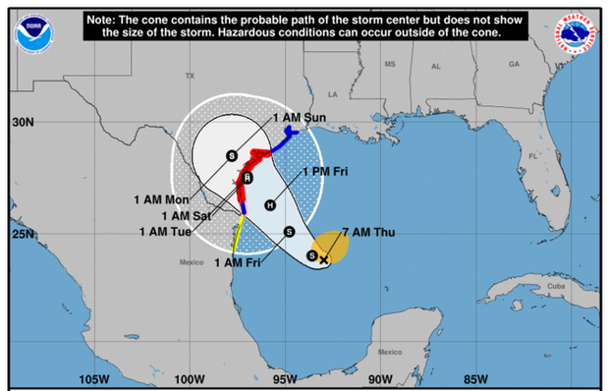
Hurricane Harvey
Around 10pm Texas time, on August 25, 2017, the hurricane made landfall at peak intensity in Rockport, Texas as a category 4 hurricane.
After striking land, the storm moved over the Copano Bay and made a second landfall in Texas just north of Holiday Beach at 1am CDT on August 26 as a Category 3 hurricane.
Afterwards, rapid weakening ensued as its speed slowed dramatically to a crawl. It was deemed a tropical storm at 1 pm CDT on August 26.
TVB engaged Research Now to conduct a survey on news media usage concerning Hurricane Harvey August 24th-26th.
Source: Hurricane timeline: Wikipedia

Slide 3
Research Overview: Methodology
WHO:
724 interviews were collected via opt-in sample.
To qualify respondents needed to be age 18+ and:
Reside in either Corpus Christi or Houston, Texas.
Had seen or heard any information or coverage of Hurricane Harvey on any media platform.
Had to be in their own home and have electricity at the time of the survey (about 5% were not).
WHEN: Interviews took place Thursday evening, August 24^{th,} 2017 and ended August 26^{th,} 2017 at midnight.
WHAT: A short online survey about respondents’ news media habits regarding Hurricane Harvey in those two markets. Respondents were asked about their media usage the previous day.
Source: Research Now Hurricane Harvey Survey. 8/24/17 Evening-8/26/17 12AM Adults 18+.

Slide 4
Local TV News Tops For Hurricane Harvey Information
Which of these sources did you watch, listen to or go to for information about the approaching dangerous weather?
Source: Research Now Hurricane Harvey Survey. 8/24/17 Evening-8/26/17 12AM Adults 18+.

Slide 5
Most Time Spent with Local TV News Assets
Source: Research Now Hurricane Harvey Survey. 8/24/17 Evening-8/26/17 12AM Adults 18+.

Slide 6
Local TV Station News Tops For Hurricane Harvey Preparation Information
When facing dangerous weather approaching your city/town/region, which source do you feel gives you the best information on how to prepare (e.g. emergency procedures, traffic information, closures)?
Source: Research Now Hurricane Harvey Survey. 8/24/17 Evening-8/26/17 12AM Adults 18+.

Slide 7
Local TV News: #1 For Trust
For each source, please indicate the extent to which you agree or disagree with the following statement: I trust the news that I see/hear on this media source
Top 2 Boxes
Source: Research Now Hurricane Harvey Survey. 8/24/17 Evening-8/26/17 12AM. Top 2 Boxes: Agree strongly and Agree somewhat. Adults 18+.

Slide 8
Why Local TV? Information That Pertains to Their Area
What are your reasons for watching local TV news during this dangerous weather time?
Source: Research Now Hurricane Harvey Survey. 8/24/17 Evening-8/26/17 12AM Adults 18+.

Slide 9
Why Local TV News Website/Apps? Updates and Accessibility
What are your reasons for using local TV news websites/apps during this dangerous weather time?
Source: Research Now Hurricane Harvey Survey. 8/24/17 Evening-8/26/17 12AM Adults 18+.

Slide 10
Key Points
News Sources: 89% of respondents used local TV news for Hurricane Harvey information; the second choice was local TV station’s websites.
Time Spent: Respondents spent more time with Hurricane Harvey coverage on local television than any other source, nearly three times more than cable TV news. In the digital sphere, respondents spent almost twice the amount of time with local TV websites and apps as social media.
Preparation Information: Twice as many people chose local TV for information on how to prepare for Hurricane Harvey than they did cable news.
Trust: Local TV news was the most trusted source for Hurricane Harvey coverage and information. Local TV digital assets were the most trusted digital source.
The top reason cited for watching local TV news during Hurricane Harvey is that respondents wanted information that pertained to their area.
The top reason for using local TV news websites and apps is that they are constantly updating and giving the latest information.

