Slide 1
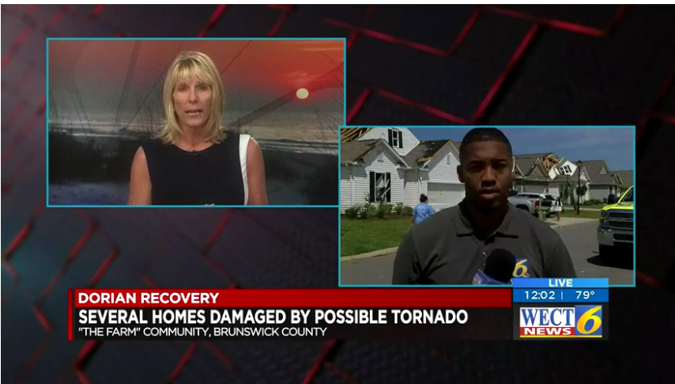
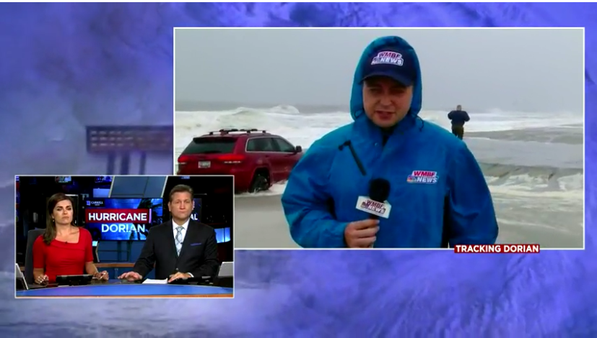
Weather Emergency Survey
Hurricane Dorian

Slide 2
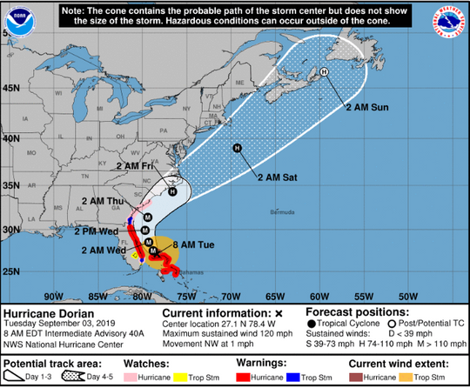
Hurricane Dorian
On 9/1 Hurricane Dorian intensified to a Category 5 storm, the most powerful storm seen since the 2003-2005 period and was forecast to make landfall in the Northern Bahamas. Later in the day, it made landfall on Elbow Cay, Bahamas with sustained winds of 185 mph.
The direction Dorian would be taking and where and if it would make landfall in America shifted daily.
Ultimately it travelled parallel to the east coast of Florida, Georgia, coming close to South and North Carolina as a category 3 hurricane, with storm surge also effecting Virginia.
The TVB through Dynata measured the media usage of the markets in the areas impacted in Georgia, South Carolina, North Carolina and Virginia.

Slide 3
Research Overview: Methodology
WHO:
861 interviews were collected via opt-in sample.
To qualify respondents needed to be age 18+ and:
Reside in the following DMAs: Savannah GA, Charleston SC, Myrtle Beach-Florence SC, Wilmington NC, Greenville-New Bern NC, Norfolk-Portsmouth-Newport News VA
Had seen or heard any information or coverage of the approaching severe weather on any media platform.
Had to be in their own home and have electricity at the time of the survey (6% of initial respondents were not included because of this reason).
WHEN: Interviews began Tuesday early evening on September 3rd, 2019 and concluded Thursday September 5th at 2PM for Savannah and September 6th, 2019 (10AM for Charleston and Myrtle Beach, and noon for Wilmington, Greenville and Norfolk).
WHAT: A short online survey about respondents’ news media habits regarding the severe weather. Respondents were asked about their media usage the previous day, from 5 a.m. to 1 a.m.
Please note that to avoid any confusion between broadcast and cable, broadcast stations were delineated by call letters and channel numbers, with separate questions for cable networks/channels.
Source: Dynata Weather Survey. 9/3-9/6/19 Adults 18+.

Slide 4
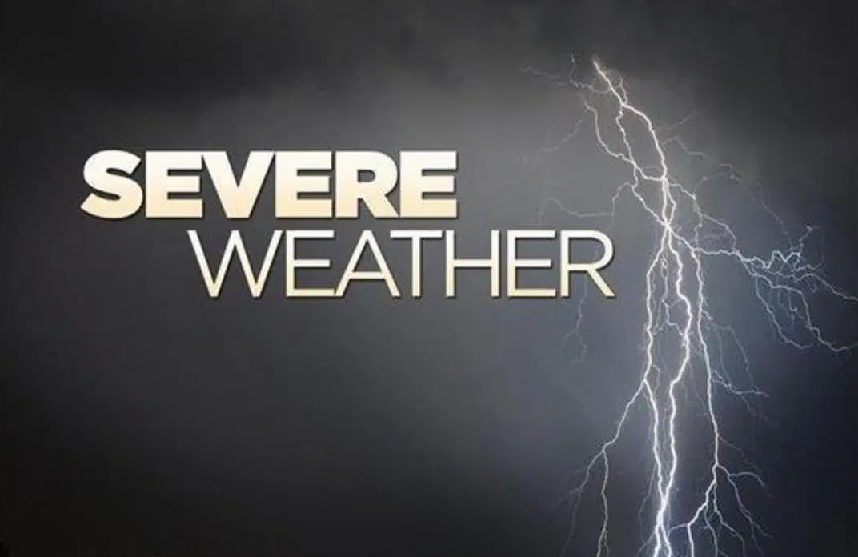
TVB and Dynata
The results of this survey mirror the findings of previous severe weather-related surveys, including Hurricanes Harvey & Irma, as well as the Boston Bomb Cyclone.
The main information source for residents in a time of crisis – and the most trusted – is their local broadcast television station assets.

Slide 5
Local TV News Tops for Hurricane Dorian Information
Which of these sources did you watch, listen to or go to for information about the approaching severe weather conditions?
Source: Dynata Hurricane Dorian Weather Survey. 9/3/19-9/6/19 Adults 18+.

Slide 6
Adults 18+ Spent Most Time with Local TV News For Hurricane Dorian Coverage
Source: Dynata Hurricane Dorian Weather Survey. 9/3/19-9/6/19 Adults 18+. Time Spent between 5 a.m. and 1 a.m.

Slide 7
Local TV Station News Tops For Severe Weather Preparation Information
When facing severe weather approaching your city/town/region, which source do you feel gives you the best information on how to prepare (e.g. emergency procedures, traffic information, closures)?
Source: Dynata Hurricane Dorian Weather Survey. 9/3/19-9/6/19 Adults 18+.

Slide 8
Local TV News Assets: #1 For Trust
For each source, please indicate the extent to which you agree or disagree with the following statement: I trust the news that I see/hear on this media source
Top 2 Boxes
Source: Dynata Hurricane Dorian Weather Survey. 9/3/19-9/6/19 Adults 18+. Top 2 boxes = Agree Strongly and Agree Somewhat

Slide 9
Why Local TV?
What are your reasons for watching local TV news during this dangerous weather time?
I want information that
pertains to the area I live in
75%
I trust the news
from my local station
70%
I feel my local broadcast station is looking out for what I need to know and
will keep me safe
51%
I like that they are constantly
updating and giving latest information
46%
I want to know the
I want to know the status of public services
e.g. school closings, road conditions public transit, shelters
46%
I like that they visually show areas affected
39%
Source: Dynata Hurricane Dorian Weather Survey. 9/3/19-9/6/19 Adults 18+.

Slide 10
Why Local TV News Website/Apps?
What are your reasons for using local TV news websites/apps during this dangerous weather time?
I trust the news from
my local broadcast stations
website/app
66%
I like that they are constantly updating
and giving me the latest information
51%
I like that I can get information
I need on my timetable
52%
I
I want to know the status of public services
e.g. school closings, road conditions public transit, shelters
49%
I like that I can access it
wherever I am
41%
I like getting the alerts
42%
I downloaded the app from my local broadcast TV station specifically for situations like this
38%
Source: Dynata Hurricane Dorian Weather Survey. 9/3/19-9/6/19 Adults 18+.

Slide 11
Hurricane Dorian Key Points
News Sources: 84% of respondents used local TV news for information about Hurricane Dorian.
Time Spent: At 3 hours and 24 minutes, respondents spent more time with local television than any other source, more than twice than the time spent with the 2nd highest platform.
Information Source for Hurricane preparation: 75% of respondents chose local TV for information when preparing to face severe weather.
Trust: Local TV news assets were the most trusted source for coverage and information. 94% of respondents agreed that Local TV News was the most trusted, while local TV news websites and apps were the second most trusted source at 88%. Social media was the lowest at 57%.
The top reason cited for watching local TV news was that respondents wanted information that pertained to their area.
The top reason for using local TV news websites and apps was that they trust the news from their station’s website/app.

