Slide 1
Weather Emergency Survey
Hurricane Irma

Slide 2
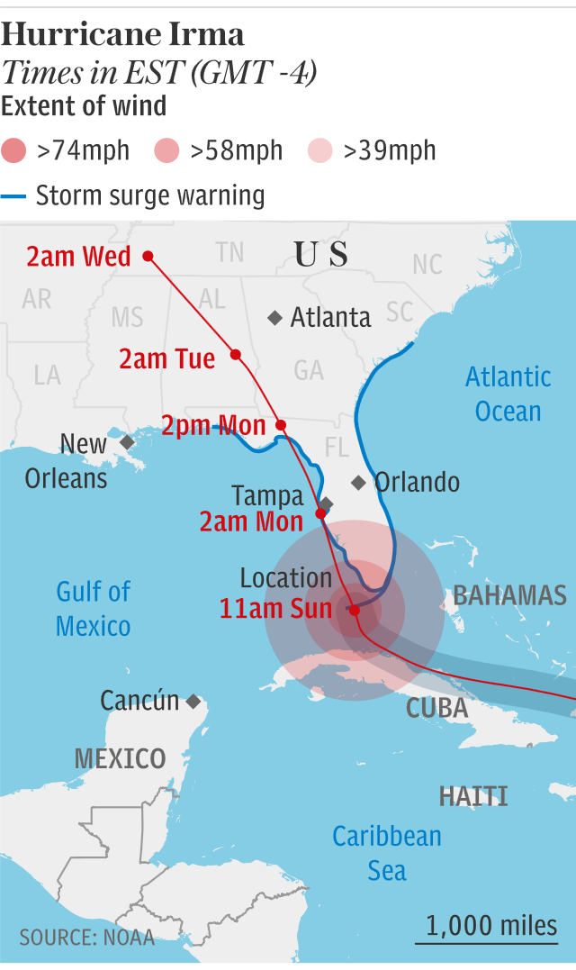
Hurricane Irma
September 4: Florida Governor Rick Scott declared a state of emergency for Florida.
September 6: The mayor of Ft. Lauderdale ordered mandatory evacuations for all residents east of US 1. The city of Tampa declared a local state of emergency.
September 8: A hurricane warning was issued for the Florida Keys, extending as far north as Miami. By evening, hundreds of thousands of Floridians had evacuated.
September 10: After crossing the Straits of Florida and being upgraded to a Category 4 hurricane, initial landfall took place at Cudjoe Key at 9:10 am. Second landfall was made, as a Category 3 hurricane, at Marco Island at 3:35 pm. Irma made its way up the west side of Florida, weakening to a Category 2 hurricane by Sunday night and reaching Tampa Monday, September 11th at 2 am.

Slide 3
Research Overview: Methodology
WHO:
1,193 interviews were collected via opt-in sample.
To qualify respondents needed to be age 18+ and:
Reside in one of the following Florida DMAs: Miami-Ft. Lauderdale, Ft. Myers-Naples, West Palm Beach-Ft. Pierce, Tampa-St. Petersburg (Sarasota), Orlando-Daytona Beach-Melbourne or Jacksonville.
Had seen or heard any information or coverage of Hurricane Irma on any media platform.
Had to be in their own home and have electricity at the time of the survey (about 8% were not).
WHEN: Interviews began midday Friday, September 8th in Miami, Ft. Myers and West Palm and midday Saturday, September 9th in the remaining Florida markets. All interviews concluded September 10th.
WHAT: A short online survey about respondents’ news media habits regarding Hurricane Irma in these markets. Respondents were asked about their media usage the previous day.
Source: Research Now Hurricane Irma Survey. 9/8/17 Midday-9/10/17 12M Adults 18+.

Slide 4
Local TV News Tops For Hurricane Irma Information
Which of these sources did you watch, listen to or go to for information about the approaching dangerous weather?
Source: Research Now Hurricane Irma Survey. 9/8/17 Midday-9/10/17 12M Adults 18+.

Slide 5
Local TV News Was Top Source For Hispanics Social Media was Second
Which of these sources did you watch, listen to or go to for information about the approaching dangerous weather?
Source: Research Now Hurricane Irma Survey. 9/8/17 Midday-9/10/17 12M Hispanic Adults 18+.

Slide 6
Adults 18+ Spent Most Time with Local TV News Assets
Source: Research Now Hurricane Irma Survey. 9/8/17 Midday-9/10/17 12M Adults 18+.

Slide 7
Hispanics Spent Close to Six Hours with Local TV News
Source: Research Now Hurricane Irma Survey. 9/8/17 Midday-9/10/17 12M Hispanic Adults 18+.

Slide 8
Local TV Station News Tops For Hurricane Irma Preparation Information
When facing dangerous weather approaching your city/town/region, which source do you feel gives you the best information on how to prepare (e.g. emergency procedures, traffic information, closures)?
Source: Research Now Hurricane Irma Survey. 9/8/17 Midday-9/10/17 12M Adults 18+.

Slide 9
Local TV News Skewed Younger than Cable Network News
Source: Research Now Hurricane Irma Survey. 9/8/17 Midday-9/10/17 12M Adults 18+.

Slide 10
Local TV News: #1 For Trust
For each source, please indicate the extent to which you agree or disagree with the following statement: I trust the news that I see/hear on this media source
Top 2 Boxes
Source: Research Now Hurricane Irma Survey. 9/8/17 Midday-9/10/17 12M Adults 18+. Top 2 boxes = Agree Strongly and Agree Somewhat

Slide 11
Why Local TV?
What are your reasons for watching local TV news during this dangerous weather time?
I want information that
pertains to the area I live in
68%
I like that they are constantly
updating and giving latest information
63%
I like that my station is looking out
for what I need to know and
will keep me safe
51%
I want to know the
I want to know the status of
public services, road conditions
51%
I trust the news
from my local station
49%
I like that they visually
show areas affected
47%
I like that they are reporting from
different neighbors in my area
35%
Source: Research Now Hurricane Irma Survey. 9/8/17 Midday-9/10/17 12M Adults 18+.

Slide 12
Why Local TV News Website/Apps?
What are your reasons for using local TV news websites/apps during this dangerous weather time?
I like that they are constantly updating
and giving me the latest information
60%
I like getting the alerts
53%
I like that I can access it
wherever I am
51%
I like that I can get information
I need on my timetable
47%
I want to know the status of
public services, road conditions
43%
I trust the news from
my local stations website/app
50%
I share information I get
from my station website/app
with friends/family
32%
I downloaded the app from my local TV station
specifically for situations like this
31%
Source: Research Now Hurricane Irma Survey. 9/8/17 Midday-9/10/17 12M Adults 18+.

Slide 13
Key Points
News Sources: 85% of respondents used local TV news for Hurricane Irma information. That number increased to 86% with Hispanic respondents.
Time Spent: At 5 hours and 9 minutes, respondents spent more time with Hurricane Irma coverage on local television than any other source. Hispanic respondents spent almost an additional hour with local television, coming in at 5 hours and 54 minutes.
Local TV News Skewed Younger than Cable TV: 65% of the local TV news audience fell between the ages of 18 and 54, compared to just 54% for cable network news.
Preparation Information: 55% of respondents chose local TV for information to prepare for Hurricane Irma.
Trust: Local TV news was the most trusted source for Hurricane Irma coverage and information. Local TV digital assets were the most trusted digital source.
The top reason cited for watching local TV news during Hurricane Harvey is that respondents wanted information that pertained to their area.
The top reason for using local TV news websites and apps is that they are constantly updating and giving the latest information.
Interestingly, 31% downloaded the app from their local TV station specifically for situations like this.

