Slide 1
Weather Emergency Survey
Getty & Kincade Wildfires

Slide 2
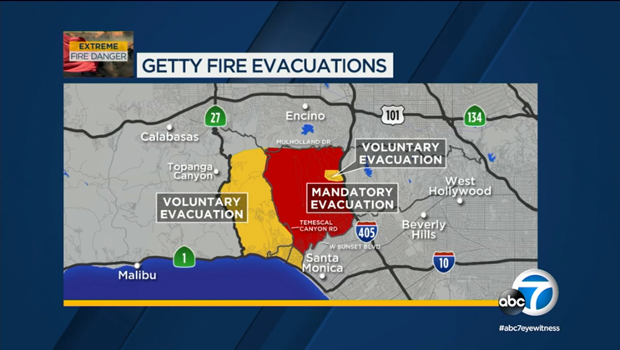
Getty Wildfire
Where: Southern California (Los Angeles County)
Beginning
Began Monday October 28, 2019 shortly after 1:30 a.m. along the 405 Freeway, near the Getty Center
Deemed an accidental start. High wind conditions caused a tree branch to break off and hit nearby powerlines near North Sepulveda Boulevard.
As of Saturday Nov 2nd 2019, 7am (which was the final update):
Size: 745 acres
79% contained
10 residences have been destroyed and 15 residences have been damaged
Homes Threatened: 7,091
Evacuation orders were lifted Friday Nov 1st for all residents.
The evacuation zone had stretched as far north as Mulholland Drive, and as far west as Temescal Canyon Road, between Sunset Boulevard and Mulholland Drive.

Slide 3
Kincade Wildfire
Where: Primarily Sonoma County
Beginning
Began Tuesday October 22nd
Spread quickly on account of high winds that touched triple digits.
As of Saturday Nov 2nd 2019:
Size: 75,000-80,000 acres
74% contained
Burned 175 homes and 372 total structures
12 homes have been destroyed and 5 have been damaged
No casualties
PG&E likely to cancel projected power outages in San Fran area
The borders of the mandatory evacuation zone are:
West: East edge of Windsor
East: Knight’s Valley
North: Between 128 and Sonoma County line

Slide 4
Research Overview: Methodology
WHO:
1,553 interviews were collected via opt-in sample.
To qualify respondents needed to be age 18+ and:
Reside in the following DMAs: Los Angeles (977 responses) or San Francisco (576 responses).
Had seen or heard any information or coverage of the fires on any media platform.
Had to be in safe quarters and have electricity at the time of the survey (4% answered no to this question and could not take the survey).
WHEN: Interviews began on the afternoon of Tuesday October 29th and concluded the morning of Monday November 4th, 2019.
WHAT: A short online survey about respondents’ news media habits regarding the severe fires. Respondents were asked about their media usage the previous day, from 5 a.m. to 1 a.m.
Please note that to avoid any confusion between broadcast and cable, broadcast stations were delineated by call letters and channel numbers, with separate questions for cable networks/channels.
Source: Dynata California Wildfire Survey. 10/29/19-11/4/19 Adults 18+.

Slide 5
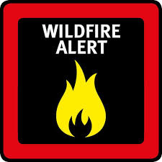
TVB and Dynata
The results of this survey mirror the findings of previous severe weather-related surveys, including Hurricanes Harvey, Irma and Dorian, as well as the Boston Bomb Cyclone.
The main information source in a time of crisis – and the most trusted – is their local broadcast television station assets.

Slide 6
Local TV News Tops for California Wildfire Information
Which of these sources did you watch, listen to or go to for information about the approaching severe fire?
Source: Dynata California Wildfire Survey. 10/29/19-11/4/19 Adults 18+.

Slide 7
Local TV News Tops for California Wildfire Information
Which of these sources did you watch, listen to or go to for information about the approaching severe fire?
Source: Dynata California Wildfire Survey. 10/29/19-11/4/19 Adults 18+.

Slide 8
Adults 18+ Spent Most Time with Local TV News For Wildfire Coverage
Source: Dynata California Wildfire Survey. 10/29/19-11/4/19 Adults 18+. Time Spent between 5 a.m. and 1 a.m.

Slide 9
Adults 18+ Spent Most Time with Local TV News For Wildfire Coverage
Los Angeles
San Francisco
Source: Dynata California Wildfire Survey. 10/29/19-11/4/19 Adults 18+. Time Spent between 5 a.m. and 1 a.m.

Slide 10
Local TV Station News Tops For California Wildfire Preparation Information
Which source do you feel gives you the best information on how to prepare for emergency situations e.g. procedures, traffic information, closures, how to help?
Source: Dynata California Wildfire Survey. 10/29/19-11/4/19 Adults 18+.

Slide 11
Local TV Station News Tops For California Wildfire Preparation Information
Which source do you feel gives you the best information on how to prepare for emergency situations e.g. procedures, traffic information, closures, how to help?
Source: Dynata California Wildfire Survey. 10/29/19-11/4/19 Adults 18+.

Slide 12
Local TV News Assets: #1 For Trust
For each source, please indicate the extent to which you agree or disagree with the following statement: I trust the news that I see/hear on this media source
Top 2 Boxes
Source: Dynata California Wildfire Survey. 10/29/19-11/4/19 Adults 18+. Top 2 boxes = Agree Strongly and Agree Somewhat

Slide 13
Local TV News Assets: #1 For Trust
For each source, please indicate the extent to which you agree or disagree with the following statement: I trust the news that I see/hear on this media source
Top 2 Boxes
Source: Dynata California Wildfire Survey. 10/29/19-11/4/19 Adults 18+. Top 2 boxes = Agree Strongly and Agree Somewhat

Slide 14
Why Local TV?
What are your reasons for watching local TV news during emergency situations?
I want information that
pertains to the area I live in
64%
I trust the news
from my local station
63%
I feel my local broadcast station is looking out for what I need to know and
will keep me safe
40%
I like that they are constantly
updating and giving latest information
38%
I want to know the
I like that they are reporting from
different neighborhoods affected
36%
I want to know the
I want to know the
I want to know the status of public services
e.g. school closings, road conditions public transit, shelters
36%
I like that they visually show
areas affected
31%
Source: Dynata California Wildfire Survey. 10/29/19-11/4/19 Adults 18+.

Slide 15
Why Local TV?
What are your reasons for watching local TV news during emergency situations?
I want information that
pertains to the area I live in
LA: 63%
SF: 66%
I trust the news
from my local station
LA: 64%
SF: 61%
I feel my local broadcast station is
looking out for what I need to know and
will keep me safe
LA: 40%
SF: 39%
I like that they are constantly
updating and giving latest information
LA: 37%
SF: 40%
I want to know the
I like that they are reporting from
different neighborhoods affected
LA: 38%
SF: 33%
I want to know the
I want to know the
I want to know the status of public services
e.g. school closings, road conditions public transit, shelters
LA: 37%
SF: 33%
I like that they visually show
areas affected
LA: 33%
SF: 28%
Source: Dynata California Wildfire Survey. 10/29/19-11/4/19 Adults 18+.

Slide 16
Why Local TV News Website/Apps?
What are your reasons for using local TV news websites/apps during emergency situations?
I trust the news from
my local broadcast stations
website/app
60%
I like that they are constantly updating
and giving me the latest information
45%
I like that I can get information
I need on my timetable
46%
I
I want to know the status of public services
e.g. school closings, road conditions public transit, shelters
41%
I like that I can access it
wherever I am
35%
I like getting the alerts
33%
I downloaded the app from my local broadcast TV station specifically for situations like this
27%
I share information I get from my broadcast station's website/app with friends/family
31%
Source: Dynata California Wildfire Survey. 10/29/19-11/4/19 Adults 18+.

Slide 17
Why Local TV News Website/Apps?
What are your reasons for using local TV news websites/apps during emergency situations?
I trust the news from
my local broadcast stations
website/app
LA: 59%
SF: 62%
I like that I can
get information
I need on my timetable
LA: 44%
SF: 50%
I like that they are constantly updating
and giving me the latest information
LA: 44%
SF: 47%
I
I like that I can access it
wherever I am
LA: 32%
SF: 39%
I want to know the status of public services
e.g. school closings, road conditions public transit, shelters
LA: 40%
SF: 43%
I like getting the alerts
LA: 36%
SF: 29%
I share information I get from my broadcast station's website/app with friends/family
LA: 32%
SF: 30%
I downloaded the app from my local broadcast TV station specifically for situations like this
LA: 24%
SF: 30%
Source: Dynata California Wildfire Survey. 10/29/19-11/4/19 Adults 18+.

Slide 18
Getty & Kincade Wildfire Key Points
News Sources: 79% of respondents used local TV news for information about the California wildfires as compared to the second highest radio at 47%.
Time Spent: At 2 hours and 35 minutes, respondents spent more time with local television than any other source, more than twice than the time spent with radio, the 2nd highest platform.
Information Source for Wildfire Preparation: 62% of respondents chose local TV for information when preparing to face emergency situations.
Trust: Local TV news assets were the most trusted source for coverage and information. 90% of respondents agreed that local TV news was the most trusted, while local TV news websites and apps were also a trusted source at 81%. Social media was the lowest at 58%.
Why local TV assets?
The top reason cited for watching local TV news was that respondents wanted information that pertained to their area.
The top reason for using local TV news websites and apps was that they trust the news from their station’s website/app.

