Slide 1
Advising Advertisers During Recessionary/Extraordinary Times
March 25, 2020

Slide 2
Agenda
Message from Steve Lanzano, President & CEO, TVB
Interview with Brian Allers, SVP, Business Development, TVB & Greg Crowley, Owner, Crowley Furniture
Interview with Brad Seitter, EVP, Local & National Business Development, TVB & Sara Gallegos, Senior Director of New Business Dev., Scripps
Automotive Update with Steve Sturm, Executive Automotive Advisor, TVB
Banking & Home Improvement with Brian Wexler, SVP Business Dev., TVB
Digital Considerations with Dave Buonfiglio, VP Digital, TVB
Audience Q&A

Slide 3
Net effect on brand health 6 months after cutting TV ads
TBCA
Total
Mentions
Buy
nowadays
Buy most
often
First
mention
Key
image
Total brand
awareness
Trial
-3
-5
-9
-8
-11
-13
-21
-39
(632)
(836)
(376)
(501)
(627)
(232)
(840)
(744)
Source: Kantar “COVID-19 Barometer,” March 2020 (Base number of brands analyzed in parentheses)

Slide 4
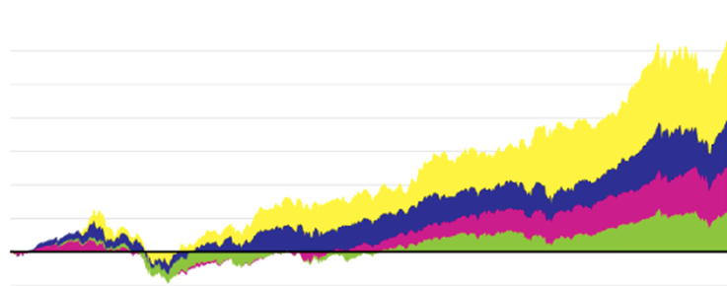
We’ve seen before that strong brands recovered NINE TIMES faster following the financial crisis of 2008
+317%
BrandZ Top 10
Powerful Brands
+196%
BrandZ Strong
Brands Portfolio
+128%
S&P 500
+59%
MSCI Word Index
2006
2007
2008
2009
2010
2011
2012
2013
2014
2015
2016
2017
2018
2019
Source: Kantar

Slide 5
M-F All Local News

Slide 6
Adults 25-54 M-F All Local News Live & Live+1 Impressions for 25 LPMs
Imps (000)
+29%
+28%
+10%
+10%
Source: Nielsen, NLTV, A25-54 Imp for 25 LPMs. M-F Local News: 10-11:30p, 4-8p, 5-7a. ABC, CBS, CW, Fox, NBC, Tel, Uni

Slide 7
Adults 18-34 M-F All Local News Live & Live+1 Impressions for 25 LPMs
Imps (000)
+84%
+83%
+52%
+52%
Source: Nielsen, NLTV, A18-34 Imp for 25 LPMs. M-F Local News: 10-11:30p, 4-8p, 5-7a. ABC, CBS, CW, Fox, NBC, Tel, Uni

Slide 8
M-F Evening News

Slide 9
Adults 25-54 M-F Evening News Live & Live+1 Impressions for 25 LPMs
Imps (000)
+42%
+18%
+19%
+42%
Source: Nielsen, NLTV, A25-54 Imp for 25 LPMs. M-F 4-8p. ABC, CBS, CW, Fox, NBC, Tel, Uni

Slide 10
Adults 18-34 M-F Evening News Live & Live+1 Impressions for 25 LPMs
Imps (000)
+106%
+67%
+68%
+106%
Source: Nielsen, NLTV, A18-34 Imp for 25 LPMs. M-F 4-8p. ABC, CBS, CW, Fox, NBC, Tel, Uni

Slide 11
M-F Late News

Slide 12
Adults 25-54 M-F Late News Live & Live+1 Impressions for 25 LPMs
Imps (000)
+25%
+4%
+5%
+24%
Source: Nielsen, NLTV, A25-54 Imp for 25 LPMs. M-F 10-11:30p. ABC, CBS, CW, Fox, NBC, Tel, Uni

Slide 13
Adults 18-34 M-F Late News Live & Live+1 Impressions for 25 LPMs
Imps (000)
+71%
+41%
+41%
+69%
Source: Nielsen, NLTV, A18-34 Imp for 25 LPMs. M-F 10-11:30p. ABC, CBS, CW, Fox, NBC, Tel, Uni

Slide 14
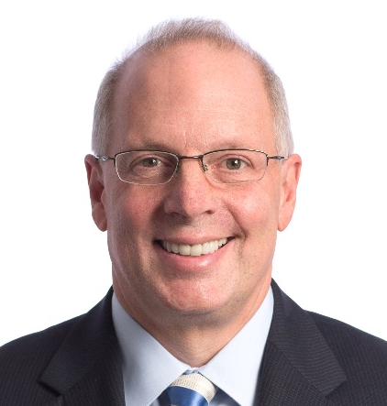
Advising Advertisers During Recessionary/Extraordinary Times
Steve Lanzano President & CEO TVB

Slide 15
Interview
Brian Allers SVP, Business Development TVB
Greg Crowley Owner Crowley Furniture

Slide 16
Interview
Brad Seitter EVP, Local & National Business Development TVB
Sara Gallegos Senior Director New Business Development Scripps

Slide 17
Target Opportunities
Healthcare/Mental Health Services
Sports Advertisers
Online Universities
Employee Recruiting (Think delivery services, grocery stores and distribution centers… Military!)
Cleaning Services
Banking & Home Improvement (More later!)
Restaurants for take out/delivery
Auto dealers

Slide 18
Interview
Brad Seitter EVP, Local & National Business Development TVB
Sara Gallegos Senior Director New Business Development Scripps

Slide 19
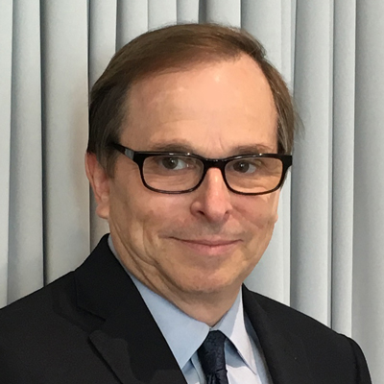
Automotive Update
Steve Sturm Executive Automotive Advisor TVB

Slide 20
Market Overview – OEM Responses
General Motors
Ceasing operations at all factories through the end of March.
Launching program to keep Chevrolet, Buick, GMC and Cadillac owners connected and help offset the economics of the outbreak.
Offering 0% interest, 84-month loans, and deferred payments up to 120 days to top-credit tiers.
Ford
Ceasing operations at all North American plants through the end of March.
Pulling all national ads promoting their vehicles and replacing them with new “Built to Lend a Hand” campaign.
Also launching a new program, for new vehicle buyers. It will delay their first payment for 90 days and promises to make up to 6 months of payments for owners who lose their jobs.

Slide 21
Market Overview – OEM Responses
FCA
Ceasing operations at North American plants until the end of March.
Putting all ad spending on hold for 2nd Quarter, with the potential to start up again in May or June. In the meantime, they are changing ad creative to reflect changing times.
Offering zero financing for 60-84 months depending on vehicle and no payments for first 90 days.
Hyundai
Closed its Alabama plant.
Reintroduced their innovative marketing program “Hyundai Assurance”.
First used in 2009
Includes 90 days deferred payments on new vehicles purchased between March 14th & April 30th
Provides up to 6 months of payment relief to owners who lose their jobs

Slide 22
Market Overview – OEM Responses
Asian & European Brands: Toyota, Honda, Nissan, Subaru, VW, Volvo, BMW, Mercedes
All companies closing North American, Japanese (Toyota) and European plants through the beginning of April.
Toyota
Launched "We Are Here For You“ marketing campaign on network & cable TV and in Tier 2 markets.
They dropped their March Sales Event.
Nissan, Mercedes, BMW and others
Guaranteeing bonus payments and relaxing performance objectives.
Some automakers’ captive finance companies are helping dealers by providing support on real estate and floorplan expenses.

Slide 23
New 2020 Industry Sales Forecast
Negative Factors
Supply Chain (parts & plants) / Weakening consumer demand / Wall Street Recovery Rising Unemployment / Consumer focus on recovery vs. purchasing
JD Power Current Trends
March forecast could drop as much as 41% from March 2019
Virus impact varies greatly across US; heavily impacted markets experiencing worst declines (Seattle -18%, San Francisco, -17%, Sacramento -17%, Los Angeles -16%, Chicago -15%, San Diego -14%).
Markets like Detroit & Minneapolis are not as heavily impacted, as of this week.
Original 2020 forecast was 16.8 million. New forecast has a range of 14 – 16 million (-5% to -20%), depending on length of medical and economic shutdown

Slide 24
Summary
Brands and their agencies are currently indicating that they will be active in May/June – this should be at all three Tiers!
If the virus outbreak is stabilized, auto production should resume in April, providing a good selection of 2020 models.
Auto brands will offer robust incentives with matching campaigns to jump start consumers (similar to what we saw in 2001 and 2008).
Most brands will offer dealers matching co-op support to jump start the market at the local level.

Slide 25
Recommendations – A “Do Now” List
Now is the time to support both your current dealer clients and new prospects with marketing and media support.
Check in with every dealer
Review their current sales and service status (new hours, staffing, traffic & sales, conditions)
Dealers will need campaigns with a “new-in” tone, reflecting current consumer attitudes and support for local communities. Put your station’s creative minds to work.
Dealer ad budgets will be stressed with the dramatic slowdown in sales. Work with them on ad schedules and spending that reflects the current reality – it won’t be forgotten after the crisis is over.
Most importantly: keep in regular contact with your dealers in this constantly-changing environment.

Slide 26
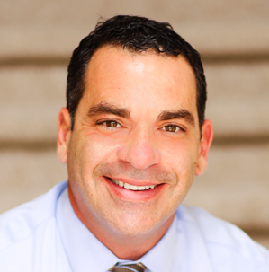
Banking
Brian Wexler SVP, Business Development TVB

Slide 27
Consumer Needs - Opportunities
Home Refinancing
Small Business Lines of Credit
Personal Loans
Savings and Retirement Advisors
Financial Support
No ATM Fees
Credit Consolidation
IRS Support

Slide 28
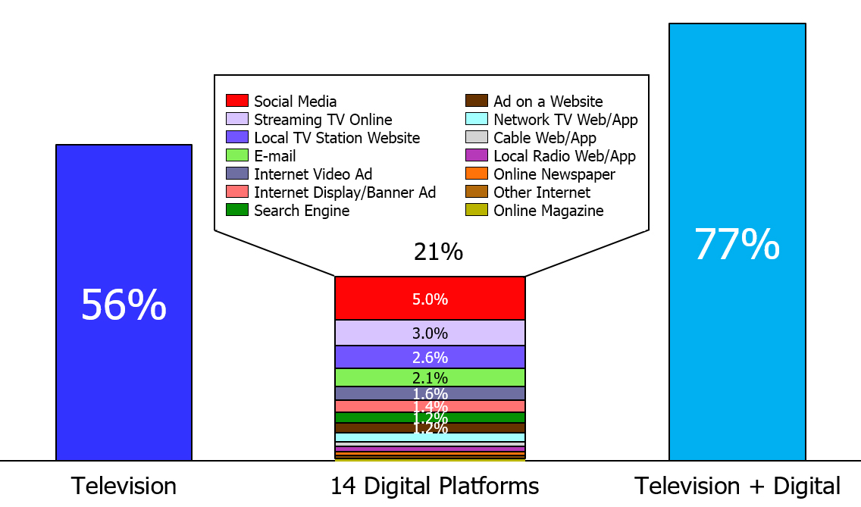
One Stop Shopping At Local Broadcast TV Stations: TV + Multiple Digital Platforms
% Citing Platform Most Important In Awareness Stage
INFLUENCE
Source: GFK TVB Purchase Funnel 2019 A18+; Most important for awareness; Digital = Search engine, Ad on a website, E-mail, Online Newspaper, Online Magazine, Social Media, Streaming TV Online, Internet Display/Banner Ad, Internet Video Ad, Local TV Stations Website/Apps, Network TV Website/Apps, Cable Website/Apps, Local Radio Website/Apps, Other Internet

Slide 29
Home Improvement
Brian Wexler SVP, Business Development TVB

Slide 30
Think Outside the Box
Home Gyms
Kitchen Remodels
Do it Yourself Projects
Pool and Patio
Landscaping
Pavers and Stones
Exterminators
Home Décor and Accents
Home Craft Projects
Lighting Interior/Exterior
Fencing
Organization: Kitchen, Closets, Garage
Home Offices – Best Buy, Staples, Office Max
Telecom Upgrades

Slide 31
Television Ads Are Motivation To Do Further Research Online
Has an advertisement on television motivated you to go the Internet to find out more information about that product or service?
Source: GfK TVB Media Comparisons Study 2020. Persons 18+ Plan to remodel any part of their current home in next year: Yes. Includes only those who answered. Q3 - Has an advertisement on television motivated you to go the Internet to find out more information about that product or service?

Slide 32
Working Together

Slide 33
People Spend the Most Time with Television of All Ad Supported Platforms
Source: GfK TVB Media Comparisons Study 2020. M-S 5A-1A. Persons 18+. Online/internet platforms such as email, social media, internet radio and websites, are totaled for any online device-PC, Smartphone and Tablets. Broadcast TV News Websites/Apps includes local TV station & network websites/apps for news/weather/sports.

Slide 34
Television is The Top Advertising Medium That Influences Purchase Decisions
Advertising medium which you feel most influences you to make a purchase decision
% Adults 18+
Source: GfK TVB Media Comparisons Study 2020. Persons 18+. Includes only those who chose a media. Q1 - Please select the one type of advertising medium which, you feel, most influences you to make a purchase decision? Broadcast TV News Websites/Apps includes local TV station & network websites/apps for news/weather/sports.

Slide 35
Successful Businesses
Spend their Marketing Dollars where their customers spend the most Time & are the most Influenced

Slide 36
Summary
Broadcast TV is the most influential medium to consumers.
Combining Broadcast TV with the right digital platform will provide maximum lift for any local business.
Use the latest consumer research to help businesses connect with their customers.
In times of crisis people need leadership; businesses need leadership… be the direction everyone seeks.
Nothing has more influence over consumers than the combination of your on-air and online voice… tell your story!

Slide 37
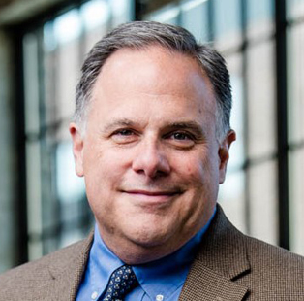
What should a local business do right now with its digital media?
Dave Buonfiglio VP, Digital TVB

Slide 38
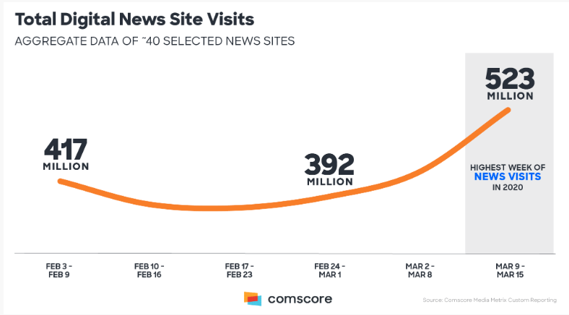
Digital News Consumption is UP!
Local news focuses on community solutions and uplifting subjects

Slide 39
Local Business Should Leverage All Digital Media Channels
Paid Media
O&O inventory
OTT
Geo-targeted display and video
Owned Media
Email blast to customers
Update website
Update social media
Update your GMB listing

Slide 40
Local Business Needs To Update Customers
Hours of operation
Changes in products, services, pricing
Delivery
Shop at home
Employee levels
Health practices
Hand sanitizer
Hand washing
Social distancing
Store cleaning

Slide 41
Other Online Activities
Update certifications
Online sales training
Clean up your own data
Catch up on digital blogs, podcasts

Slide 42
Help advertisers break through the clutter with your premium owned and operated inventory.

Slide 43
Audience Q&A

Slide 44
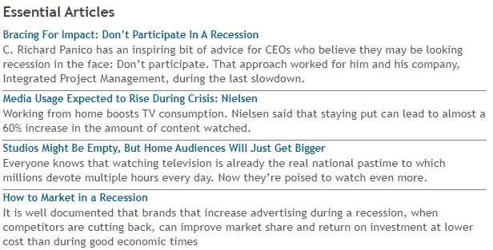
TVB is providing members with essential resources to advise advertisers,
protect revenue and manage teams during this critical period.
Resources are available via our website and mobile app TVBGo.

Slide 45
Thank you!

